Slide 1

HEAT RELEASE RATE Updates
Materials Working Forum
Cologne, Germany
(pre-recorded presentation)
Michael Burns, FAA Tech Center
June, 2023
Notes:
WELCOME
Hello, my name is Mike Burns with the FAATC and I’d like to present today update information for the heat release rate test method.

Slide 2
AGENDA
OSU Update
HR2 Background
Completed / Current Work
TRL 6 Update (Reproducibility)
Chapter A4 Placeholder: International System of Units (SI)
TRL 7 Details and Planning (and beyond)
Notes:
SLIDE #2: AGENDA
I’d like to briefly discuss a recent update that was posted relative to the OSU heat release rate apparatus. Then shift gears and talk a little about the HR2 with some background information and where we are today. Next, briefly talk about some research work & projects that have been completed and research work that is currently underway. I have some TRL 6 update information I’d like to share. This activity looks closely at reproducibility within several HR2 units. There is currently some work being done to update the handbook, revision 3, Chapter A4, placeholder document standardizing on SI units. Then I’d like to close out with a discussion on the initial details and planning of the next test series, TRL 7, followed by what comes next.

Slide 3
OSU Update to FAA FTHB
Chapter 5 update posted to Fire Safety Website 4/18/23
Update includes missing detailed dimensions for the inner and outer pyramid cones
A correction was made to the wording in the use of the HIS (5.3.8 subsequent to replaced with before conducting)
Section 5.4.1 supplement section removed
5.4.1 to be added: reducing thickness of sample
Notes:
SLIDE #3: OSU Update to FAA FTHB
In the FAA fire test handbook, Chapter 5, there was a recent update posted to the Fire Safety Website on 4/18/23. This update includes some missing detailed dimensions for the inner and outer pyramid cones of the exhaust stack area. Additionally, there was a small correction made to the wording in the use of the hot surface igniter in section 5.3.8. The words ‘subsequent to; were replaced with ‘before conducting’. Section 5.4.1 is a supplemental section in the back of the chapter that was never really developed relating to sample thickness so that was removed.

Slide 4
OSU Update to FAA FTHB
Notes:
SLIDE #4 OSU Update to FAA FTHB
In this updated Figure nearly all dimensions are pointed out that previously may have been missing dimensions or at the very least not very clear how to accurately determine for the inner and outer cones. The areas circled in red are such dimensions specifically the height of the outer cone. I found a very old drawing that has this dimension but was never transferred to the current handbook drawings at some point. Now as you can see the proper opening dimensions of both cones are also detailed at their exhaust outlet. It is advised for all labs to review the figure closely and compare dimensions with what their unit may have to ensure compliance. If issues are found please contact me or the local certification official for guidance on how to proceed.

Slide 5
HR2 BACKGROUND
TRL 5 (Repeatability) - May 2019
NPRM Released - July 2019
FAATC Virtual Forum - April 2021
Conference Presentations - October 2022
Completed Work:
  Smoke monitoring – Completed
  Air MFC replacement with sonic choke – Completed
  Type K for Type E TC research – Completed
  Distilled water usage for TC cleaning – Completed
  Internal Alignment Fixture – Completed
Notes:
SLIDE #5: HR2 BACKGROUND
Moving onto the HR2 I’d like to briefly talk about some of the background milestones and work that was completed. TRL 5 test series that focused on the repeatability of an HR2 unit was completed in May 2019. The NPRM was released in July 2019 when the development of Chapter A4 had its start. We had a virtual forum that was conducted by FAA Tech center personnel in April of 2021 and most recently our Conference in October 2022
Here is a short list, not all-inclusive, of some of the completed work that has been done over the past year or so. Slightly modified HR2’s and the FAATC OSU were used to monitor smoke emissions using laser technology. This data has been shown in previous task group presentations.
Research was conducted on the possibility of using a sonic choke as an alternative to the use of a mass flow controller for regulating the main air supply. This alternative is currently being considered and may be placed in the associated appendix of this chapter.
Some work was conducted looking at possibly replacing the current Type K thermocouples with Type E to obtain improved accuracy of our temperature measurement.
A new development has been accepted using a spray of distilled water for cleaning thermocouples in the exhaust of soot buildup and this has been working very well.
An innovative ‘Internal Alignment Fixture’ was looked at which is mounted into the hot section of the unit. This device holds firmly the pilot burners and assures the positive positioning of a lot of components. Its biggest drawback is the potential to be difficult to clean however this option is still on the table in the future if desired.

Slide 6
TRL 6 Update (Reproducibility)
Phase I completed in Winter 2021:
Inconclusive, indicated more work was needed.
Phase II (in progress)
  Completed testing of M.E. and Deatak units at the FAATC
  Current testing of Boeing and Chemitox units underway but with some difficulties
    Heat Flux Gauges and MFC’s
Notes:
SLIDE #6: TRL 6 Update (Reproducibility)
Phase I of TRL 6 testing was completed in the winter of 2021 and results indicated more work was needed.
After improvements were made to the unit Phase II started and is still in progress today. Two HR2 units were tested at the FAATC and that work has been completed. Current testing of a Boeing and Chemitox unit is underway but with some difficulties. Recent changes to suppliers of Schmidt-Boelter Heat Flux Gauges and a main air MFC narrowed our options to one manufacturer. The decision was recently made to allow the use once again of Gardon-type heat flux gauges of which information was added to the current appendix. The same problem exists for the main air MFC which is the reason we may revisit the use of a sonic choke and also have that added to the appendix as an alternative device for airflow control.

Slide 7
CHAPTER A4 (REV.3) UPDATE
Updating to International System of Units (SI)
Calculating ΔT using a ‘cold’ calibration approach
  Focus on Methane and Airflow precision
  Globar/Insulation efficiency tool added
  Sections can be found in Appendix section
Notes:
SLIDE #7 CHAPTER A4 (REV.3) UPDATE
For Chapter A4 in the handbook revision 3, there is an effort to standardize terms in SI units. Historical values have always been in Watts but there was always a need for additional conversion factors to make that determination, it seemed an appropriate time to make this change at this point.
With assistance from Dr. Richard Lyon in the FAATC chemistry lab, work has been done to mathematically calculate what the ΔT should be during a calibration using a ‘cold’ calibration approach. This is a routine calibration of the HR2, however, without the globar heating elements turned on. In this way, the ability to focus on Methane and airflow precision can be accomplished without other influences.
An efficiency calculation was also added to the appendix that allows manufacturers and lab operators the ability to track the fraction of effective heat lost to the main body. This percent heat loss can be monitored over time while observing long term stability of the unit.

Slide 8
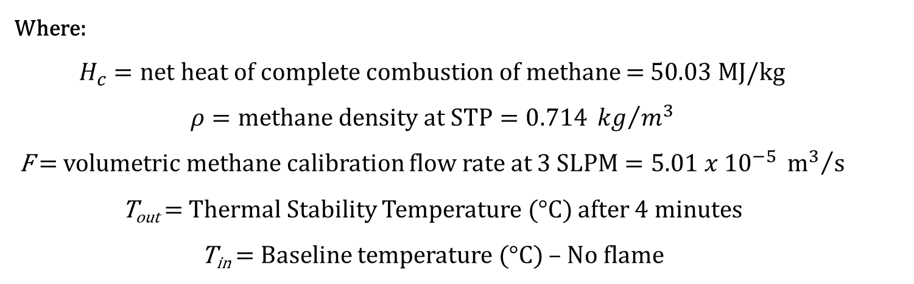
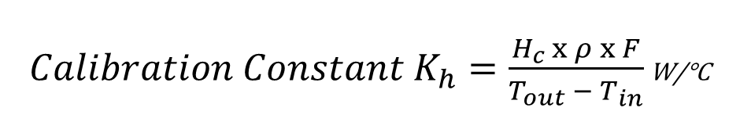
𝐇𝐑𝟐 𝐇𝐞𝐚𝐭 𝐓𝐫𝐚𝐧𝐬𝐟𝐞𝐫 𝐂𝐨𝐞𝐟𝐟𝐢𝐜𝐢𝐞𝐧𝐭
Replacing:
${Calibration Constant K}_{h}=\frac{H_{c} x ρ x F}{T_{out} −{ T}_{in}}$ W/°C
Where:
$H_{c}=net heat of complete combustion of methane$ = 50.03 MJ/kg
$$ρ=methane density at STP=0.714 {kg}/{m^{3}}$$
F = volumetric methane calibration flow rate at $3 SLPM=5.01 x {10}^{−5} {m^{3}}/s$
T_{out} = Thermal Stability Temperature (°C) after 4 minutes
T_{in} = Baseline temperature (°C) – No flame
Notes:
SLIDE #8 𝐇𝐑𝟐 𝐇𝐞𝐚𝐭 𝐓𝐫𝐚𝐧𝐬𝐟𝐞𝐫 𝐂𝐨𝐞𝐟𝐟𝐢𝐜𝐢𝐞𝐧𝐭
In simplifying the current equation found in the FAA rule to determine the calibration constant Kh, only three criteria are needed: The net heat of complete combustion of methane, methane density at standard temperature and pressure, and the volumetric calibration flow rate. Multiplying these factors together and dividing by the measured ΔT where T_{out} = Thermal Stability Temperature and T_{in} = Baseline temperature – No flame, continues to result in a calibration constant in terms of W/°C

Slide 9
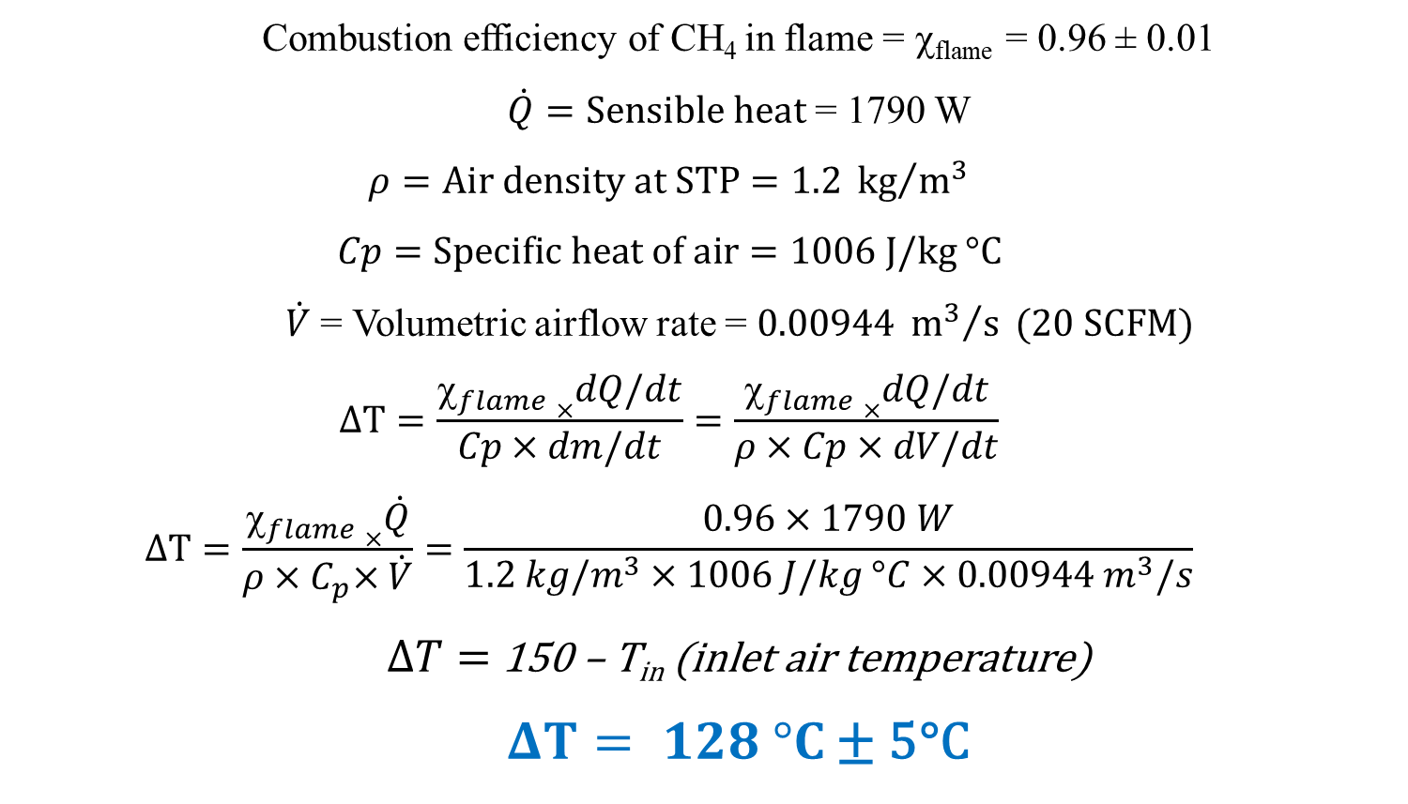
Calibration ΔT: Sensible Heat Equation
Combustion efficiency of CH₄ in flame = χ_{flame} = 0.96 ± 0.01
$\dot{Q}=Sensible heat$ = 1790 W
$$ρ=Air density at STP=1.2 {kg}/{m^{3}}$$
$$Cp=Specific heat of air=1006 J/kg °C$$
$\dot{V}$ = Volumetric airflow rate = $0.00944 {m^{3}}/s (20 SCFM)$
$$∆T=\frac{\left.χ_{flame}×\right.dQ/dt}{Cp×dm/dt}=\frac{\left.χ_{flame}×\right.dQ/dt}{ρ×Cp×dV/dt}$$
$$∆T=\frac{\left.χ_{flame}×\right.\dot{Q}}{ρ{×C}_{p}×\dot{V}}=\frac{0.96×1790 W}{\left.1.2 kg/m^{3}\right.×1006 J/kg °C×0.00944 m^{3}/s}$$
$∆T=$ 150 – T_{in} (inlet air temperature)
$ΔT= 128 °C$ ± 5°C
Notes:
SLIDE #9 Determining the Calibration ΔT Using Sensible Heat Equation
This is a routine calibration of the HR2, however, without the globar heating elements turned on.
As mentioned previously, mathematically calculating the ideal ΔT range during a ‘cold’ calibration is achievable using sensible heat equation by entering sensible heat value, air density at standard temperature and pressure, the specific heat of air, and the volumetric airflow rate.
With combustion efficiency losses applied, the exhaust gas temperature is calculated to be 150°C. When subtracting out the inlet air temperature we can calculate the expected thermopile ΔT to be 128°C with most likely a plus or minus 5°C tolerance. This calibration procedure would only be used for troubleshooting purposes of flow control devices.

Slide 10
TRL 7 Details and Planning
Currently planning is underway for this follow on activity (and beyond)
Define representative families of materials / material constructions
Choose one or two specimens to represent those families
Notes:
SLIDE #10 TRL 7 Details and Planning
Currently planning is underway for the next TRL test series, TRL7. In this, we are looking for assistance in defining representative families of materials and material constructions. We would then choose one or two specimens to represent those families. Participation in the break-out task group is encouraged.

Slide 11
TRL 7 Details and Planning
Goal is to evaluate relative performance of these samples on the HR2 vs. OSU to ensure there is no unexpected behavior.
What commonly used materials and constructions tested for HR should be included in this analysis?
Looking for materials to support this testing
Notes:
SLIDE #11 TRL 7 Details and Planning
The goal of TRL 7 would be to evaluate the relative performance of test samples on the HR2 vs. OSU to ensure there is no unexpected behavior. For example, failing in the OSU when passing on the HR2. What commonly used materials and constructions tested for heat release should be included in this analysis? Finally, there would be a need to acquire these materials to support this testing.

Slide 12
NEXT
Review ‘cold’ calibration troubleshooting method
Continue TRL6 testing
  Response Parameters - Complete 100 calibration cycles per unit as needed
  Define Nominal Operating Parameters Range (BL, TST, CF)
  Additional unit buildups for comparative testing (TRL 6)
TRL7 planning and acquisition of materials
Formalize endgame for TRL test series (define activities, goals etc.)
Update Rev3 placeholder document
Notes:
SLIDE #12 NEXT
Ok, so to wrap things up I’d like to summarize what’s next. We will continue to review the ‘cold’ calibration troubleshooting method. Work will continue on TRL6 testing looking to generate data to help determine response parameter ranges for baseline temperature, thermal stability temperature, and calibration factor. As always we are very interested in having additional unit buildups for this activity. We will continue to push forward in TRL7 planning and acquisition of materials while formalizing the endgame for this TRL test series. And finally, updates to the handbook revision 3 placeholder document will be incorporated as needed.
CLOSING
In closing, I thank you for your attention. Have a blessed day.

