Slide 1


Preliminary Results from the MCC Inter-Laboratory Study
Richard N. Walters
Richard E. Lyon & Natallia Safronava
Federal Aviation Administration
William J. Hughes Technical Center
Fire Safety Branch ANG-E21
Atlantic City, New Jersey 08405
Federal Aviation
Administration

Slide 2
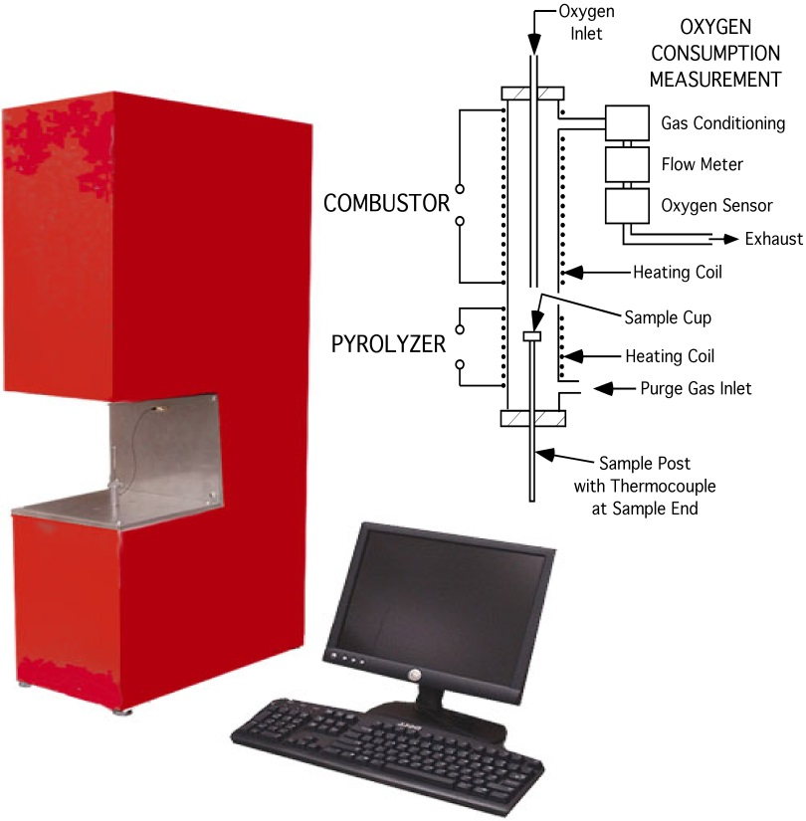
FAA Microscale Combustion Calorimeter
(ASTM D7309-21)
The MCC test measures Materials Properties related to Flammability on a milligram size scale.
One of the outputs: Fire Growth Capacity (FGC).
The FGC is a measure of ignitability and burning rate of the material, i.e., the total fire hazard
MCC is proposed method for alternate means of compliance when a small change is made to a construction

Slide 3
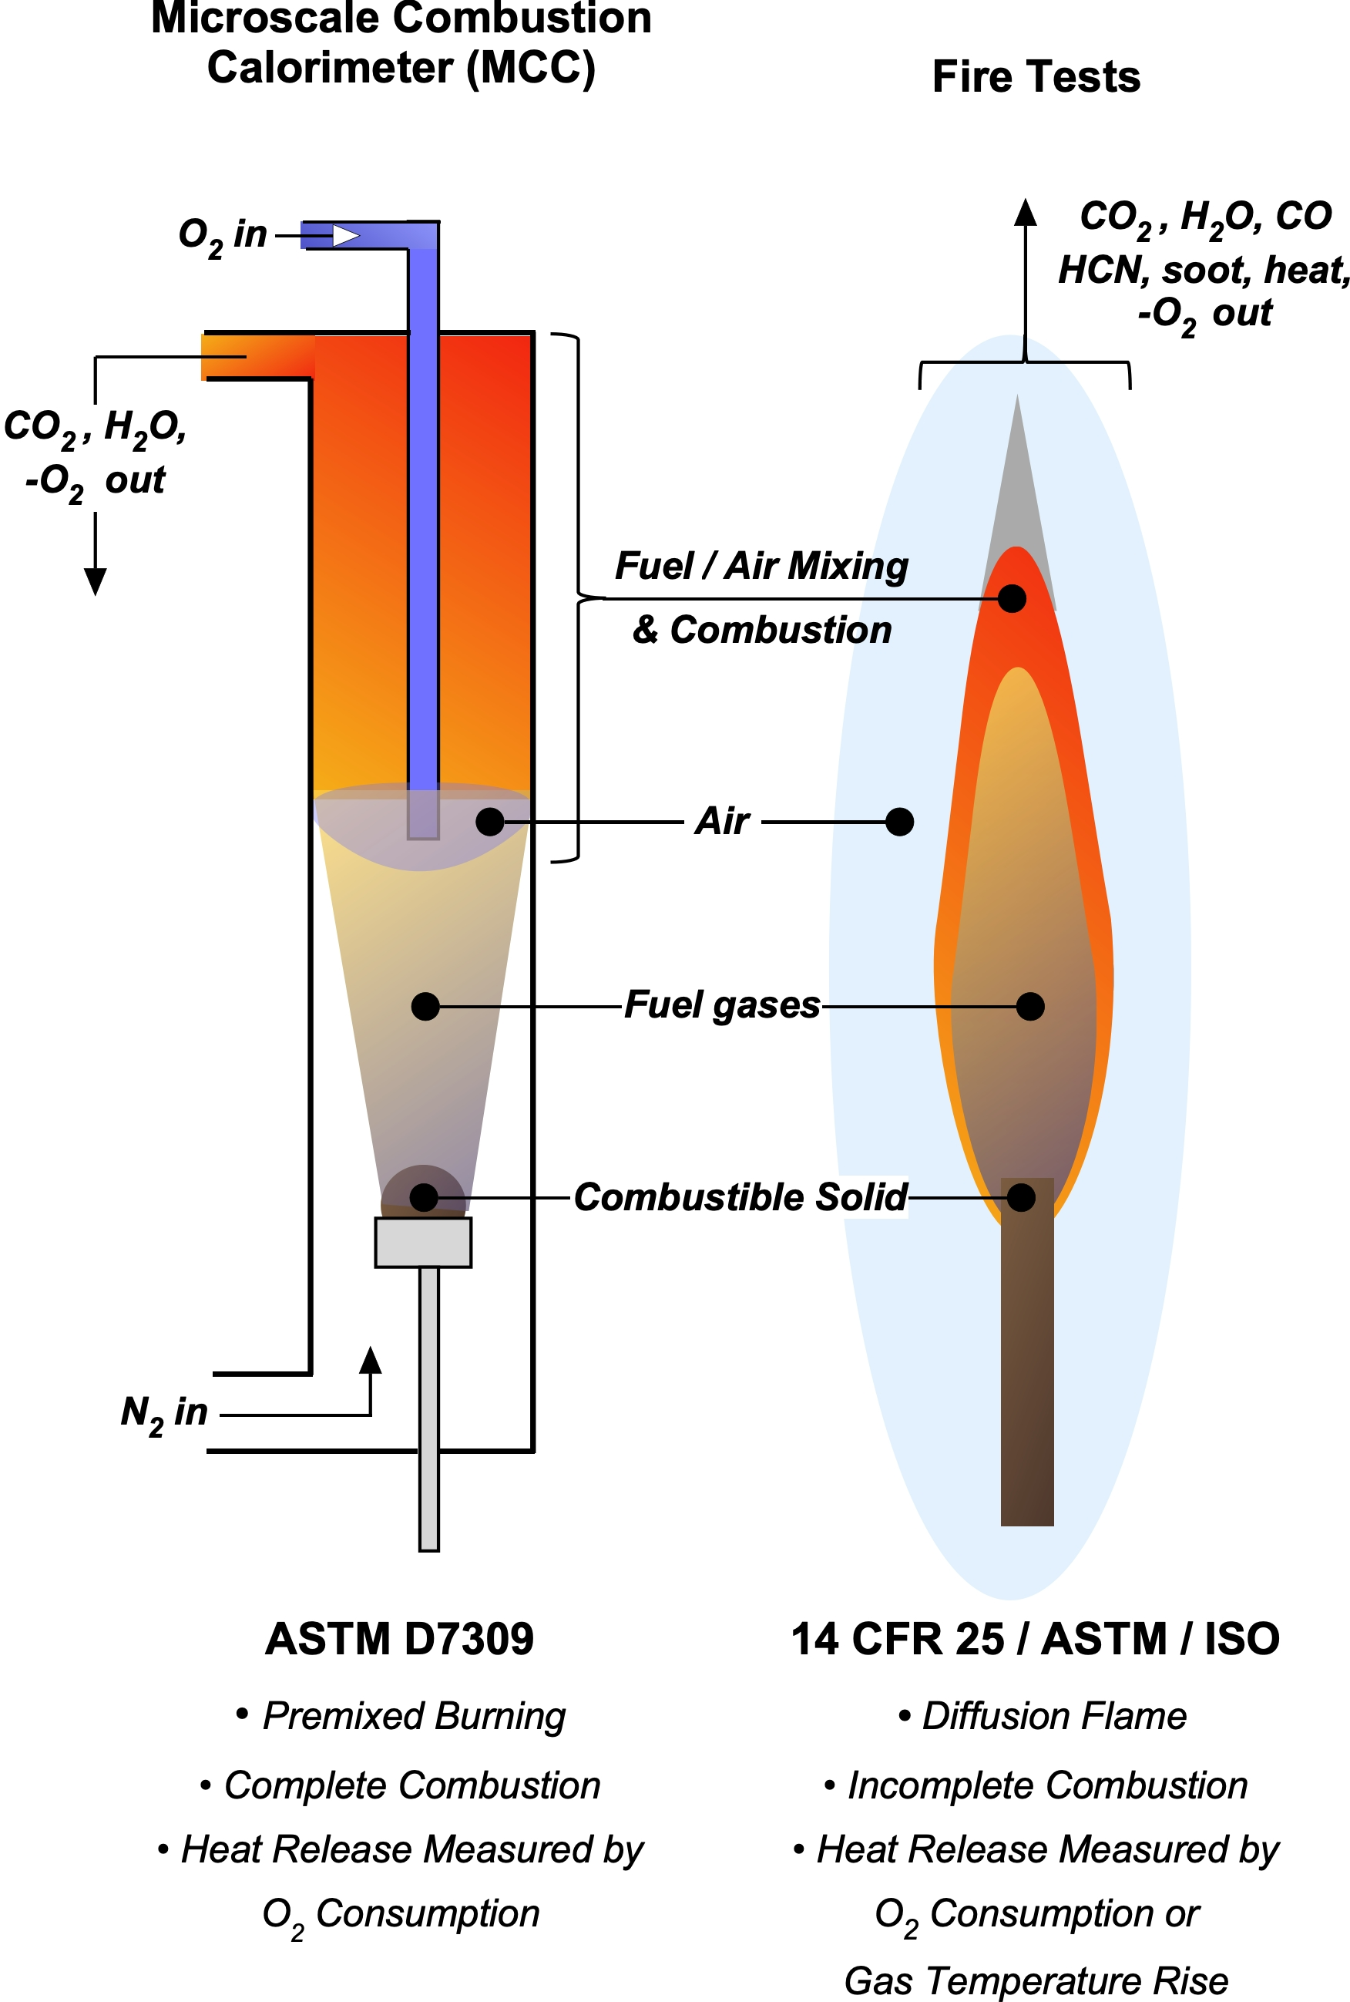
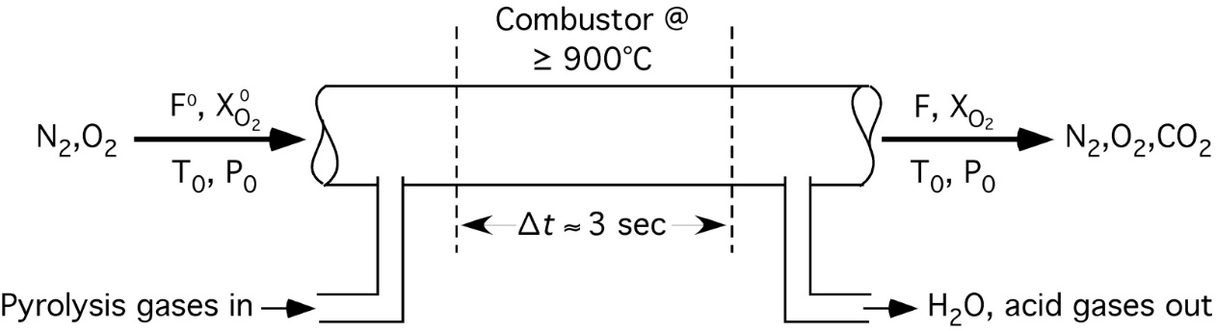
FAA Microscale Combustion Calorimeter
HRR by
O2 Consumption

Slide 4
FAA Microscale Combustion Calorimeter
HRR by
O2 Consumption

Slide 5
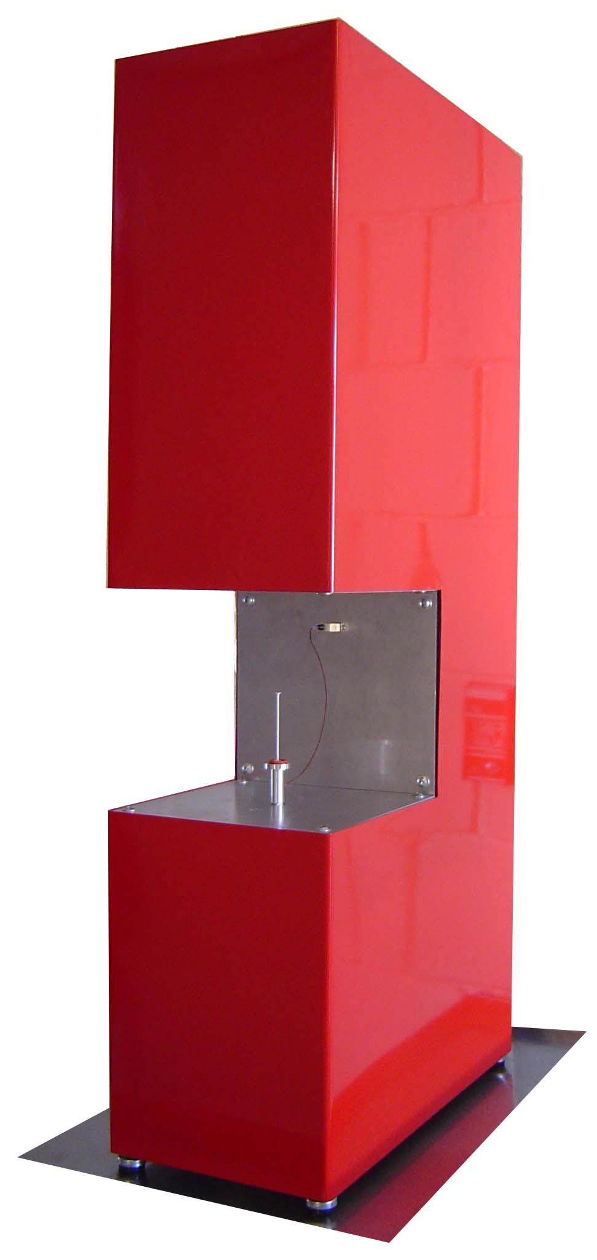
Standard Test ASTM D 7309 (Method A)
Anaerobic pyrolysis at 1 K/s + complete combustion of gases at 900°C, 20% O₂
700
Peak HRR &
Heat Release Capacity, η_{c}
600
500
Peak Pyrolysis
Temperature
400
Onset (Ignition)
Temperature
Heat Release Rate Q′ (W/g)
Total Heat Release
Heat of Combustion, Q∞
(Fire Load)
300
200
100
Pyrolysis Residue μ
(Char Fraction)
0
450
500
550
600
650
700
Temperature (°C)
Microscale Combustion
Calorimeter

Slide 6
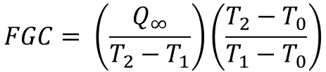
Fire Growth Capacity - FGC
-5% Q∞
MCC procedure for FGC
80
Q∞
10
70
60
8
Measure specific heat release rate Q′ versus temperature T as per ASTM D7309 (5 replicates)
Integrate Q′/β versus T to obtain Q versus T, i.e., Q(T )
Obtain total heat release
Q(T∞) = Q∞ = h_{c}(J/g)
Obtain T₁ at 5% deflection from Q(T) baseline, i.e., at 0.05Q∞
Obtain T₂ at Q∞ i.e., 0.95Q∞.
Calculate Fire Growth capacity (FGC)
T₂
50
6
40
+5%
Q∞
Specific Heat Release Rate, Q′ (W/g)
4
30
Q (J/g)
20
2
10
T₁
0
0
200
300
400
500
600
700
800
900
Temperature, T (°C)
T₀ = 25°C (298K)
T₁ = Ignition temperature
T₂ = Burning temperature
$$FGC= \left(\frac{Q_{∞}}{T_{2}−T_{1}}\right)\left(\frac{T_{2}−T_{0}}{T_{1}−T_{0}}\right)$$

Slide 7
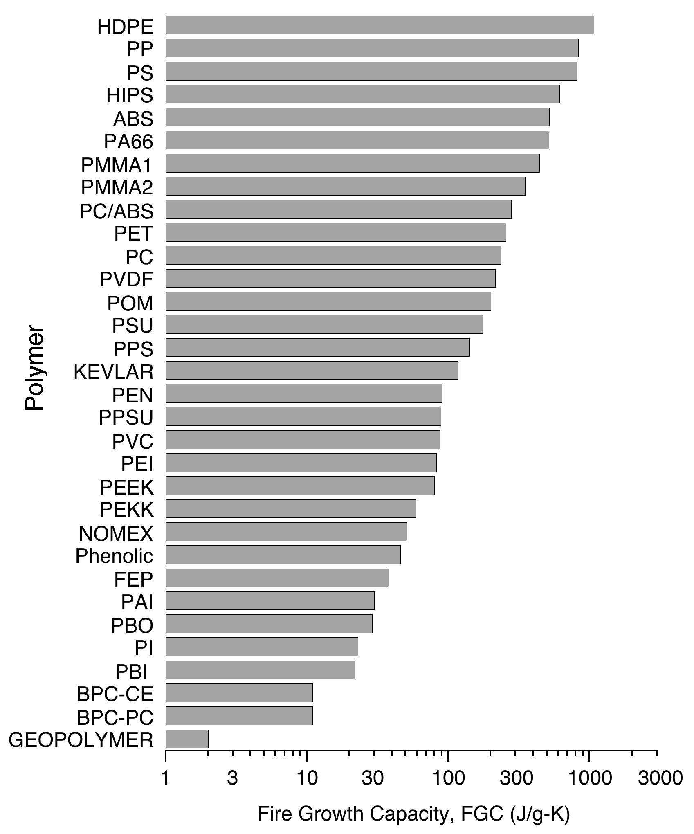
Commodity Plastics
Engineering Plastics
Specialty Plastics
Heat Resistant Plastics
Fire Resistant Polymers
Fire Growth Capacity, FGC (J/g-K)

Slide 8
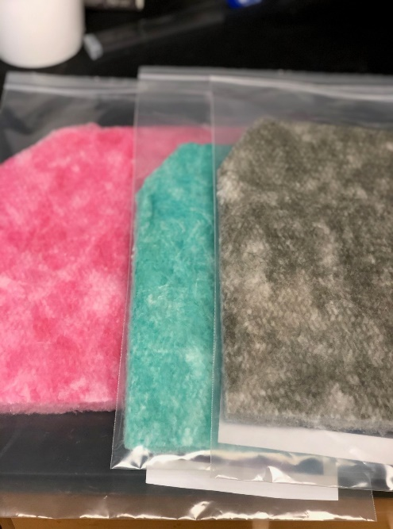
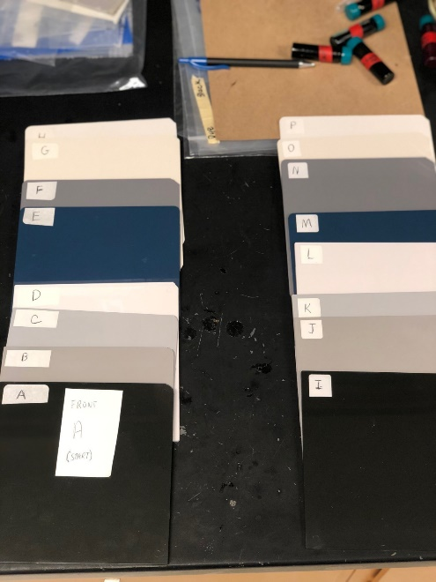
Similarity Project Background
Small changes in the composition of certified aircraft cabin materials are often needed due to unavailability of the original components or environmental regulations
Recertification of the entire constructions are costly
Aircraft manufacturers and suppliers asked the FAA to explore alternative means of complying with the FAR in 2015.
The Material Similarity Task Group was created to develop a method and criterion for comparing flammability of samples at micro-scale using ASTM D7309 (MCC).

Slide 9

Similarity Criterion
$$\frac{∆FGC}{{FGC}_{B}}≤ 0.3$$
The no-effect level of a material change at micro-scale is equal to the relative uncertainty of bench-scale FAR fire test results at the 95% confidence level, i.e., 30%, as determined by testing.
__________________________________________
Next steps:
Jeff Gardlin’s presentation on Transport Airplane Issue List (TAIL).
ASTM D7309-21 inter-laboratory study to-
  Determine repeatability and reproducibility of FGC
  Include ultra-low heat release aircraft phenolic resin.

Slide 10
Similarity Criterion
$$\frac{∆FGC}{{FGC}_{B}}≤ 0.3$$
The no-effect level of a material change at micro-scale is equal to the relative uncertainty of bench-scale FAR fire test results at the 95% confidence level, i.e., 30%, as determined by testing.
__________________________________________
Next steps:
Jeff Gardlin’s presentation on Transport Airplane Issue List (TAIL).
ASTM D7309-21 inter-laboratory study to-
  Determine repeatability and reproducibility of FGC
  Include ultra-low heat release aircraft phenolic resin.

Slide 11
ASTM E691
Conducting an Inter-Laboratory Study to Determine the Precision of a Method
Repeatability
  An action, event, or other thing that is done again
Reproducibility
  Create something very similar to (something else) in a different medium or context

Slide 12
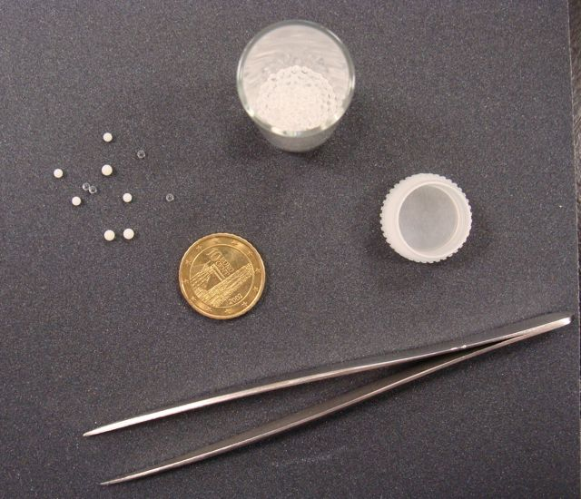
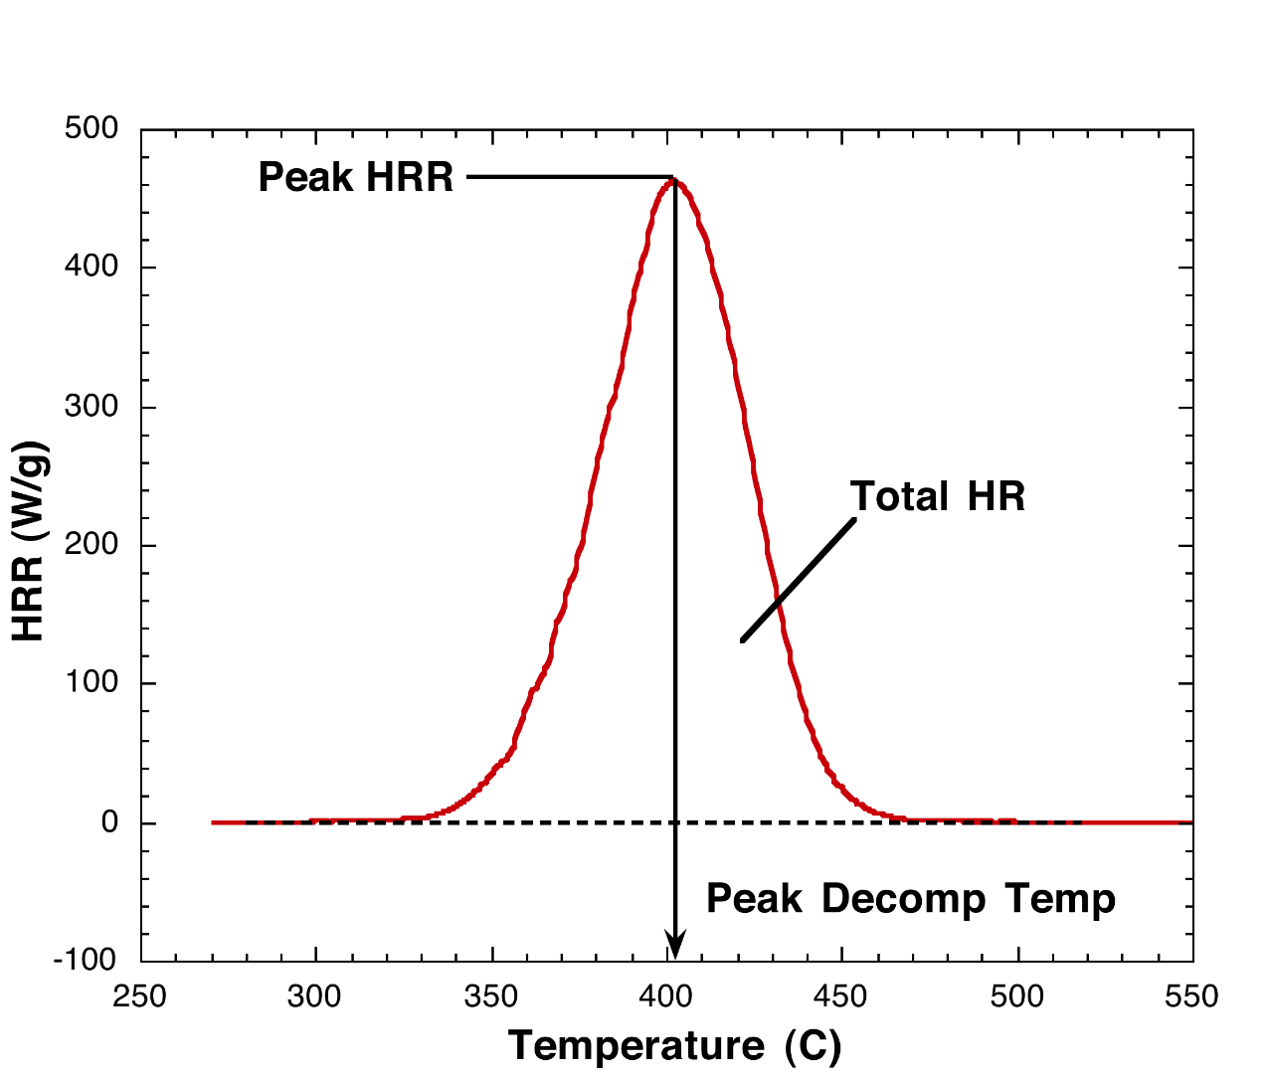
Measured Values
Sample Weight (mg)
Peak Heat Release Rate (W/g)
Peak Heat Release Temperature (C)
Total Heat Released (kJ/g)
Fire Growth Capacity (J/g-K)
Char Yield (%)

Slide 13
Inter-Laboratory Study – Round 1
4 manufacturers/licensees of the MCC
  Deatak
  Fire Testing Technologies
  Concept Equipment Ltd
  Me
Polystyrene sample sent to labs
  Over 20 labs were asked to participate
  Several labs could not participate due to equipment not working
Data received from 14 labs
  Several labs need equipment adjusted
  Several labs equipment was fine but data was re-analyzed and interpreted by me

Slide 14
Lab Comparison – Peak Heat Release Rate
±63 W/g
1118 W/g
±5.6%
1 2 3 11 12 14

Slide 15
Lab Comparison – Total Heat Release
±1.1 kJ/g
40.6 kJ/g
±2.8%
3 4 14

Slide 16
Lab Comparison – Fire Growth Capacity
±35 J/g-K
868 J/g-K
±4.1%
2 3

Slide 17
Lab Comparison – Peak Temperature
±6 C
441 C
±1.5%
5 7 11 14

Slide 18
Sources of Error
Heat Release Rate
  Bad O₂ sensor/calibration
  Leak in system
  Sample size
  Bad weight measurements
  Flow controllers/meter out of calibration
Temperature
  Thermal lag
  DAQ board calibration
  Time shift

Slide 19
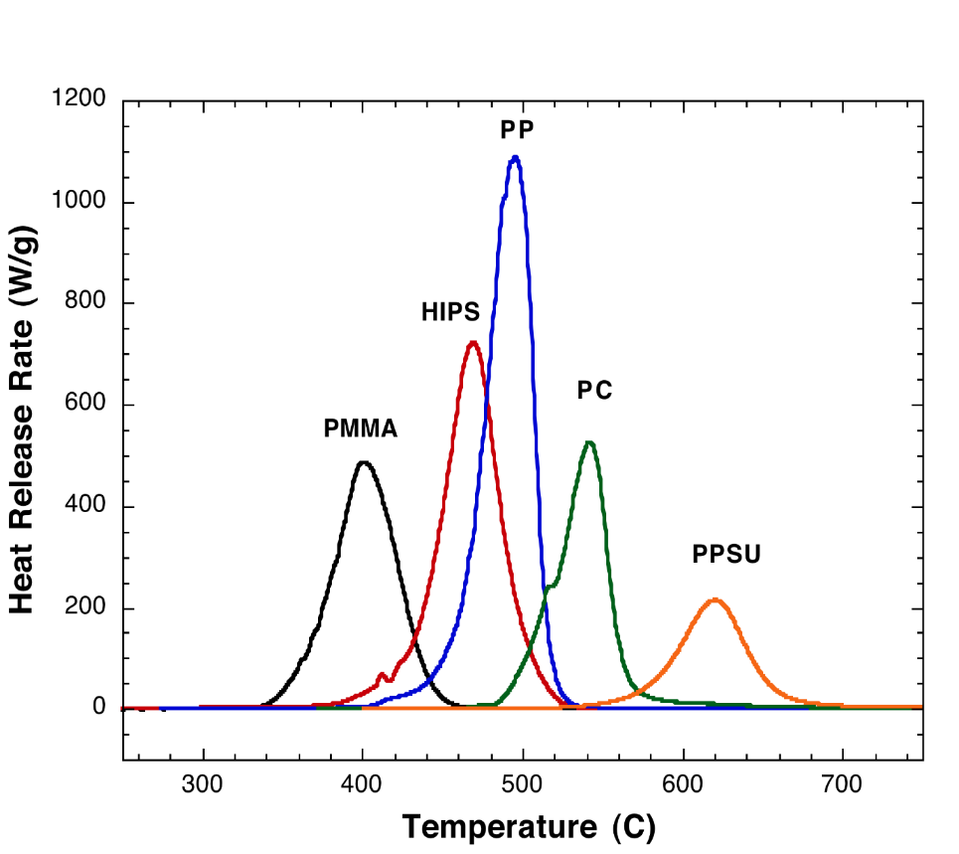
Future Work
Offer suggestions to operators to fix errors
Inter-laboratory study – Round 2 (ASTM)
Send set of 5-6 samples to labs
Results submitted directly to ASTM
Updated Precision & Bias statement
FAA report

Slide 20
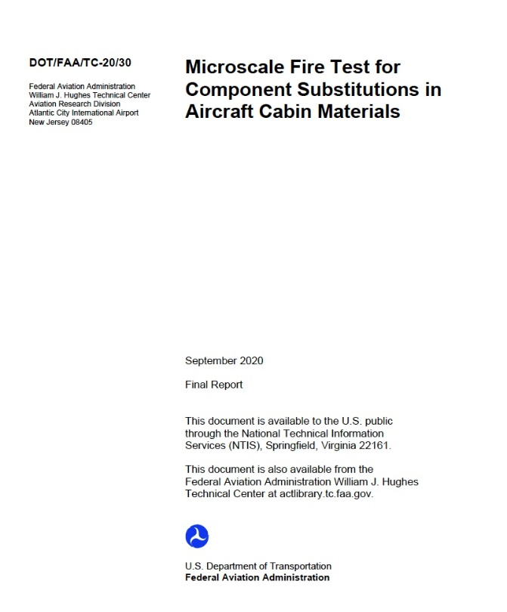
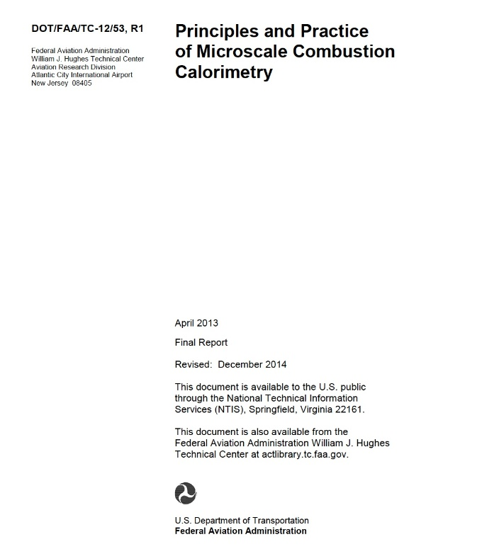
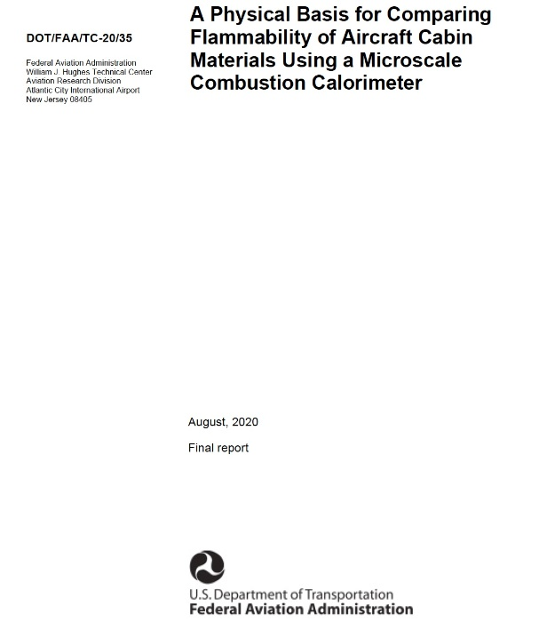
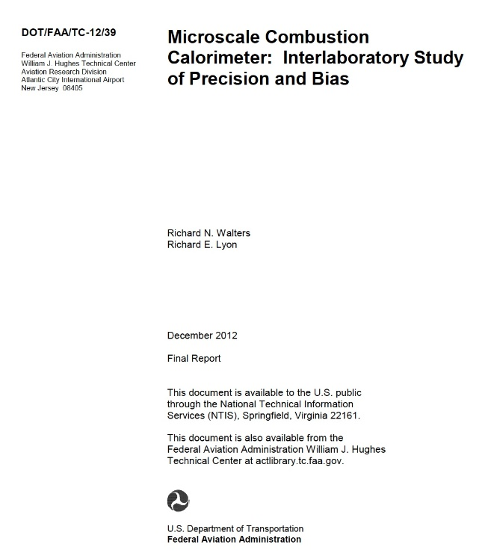
FAA Reports - https://www.fire.tc.faa.gov/
Similarity
MCC
ILS
FGC

Slide 21
Contact Info
Richard Walters, PhD
Federal Aviation Administration
William J Hughes Technical Center
Fire Safety Branch ANG-E21 Bldg 277
Atlantic City International Airport, NJ 08405
609-515-9508
richard.walters@faa.gov

