Slide 1
Fire Containment Bags for PEDs
International Aircraft Systems Fire Protection Forum (IASFPF)
Dan Keslar
October, 2023

Slide 2
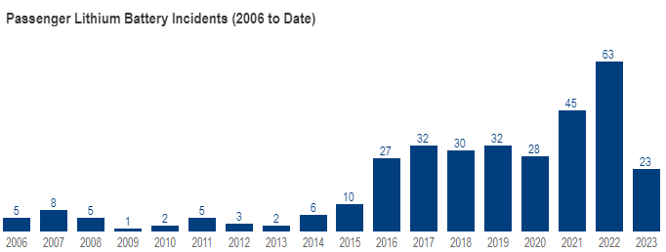
Background
Portable Electronic Devices (PEDs) containing lithium batteries may undergo thermal runaway
Significant increase in lithium battery incidents involving smoke, fire or heat in cabin of aircraft within recent years
Aircraft cabin incidents involving smoke, fire or heat from lithium batteries – 2006 to July, 2023
[1] – https://www.faa.gov/hazmat/resources/lithium_batteries/incidents

Slide 3
FAA Perspective
As a response to these threats, manufacturers have developed fire containment bags as a means to store overheating PEDs
Current FAA guidance [2-4] recommends:
  Using a handheld extinguisher to knock down open flames
  Dousing PED with water or non-alcoholic liquids to cool device
FAA currently does not object to the use of containment products, granted that these procedures are followed
However, FAA does not support any manufacturer procedures that suggest moving an overheated device [2]
[2] – InFO 17021 [3] – AC 20-42D
[4] – SAFO 09013

Slide 4
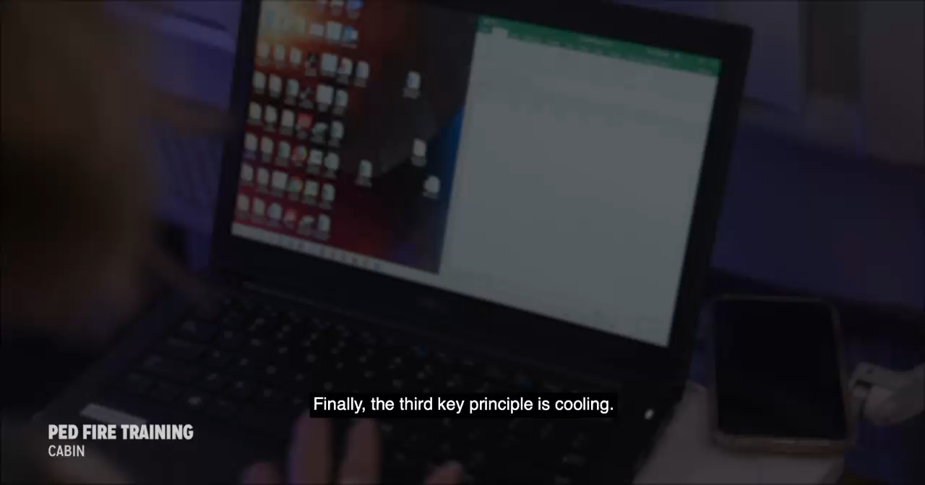
FAA PED Fire Training Video - Cabin
Full video [5]
[5] – https://www.fire.tc.faa.gov/Training/PortableElectronicDeviceFireTrainingCabin

Slide 5
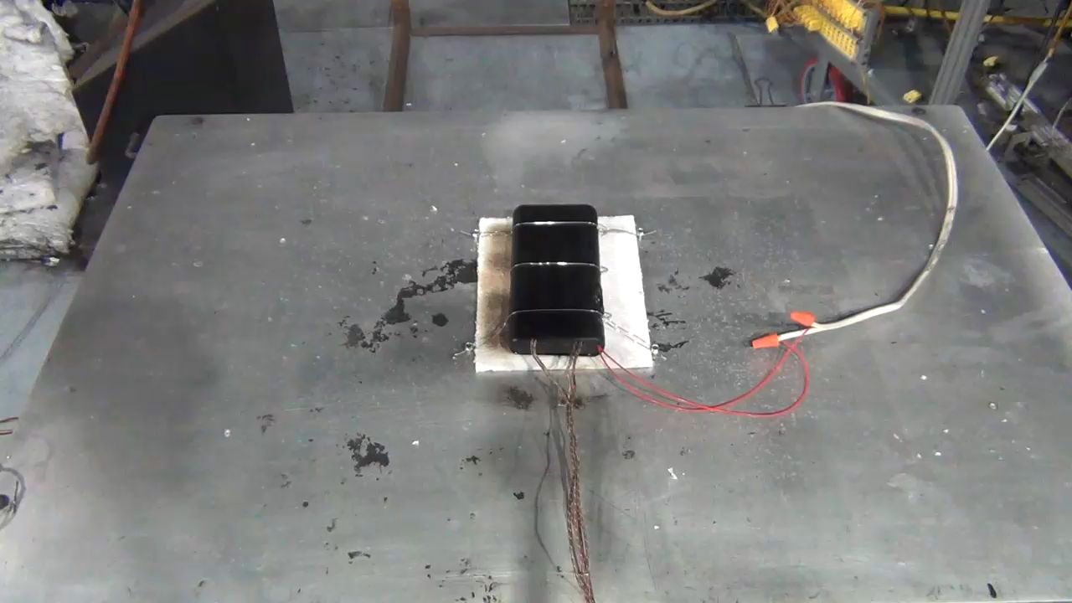
Lithium Battery Watt-hour Restrictions
Lithium-ion batteries limited to 100 watt-hour (Wh) on aircraft [6]
With airline approval, passenger may also carry two spare larger lithium-ion batteries (101-160 Wh)
Batteries near the max limit have the potential to produce a significant in-flight fire
96 Wh Power Bank – 100% SoC
[6] – 49 CFR 175.10(a)(18)(i)
Notes:
- Many cell phones carry anywhere from 10 – 15 Wh batteries, so this Power Bank could fully charge a phone around 6 to 10 times

Slide 6
Fire Containment Bag Test Setup
Tests are being performed with two fire loads: a mid-sized tablet and a power bank
PEDs charged to 100% state of charge (SoC)
Initiating cell heated at a rate of 10°C/min
Thermocouples placed throughout interior and exterior of bag
Tests follow manufacturer procedures as closely as possible

Slide 7
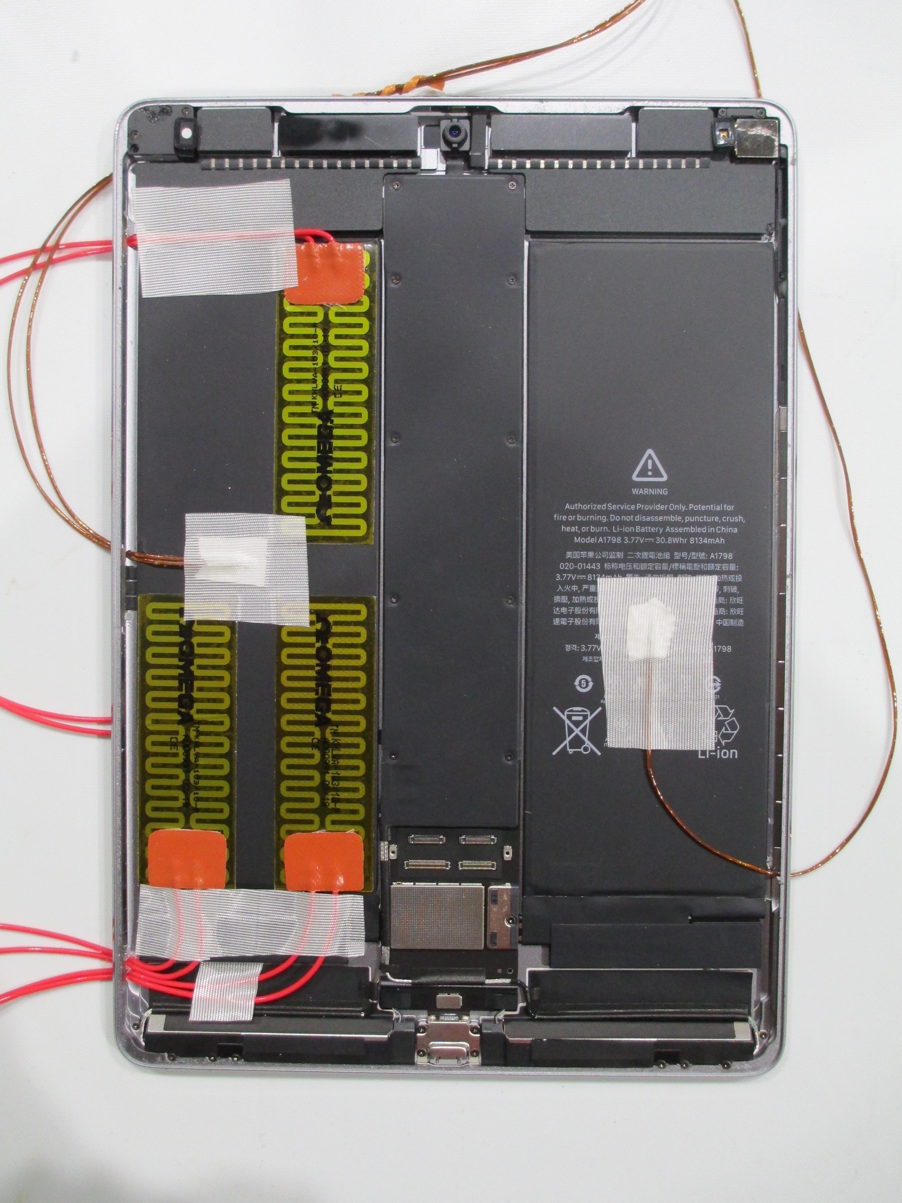
Mid-sized Tablet
Internal Tablet Setup
Used to replicate a medium sized PED thermal runaway scenario
Tablets can be found in both flight deck (electronic flight bags) and cabin
Contains a 30 Wh battery (two 15 Wh pouch cells)
Three 1” x 3” 10 W/in² stick on polyimide heaters used

Slide 8
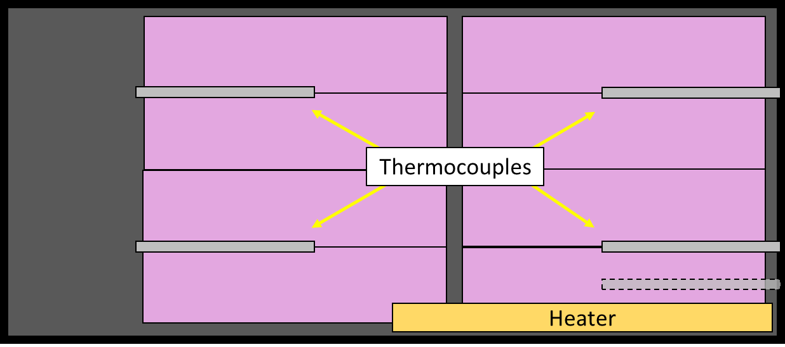
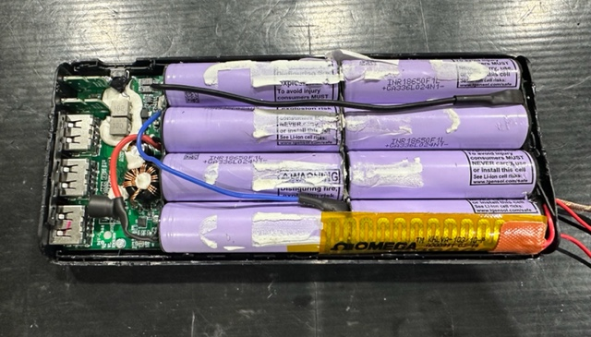
Power Bank
Power Bank Setup
Used to replicate a “worst case” scenario (close to 100 Wh limit)
96 Wh battery (eight 18650 cells)
Thermocouples placed between every other cell
One 1” x 3” 10 W/in² heater attached to the outermost cell

Slide 9
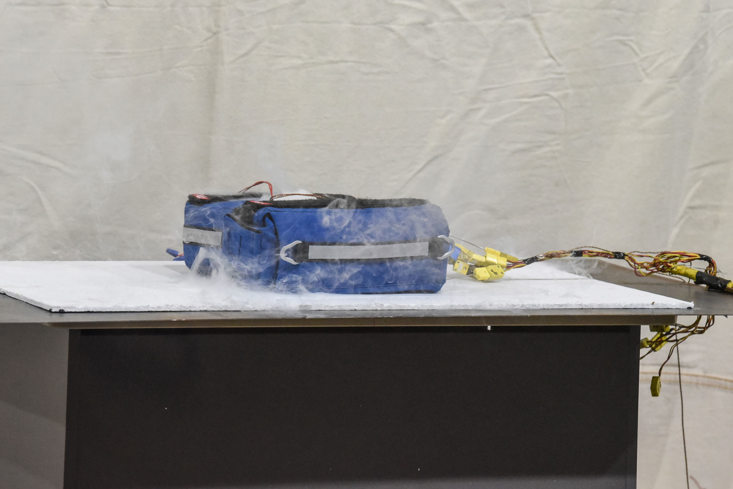
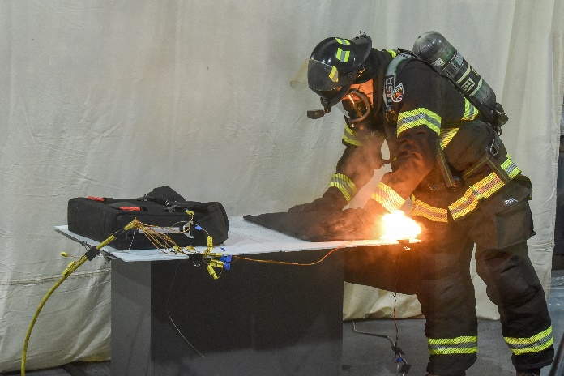
Manufacturer A Testing
Manufacturer A produces two types of bags – a cabin and flight deck version
Manufacturer has two sets of instructions depending on if the PED is overheating or already on fire
Eight total tests conducted – four replicating each scenario
PED Overheating Test
PED Already on Fire Test

Slide 10
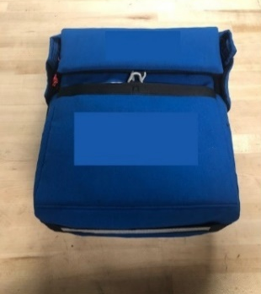
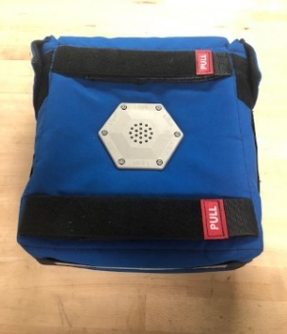
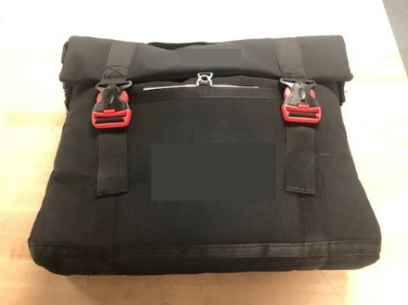
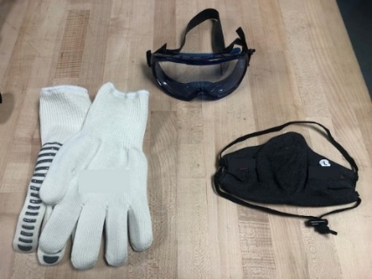

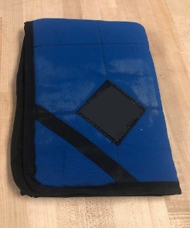
Manufacturer A Testing
Flight Deck Bag
Cabin Bag
Manufacturer A product includes:
  Fire Containment Bag
  PED Pads (x2)
  Fire Shield Blanket
  PPE (gloves, mask, goggles)
PED Pad contains mineral-based extinguishing agent that is released when heated
Bags equipped with a filter and vent for smoke
PPE
PED Pad
Fire Blanket

Slide 11
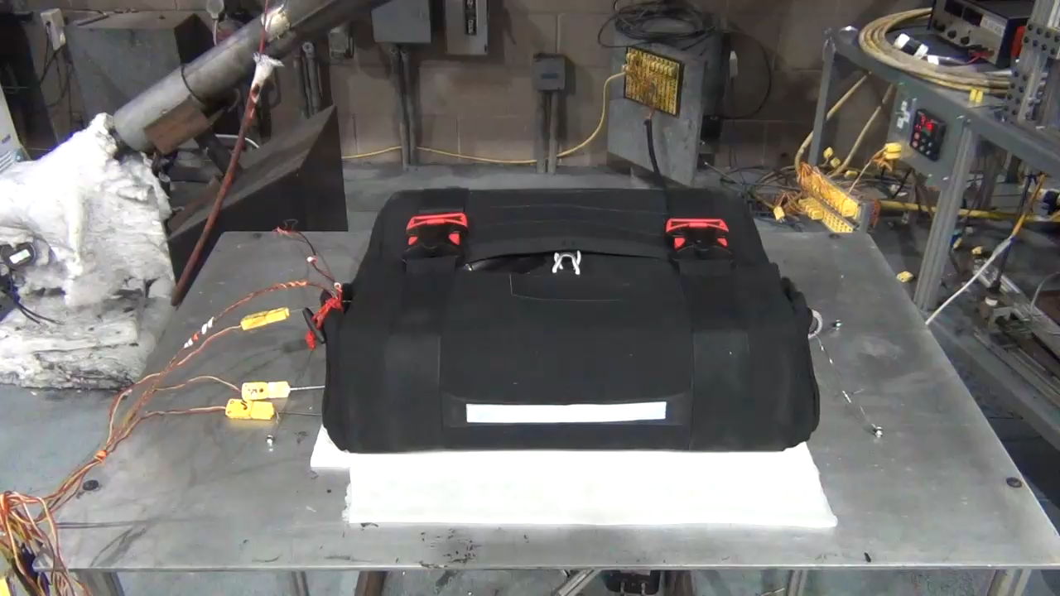
Manufacturer A – Tablet is Overheating
Cabin Bag – Tablet stored within – Filter faced down
Tablets would consistently produce smoke – no flame
Visible smoke released from bag for all tests
Filter effectiveness varied from test to test
  May be caused due to bag orientation
  Bag oriented with filter side up seemed to perform better

Slide 12
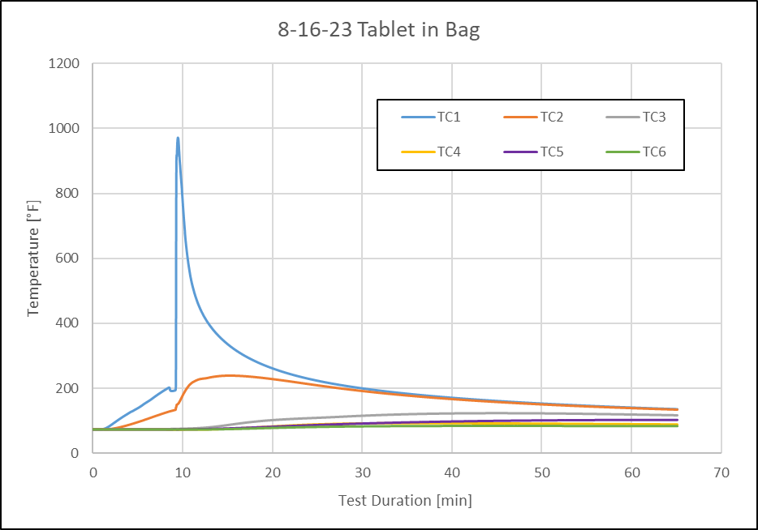
Tablet Overheating - Data
Max temperature of TCs attached to exterior of bag was 110°F for all tablet tests

Slide 13
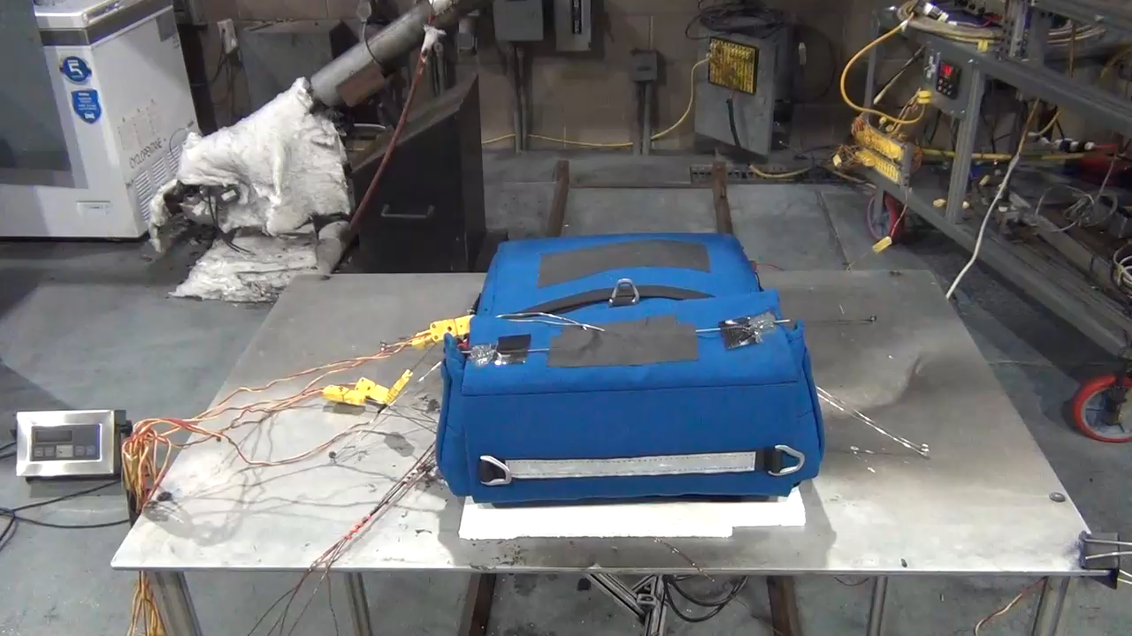
Manufacturer A – Power Bank is Overheating
No visible flame or shrapnel escaped bag for all tests
PED Pads showed to be effective in suppressing flames when kept in bag
Cabin bag performed much better compared to flight deck version
Substantial amount of smoke released
  Smoke escaped from tear in bag that occurred after pressure buildup
Flight Deck Bag – Filter faced down

Slide 14
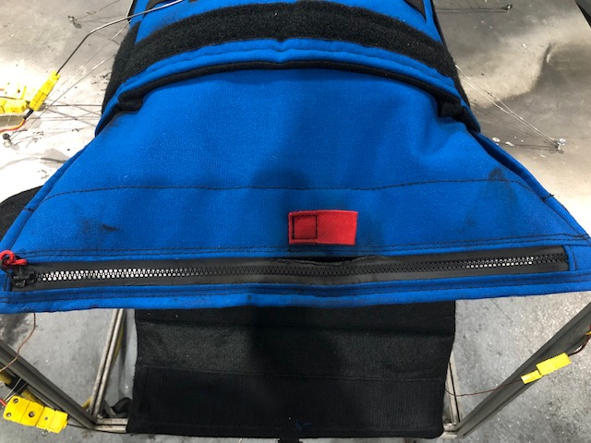
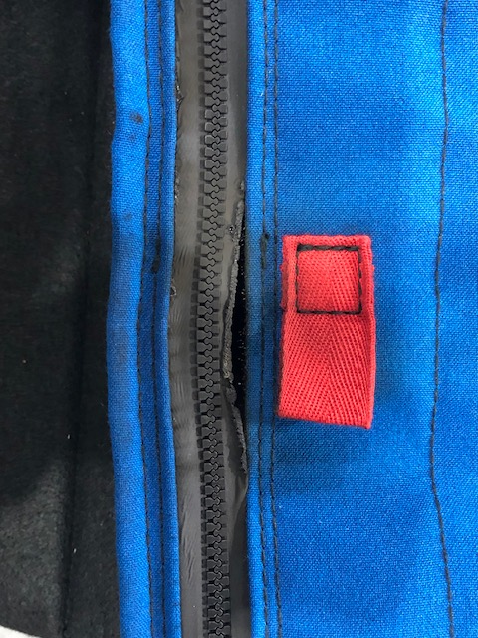
Fire Containment Bag Tear
Post Test Picture – Tear in Flight Deck Bag

Slide 15
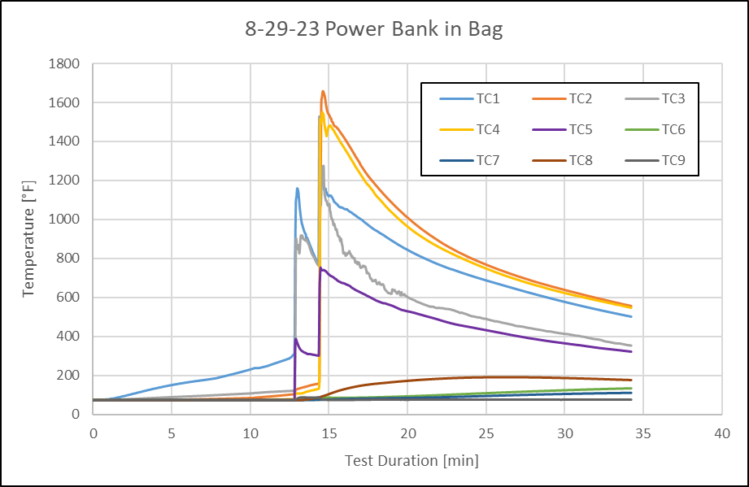
Power Bank Overheating - Data
Max temperature of TCs attached to exterior of bag was around 190°F for all power bank tests

Slide 16
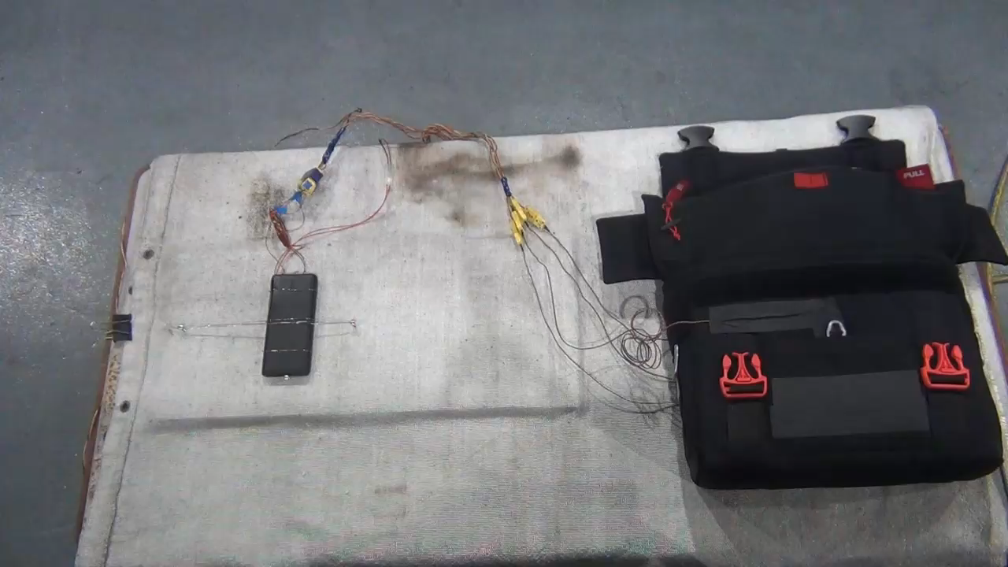
Manufacturer A – Power Bank is Already on Fire
Hot shrapnel ejected from power bank as technician approached to place pad and fire blanket on PED
Heat propagation of cells created second fire flare up after PED pad was placed on top
Power Bank was secured down within this test – likely to move sporadically in a realistic scenario
Cabin Bag – PED stored within

Slide 17
Areas of Concern
The use of fire containment bags is a significant challenge, as manufacturers must develop a product that can:
  Mitigate the spread of smoke and fire for PEDs up to 100 Wh (Or 160 Wh for certain airlines)
  Sufficiently protect crewmembers throughout handling without:
    Delaying response time
    Impairing a crewmembers’ ability to handle the device and product (ergonomics)
Thermal runaway in PEDs can happen suddenly, with little to no signs beforehand – high risk of injury

Slide 18
Next Steps
Additional testing with fire containment products from at least three other manufacturers will be conducted
Upon testing completion, a report with all findings will be published and released to the public – proprietary info will be censored
Any suggestions or feedback for how testing could be improved?

Slide 19
Questions?
Contact:
Dan Keslar
Federal Aviation Administration
William J. Hughes Technical Center
Fire Safety Branch, Bldg. 203
Atlantic City Int’l Airport, NJ 08405
(609) 485-5767
Daniel.Keslar@faa.gov

