Slide 1
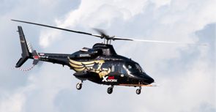
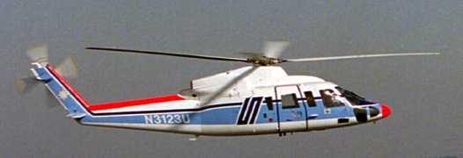
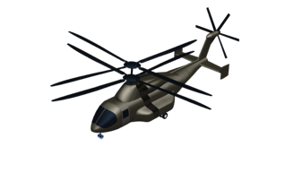
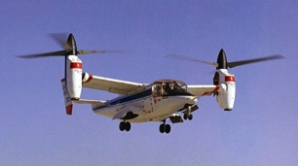
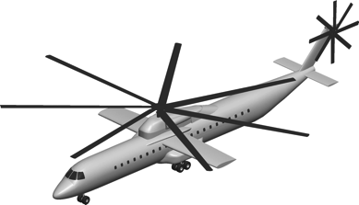
Simulating the Impact Response of Composite Airframe Components
Karen E. Jackson, Ph.D.
Structural Dynamics Branch
NASA Langley Research Center
Hampton, VA
7th Triennial Aircraft Fire and Cabin
Safety Research Conference
December 2-5, 2013
Philadelphia, PA

Slide 2
Outline
• Background Information
• Approach
• Objectives
• Results of Testing and Simulation
- I-Beams
- T-Sections
- Cruciform Sections
• Conclusions
• Acknowledgements

Slide 3
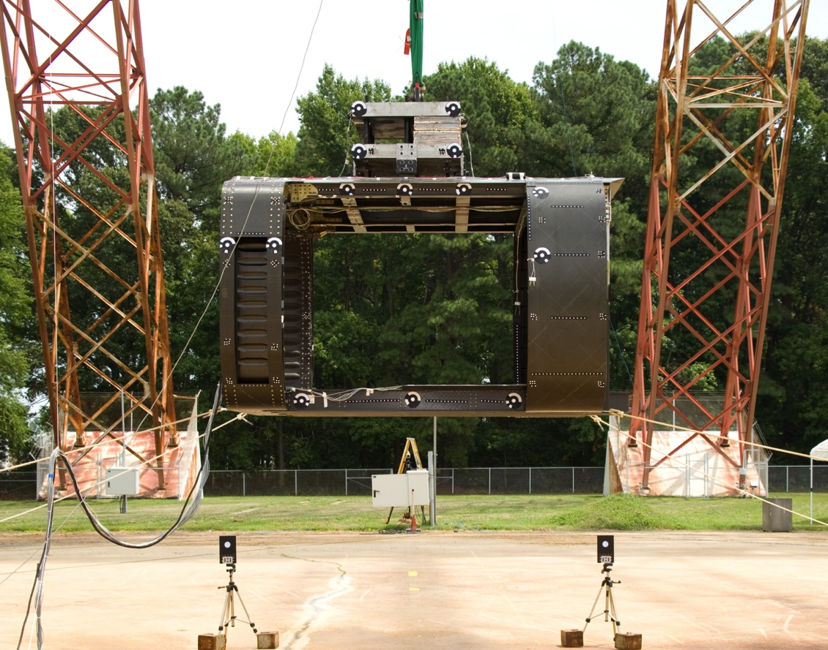
Background Information
• In 2010, the NASA Rotary Wing Crashworthiness Research Program
obtained residual hardware from the Survivable Affordable Repairable
Airframe Program (SARAP)
from the US Army AATD
• The Technology Validation
Article (TVA) was fabricated
by Sikorsky, during SARAP
Phase II, using composites
• A drop test was conducted in
2008 to evaluate the perform-
ance of a “tilting roof” concept
that was intended to dissipate
the kinetic energy of high
mass items during crash events
Pre-test photo of the SARAP TVA in 2008

Slide 4
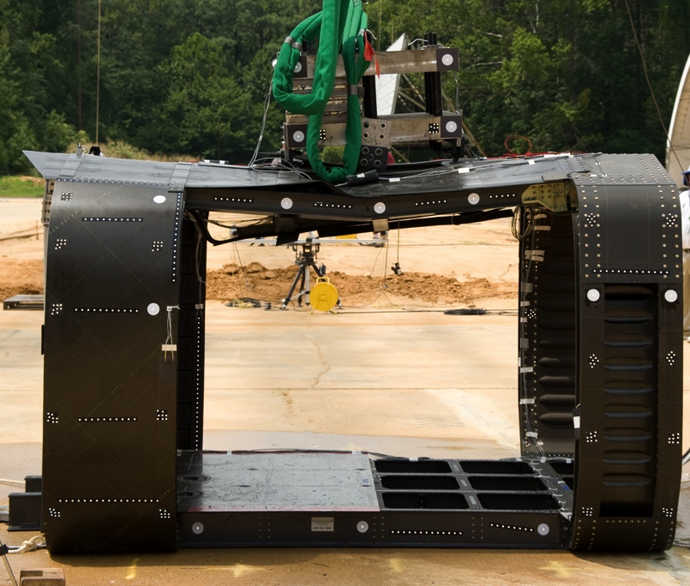
Background Information
•NASA’s Rotary Wing crashworthiness project is focusing on prediction of
damage initiation and progressive failure in composite aircraft structures
subjected to impact loads
•Sikorsky had an ongoing research
project to define best practices for
structural modeling, and to develop
test methods to derive parameters
used in LS-DYNA to represent
composite materials and to predict
their failure.
• In May 2011, a NASA-Sikorsky
cooperative agreement was established
to conduct composite airframe structural
testing under dynamic loading; develop accurate
material models to predict impact response using
LS-DYNA; and, validate analytical models through test-analysis comparison.
Post-test photo

Slide 5
Approach
• Obtain six different component types of varying complexity
from the SARAP TVA including:
- Material characterization testing of laminated coupons
- Dynamic impact testing of I-beam, T-section, and
cruciform section subcomponents
- Dynamic impact testing of two full-scale components
(subfloor section and fuselage section – stay tuned!)
• Conduct Non-Destructive Evaluation (NDE) of smaller test
articles using two different methods:
- Baseline ultrasonic C-scanning
- Single sided flash thermography
• Utilize a building block approach for testing, finite element
model development, and model calibration

Slide 6
Approach
Roof – Damaged, unused
Front Frame –
Frame vertical drop test
Rear Frame –
Partially damaged
Potential future use
Front Subfloor –
Subfloor longitudinal drop test
Rear Subfloor –
Cut into cruciforms, I-beams,T-sections, and material coupons

Slide 7
Objectives
• Work cooperatively with Sikorsky to characterize the response
of composite airframe components subjected to impact loads
• Assess the capabilities of LS-DYNA to predict the structural
response of composite airframe components subjected to
impact loads, including damage initiation and progressive
failure using two different material models:
-Progressive damage model (Mat 54)
-Continuum damage mechanics model (Mat 58)
• Document lessons learned:
Jackson K.E., Littell J.D., Horta L.G., Annett M.S., Fasanella E. L.,
Seal M.D., “Impact Testing and Simulation of Composite Airframe Structures,” NASA/TM-2013-XXXXXX, October 2013.

Slide 8
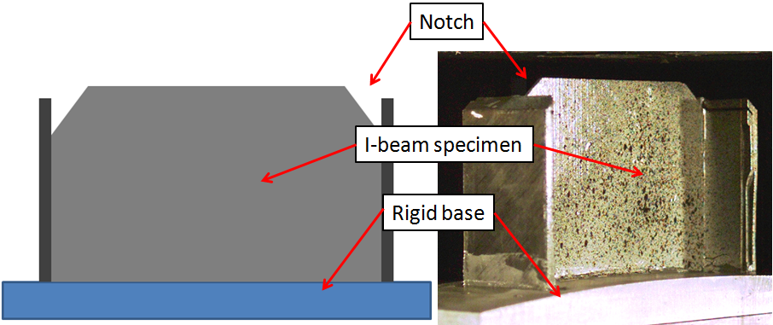
Results of Testing and Simulation:
I-beam Sections
Test configuration
Schematic drawing
•I-beams were extracted from the rear subfloor
•Dimensions 4.6-in. tall x 6.2-in. wide
•Two impact tests at 189.6-in/s (4-ft drop height) and 265.2-in/s (8-ft drop)
•Impact mass weighed 204.8-lb.
•Bottom edge was potted into a rigid base
•Corner notches were cut to serve as crush initiators
•Web sprayed with speckle pattern for photogrammetry

Slide 9
Results of Testing and Simulation:
I-beam Section (189.6-in/s)
Failure Events
+1 ms: Material crushing
from the upper edge
+5 ms: Material crushing
of upper web (primarily),
localized layer bending
and minor delamination
+10 ms: Material crushing
of web and side flanges
Test video

Slide 10
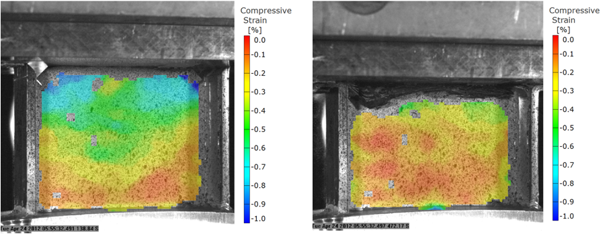
Results of Testing and Simulation:
I-beam Section (189.6-in/s)
Time = 1-ms
Time = 7.2-ms
•Stress wave traveling through
the specimen
•Wide variations in strain, -1.0% at
the top (blue/green) to -0.1% at
the bottom (orange)
•Time of max displacement
•Uniform strain close to 0.0%
•Strain field blocked as material
crushes near the top edge

Slide 11
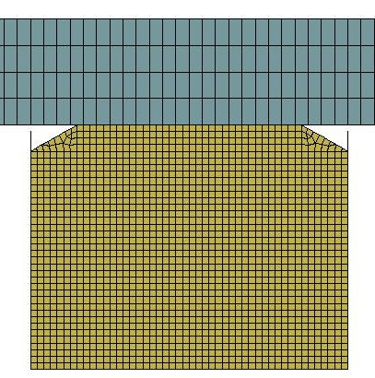
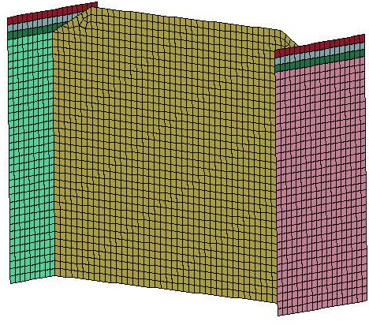
Results of Testing and Simulation:
I-beam Section (189.6-in/s)
•Model has 24,300 nodes; 3,050 shells; 6,400 solids; and 7 parts
•Bottom nodes are fixed
•Two velocity conditions assigned to block: 189.6- and 265.2-in/s
•Impact block weighed 204.8-lb

Slide 12
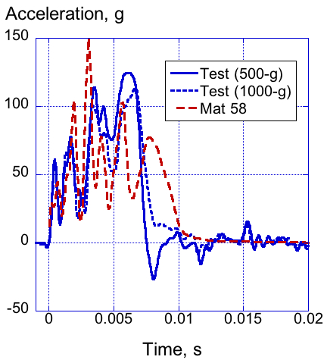
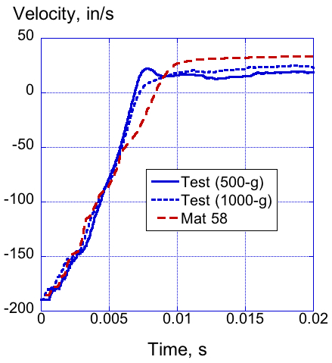
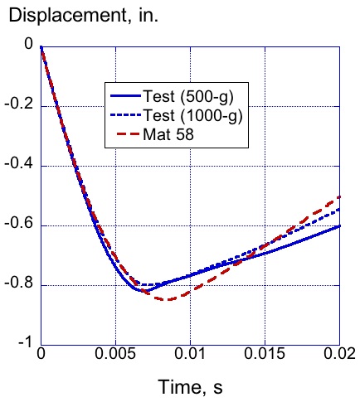
Results of Testing and Simulation:
I-beam Section (189.6-in/s)
Test-Analysis Comparisons for Mat 58
•Excellent comparison with time history responses
•Maximum crush displacement predicted within 5%

Slide 13
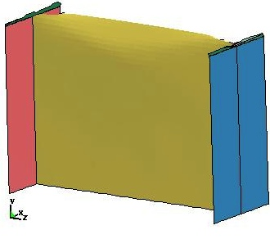
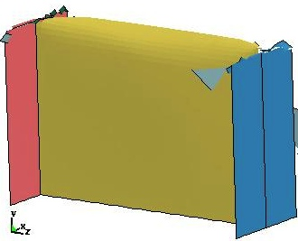
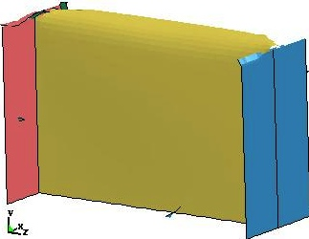
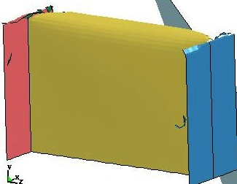
Results of Testing and Simulation:
I-beam Section (189.6-in/s)
Image Sequence of Mat 58 I-Beam Model
T=0.0024-s
T=0.0048-s
T=0.0072-s
T=0.01-s

Slide 14
Results of Testing and Simulation:
T-Section
T-Section Dynamic Crush Tests
•T-sections were extracted from the edge of the subfloor, where
a lateral I-beam terminates at a longitudinal I-beam, forming a
‘T’ shape
•Two specimens were extracted, with dimensions 9-in. tall, 6.2-in.
wide, and 13-in. long
•Vertical drop tests were performed at 2-ft (134.9-in/s) and 4-ft
(192-in/s) drop heights
•Impact block weighed 204.8-lb.
•Data were collected from an accelerometer mounted to the
impact block and from photogrammetry

Slide 15
Results of Testing and Simulation:
T-Section (192-in/s)
Failure Events
+1 ms: Complete fracture
of the vertical flanges
above the fillet
+5 ms: Vertical flanges
are being wedged inside
the horizontal flanges
+20 ms: Time of max
deflection, vertical web
fractures at the base
near doublers
Test video

Slide 16
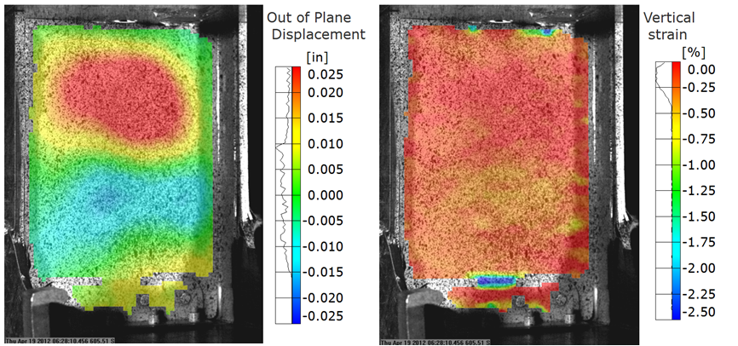
Results of Testing and Simulation:
T-Section (192-in/s)
Out-of-plane displacement
Compressive strain
•Fringe plot taken 0.5-ms after impact
•Out-of-plane displacements exhibit
oil canning mode, upper half
displaces toward the camera, bottom
half away from the camera
•Fringe plot taken 0.5-ms after
impact
•Low uniform strain, except at
bottom web intersection with
doublers

Slide 17
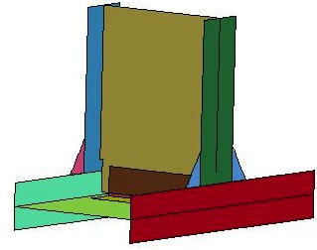
Results of Testing and Simulation:
T-Section (192-in/s)
•Model has 15,367 nodes; 13,746 shells; 512 solids; and 9 parts
•Bottom nodes are fixed
•Two velocity conditions assigned to block: 134.9- and 192-in/s
•Impact block weighed 204.8-lb

Slide 18
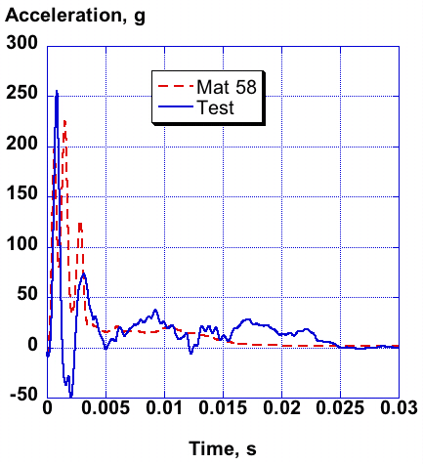
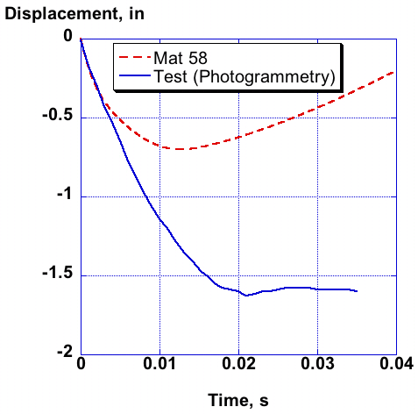
Results of Testing and Simulation:
T-Section (192-in/s)
Test-Analysis Comparisons for Mat 58
•Model accelerations generally higher than test
•Maximum crush displacement significantly under predicted due to
the fact that the simulation did not capture delamination failure

Slide 19
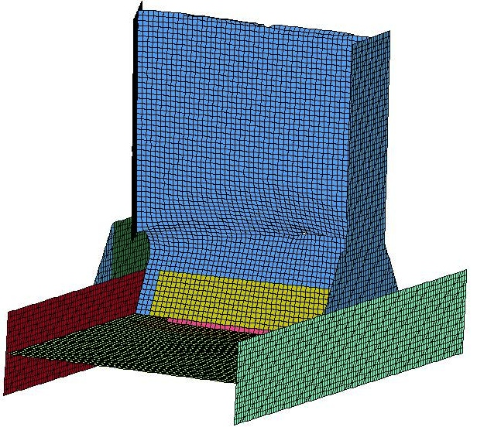
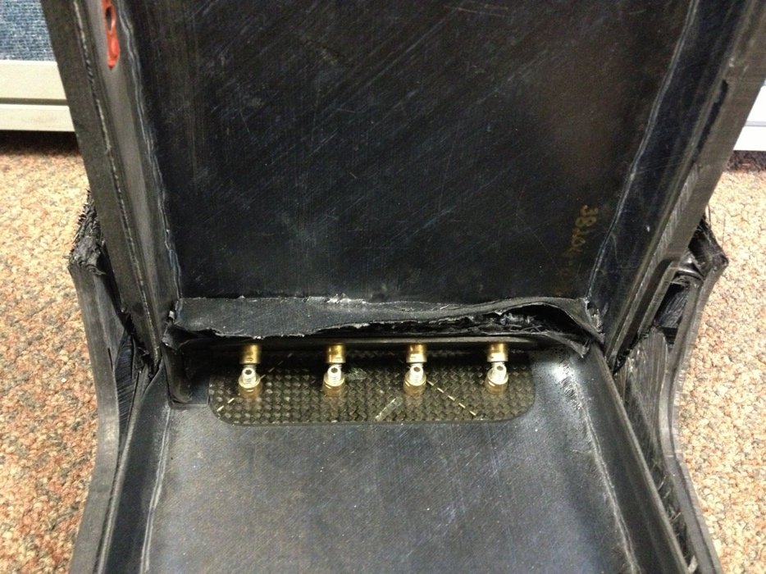
Results of Testing and Simulation:
T-Section (192-in/s)
T-Section Model Deformations and Failures
•Model not able to capture delamination failure mode
or rivet-on-rivet contact

Slide 20
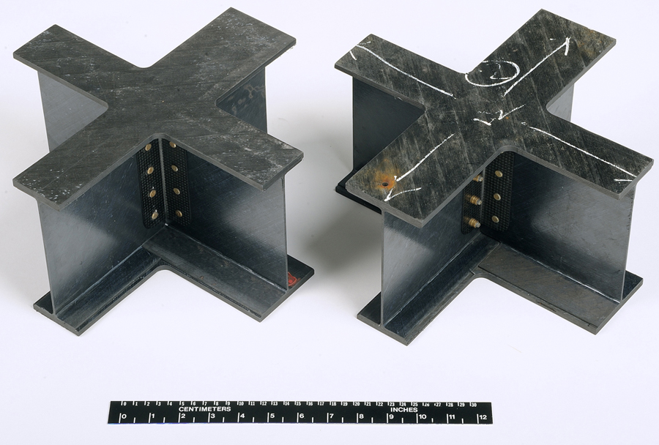
Results of Testing and Simulation:
Cruciform Sections
Cruciform Section Dynamic Crush Tests
•Two cruciform sections were extracted from the intersection of lateral and
longitudinal I-beams, with dimensions 6-in. tall, 12-in. wide, and 12-in. long
•Vertical drop tests were
performed at 192.5-in/s
and 268.6-in/s with an
impact block weighing
215-lb.
•Data were collected
from an accelerometer
mounted to the impact
block and from
photogrammetry
Photographs of two cruciform sections

Slide 21
Results of Testing and Simulation:
Cruciform Section (268.6-in/s)
Failure Events
+1 ms: Crushing of the
left quadrant, delamination
+2 ms: Failures present
in three quadrants,
localized buckling,
debonding and fracture
+15 ms: Time of max
crush displacement,
Damage located approx.
1-in. below upper flanges
Following impact, it was
possible to completely
separate the top & bottom
portions of the specimen
Test Video

Slide 22
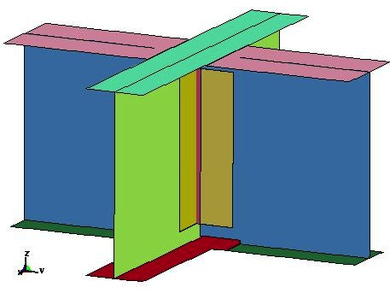
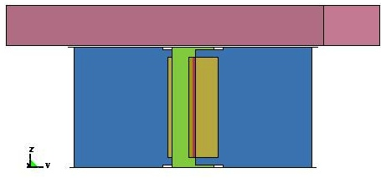
Results of Testing and Simulation:
Cruciform Section (268.6-in/s)
Cruciform model with drop mass
Three quarter view of cruciform model
•Model has 16,916 nodes; 15,750 shells; 512 solids; and 10 parts
•Bottom nodes are fixed
•Two specimens were impacted at: 192.5- and 268.6-in/s
•Impact block weighed 215-lb

Slide 23
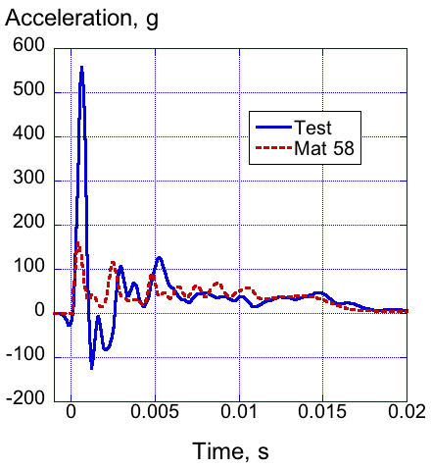
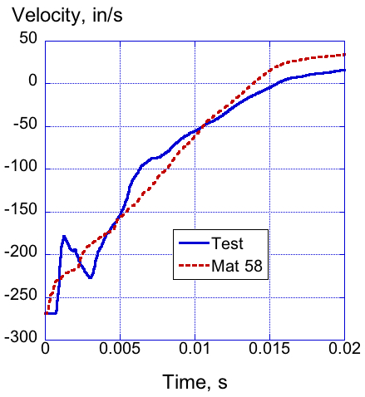
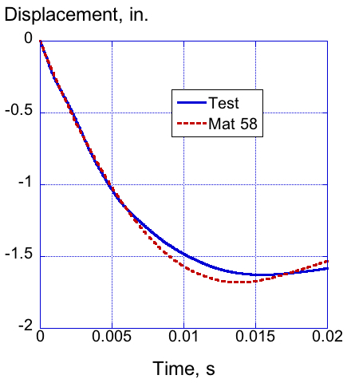
Results of Testing and Simulation:
Cruciform Section (268.6-in/s)
Test-Analysis Comparisons for Mat 58 Model at Higher Velocity
• Mat 58 model shows excellent comparison with time-history test
responses
• Model predicts a slightly higher rebound velocity
• Max crush displacement is predicted within 3%

Slide 24
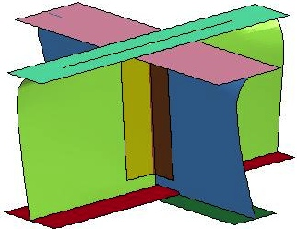
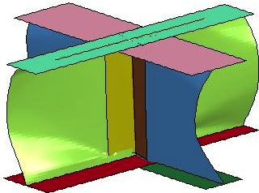
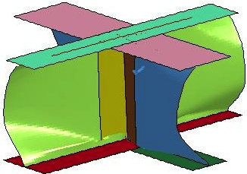
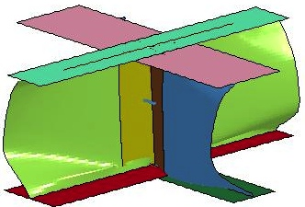
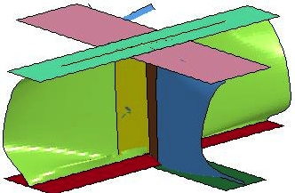
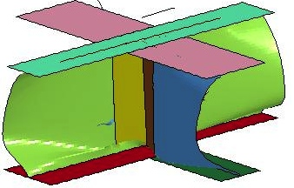
Results of Testing and Simulation:
Cruciform Section (268.6-in/s)
Image Sequence of Mat 58 Cruciform Model (Higher Velocity)
T=0.002-s
T=0.004-s
T=0.006-s
T=0.08-s
T=0.01-s
T=0.012-s

Slide 25
Conclusions
• Testing was conducted of composite airframe structures
highlighting several failure modes:
- I-beams exhibited material crushing, localized bending, and
layer splitting
- T-sections exhibited delamination and brittle fracture
- Cruciform sections exhibited global/local buckling, material
crushing, and brittle fracture
• Finite element models were developed and simulations were
executed using LS-DYNA with Mat 58 (a continuum damage
mechanics based failure model)
• Model calibration was performed by comparing test/analysis
time history responses, structural deformations, failure
initiation and progression

Slide 26
Conclusions
• Mat 58 generally performed well in predicting time history
responses and structural deformation for the I-beams and
cruciform specimens
• However, Mat 58 is not capable of predicting delamination.
Consequently, prediction of the time-history responses and
structural behavior of the T-section was poor.

Slide 27
Acknowledgements
We would like to thank:
- US Army Aviation Applied Technology Directorate (AATD) for
providing the SARAP TVA
- Charles Clarke, Brian Wilson, and Joe Shen of Sikorsky for
providing baseline finite element models and for many helpful
conversations related to testing and simulation
- NASA technicians for assistance in conducting impact
testing, including instrumentation and test set-up
- Members of the NASA Nondestructive Evaluation Services
Branch who performed the NDE assessment

