Slide 1
Proposed Brace for Impact Position for Transport Category Aircraft
Seventh Triennial International Fire & Cabin Safety Research Conference
Amanda Taylor
4 December 2013

Slide 2
Talk Overview
Background
National Transportation Safety Board Recommendation
Testing
Instrumentation
Test Matrix
Seat Back
Injuries
Observations
New Brace Recommendation

Slide 3
Background
Brace position protects occupants from secondary impact
  That is, the impact between a body segment, such as the head, and whatever it might hit in a crash.
During the 1980s, brace position recommendations were adjusted based on the then-new dynamic impact test techniques.
These formed the basis of AC 121-24C Appendix 4.

Slide 4
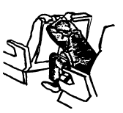
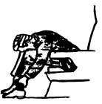
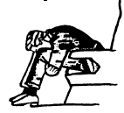
Background
Passenger brace positions in AC 121-24C

Slide 5
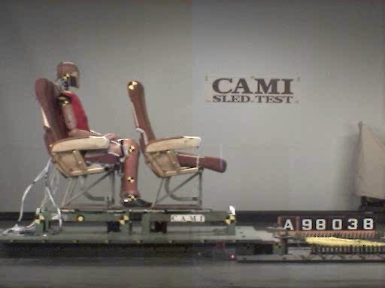
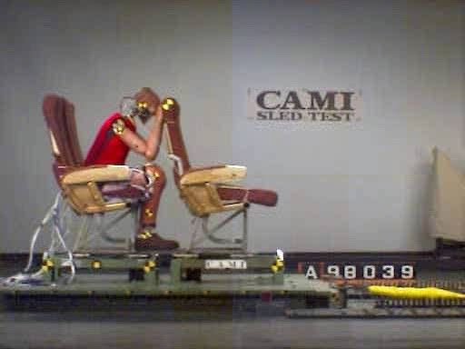
Background
Upright Position
Braced Position

Slide 6
Background
Notes:
The Head Injury was measured using a tool called HIC or head injury criteria to which will be described later in the presentation. There was a significant drop in the HIC numbers for the braced versus the upright dummy. This led researchers to recommend the brace position while requiring manufacturers to test in the upright position to protect occupants not able to brace in time since the data showed it was more injurious to be upright.

Slide 7
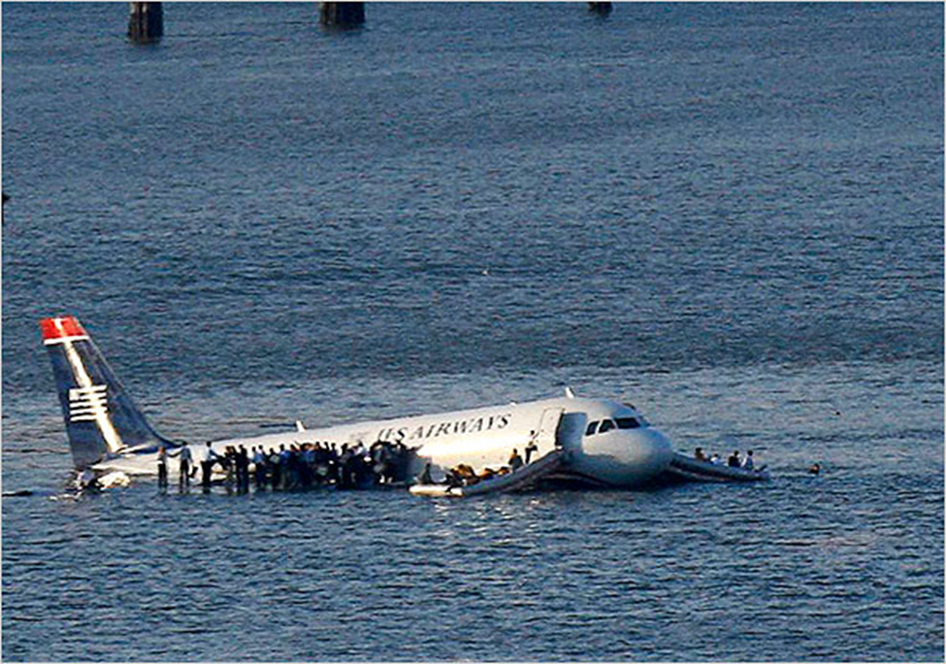
Background
January 15, 2009 US Airways flight 1549, an Airbus A320 ditched in the Hudson River about 8.5 miles from LaGuardia Airport.
4 passengers sustained serious injuries, 3 of which occurred during the impact.
NTSB Safety Recommendation A10-78
Photo: Brendan Mcdermid/Reuters

Slide 8
Background
2 females sustained similar shoulder fractures, both described assuming similar brace positions.
Placing their arms on the seat in front of them and leaning over, this is similar to the one depicted in the US Airways safety card.
NTSB Safety Recommendation A10-78
Passenger brace positions shown in the US Airways safety information card.

Slide 9
NTSB Recommendation
  “Conduct research to determine the most beneficial passenger brace position in airplanes with non-breakover seats installed. If the research deems it necessary, issue new guidance material on passenger brace positions.”
NTSB Safety Recommendation A10-78

Slide 10
Testing
Civil Aerospace Medical institute (CAMI) investigated this by conducting a series of sled impact tests to best represent as many scenarios seen in the current flying fleet.
This was done by varying:
  Seat pitch
  Brace position (both arm and leg positions)
  Seat back type

Slide 11
Testing
Several tests on the deceleration sled at CAMI were completed using the typical transport category impact.
To evaluate the risk for injury, the Anthropomorphic Test Device (ATD) was equipped with head, torso, and leg instrumentation.

Slide 12
Seat Back Types
Locked-Out
Energy-Absorbing
Full Break-Over

Slide 13
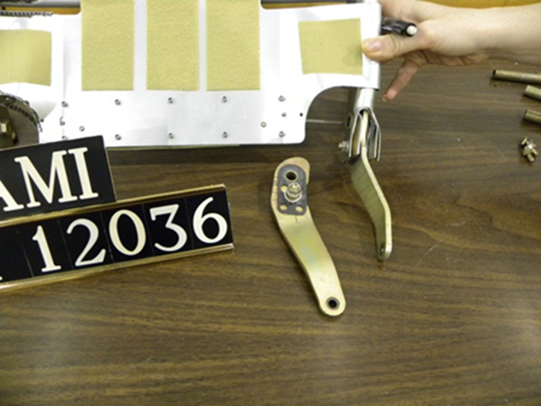
Locked-Out Seat Back
Seat Back, when struck from behind, will flex forward but stay in a mostly upright configuration post test.
This usually results in permanent deformation to the seat frame.

Slide 14
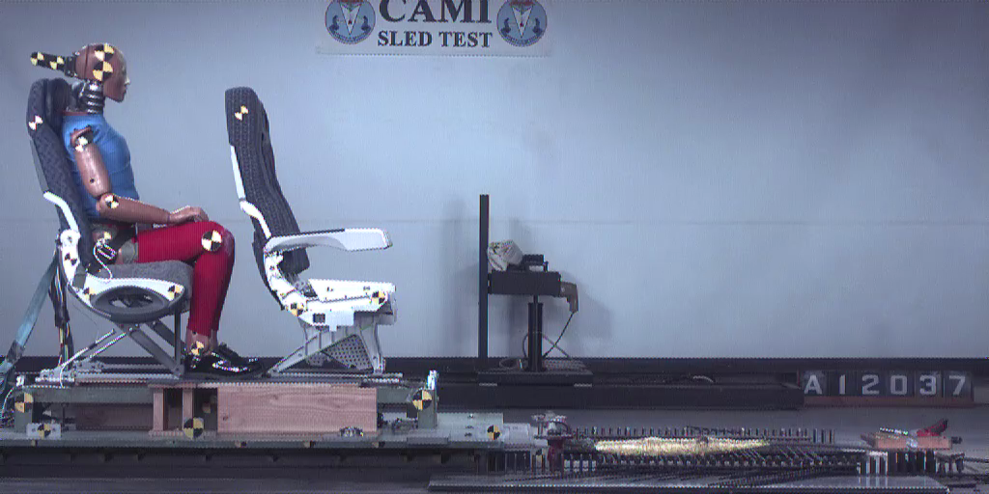
Locked-Out Seat Back
Upright Position

Slide 15
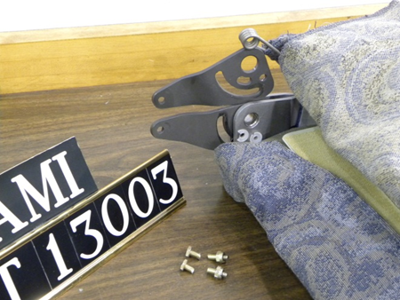
Energy-Absorbing Seat Back
This seat had a dual shear mechanism where the seat back frame connects to the hydro lock, as well as a friction washer on a bolt that travels in a slot.

Slide 16
Energy-Absorbing Seat Back
This allows the seat to absorb some of the ATD’s energy prior to folding over to contact the seat pan or occupant in front.
The friction washer was tuned by pushing at the top of the seat tray with 35 lbs.

Slide 17
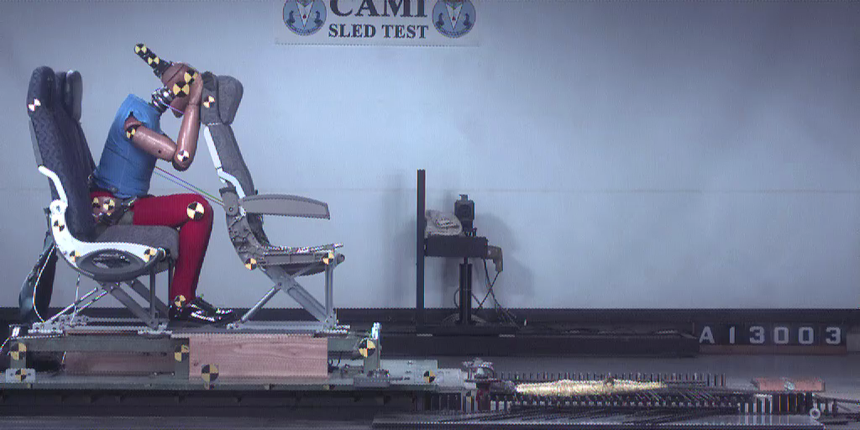
Energy-Absorbing Seat Back
Current Brace Position

Slide 18
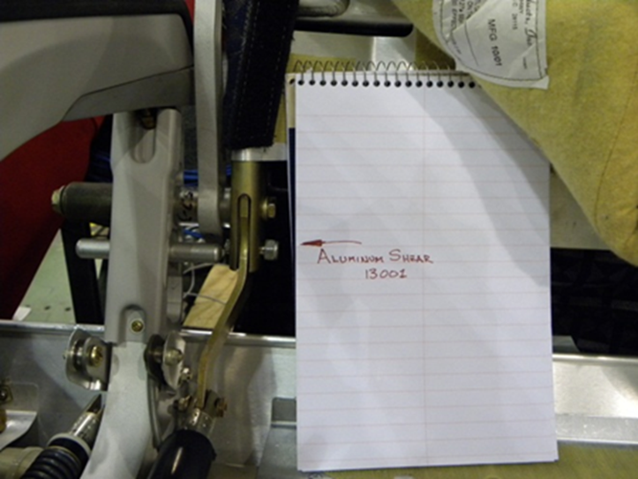
Full Break-Over Seat Back
Seat back that when struck will completely fold over, limited only by coming into contact with the seat bottom or occupant in front.

Slide 19
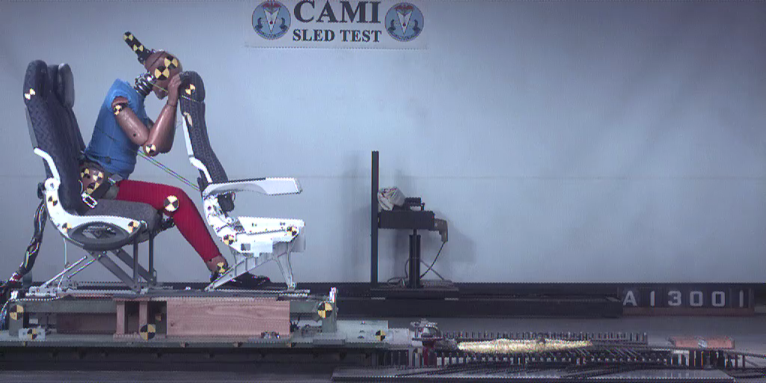
Full Break-Over Seat Back
Current Brace Position

Slide 20
Injuries
To assess injuries an evaluation of loads and accelerations recorded from the dummy are compared with existing injury criteria that are derived from humans.
Head, neck, upper leg, and lower-leg injuries were evaluated.

Slide 21
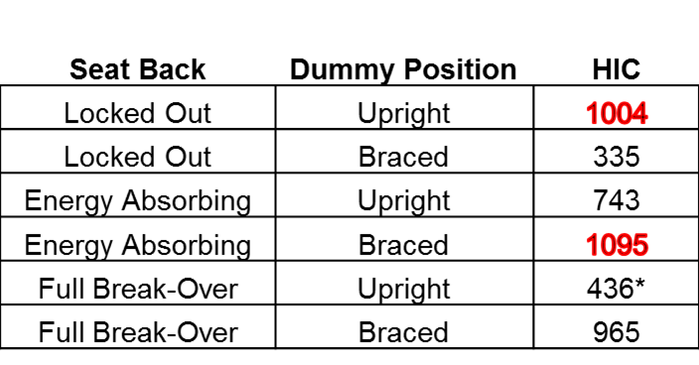
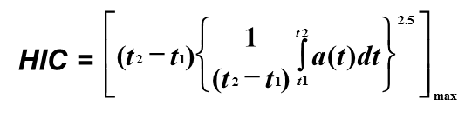
Head Injuries
Head Injury Criteria (HIC) is the maximum integral value of the head acceleration.
The HIC limit is 1000, which represents a 23% risk of a serious head injury
*In this test the chin of the dummy caught on the top of the tray table causing excessive bending moments and loads, which in turn lowered the HIC.

Slide 22
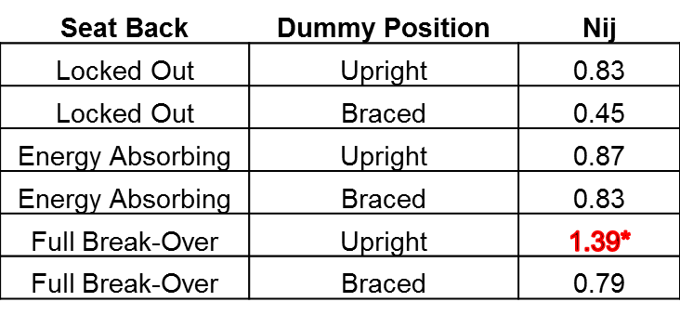

Neck Injuries
Normalized neck injury criteria (N_{ij}) was used to evaluate neck injury risk.
Not currently used in aviation testing, but a limit of 1 is called out in automotive testing (FMVSS 208).
*In this test the chin of the dummy caught on the top of the tray table causing excessive bending moments and loads, which in turn lowered the HIC.
Notes:
Federal Motor vehicle safety standard 208

Slide 23
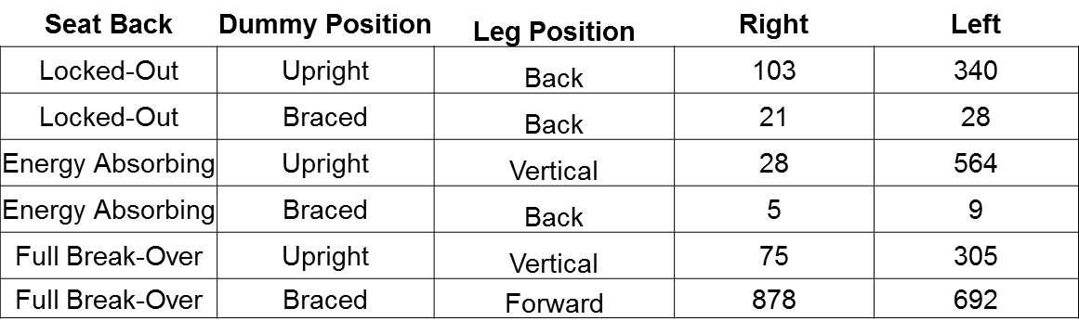
Upper Leg Injuries
Risk of injury is based on the load measured in the femur.
Fz limit is 2250 lbs, which represents a 15% risk of serious injury to the knee-thigh-hip complex.

Slide 24
Lower Leg Injuries
To evaluate lower leg injuries the tibia index (TI) was utilized.
This incorporates the bending moments, as well as axial force.
This was done at both the upper and lower ends of the tibia for each leg.
The position of the legs were altered between vertical, forward, and aft to find the most effective way to limit flail.

Slide 25
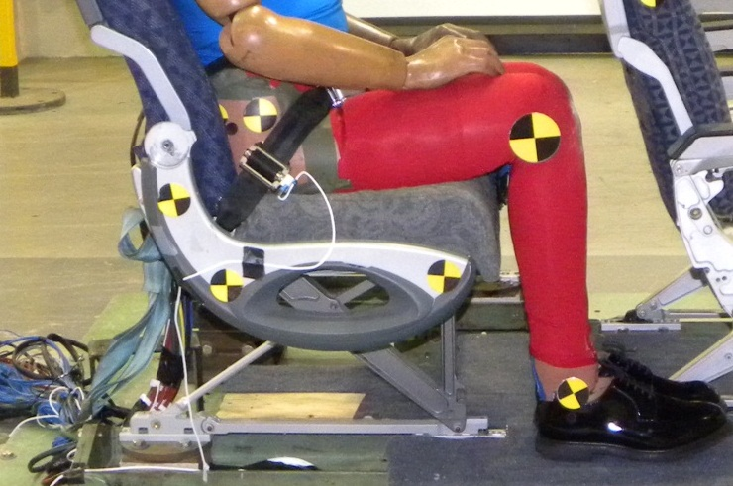
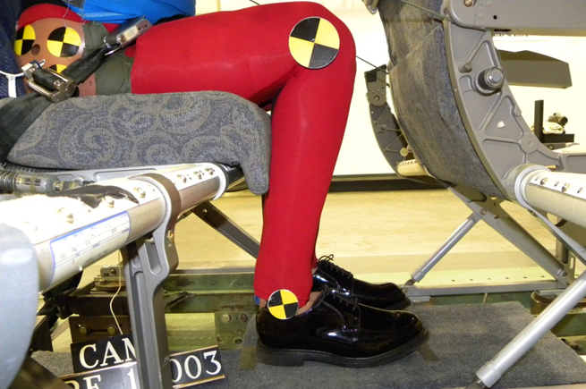
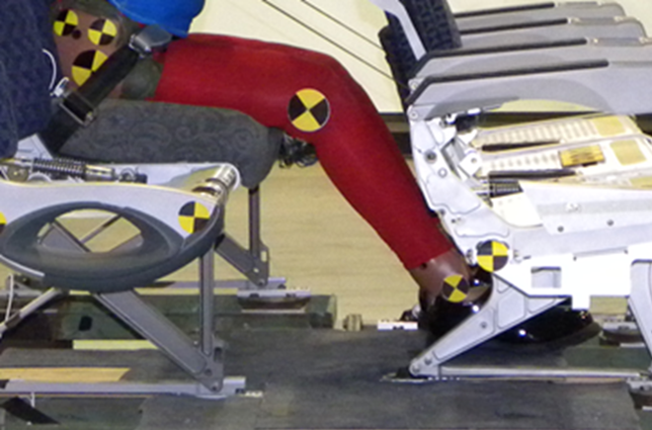
Lower Leg Injuries
Legs Vertical
Legs Aft
Legs Forward

Slide 26
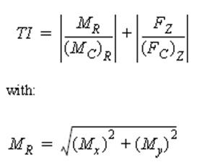
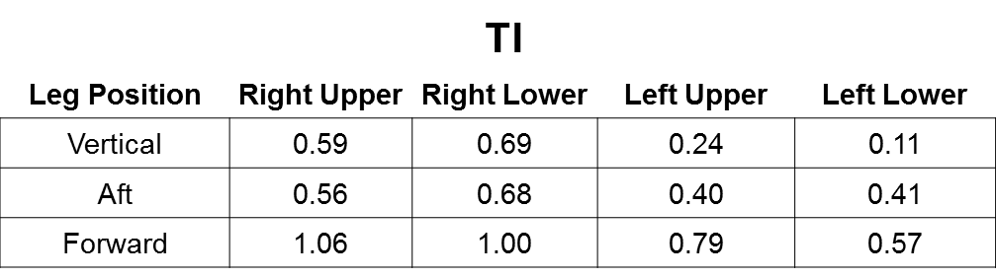
Lower Leg Injuries
Lower leg injuries are not currently a pass/ fail testing criteria in aviation.
Currently the European Enhanced Vehicle Safety Committee (EEVC) limits the TI to 1.3 for automotive testing.

Slide 27
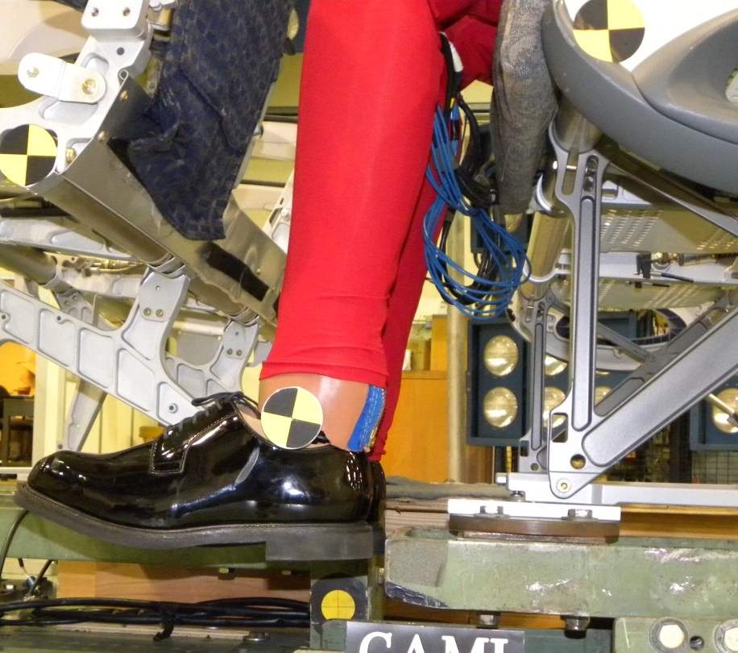
Lower Leg Injuries
A test was run with no floor to simulate a shorter stature occupant whose legs do not touch the floor and will flail forward unimpeded.
The TI was well within the injury limits.
Injury risk was on par with the baseline tests.

Slide 28
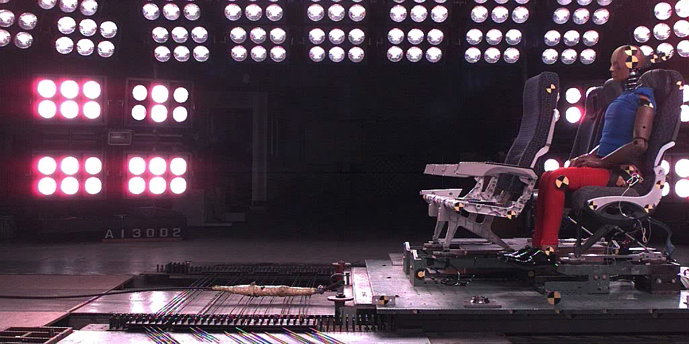
Lower Leg Injuries
Upright Position

Slide 29
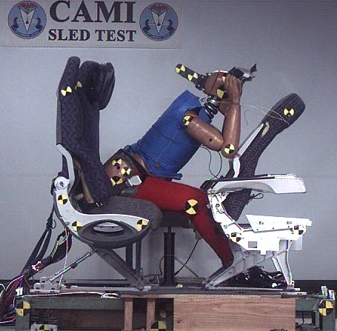
Observations
HIC values were above the limit on several tests.
The arms were observed pushing the seat back away from the occupant both in braced and upright positions.
This effectively allowed the occupant’s head to accelerate relative to the seat back, increased injury risk.

Slide 30
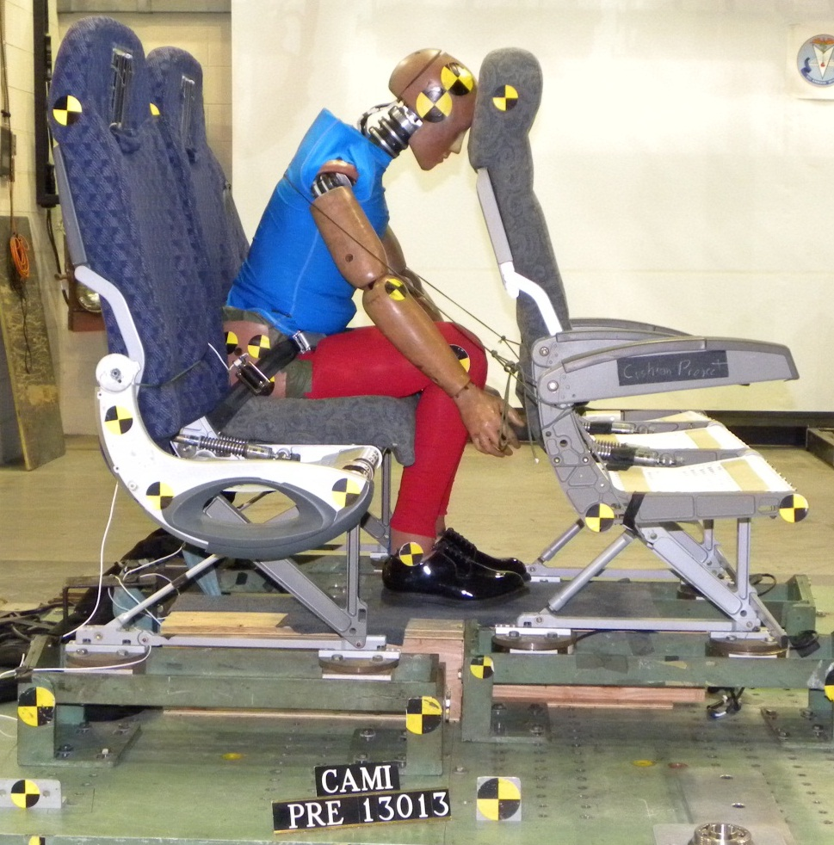
New Brace Recommendation
A need to keep the arms from interacting with the seat back was indicated.
Placing the arms down by the side of the lower legs prevents them from interacting with the seatback.
Holding onto the lower legs may provide a more stable position.

Slide 31
New Brace Recommendation
The TI numbers for the lower legs indicate that the leg position did not change the injury potential.

Slide 32
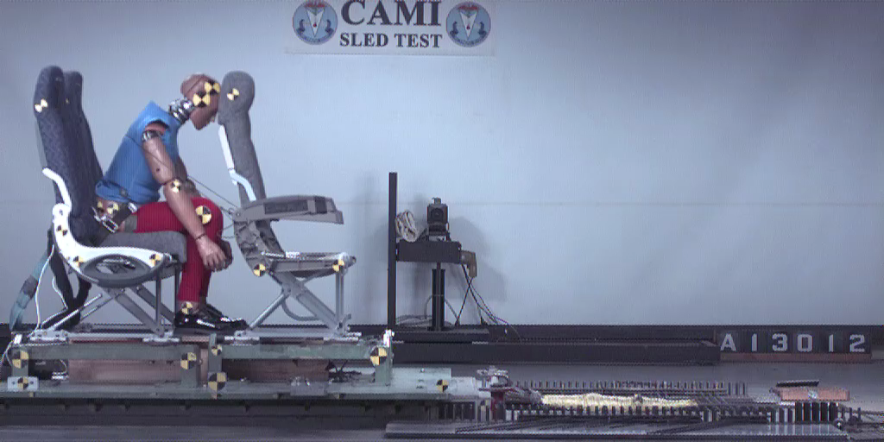
New Brace Recommendation
Full Break-Over Seat Back

Slide 33
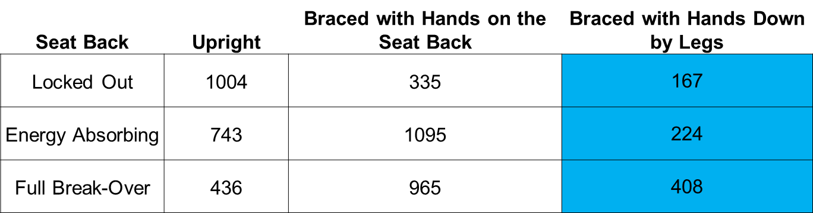
New Brace Recommendation
The HIC for the new brace position was lower for each type of seat back.

Slide 34
New Brace Recommendation
Being subjected to combined vertical/horizontal loads while in the current or proposed brace positions could alter the spinal injury risk, compared to the upright position, due to the spinal misalignment.
An evaluation of this difference in injury risk requires data relating injury tolerance to spine bending angle (currently not available).
Since the current and proposed brace positions result in a similar initial torso angle and torso kinematics, a difference in spinal injury risk is not expected.

Slide 35
Conclusion
In answer to the NTSB recommendation to “Conduct research to determine the most beneficial passenger brace position in airplanes with non-breakover seats installed.”
Testing showed that as the seat technology has changed the most effective brace position has as well.
The older brace position was effective in lowering HIC locked-out, but amplified HIC in the energy-absorbing seats that are more prevalent on newer aircraft.

Slide 36
Conclusion
The proposed brace position reduced HIC in all tested seat configurations, making it a good candidate for use in nearly all passenger seats in the flying fleet.
This finding is based on results of impact tests with test dummies, but further study is necessary to determine whether the proposed position is practical to implement from a human factors perspective.
This work is to support the Fire & Cabin Safety Technical Community Representative Group Project 2011-05/2012-06: Prevention of Injuries That Impede Egress.

Slide 37
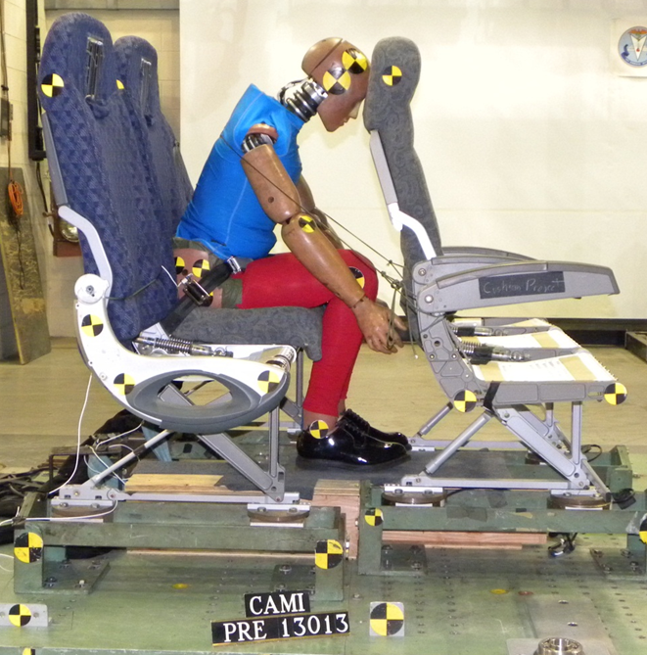
Questions?

