Slide 1
Lithium Battery Thermal Runaway Initiation Variation
Triennial Conference, Atlantic City
FAA Fire Safety
10/2016

Slide 2
Background
Lithium Metal cells
RTCA SC235 is creating a standard for lithium metal batteries aboard aircraft and there was disagreement about different thermal runaway initiation methods.
Lithium Ion cells
SAE G-27 is creating a packaging standard for shipment of lithium batteries and cells aboard aircraft and a heating rate needs to be specified in the document

Slide 3
Introduction
Lithium Metal
There are numerous methods to initiate thermal runaway in a lithium metal cell.
Overheat
Overcharge
Reverse Charge
Internal short circuit
Damage
How does the maximum temperature rise and gas production vary?
How consistent is the temperature rise and gas production for a specific method?
Lithium Ion
How does a change in heating rate effect thermal runaway?
Maximum temperature
Gas composition

Slide 4
Thermal Runaway Methods
Overheat – Cell is heated with an external heat source (cartridge or heat strip).
Overcharge – A voltage approximately 1.5* the nominal voltage is applied to the cells with a current limitation of approximately 10C
Reverse Charge – A negative voltage is applied to the cell to cause thermal runaway.

Slide 5
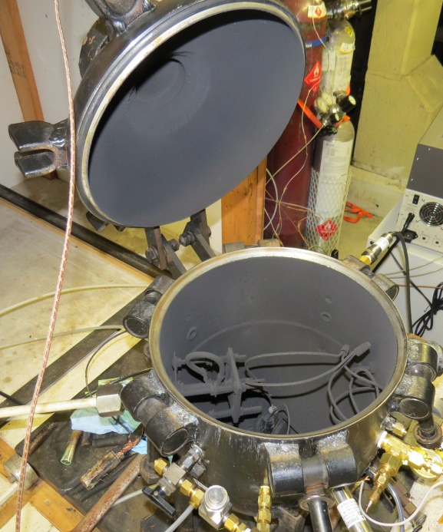
Test Setup
Tests were carried out in a 21.7L combustion sphere.
Pressure Transducer
In all tests, air was removed and replaced with 14.7 psia N₂ before thermal runaway initiation
Gas collection port for sample bag.

Slide 6
Test Setup
Lithium Metal Cells
LiSO₂
Overheat
LiMnO₂
Overheat
Overcharge
Reverse charge
LiFeS₂
Overheat
Overcharge (if cells are available without PTC)
Reverse charge (if cells are available without PTC)
LiCFx
Overheat
Overcharge
Reverse Charge
Lithium Ion Cells
LiCoO₂
Slowest heating rate (.3 C/min)
Fastest heating rate (26.7 C/min)
5 to 10 C/min

Slide 7
Gas Analysis
Partial pressures were used to determine gas volumes.
GC, NDIR, FID were used for gas concentrations.
GC:
Hydrogen
Methane
Ethane
Ethylene/Acetylene
Propane
Propylene
Butane
Butene
NDIR
CO
CO₂
FID
THC

Slide 8
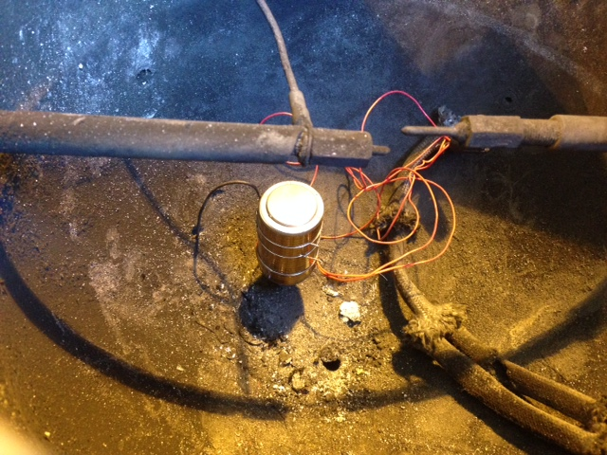
Example Test Setup (Heater Strip)
Thermocouple
Heater Strip
Heater Strip Capacity: 28 volts, 1.5 amps

Slide 9
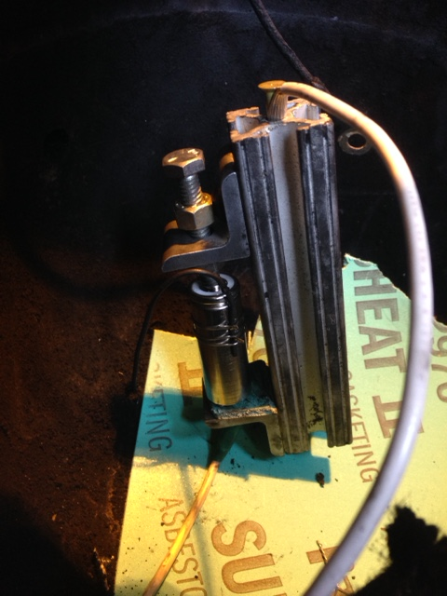
Example Test Setup (Overcharge/Reverse Charge)
Electrical Connection
Thermocouple
Electrical Connection
Overcharge/Reverse Charge

Slide 10
Results LiMnO₂ 123a
 | Heater | Overcharge | Reverse Charge
Gas Volume (L) | 1.95 | 2.91 | Unable due to PTC
THC (%) | 16.438 | 8.5 | Unable due to PTC
Hydrogen (%) | 27.48 | 26.14 | Unable due to PTC
CO (%) | 24.59 | 15.97 | Unable due to PTC
CO2 (%) | 22.143 | N/A | Unable due to PTC
Max Temp. (C) | 564 | 690 | Unable due to PTC
 | Gas Volume (L) | Max Temp. (C)
Heater Test 1 | 1.95 | 564
Heater Test 2 | 1.95 | 626
Heater Test 3 | 1.83 | 656
Overvoltage test: voltage varied. Initially it was set to 1.5*nominal and maintained for about a day. It was then increased gradually until runaway occurred.

Slide 11
Results LiCFx A
 | Heater | Overcharge | Reverse Charge
Gas Volume (L) | 1.77 | Unable due to PTC | Unable due to PTC
THC (%) | 26.1 | Unable due to PTC | Unable due to PTC
Hydrogen (%) | 37.9 | Unable due to PTC | Unable due to PTC
CO (%) | 3.6 | Unable due to PTC | Unable due to PTC
CO₂ (%) | 2.4 | Unable due to PTC | Unable due to PTC
Max Temp. (C) | 587.8 | Unable due to PTC | Unable due to PTC
 | Gas Volume (L) | Max Temp. (C)
Heater Test 1 | 1.7714 | 587.8
Heater Test 2 | 1.7714 | 660.9
Heater Test 3 | 1.594 | 657.8

Slide 12
Results LiSO₂ D
 | Heater | Overcharge | Reverse Charge
Gas Volume (L) | 6.774 | N/A | N/A
THC (%) | 4.6 | N/A | N/A
Hydrogen (%) | .189 | N/A | N/A
CO (%) | 0 | N/A | N/A
CO₂ (%) | .346 | N/A | N/A
Max Temp. (C) | N/A | N/A | N/A
LiSO₂ did not show a thermal runaway temperature increase

Slide 13
Results LiFeS₂ AA
 | Heater | Overcharge | Reverse Charge
Gas Volume (L) | 1.0599 | N/A | N/A
THC (%) | 23.82 | N/A | N/A
Hydrogen (%) | 56.4 | N/A | N/A
CO (%) | 6.016 | N/A | N/A
CO₂ (%) | 0 | N/A | N/A
Max Temp. (C) | 555.6 | N/A | N/A
Note: Heater temperature needed to reach 445C for runaway to occur

Slide 14
Results Heating Rate
Average results (2 tests)
 | Low Heating rate | 5 to 10 C/min | Fast Heating rate
Heating Rate (C/min) | .315* | 7.3 | 26.74*
Gas Volume (L) | 1.19 | 1.77 | 1.44
THC (%) | 19.6558 | 14.85 | 17.2
Hydrogen (%) | 28.2395 | 27.4455 | 24.33
CO (%) | 6.029 | 10.875 | 8.3271
CO₂ (%) | 33.22 | 25.725 | 28.1
Max Temp. (C) | 275.1* | 367.8 | 364.47*
*Result from only one test

Slide 15
Results Heating Rate
Standard Deviation
 | Low Heating rate | 5 to 10 C/min | Fast Heating rate
Gas Volume (L) | .26 | 0 | .066
THC (%) | 5.33 | .15 | .79
Hydrogen (%) | 4.83 | 1.18 | 2.26
CO (%) | 1.07 | .825 | 1.55
CO₂ (%) | 5.67 | 3.83 | 1

Slide 16
Results Heating Rate
Largest cause of gas variation
Typical Test
Cell ruptures from pressure
Electrolyte evaporates
More time before runaway
More evaporation
Less electrolyte available to react during runaway.
Less gas volume.

Slide 17
Summary
Lithium metal
Consistency in heater strip results.
1.5*nominal voltage wasn’t sufficient to cause runaway after a day.
At higher c-rates PTCs interfered with additional overvoltage, reverse charge tests.
Lithium ion
The lower heating rate resulted in lower temperature increase, less gas volume, less consistency
A larger amount of electrolyte evaporated from the cell before runaway.
5 to 10 C/min and higher resulted in higher temperatures and gas volume

Slide 18
Future Work
MnO2 cells without build-in PTC’s were recently aquired for future tests.

Slide 19
Questions?
Contact information:
Thomas.Maloney@faa.gov
1-609-485-7542

