Slide 1
Lithium Metal and Lithium-ion Battery Packaging Development

Slide 2
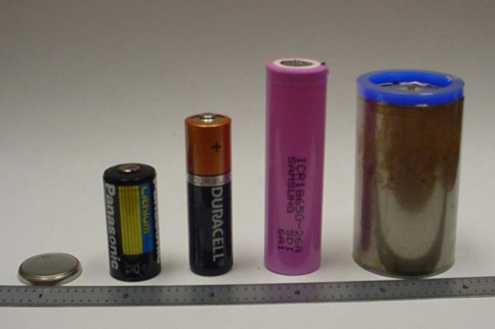
Prelude
Just so we are all on the same page
These are typical lithium cells

Slide 3
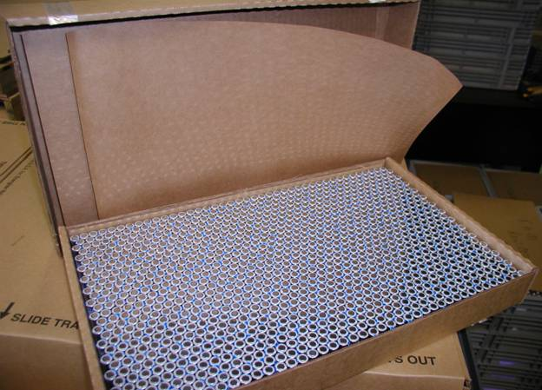
Prelude
This is a typical lithium cell with hundreds of its closest friends

Slide 4
Prelude
This is a typical lithium cell with hundreds of its closest friends being shipped via air

Slide 5
Prelude
This is the aircraft after a typical lithium cell with hundreds of its closest friends has been shipped via air
Flight after Flight, Day after Day, Year after Year

Slide 6
Prelude
A thermal runaway is an extremely rare event
But if it happens . . .

Slide 7
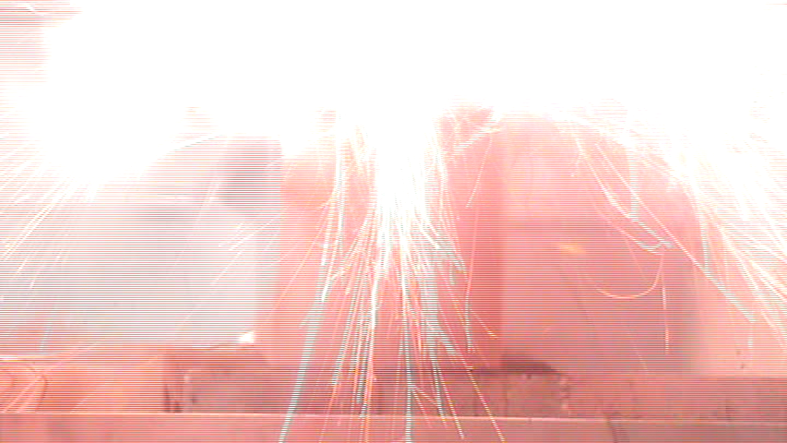
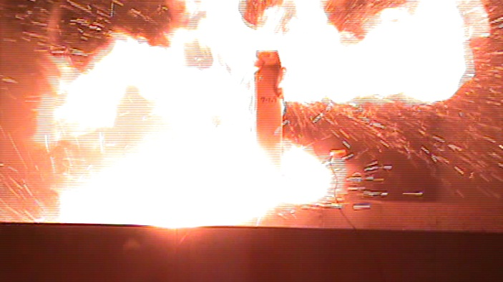
Introduction
This is a battery packaged for shipment experiencing a thermal runaway
This is a battery experiencing a thermal runaway
This is a battery packaged for shipment with a Thermal Management System experiencing a thermal runaway

Slide 8
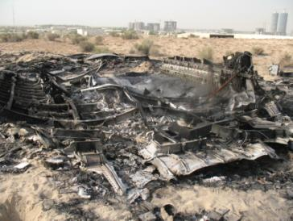
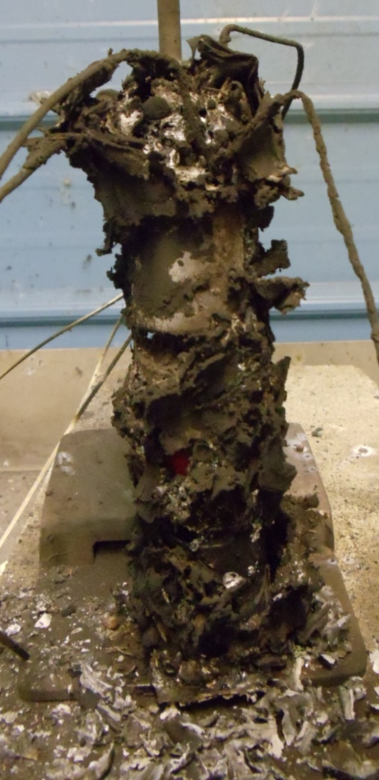
Introduction
This is what’s left

Slide 9
Introduction
One characteristic of a cell going into thermal runaway is that it continues to increase in temperature until it vents. This temperature is often in excess of the temperature required for adjacent cells to go into thermal runaway. Therefore when one cell goes into thermal runaway it usually propagates to the adjacent cells.
There are multiple ways of trying to contain the detrimental effects of a thermal runaway. The methods are usually contained in two categories:
Brute Force
Thermal Management
FedEx has concentrated resources on thermal management; the cooling of the cell experiencing the thermal event thus preventing the propagation of a thermal runaway.

Slide 10
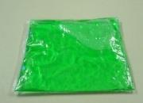
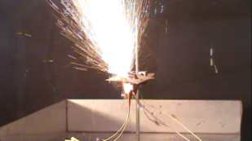
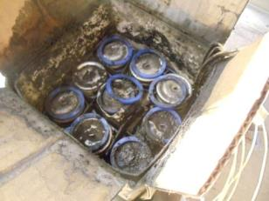
Cooling Concept
Liquid Cooling Concept:
A pouch containing a liquid coolant is placed above the cells.
When a cell experiences a thermal event, the heat from the cell ruptures the pouch thereby releasing the coolant.
The coolant flowing over and around the cells decreases the temperature and prevents adjacent cells from experiencing temperatures that would cause additional thermal runaways.
Only the cell forced into thermal runaway vented

Slide 11
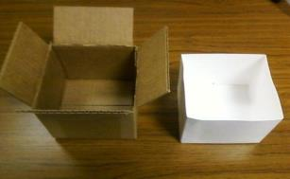
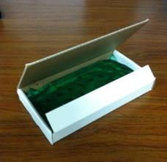
Refinements
Modifications to the existing packaging to optimize the cooling concept are required.
The liquid coolant has a tendency to soak into any absorbent material, i.e. cardboard. Therefore the cells have been placed in a coated tray in order to retain the fluid.
A buffer was required between the cells and the gel pack. Without a buffer the liquid in the gel pack would start to boil before the pouch ruptured. Thereby cooling the top of the cell and allowing the bottom of the cell to continue to heat and vent out the side.

Slide 12
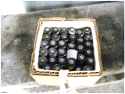
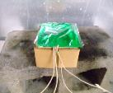
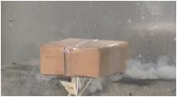
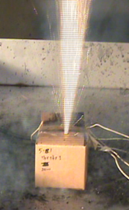
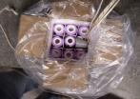
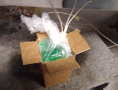
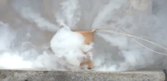
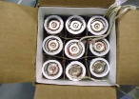
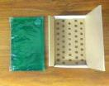
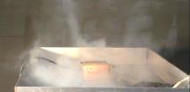
Results
Forced thermal runaway testing has been successfully performed on CR123 lithium primary, 18650 lithium-ion (typically found in laptops) and “D” size lithium primary cells.
CR123
18650
33550
D size
Thermal Events -
Sparks and Flames blow through box
Gel Packs prevented jets of sparks and flames from exiting the box. Only the cell experiencing the thermal runaway vented.

Slide 13
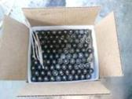
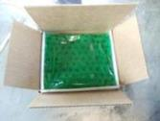
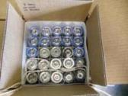
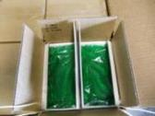
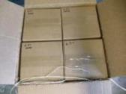
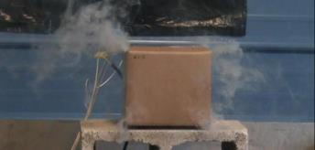
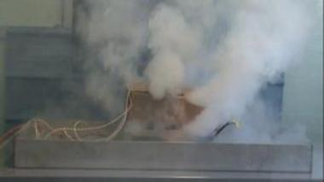
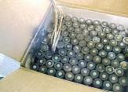
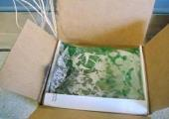
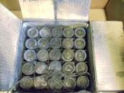
Large Scale Tests
CR123 Lithium Primary
99 Per Box w/ Gel Packs
Two Boxes Per Carton
Only One Cell Vented
33550 Lithium Primary
25 Per Box w/ Gel Packs
Four Boxes Per Carton
Only One Cell Vented

Slide 14
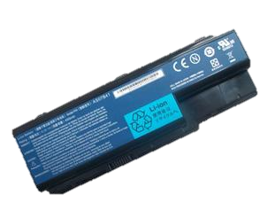
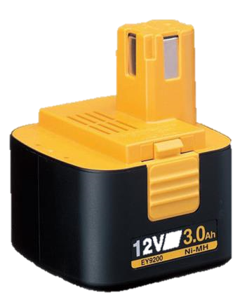
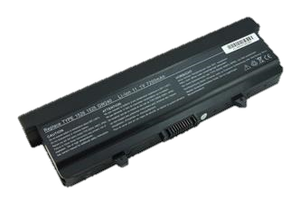
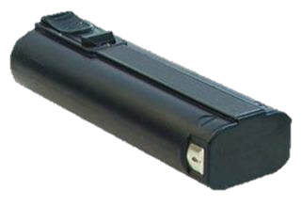
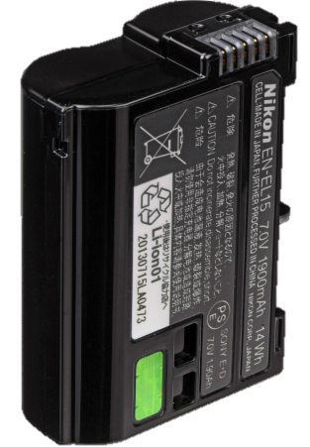
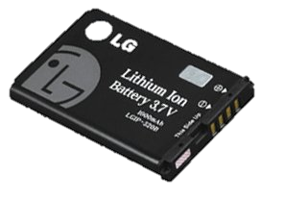
Multi Cell Battery
Thermal Management becomes difficult when the cells are encased in a housing.

Slide 15
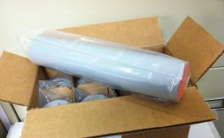
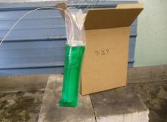
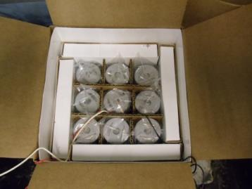
Multi Cell Battery Tests
Gel Pack Sleeve
Three “D” size Lithium primary cells with electronics encased in rigid plastic
Multiple Gel Pack designs and packaging configurations have been tested. Several configurations prevented flames from escaping the packaging and stopped the propagation of the thermal runaway in a multi-cell Lithium metal battery.
Gel Pack box liner

Slide 16
Natures Thermal Management System

Slide 17
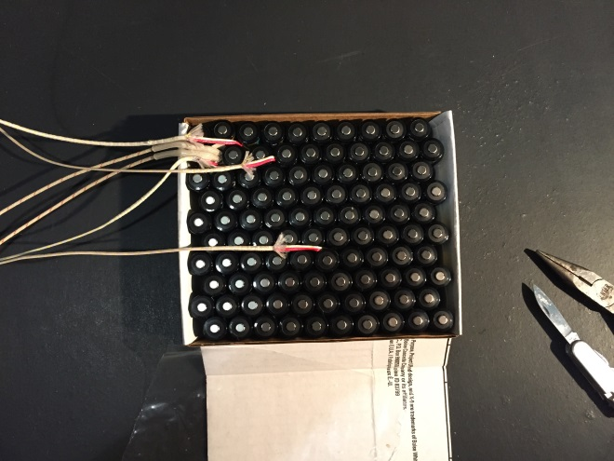
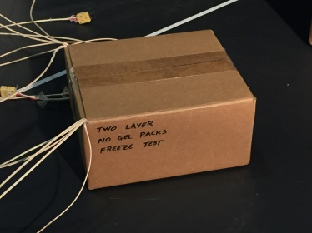
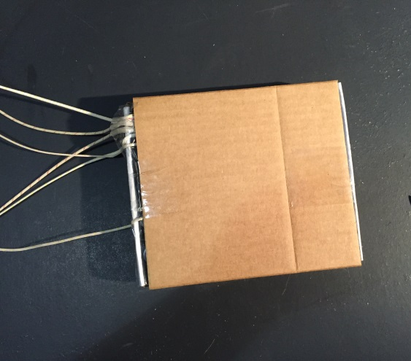
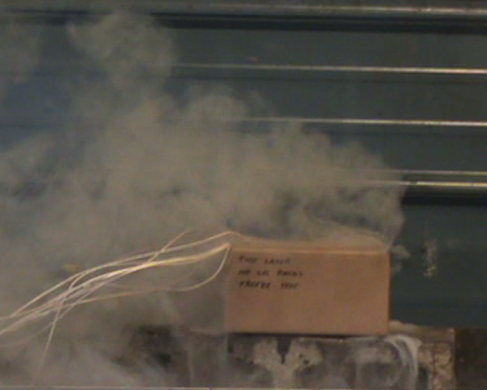
Alternate Thermal Management Strategies
Batteries can be cooled as a packaged commodity
100 cells in a tray
2 trays of cells in a box
Chilled to 0°F
(in cooling chamber for 18 hours)
Heat one cell until thermal runaway
No other cells vented
Temperature 5 cells away 4°F after thermal event

Slide 18
Questions
ANY QUESTIONS ?

