Slide 1
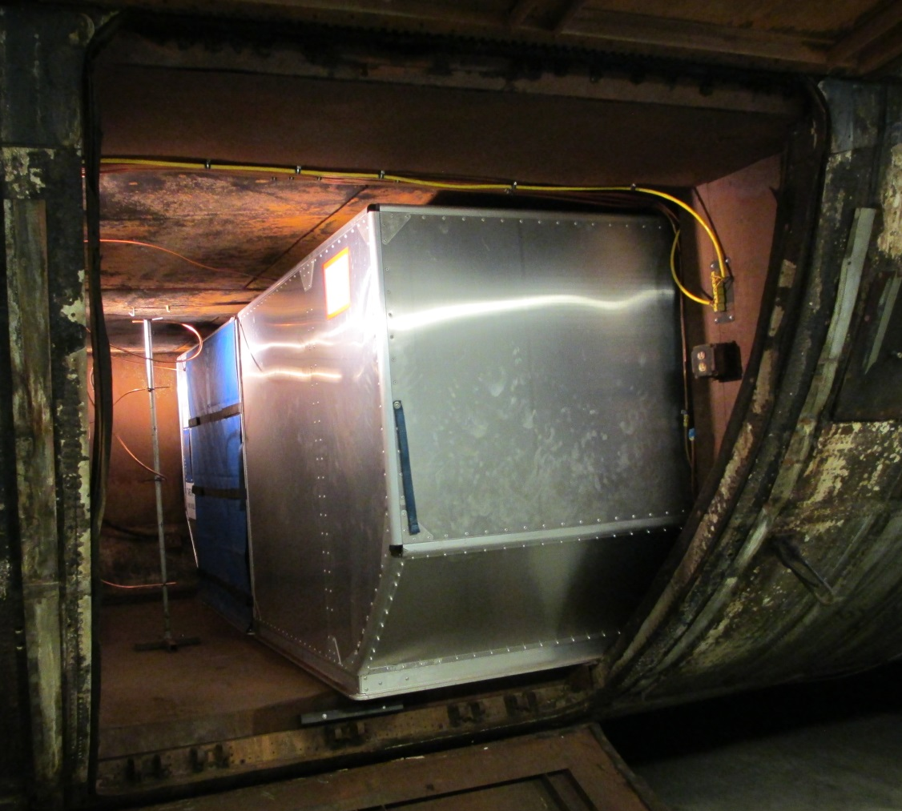
Class-C Cargo Compartment ULD Suppression Agent Penetration
The 8th Triennial International Aircraft Fire and Cabin Safety Research Conference
Dhaval Dadia, FAA Technical Center
October 27, 2016

Slide 2
Background
Tests have shown that flammable vapors from batteries in thermal runaway could accumulate in cargo containers.
Pressure pulse from igniting flammable vapors could dislodge the liners or open the decompression panels in a class-C compartment.
Halon fire suppression system would be rendered ineffective.

Slide 3
Objective
Measure the rate at which the fire suppression agent dissipates in the class-C cargo compartment.
Compare theoretical agent dissipation rates to measured agent dissipation rates

Slide 4
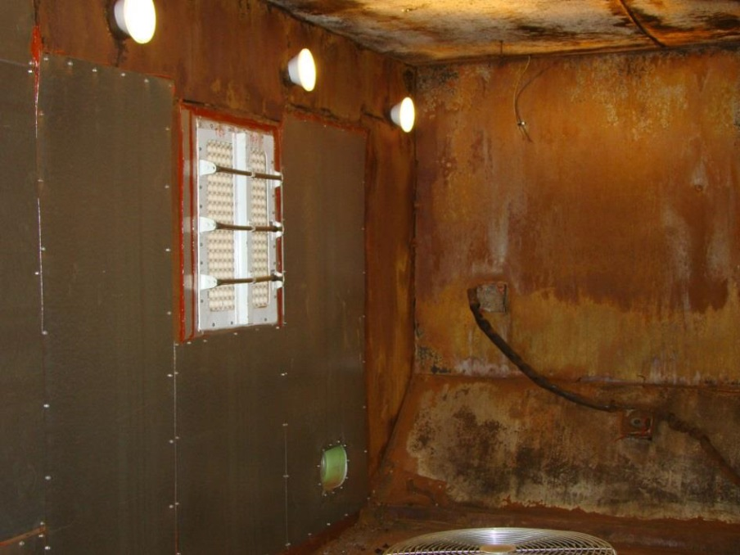
DC-10 Class-C Cargo Compartment

Slide 5
Class-C Compartment Setup
Compartment filled with 6 AKE ULDs.
ULDs filled with cardboard boxes. ~15% free volume.

Slide 6
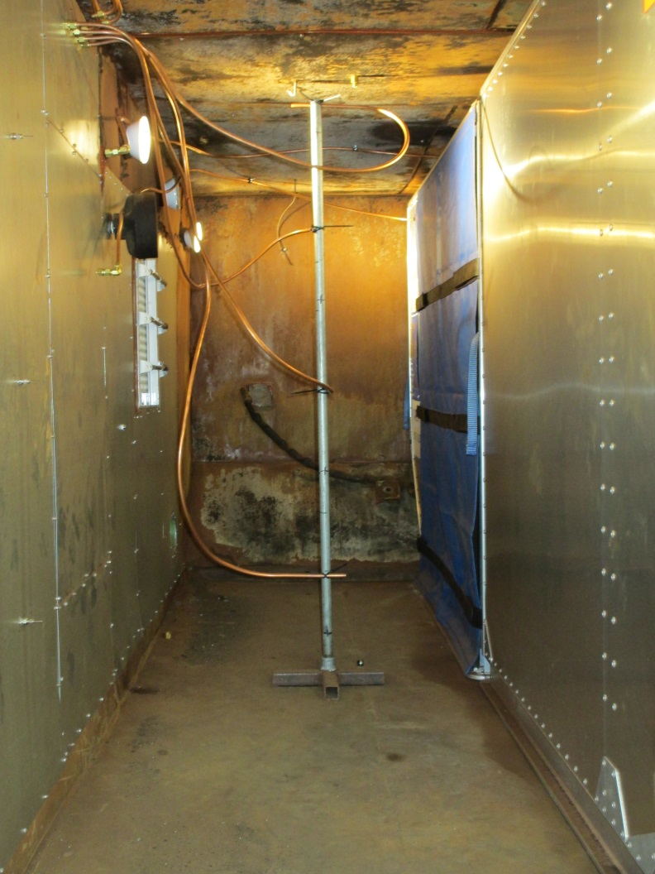
Class-C Compartment Test Setup
Testing was conducted to measure concentrations of FE-25 within a fully loaded class-C compartment.
Gas probes placed in the empty space within compartment.
Compartment volume: 1303 ft³.
Tests conducted to measure concentrations of FE-25 at various heights to observe stratification.
Probe 1
Probe 2
Probe 3
Probe 4

Slide 7
Class-C Compartment Test Setup
21 lbs of FE25 discharged into the compartment.
AKE ULD

Slide 8
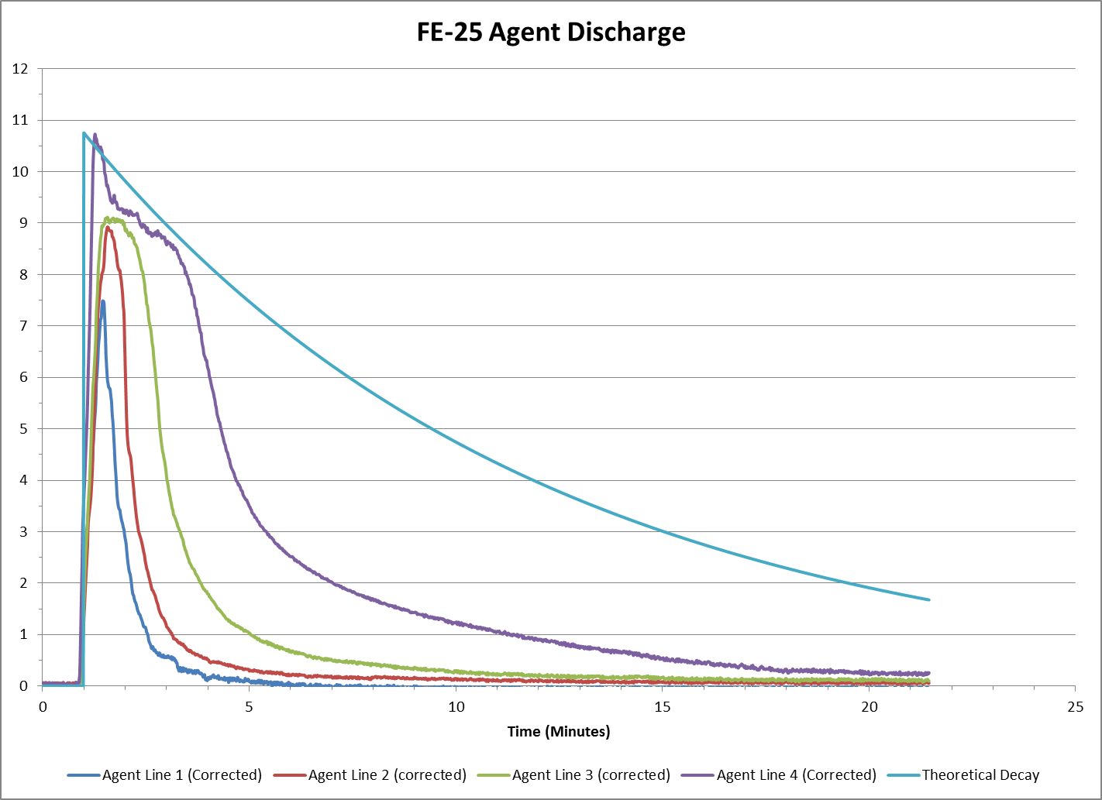

Slide 9
Results
Agent in the compartment dissipates much quicker than theoretical calculations.
Determine theoretical values by including
Effects of ventilation.
Leakage compensation
Correction factors could help determine agent dissipation rates in the compartment.
Help determine agent concentration levels to inert compartment as well as containers.
Input and test data from others is welcome.

Slide 10
Questions?
Dhaval Dadia
dhaval.dadia@faa.gov
(609) 485-8828

