Slide 1

DEVELOPMENT OF A NEW METHOD FOR THE REPLACEMENT OF
“MULTILAYER CUSHIONS”
ON DYNAMIC SEATS
Andrea Scialpi Testori Aero Supply
ATLANTIC CITY October 26, 2016

Slide 2
TESTORI AERO SUPPLY
“MULTILAYER 16g CUSHIONS REPLACEMENT“ PROJECT OVERVIEW
BACKGROUND
The replacement of seat cushions on seats installed on aircraft required to comply FAR/CS 25.562 is one of the key areas of business of TESTORI AERO SUPPLY (TAS).
TAS holds an EASA DOA ( EASA.21J.350) and POA (IT21G.0014) with a a quite consolidated experience in design and manufacturing of aircraft seat cushions.
The replacement of seat cushions requires substantiation through seat dynamic testing (ref. FAA AC 25.562-1B Ch.1).
The following constraints are well-known to the companies active in this market:
  High costs and lead-times to procure test articles, especially the seats.
  lack of knowledge on the already certified seat design.
  Lack of cooperation from seat manufacturers

Slide 3
TESTORI AERO SUPPLY
“MULTILAYER 16g CUSHIONS REPLACEMENT“ PROJECT OVERVIEW
BACKGROUND Cont’d
In order to find an alternative to dynamic testing TAS has evaluated in detail the content of FAA report DOT/FAA/AR-05/5,I Development and Validation of an Aircraft Seat Cushion Component Test—Volume I
The documents establishes criteria to evaluate replacement cushions on 16g seats through comparative compression testing based on American Society for Testing and Materials standard test method D 3574-03
Load-deflection data are generated for cylindrical test specimens representative of the types of foams to be compared.
The cushion replacement methodology is, in part, based on the fact that a criterion curve exists, which enables the cushion designer and the certification engineer to define and certify a replacement cushion that produces a lower lumbar load than the originally certified cushion.
FAA has issued a Policy Statement that allows the use of a Component Test Method to Demonstrate Compliance with 25.562 (c) (2) for Replacement Seat Bottom Cushions. Specifically the use of this policy is limited to non-flotation monolithic cushions.

Slide 4
TESTORI AERO SUPPLY
“MULTILAYER 16g CUSHIONS REPLACEMENT“ PROJECT OVERVIEW
TESTORI AERO SUPPLY PROJECT DEVELOPMENT
TAS has developped, together with Italian University Politecnico di Milano Department of Aerospace Engineering, a test bench meeting the limitations specified in FAA Report DOT/FAA/AR-05/5,I.
TAS submitted the application for a cusion replacement project to EASA that issued a Means of Compliance Certification Review Item, CRI-D-01 (Development and validation of a Cushion Component Test for replacement of cushions of aircraft seats required to comply with JAR/CS 25.562).
EASA finally released to TAS STC 10045993 on August 2, 2013. TAS has then developed and been granted additional EASA STC’s for the replacement of Monolithic Cushions replacement on dynamic seats.

Slide 5
TESTORI AERO SUPPLY
“MULTILAYER 16g CUSHIONS REPLACEMENT“ PROJECT OVERVIEW
TESTORI AERO SUPPLY PROJECT DEVELOPMENT cont’d
In 2015 TAS has decided to launch a project to develop a component test method similar to that outlined the FAA/DOT/AR-05/5,I but applicable to multilayer non monolithic cushions.
TAS has applied to participate to a European Commission programme for research and innovation named Horizon 2020 and has submitted the project “ Development of replacement method for all kind of 16g dynamically tested aircraft seat cushions”
TAS, classified as Executive Agency for Small and Medium-sized Enterprise (EASME) according to European Commission standards, has presented the project in the program section dedicated to business innovation research for transport.

Slide 6
TESTORI AERO SUPPLY
“MULTILAYER 16g CUSHIONS REPLACEMENT“ PROJECT OVERVIEW
TESTORI AERO SUPPLY PROJECT DEVELOPMENT cont’d
TAS approach to the 16g multilayer non monolithic cushions replacement project has been developed in cooperation Politecnico of Milan and with the support of GEVEN, an Italian aircraft seat manufacturer.
The project has been evaluated by a panel of experts appointed by the European Commission and has been accepted as innovative project eligible to receive a founding by the European Union.
TAS and the European Commission have signed the grant agreement number 711347 on January 2016.
Subsequently, TAS has signed with EASA (European Aviation Safety Agency) a TAC (Technical Advice Contract) to receive technical guidance during the project.

Slide 7
TESTORI AERO SUPPLY
“MULTILAYER 16g CUSHIONS REPLACEMENT“ PROJECT OVERVIEW
TESTORI AERO SUPPLY CERTIFICATION PROGRAM LIMITATIONS
TAS has decided, for the time being, to develop a means of compliance limited to economy class seats.
The key point of TAS choice are mainly related to the fact that nowadays many E/C seat cushions are monolithic and are offering limited comfort to the passengers.
TAS is willing to offer to the E/C passengers more comfortable cushions even in high density E/C Class.

Slide 8
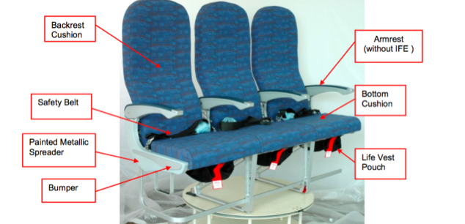
TESTORI AERO SUPPLY
“MULTILAYER 16g CUSHIONS REPLACEMENT“ PROJECT OVERVIEW
TAS has decided to utilize an E/C seat model “PIUMA” manufactured by GEVEN SPA.
The PIUMA has a quite conventional design with aluminum structure and is already certified for installation on a wide range of large aeroplanes, such as ATR 42/72, Airbus A320 and A330, Boeing B737 NGs.

Slide 9
TESTORI AERO SUPPLY
“MULTILAYER 16g CUSHIONS REPLACEMENT“ PROJECT OVERVIEW
SEAT CUSHION MATERIAL SELECTION CRITERIA
For the project, TAS, based on its yearly experience in cushion manufacturing, has decided
to use graphite based foams of different density and having different indentation hardness:
“Hard foams” having a density of approx. 65-70 kg/m3, typically used as cushion lowest layer sustaining the loads at the contact with the seat pan. Normally these foams have an indentation hardness of 6 kPa. The percentage in volume of “hard foam” is typically 60-70%.
“Medium foams” having a density of approx. 50-55 kg/m3, typically used as intermediate layer between the seat cover and the hard layer in cushions with two layers (or directly above the “hard foam” layer in case of three layer cushions). Normally these foams have an indentation hardness of 3-4 kPa. The percentage in volume of “medium foams” is typically 20-30%.
“Soft foams” having a density of approx. 45-55 kg/m3. The soft layer is located below the seat cover and is the first contact with the passenger. The aim of this foam is to improve passenger comfort and contribute to Deep Vein Thrombosis (DVT) prevention. The percentage in volume of this layer is normally 10%.

Slide 10
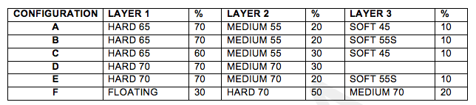
TESTORI AERO SUPPLY
“MULTILAYER 16g CUSHIONS REPLACEMENT“ PROJECT OVERVIEW
MATERIAL SELECTION
TAS has finally selected 6 different multilayer seat bottom cushion configurations as per below table:

Slide 11
TESTORI AERO SUPPLY
“MULTILAYER 16g CUSHIONS REPLACEMENT“ PROJECT OVERVIEW
PROJECT DESCRIPTION
The project consists in two different phases, each one involving component testing, seat dynamic testing and simulation based on an analytical model developed by the University Politecnico di Milano.
In PHASE 1 the results of the compression tests on foam compositions C and D, together with the results of the lumbar load measurements obtained in the dynamic tests run on the same foam compositions installed on PIUMA seat, will be collected and used to refine the calibration of the analytical model.
In PHASE 2 the results of the compression tests on each of the remaining foam compositions (A, B, E and F) will be used as input for the model to simulate the peak of the lumbar load that would be measured in a dynamic test conducted on seat cushions having that composition. Actual dynamic tests will then be performed to confirm and validate the output of the simulation.

Slide 12
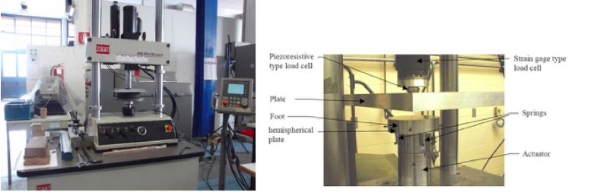
TESTORI AERO SUPPLY
“MULTILAYER 16g CUSHIONS REPLACEMENT“ PROJECT OVERVIEW
DYNAMIC COMPRESSION TEST
The test consists of a compression test applying a force of 15 KN and travelling at a speed of 0.76 m/sec (33 inch second), up and down (up to 90% of the original thickness) as per FAA/DOT/AR-05 chapter 4

Slide 13
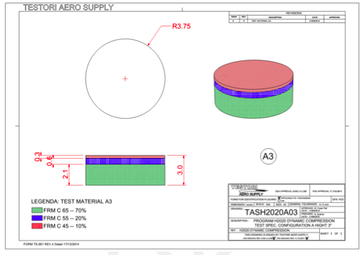
TESTORI AERO SUPPLY
“MULTILAYER 16g CUSHIONS REPLACEMENT“ PROJECT OVERVIEW
DYNAMIC COMPRESSION TEST SPECIMENS
TAS will manufacture multilayer cylindrical test specimen having 8” diameter and thickness equal to 2”, 3”, 4” and 4,5”.
Each layer will be glued on the other using the TAS standard glue normally used by TAS during seat cushions manufacturing.
TAS will manufacture approx. 20 specimen for each sample configuration.

Slide 14
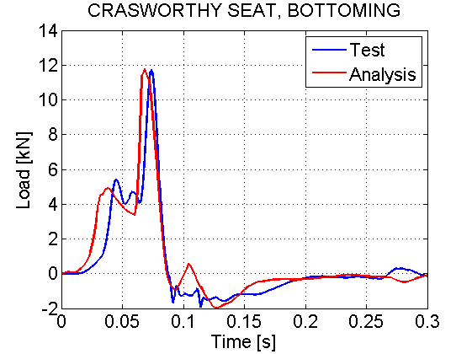
TESTORI AERO SUPPLY
“MULTILAYER 16g CUSHIONS REPLACEMENT“ PROJECT OVERVIEW
POLITECNICO DI MILANO DATA ANALYSIS METHOD
The target of the project is the set-up of a procedure to assess the response of new CS-25 seat cushions, for retrofitting on existing seats, without carrying out a full seat dynamic test.
The basic ideas are as follows:
The seat, in its original configuration, has already been certified but the test results are in general not available
Samples from the original cushion must be manufactured and tested
Samples from the new cushion are tested
Load responses from the two tests are compared by using a simplified dynamic analysis

Slide 15
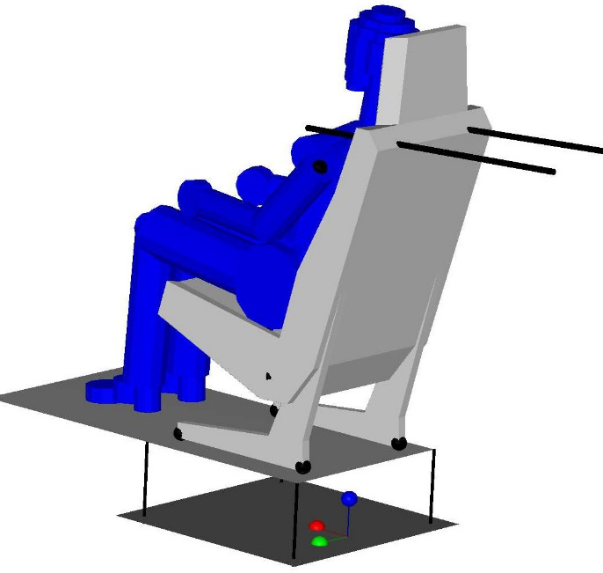
TESTORI AERO SUPPLY
“MULTILAYER 16g CUSHIONS REPLACEMENT“ PROJECT OVERVIEW
POLITECNICO DI MILANO DATA ANALYSIS METHOD
The first part of the activity is the preparation of a simplified dynamic model of the seat and ATD. This will be a 2-DoF rigid body model, based on a more complex, fully validated, multi-body model. The 14-g acceleration is input into the seat/sled element, at the bottom.
UPPER
BODY
LUMBAR
SPINE
LOWER
BODY
PELVIS-
CUSHION
SEAT/SLED

Slide 16
TESTORI AERO SUPPLY
“MULTILAYER 16g CUSHIONS REPLACEMENT“ PROJECT OVERVIEW
POLITECNICO DI MILANO DATA ANALYSIS METHOD
The 2-DoF model will be tuned as follows:
Dynamic seat tests will be carried out at Geven on full seat
The main information from these tests is the lumbar spine load vs. time
Sample of the same cushions used in the dynamic tests undergo compression testing
The main output is load response vs. cushion deflection

Slide 17
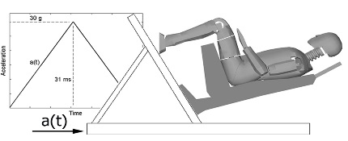
TESTORI AERO SUPPLY
“MULTILAYER 16g CUSHIONS REPLACEMENT“ PROJECT OVERVIEW
POLITECNICO DI MILANO DATA ANALYSIS METHOD
5. The cushion load-deflection response is input in the 2-DoF model; tuning should bring to a result as follows in terms of lumbar spine load
UPPER
BODY
LUMBAR SPINE
LOWER
BODY
PELVIS-CUSHION
SEAT/SLED

Slide 18
TESTORI AERO SUPPLY
“MULTILAYER 16g CUSHIONS REPLACEMENT“ PROJECT OVERVIEW
POLITECNICO DI MILANO DATA ANALYSIS METHOD
The expected output from this test campaign and data post-processing is a final 2-DoF model that should be used to assess the new cushion performance in comparison with a reference (already certified) cushion. The procedure should be as follows:
Samples from the old cushions are tested and characterised at low speed (~ 0.76 m/s)
Samples from new cushions are tested under the same conditions
The load-deflections curves are input in the 2-Dof model
The resulting lumbar spine loads are compared
The pass/fail criterion suggested is that peak lumbar spine load simulated for the new cushion is not greater than that simulated for the old cushion (conservatively assuming that the results of previously performed certification tests are not available).

Slide 19
TESTORI AERO SUPPLY
“MULTILAYER 16g CUSHIONS REPLACEMENT“ PROJECT OVERVIEW
POLITECNICO DI MILAN DATA ANALYSIS METHOD
NOT ACCEPTABLE

Slide 20
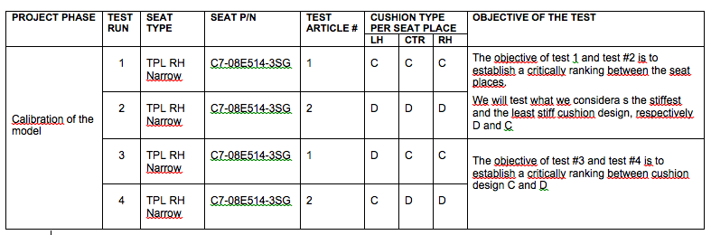
TESTORI AERO SUPPLY
“MULTILAYER 16g CUSHIONS REPLACEMENT“ PROJECT OVERVIEW
PHASE 1 : calibration of the model

Slide 21
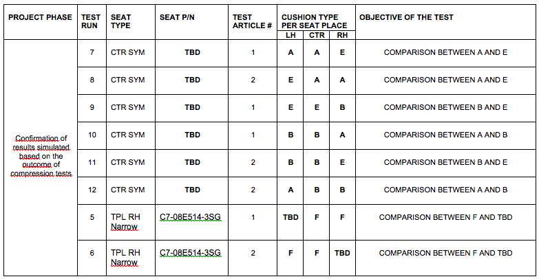
TESTORI AERO SUPPLY
“MULTILAYER 16g CUSHIONS REPLACEMENT“ PROJECT OVERVIEW
PHASE 2: Validation of the model
to confirm the results simulated

Slide 22
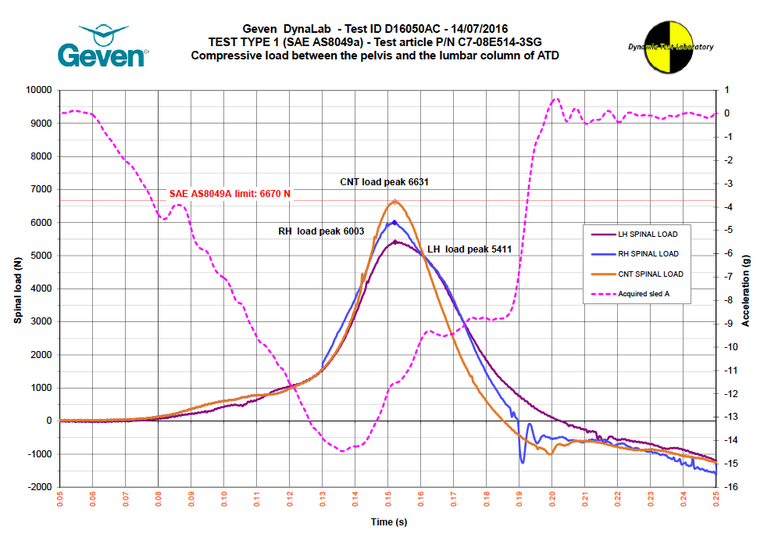
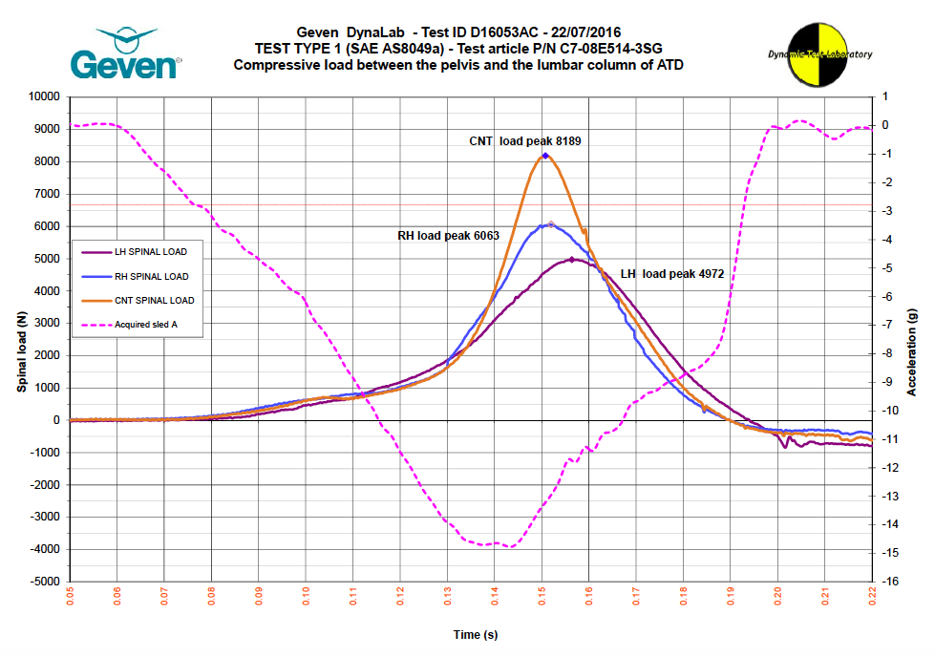
TESTORI AERO SUPPLY
“MULTILAYER 16g CUSHIONS REPLACEMENT“ PROJECT OVERVIEW
PROJECT STATUS: RESULTS FROM PHASE 1 DYNAMIC TESTS
TEST # 1 TEST # 3

Slide 23
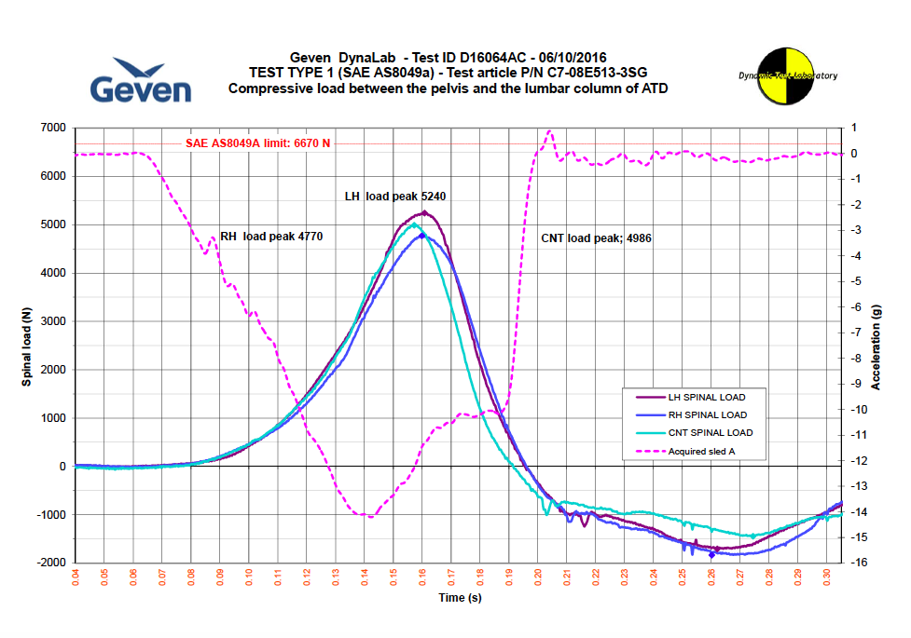
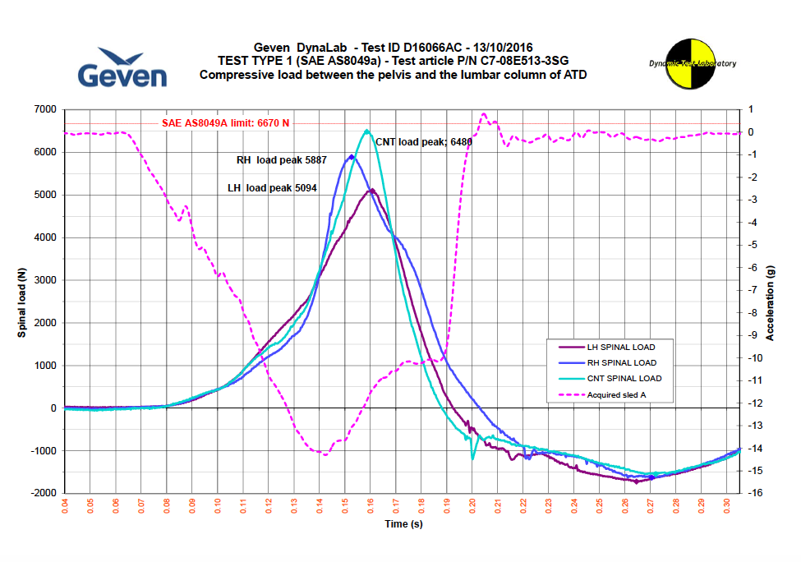
TESTORI AERO SUPPLY
“MULTILAYER 16g CUSHIONS REPLACEMENT“ PROJECT OVERVIEW
PROJECT STATUS: RESULTS FROM PHASE 1 DYNAMIC TESTS cont’d
TEST # 2 TEST # 4

Slide 24
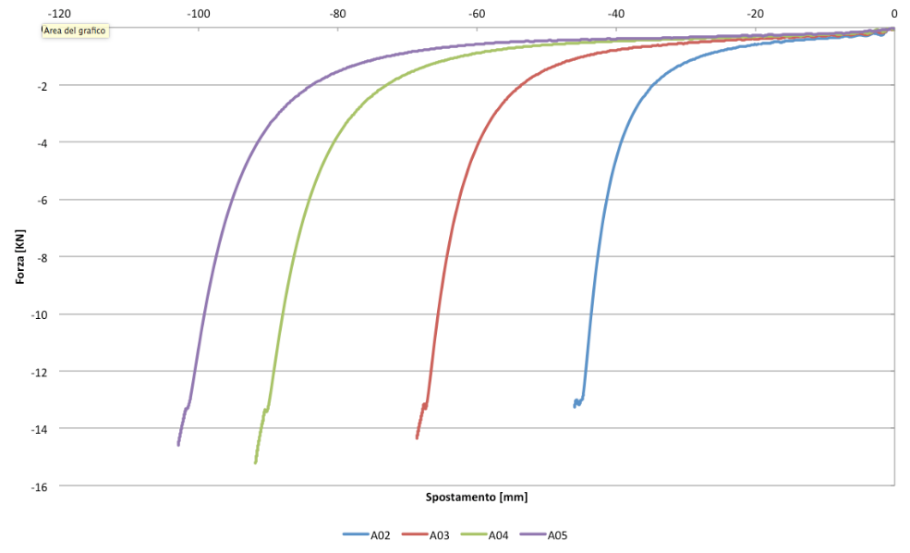
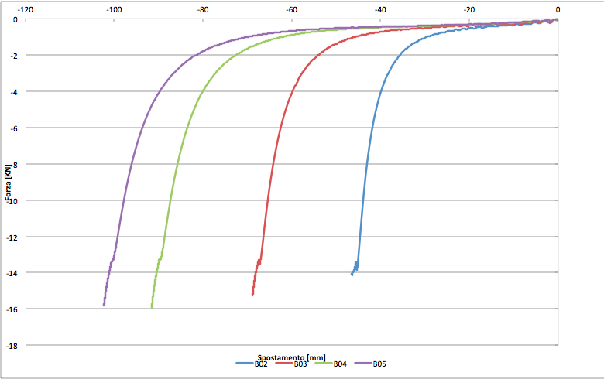
TESTORI AERO SUPPLY
“MULTILAYER 16g CUSHIONS REPLACEMENT“ PROJECT OVERVIEW
PROJECT STATUS: RESULTS FROM COMPRESSION TESTs
Almost all compression tests have been performed (5 configurations completed out of 6)
Below you can find the average graphs ( A02 means the average curve of 20 specimen configuration A having a thickness of 2”inch) for each configuration
CONFIGURATION A CONFIGURATION B

Slide 25
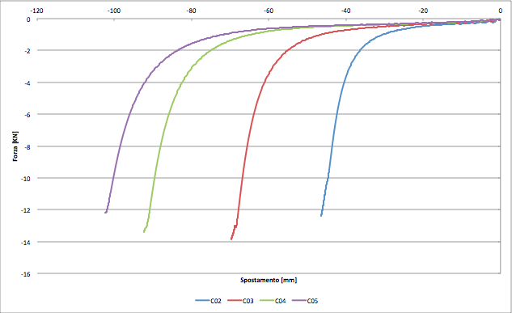
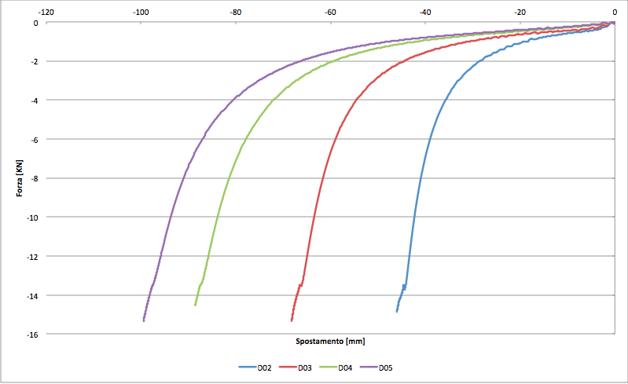
TESTORI AERO SUPPLY
“MULTILAYER 16g CUSHIONS REPLACEMENT“ PROJECT OVERVIEW
PROJECT STATUS: RESULTS FROM COMPRESSION TESTs cont’d
CONFIGURATION C CONFIGURATION D

Slide 26
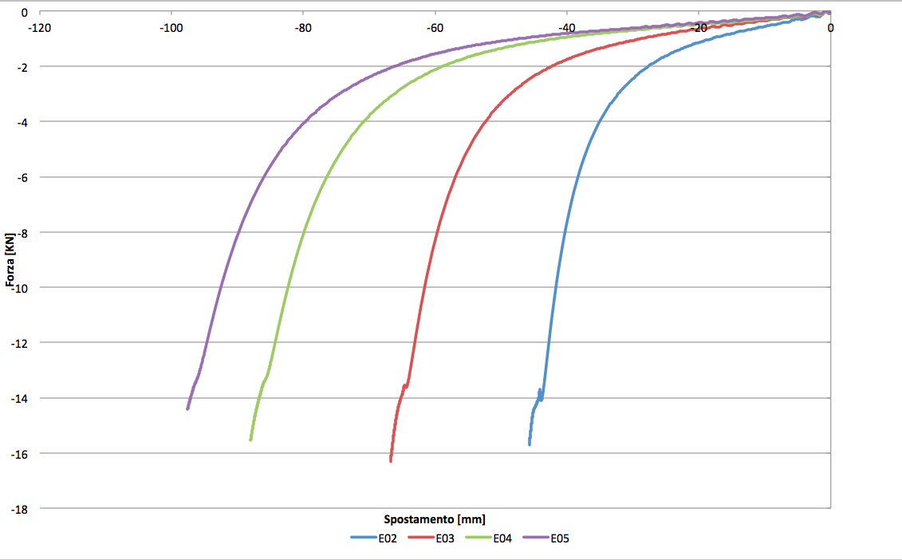
TESTORI AERO SUPPLY
“MULTILAYER 16g CUSHIONS REPLACEMENT“ PROJECT OVERVIEW
PROJECT STATUS: RESULTS FROM COMPRESSION TESTs cont’d
CONFIGURATION E CONFIGURATION F

Slide 27
TESTORI AERO SUPPLY
“MULTILAYER 16g CUSHIONS REPLACEMENT“ PROJECT OVERVIEW
PROJECT STATUS cont’d
Calibration of the model is currently on-going
Comparison between the preliminary lumbar load data given as output by the model and the results from phase 1 dynamic tests.

Slide 28

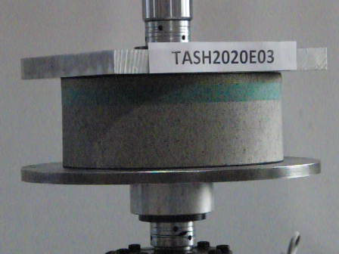
TESTORI AERO SUPPLY
“MULTILAYER 16g CUSHIONS REPLACEMENT“ PROJECT OVERVIEW
SEAT DYNAMIC TEST
DYNAMIC COMPRESSION TEST

Slide 29
TESTORI AERO SUPPLY
“MULTILAYER 16g CUSHIONS REPLACEMENT“ PROJECT OVERVIEW
QUESTIONS

