Slide 1
FireFOAM Modeling of Water Mist for Suppression of Compartment Fires
N. Ren, H.Z. Yu, K.V. Meredith and Y. Wang
8th Triennial International Fire and Cabin Safety
Research Conference
Oct. 24-27, Atlantic City

Slide 2
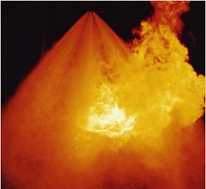
Water mist
Effective for
  Confined spaces
  Compartment fires
  Ignitable liquids
Application
  Hotel, office, data center, etc.
  Shipboard, airplane, etc.
  Flammable liquid, etc.
Challenge
  Complex suppression mechanisms
  Limited codes and standards
  Design, installation, inspection
  Reliability

Slide 3
Modeling: Motivation
Gain insight into water mist suppression mechanisms
  Better understanding of the tests
Provide engineering guidance
  More efficient full-scale test design
  Interpolation/extrapolation of the tests

Slide 4
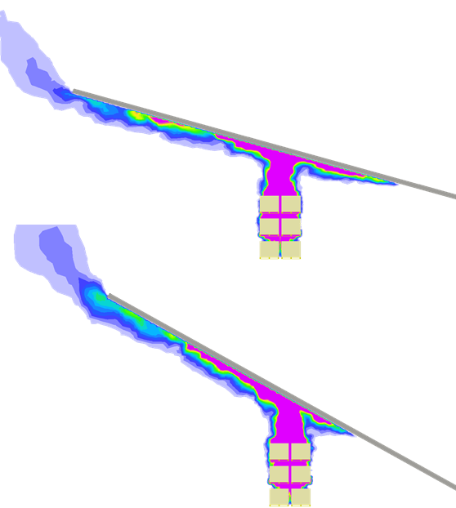
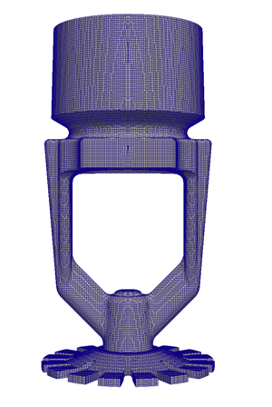
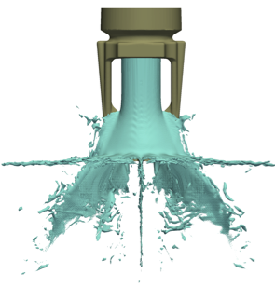
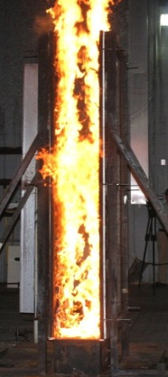
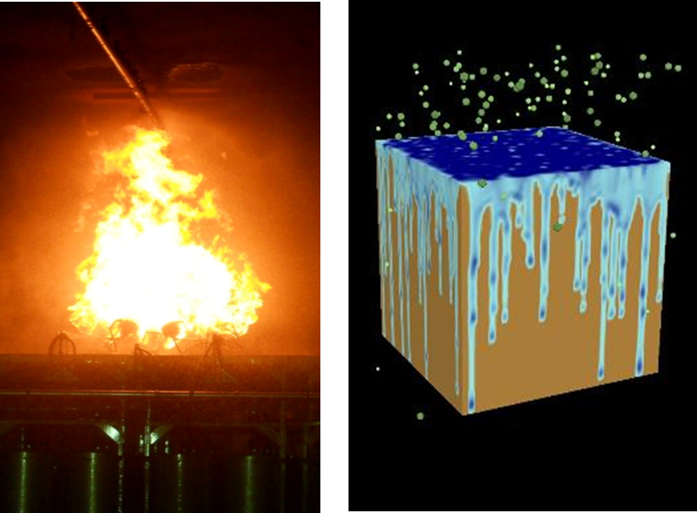
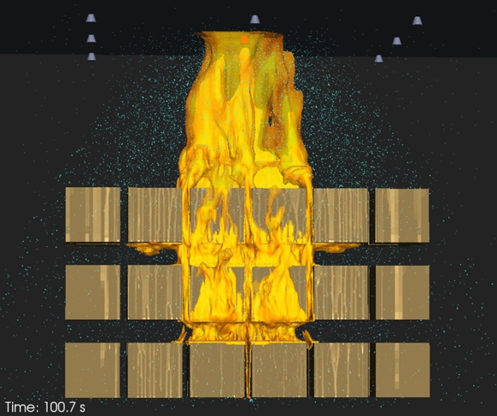
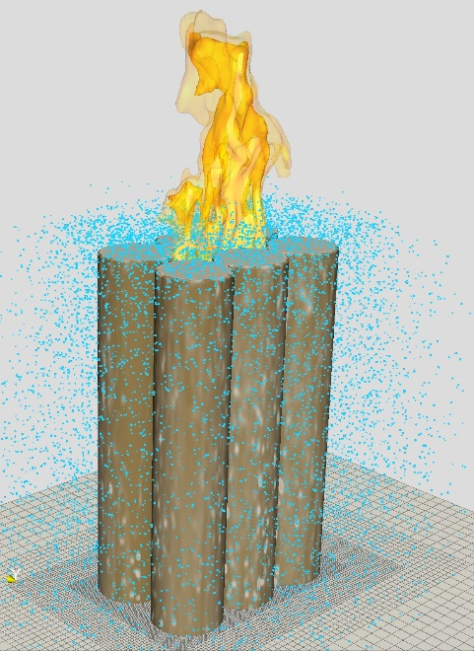
Previous
Studies

Slide 5
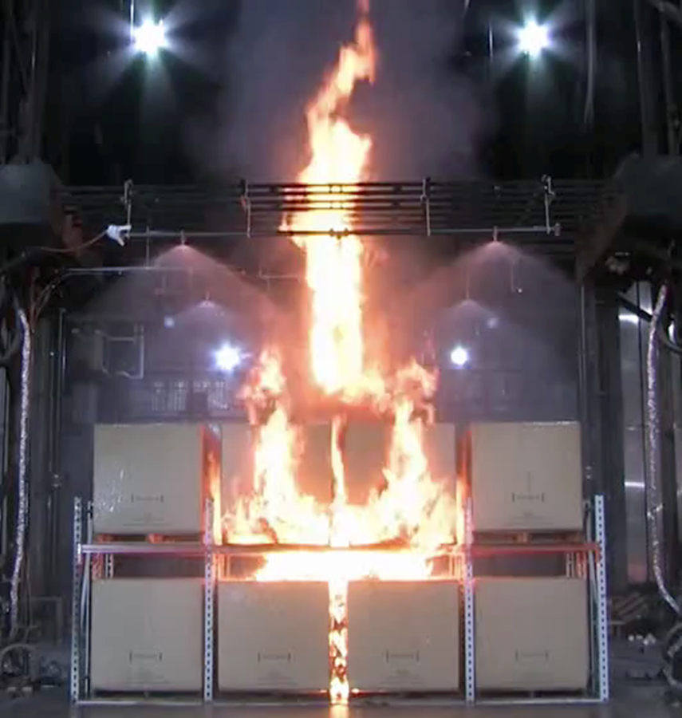
Water-based suppression mechanisms
Cooling
Wetting
Oxygen depletion
Flame extinction
Radiation attenuation
etc.

Slide 6
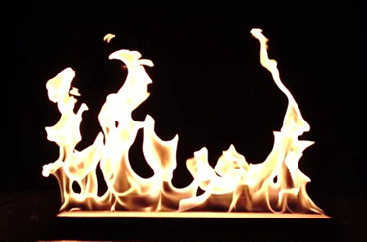
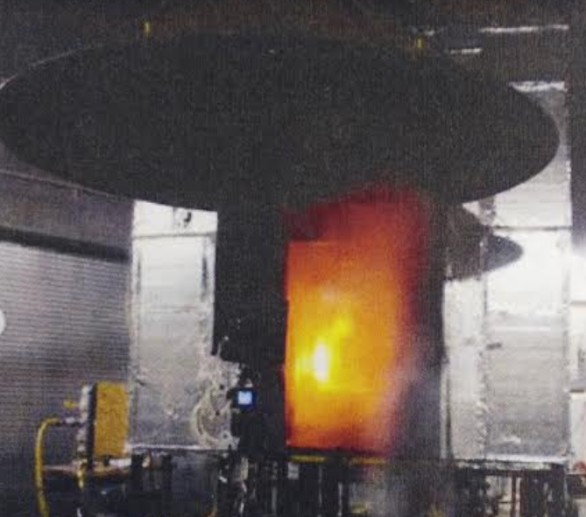
Objectives
Flame extinction
  Develop a flame extinction model with the presence of water mist spray
Validation
  Bench-scale
    Wolfhard-Parker line burner without spray (U. MD)
  Full-scale
    Enclosure fire suppression (H.Z. Yu et al.)

Slide 7
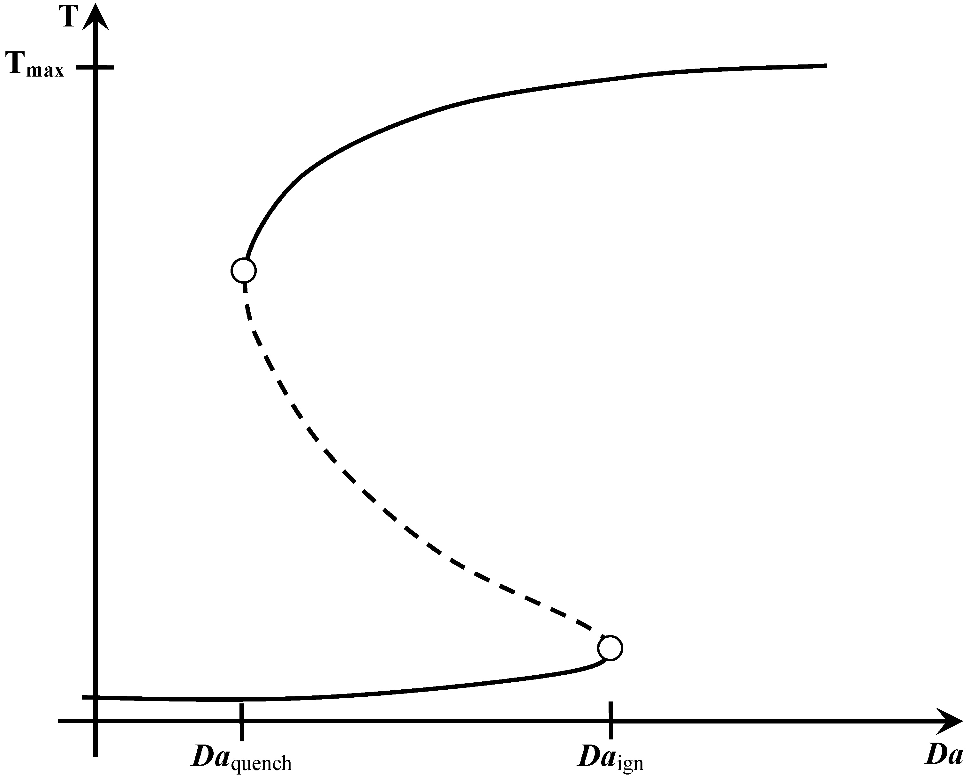
Flame extinction
Heat release rate
  Fuel, oxidizer concentration
  Flame temperature
Heat loss rate
  Strain rate
  Radiation
  Conduction

Slide 8
Literature review
Fixed flame temperature
  FDS
Critical Damköhler number
  A. Trouve, et. al., J. Hewson, et. al.
  H.Z. Yu (Strain rate - temperature)
Reactive volume fraction model
  S.B. Dorofeev (pre-mixed eddies)
Other models
  A. Yu. Snegirev (Perfectly stirred reactor)
  H. Pitsch, et. al. (Flamelet model)
  etc.

Slide 9
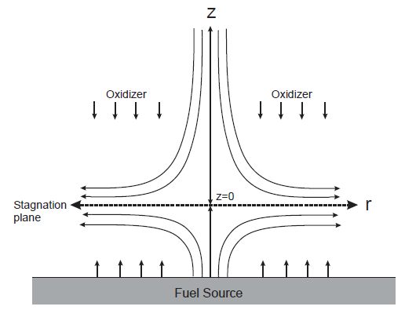
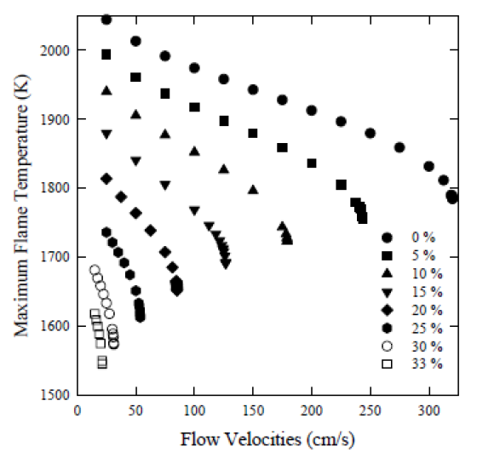
Temperature – strain rate
Bert Yu
  Opposite flow with detailed chemistry model (OPPDIF)
Add more N₂

Slide 10
Sub-grid model
Strain rate
  Turbulent mixing
  Eddy spectrum and cascade
    H.Z. Yu
Flame temperature
  Energy balance on flame sheet
Air
Fuel
Grid size

Slide 11
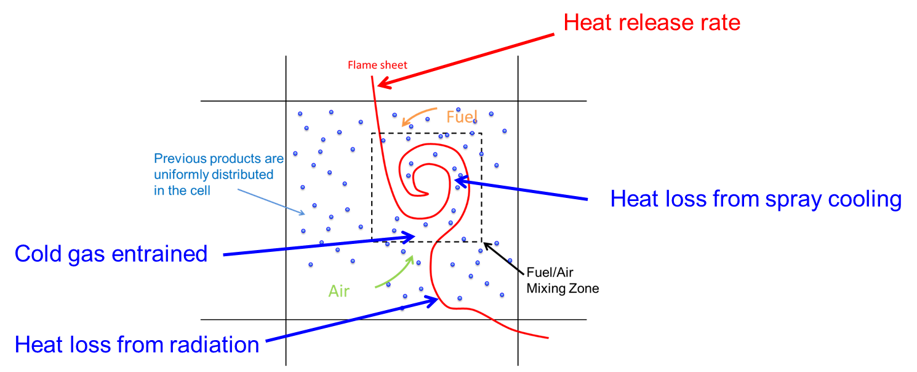
Flame temperature
Chemical heat release
Heat up new generated products
Heat up entrained inert/products
Vaporize droplet and
heat up water vapor
Radiative heat loss

Slide 12
Model formulation

Slide 13
FireFOAM
Turbulence model
Combustion model
  EDC with extinction
Radiation model
  FVDOM

Slide 14
Bench-scale validation
(Wolfhard-Parker Burner)

Slide 15
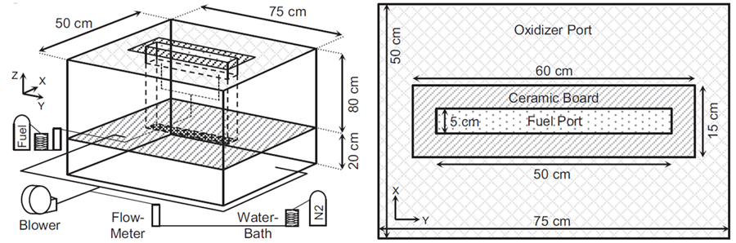
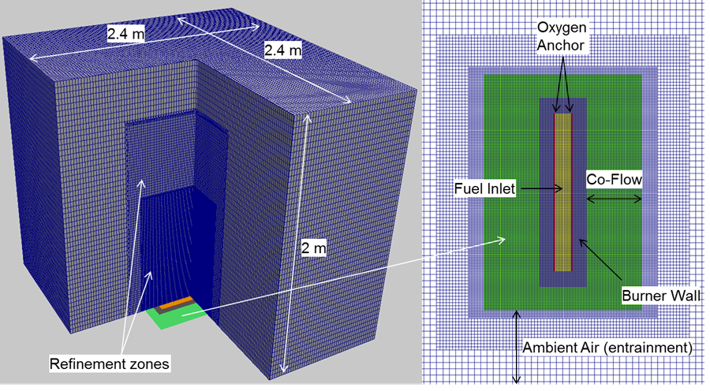
Validation (J. White et al. 2015)
Propane fires of 50 kW
Inert quenching
  Oxygen mole fraction ranges from 12% to 21% in co-flow
J.P. White, E.D. Link, A.C. Trouve, P.B. Sunderland A.W. Marshall, J.A. Sheffel, M.L. Corn, M.B. Colket, M. Chaos, H.Z. Yu,
“Radiative emissions measurements from a buoyant, turbulent line flame under oxidizer-dilution quenching conditions,” Fire Safety Journal, Vol. 76 (2015) pp. 74-84

Slide 16
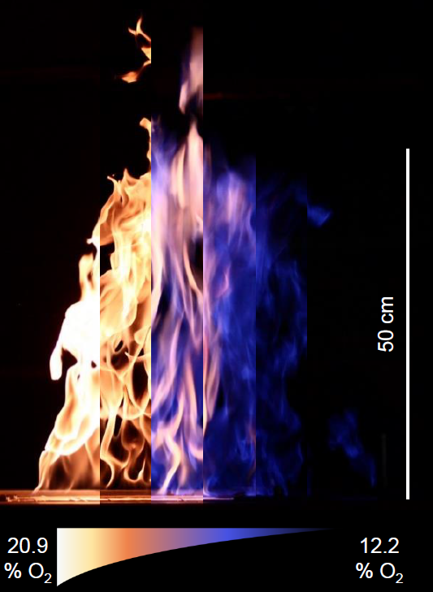
Radiation (J. White et al.)

Slide 17
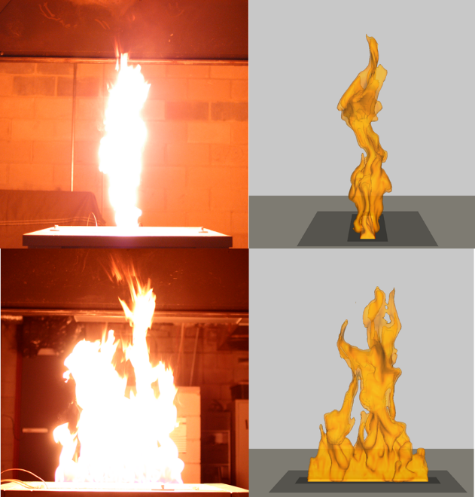
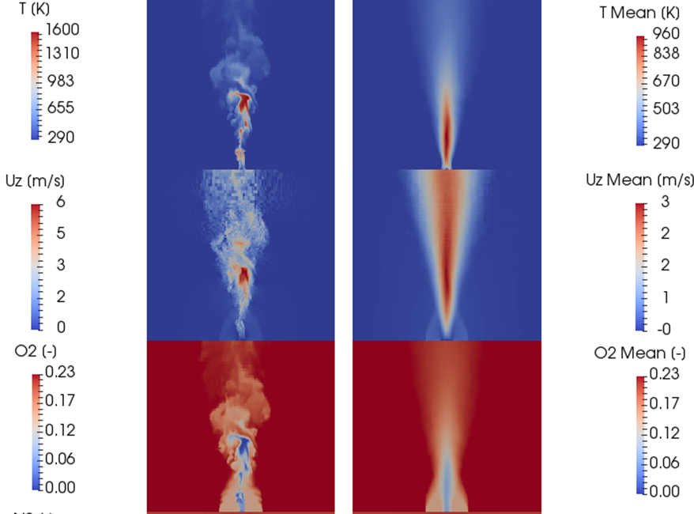

Slide 18
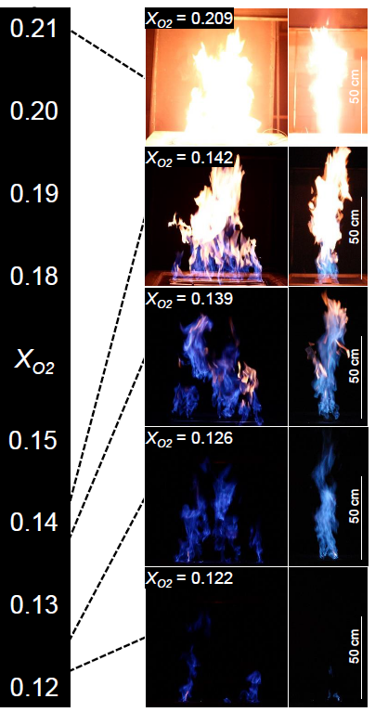
Combustion efficiency
Combustion efficiency

Slide 19
Flame height

Slide 20
Full-scale validation
(Enclosure fire suppression)

Slide 21
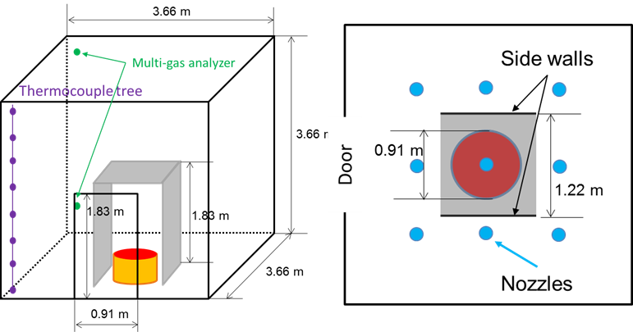
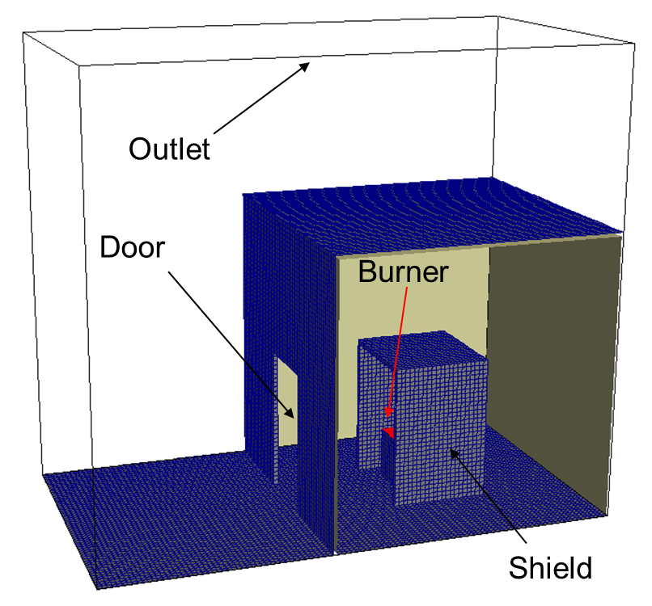
Full scale enclosure fire
156 kW
686 kW
Experimental setup
Numerical setup

Slide 22
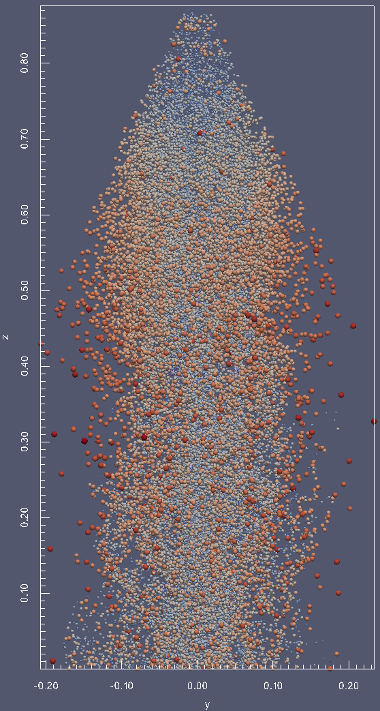
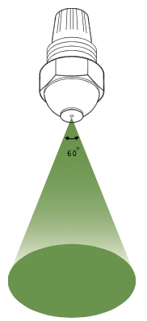
Spray info
Hago 20-60P nozzle
Full cone with 60° cone angle
Discharge pressure 41.4 bar (90 m/s)
Flow rate 2.78 L/min per nozzle
Median volumetric diameter of spray: 88 micron

Slide 23
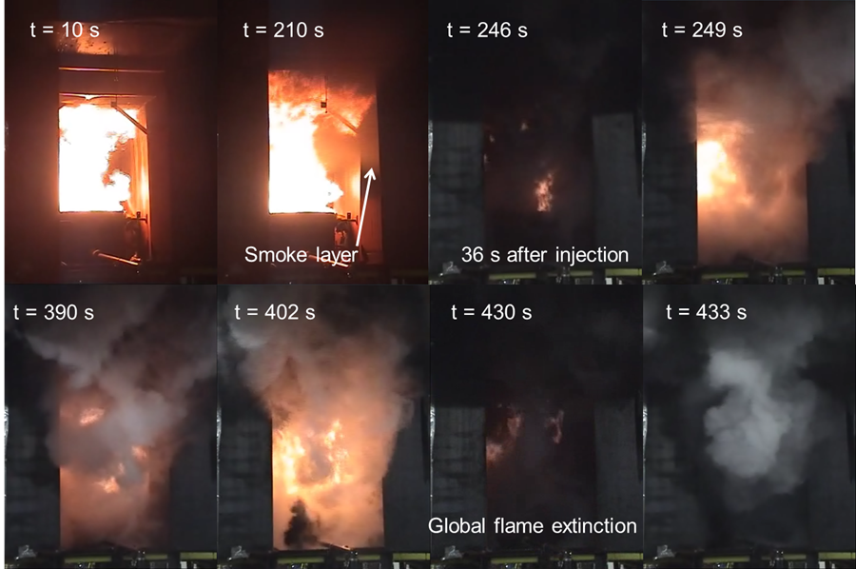
686 KW

Slide 24
Chemical HRR
Injection starts

Slide 25
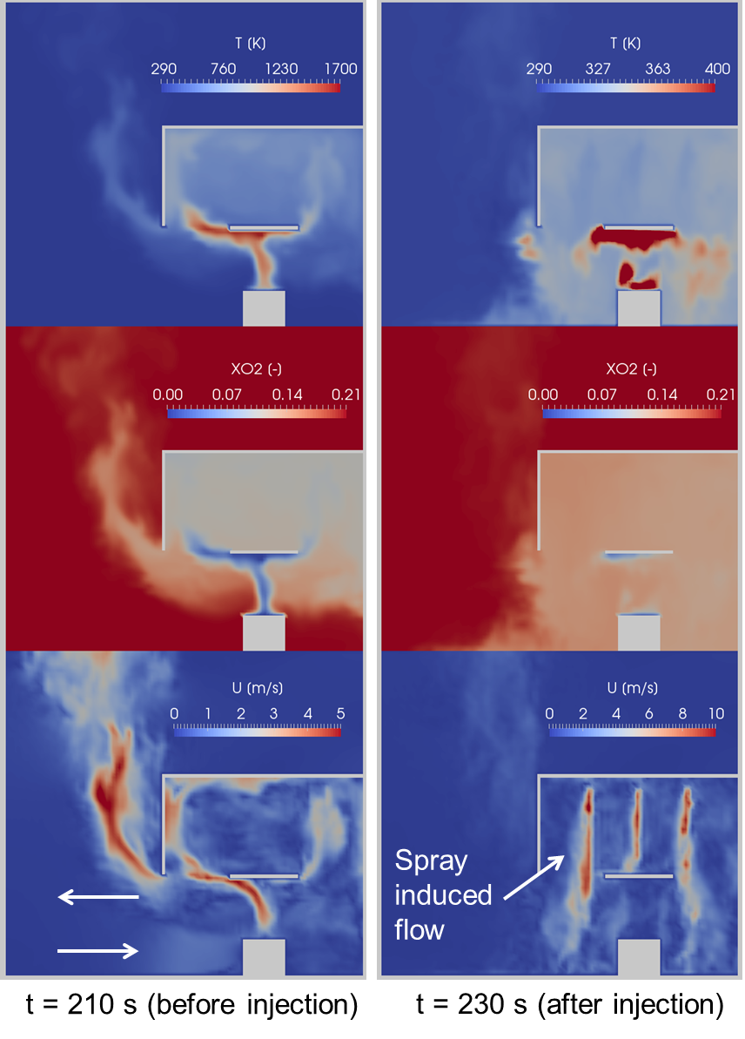
Oxygen depletion
686 kW fire
T ≈ 700 K
T ≈ 350 K
T
156 kW
O₂
686 kW
U

Slide 26
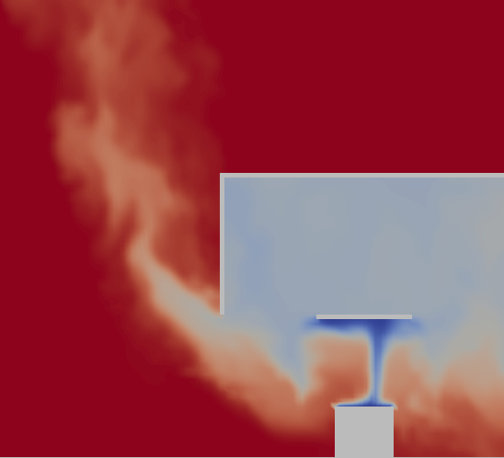
Parametric study
686 kW fire
Early spray injection
  Cooler environment
  More oxygen
Half injection pressure
  Lower flow rate
  Lower spray momentum
Half Injection Pressure

Slide 27
Summary
A temperature – strain rate based flame extinction model is developed in FireFOAM and validated
Wolfhard-Parker line burner
  Inert thermal-quenching
Enclosure fire suppression
  Spray mixing is important
  Hot smoke layer enhance spray evaporation
    Larger fire & hotter environment facilitates flame extinction

Slide 28
Acknowledgement
FM strategic research program
  Sergey B. Dorofeev
  Louis Gritzo
University of Maryland
  Prof. André Marshall
  Prof. Arnaud Trouvé
  Dr. James White

Slide 29
Questions?

