Slide 1
NTSB Cargo Fire Safety Recommendations
Joseph Panagiotou
8th Triennial International Aircraft Fire and Cabin Safety research conference

Slide 2
Basis of NTSB Cargo Fire Safety Recommendations.
UPS Philadelphia
UPS Dubai
Asiana Jeju Island
Cargo container fire study

Slide 3
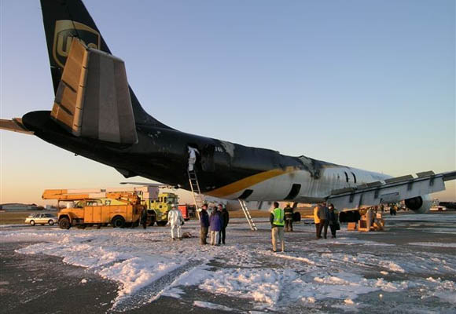
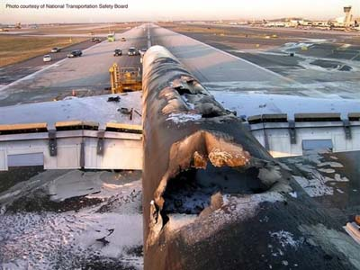
UPS Philadelphia
February 7, 2006
Flight 1307
McDonnell Douglas DC-8
long time between smell of smoke and cargo fire alarm
No fire suppression in flight
Unidentified fire source
Aircraft was a total loss
NTSB Report:
http://www.ntsb.gov/doclib/reports/2007/AAR0707.pdf

Slide 4
UPS Philadelphia Recommendations
Ensure that the performance requirements for smoke and fire detection systems on cargo airplanes account for the effects of cargo containers on airflow around the detection sensors and on the containment of smoke from a fire inside a container, and establish standardized methods of demonstrating compliance with those requirements. (A‑07‑98)
Work was done by the FAA Tech Center to evaluate cargo loading effects
NTSB cargo study established different container types have different smoke leakage paths
CLOSED – SUPERCEDED 11/28/2012
Require that fire suppression systems be installed in the cargo compartments of all cargo airplanes operating under 14 Code of Federal Regulations Part 121. (A‑07‑99)
FAA cost benefit analysis did not support this recommendation
CLOSED - UNNACCEPTABLE ACTION 4/27/2011

Slide 5
UPS Philadelphia Recommendations
Require aircraft operators to implement measures to reduce the risk of primary lithium batteries becoming involved in fires on cargo-only aircraft, such as transporting such batteries in fire resistant containers and/or in restricted quantities at any single location on the aircraft. (A-07-104)
PHMSA unable to require more restrictive measures than ICAO due to FAA Modernization and Reform act of 2012
CLOSED - RECONSIDERED 12/26/2012
Until fire suppression systems are required on cargo-only aircraft, as asked for in Safety Recommendation A-07-99, require that cargo shipments of secondary lithium batteries, including those contained in or packed with equipment, be transported in crew-accessible locations where portable fire suppression systems can be used. (A-07-105)
PHMSA unable to require more restrictive measures than ICAO due to FAA Modernization and Reform act of 2012
CLOSED – RECONSIDERED 12/26/2012

Slide 6
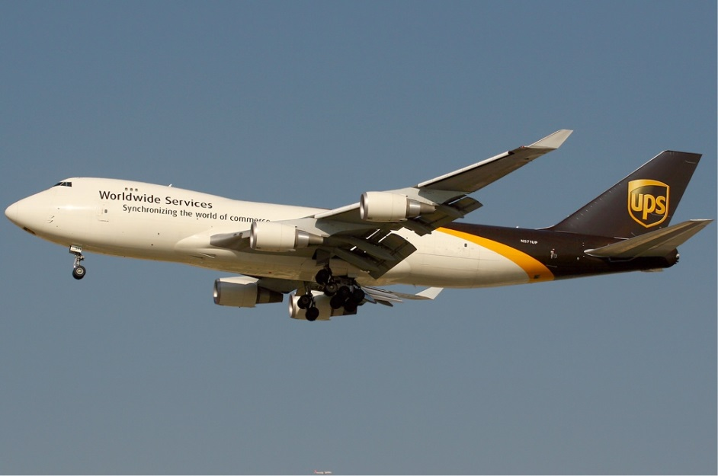
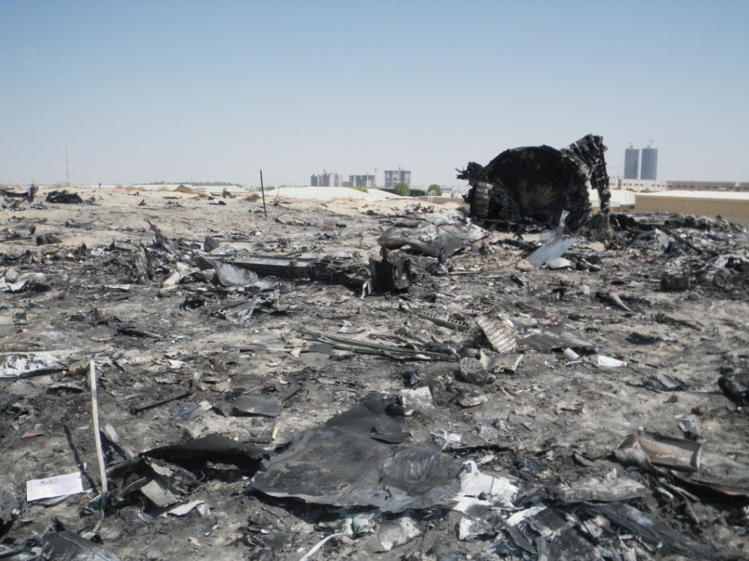
UPS Dubai
September 3, 2010
Flight 006
Boeing 747-400F
2 ½ minutes between cargo fire alarm and onset of system loss
Heavy smoke in the flight deck
suppression by depressurization ineffective
aircraft out of control
Unidentified source
loss of crew and aircraft
GCAA final Report:
www.gcaa.gov.ae

Slide 7
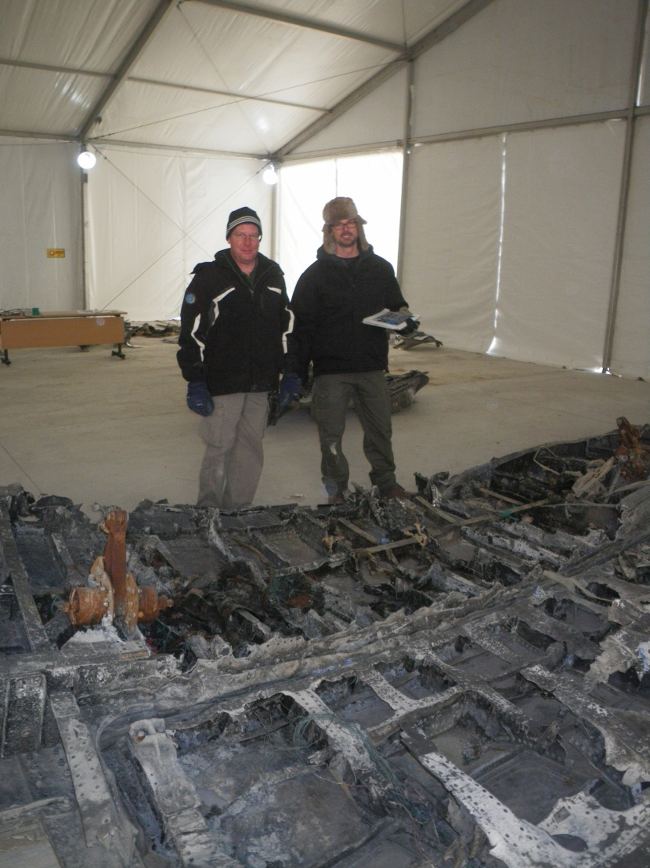
Asiana Cargo Flight 991
July 28, 2011
Boeing 747-400F
Short time between cargo fire alarm and control difficulties
smoke in the flight deck
Aircraft out of control
loss of crew and aircraft
Report completed by KARAIB

Slide 8
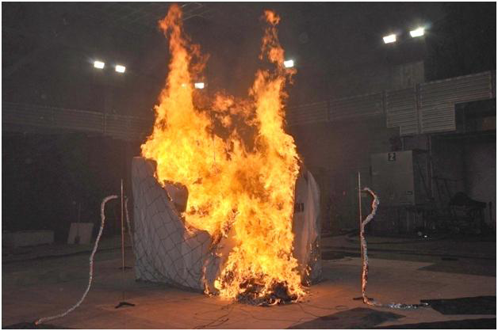
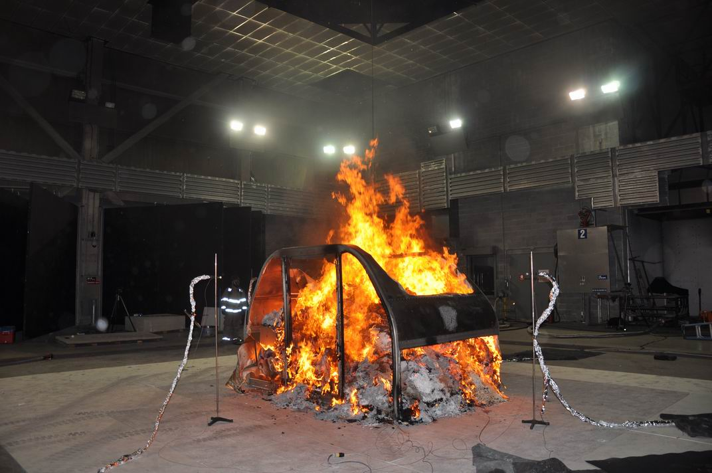
Cargo Container Fire Study
Container design impacts time to detection
Exceeds 1 min detection time regulation
Container materials can add to the fire load
Fire growth rate after becoming detectable is rapid
For information about the NTSB’s cargo container fire study (NTSB Materials Laboratory Study Report 12-019), see case number DCA10RA092 on the NTSB’s website at http://www.ntsb.gov/investigations/dms.html.
http://www.fire.tc.faa.gov/pdf/systems/Nov11Meeting/Panagiotou-1111-HeatReleaseRate.pdf

Slide 9
UPS Dubai Recommendations
Develop fire detection system performance requirements for the early detection of fires originating within cargo containers and pallets and, once developed, implement the new requirements. (A-12-68)
OPEN - ACCEPTABLE RESPONSE
Require the installation and use of active fire suppression systems in all aircraft cargo compartments or containers, or both, such that fires are not allowed to develop. (A-12-70)
OPEN - ACCEPTABLE RESPONSE

Slide 10
Work being done to address A-12-68 & A-12-70
FAATC Completed work:
Effectiveness of Fire Containment Covers (FCCs) subjected to class-A fires
Effectiveness of Fire Containment Covers (FCCs) subjected to lithium battery fires
Effectiveness of oxygen starvation in ULDs subjected to class-A fires
Effectiveness of Fire Resistant Containers (FRCs) subjected to class-A fires
Effectiveness of Fire Resistant Containers (FRCs) subjected to lithium battery fires

Slide 11
Work being done to address A-12-68 & A-12-70
FAATC work in progress:
Effectiveness of water mist systems in class-E cargo compartments
Agent penetration in Class-C cargo compartments
Class-C Cargo Compartment Halon Replacement Initiative

Slide 12
UPS Dubai Recommendations
Ensure that cargo container construction materials meet the same flammability requirements as all other cargo compartment materials in accordance with Title 14 Code of Federal Regulations 25.855. (A-12-69)
Is it cargo? Is it aircraft? Hot potato!
FAA & PHMSA unsure about who is the responsible authority
2/11/2016 FAA response letter indicates 3 possible directions:
New TSO addressing flammability requirements of polypropylene containers
Require use of fire containment covers
Require use of fire resistant containers
Update to be provided by 12/31/2016
OPEN – ACCEPTABLE RESPONSE

Slide 13
Asiana Cargo Recommendations
KARAIB determined that the cause of this accident was a fire that developed on or near two pallets containing dangerous goods.
Class 3 flammable liquids (253 gallons)
Class 9 Lithium cells and batteries (18 battery packs for hybrid-electric vehicle use ~570lb)
All the dangerous goods on the main deck were concentrated in two adjacent pallet positions near the aft portion of the aircraft.
February 9, 2016 NTSB makes recommendations to PHMSA

Slide 14
Asiana Cargo Recommendations
Segregation of hazardous materials
Require that Class 3 flammable liquids and fully regulated Class 9 lithium batteries be physically segregated when stowed on board an aircraft such that packages containing these materials may not be placed on the same or adjacent pallets or ULDs. (A-16-001)
OPEN – ACCEPTABLE RESPONSE

Slide 15
Asiana Cargo Recommendations
Maximum loading density
Establish maximum loading density requirements that restrict the quantities of Class 3 flammable hazardous materials or Class 9 lithium batteries stowed on a single pallet or ULD, or on a group of pallets or ULDs, within an aircraft such that cargo fires can be effectively managed by on-board fire suppression capabilities. (A-16-002)
OPEN - ACCEPTABLE RESPONSE

Slide 16
Summery of OPEN recommendations
Develop fire detection system performance requirements for the early detection of fires originating within cargo containers and pallets and, once developed, implement the new requirements. (A-12-68)
Ensure that cargo container construction materials meet the same flammability requirements as all other cargo compartment materials in accordance with Title 14 Code of Federal Regulations 25.855. (A-12-69)
Require the installation and use of active fire suppression systems in all aircraft cargo compartments or containers, or both, such that fires are not allowed to develop. (A-12-70)
Require that Class 3 flammable liquids and fully regulated Class 9 lithium batteries be physically segregated when stowed on board an aircraft such that packages containing these materials may not be placed on the same or adjacent pallets or ULDs. (A-16-001)
Establish maximum loading density requirements that restrict the quantities of Class 3 flammable hazardous materials or Class 9 lithium batteries stowed on a single pallet or ULD, or on a group of pallets or ULDs, within an aircraft such that cargo fires can be effectively managed by on-board fire suppression capabilities. (A-16-002)

