Slide 1
8th Triennial International Aircraft Fire and Cabin Safety Research Conference
Development of New Flammability Tests for Magnesium-Alloy Cabin Components
8th Triennial Conference on Aircraft Fire and Cabin Safety Research, Tropicana Hotel Casino, Atlantic City, NJ
Tim Marker, FAA Technical Center
October 24-27, 2016

Slide 2
Key Activities and Timeline
(2006) FAA approached by industry to discuss potential use of magnesium in aircraft
(2007) IAMFTWG Mag Task Group formed
(2007-2008) Initial Phase of Research
Discuss Threats
Potential Areas of Use
Establish Need for Threat-Based Test
Initial Lab-Scale Testing
(2008-2010) Full-Scale Testing
(2010-Present) Final Phase of Research
Lab-Scale Test Development (oil burner)
Finalize Lab-Scale Test
Lab-Scale Test Into Fire Test Handbook
Final FAA Policy
Develop In-flight Flammability Test

Slide 3
Magnesium Alloy Use in Commercial Aircraft
Industry Question: Why can’t Magnesium-Alloy be used in the construction of an
aircraft seat frame?
Regulatory Response: Current FAA TSO C-127 “Rotorcraft and Transport Airplane
Seating Systems” makes reference to SAE standard (AS8049), “Performance
Standard for Seats in Civil Rotorcraft, Transport Aircraft and General Aviation”
Para 3.3.3 states, “Magnesium alloys shall not be used.”

Slide 4
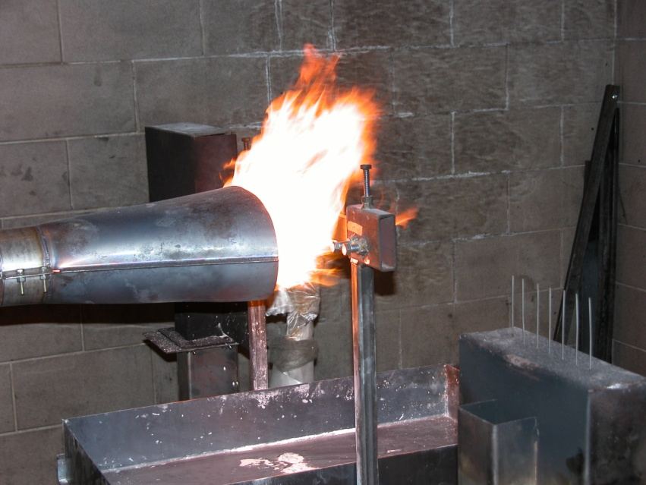
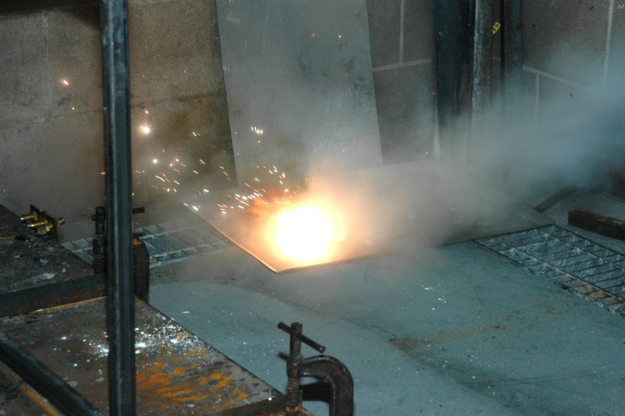
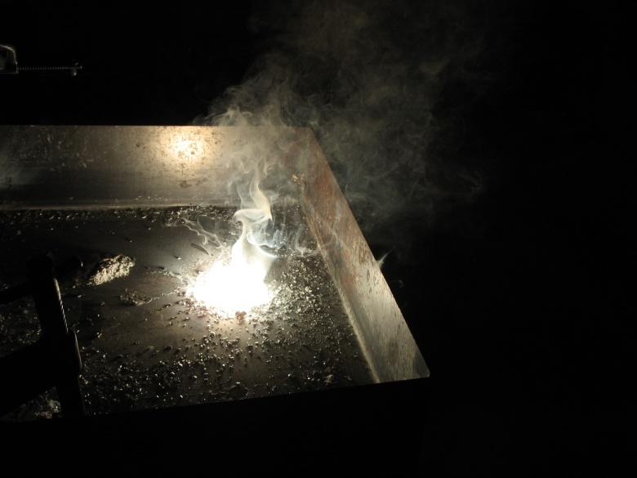
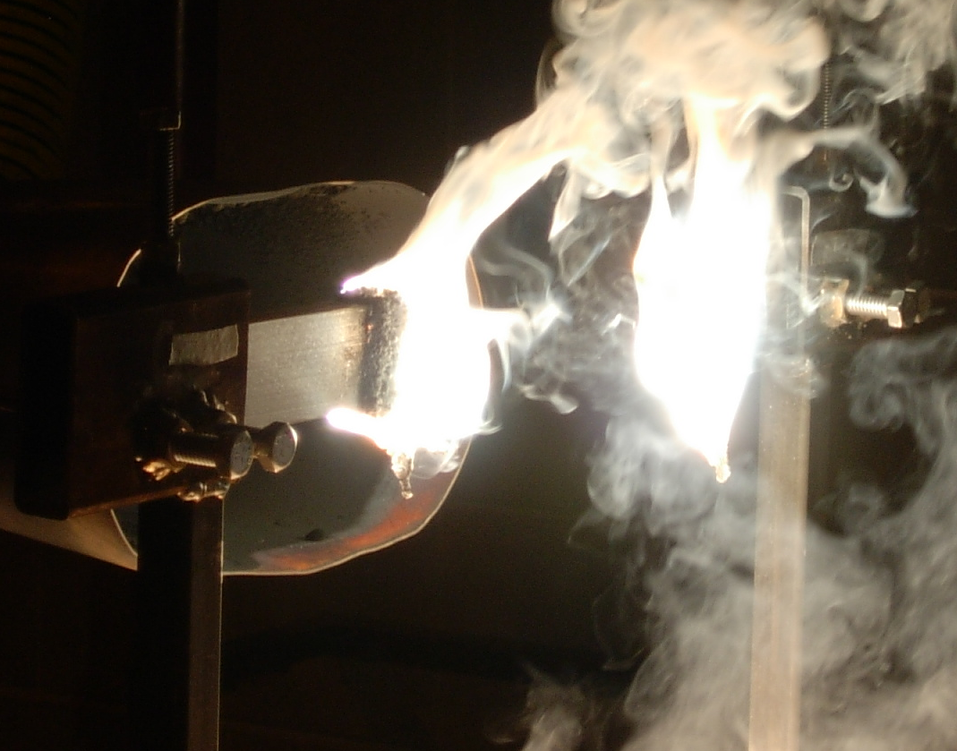
Initial Laboratory-Scale Testing (2007-2008)

Slide 5
Full-Scale Testing (2008-2010)
Method: Conduct baseline tests using OEM aluminum-framed triple seats. Tests will simulate a post-crash fire with fuselage rupture, allowing external fire to directly impact the cabin materials.
Then…
Conduct additional tests in an identical fashion using mag-alloy in the construction of the primary seat components. External fuel fire permitted to burn for 5 minutes, then internal fire permitted to burn for 5 additional minutes before applying water.
Outcome: Determine if the use of mag-alloy poses additional hazard during the
10-minute event.

Slide 6
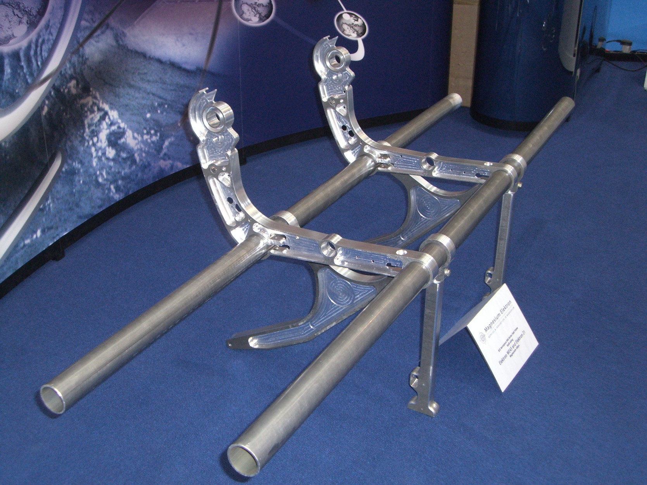
Primary Seat Components
Spreader
Leg
Cross Tube

Slide 7
Full-Scale Test Apparatus
water applied at end of all tests
(not just magnesium), for similarity

Slide 8
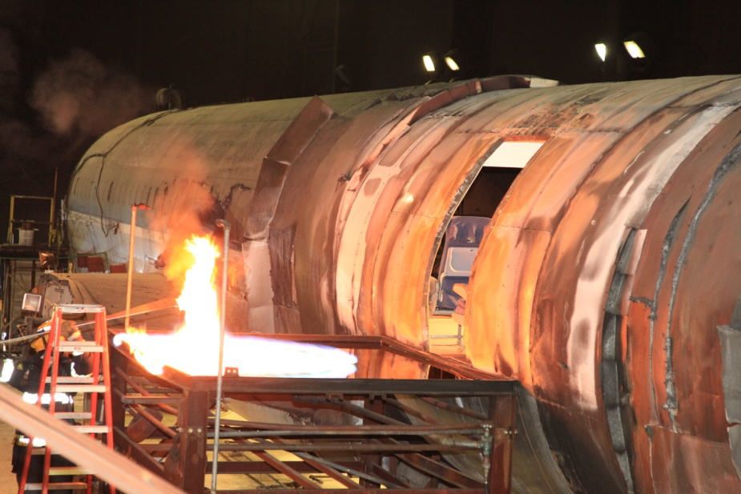
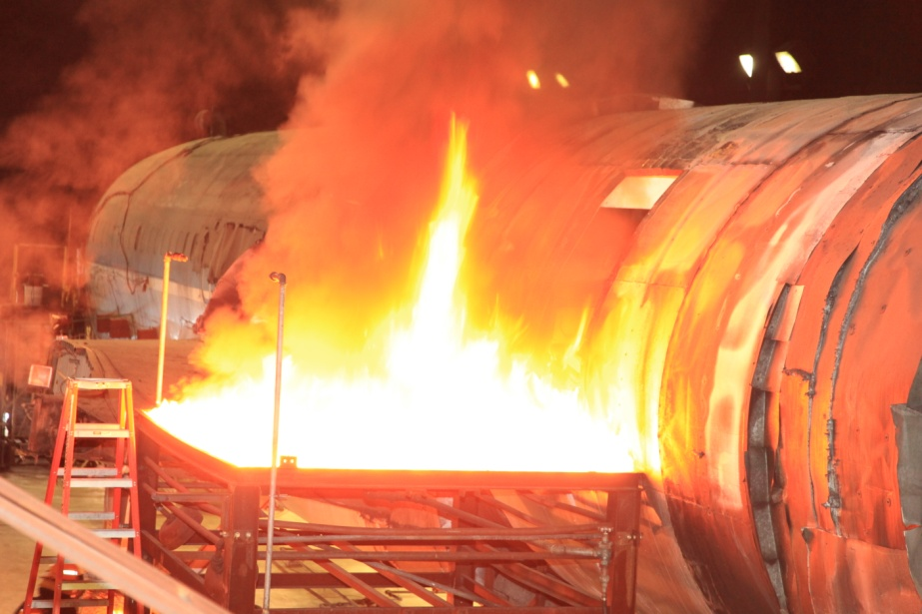
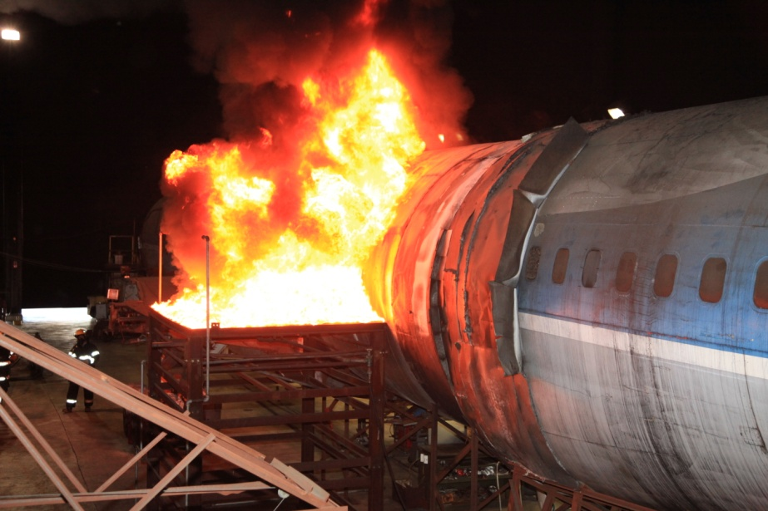
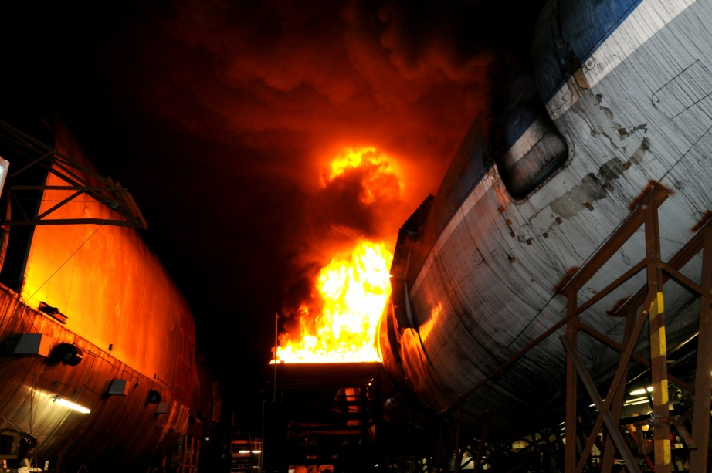
Full-Scale Testing

Slide 9
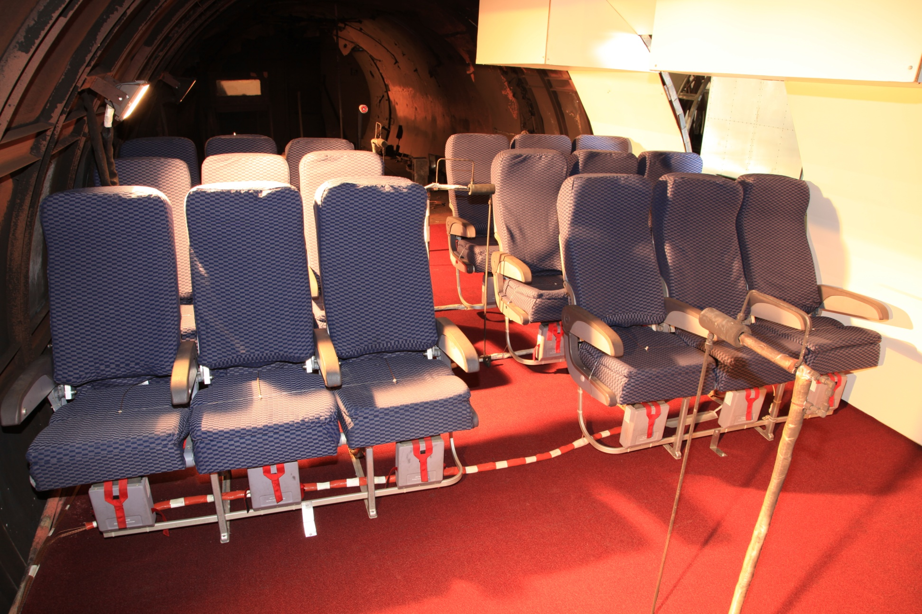
Full-Scale Test Configuration

Slide 10
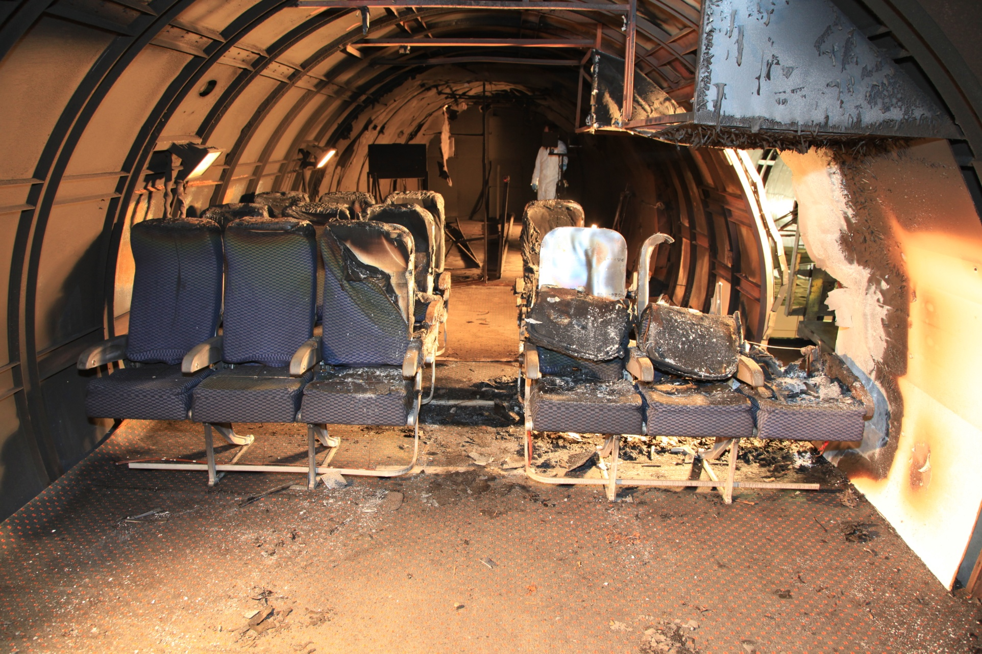
Typical Test Result

Slide 12
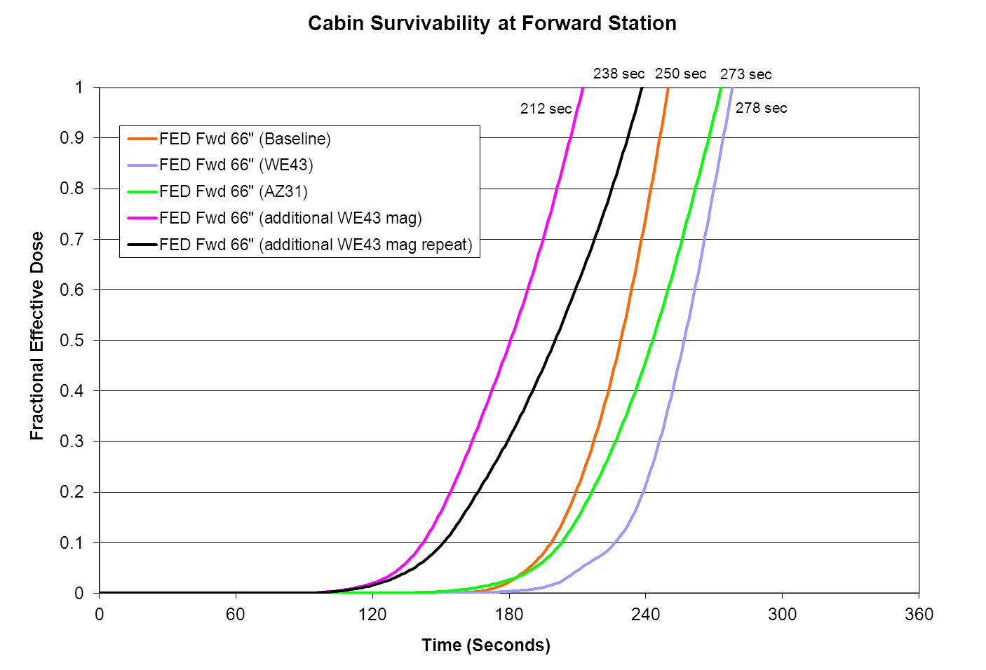

Slide 13
Full-Scale Testing Summary
Magnesium alloy components had little/no effect on survivability
Slight flashing of burning mag-alloy during water application for WE43 test
Noticeable difficulty extinguishing burning mag-alloy during AZ31 test
Incapacitation results very similar for baseline and mag-alloy tests
slightly better for mag-alloys at forward location
slightly worse for mag-alloys at mid location
More severe fire condition caused more rapid incapacitation during
“all-mag” tests

Slide 14
http://www.fire.tc.faa.gov/pdf/AR11-13.pdf

Slide 15
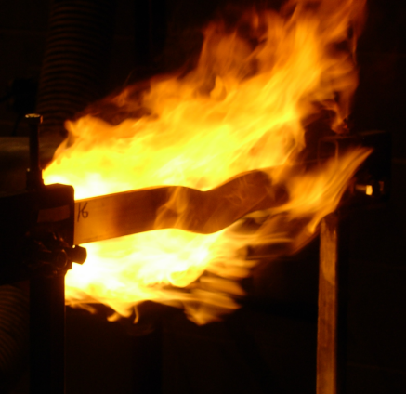
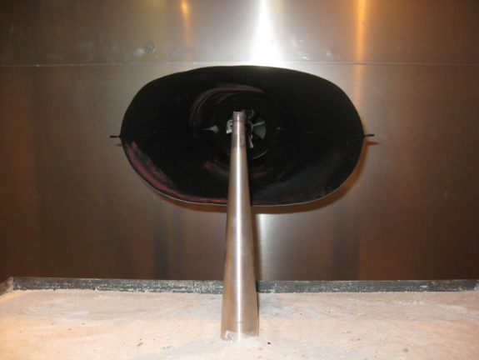
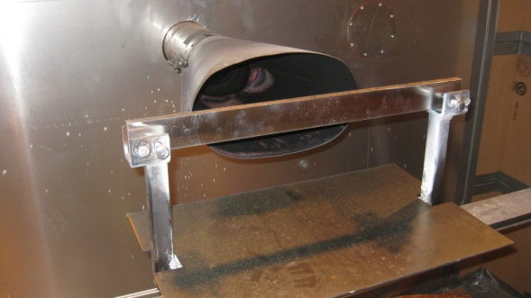
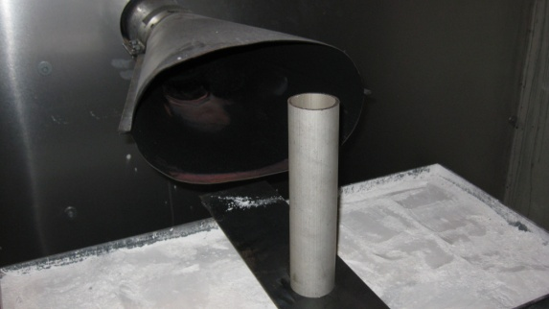
Development of a Lab-Scale Test
Horizontal Bar
Vertical Cone
Various Shapes
Shorter cones
Taller cones
Stepped cones
Rectangular stepped shape
Horizontal cylinders
Rectangular tubing horizontal
Rectangular tubing vertical
I-Webs horizontal
T-Webs horizontal
Inverted cones
Cylindrical tubes horizontal
Cylindrical tubes vertical
Spring 2007
Spring 2011
Horizontal Bar
Hollow Cylinder
Spring 2012
Summer 2011

Slide 16
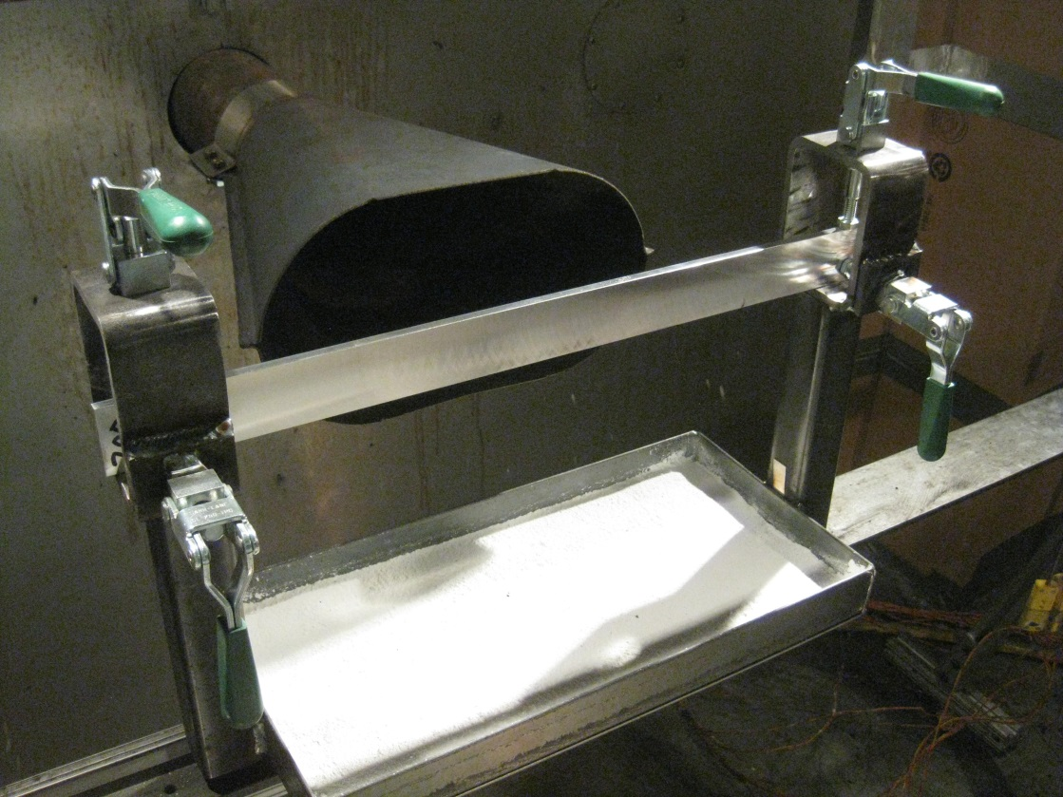
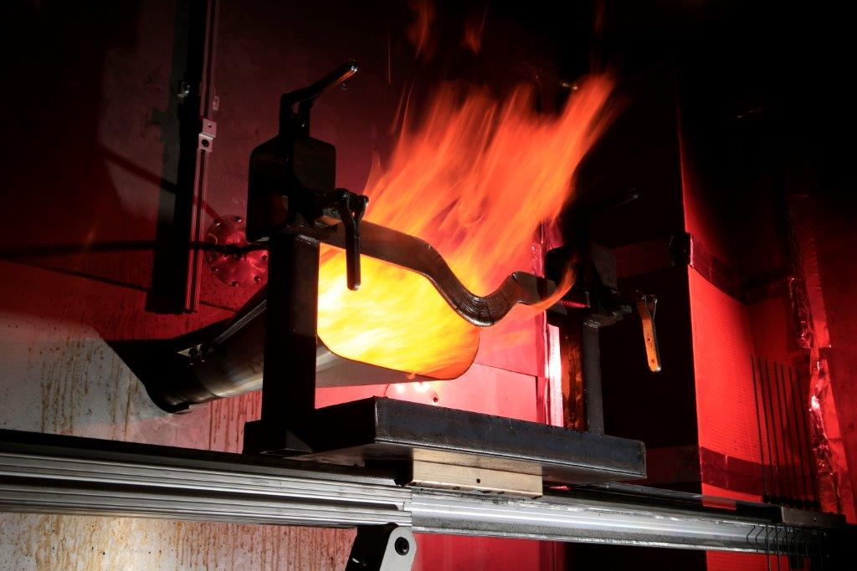
Magnesium Alloy Flammability Testing Rig

Slide 17
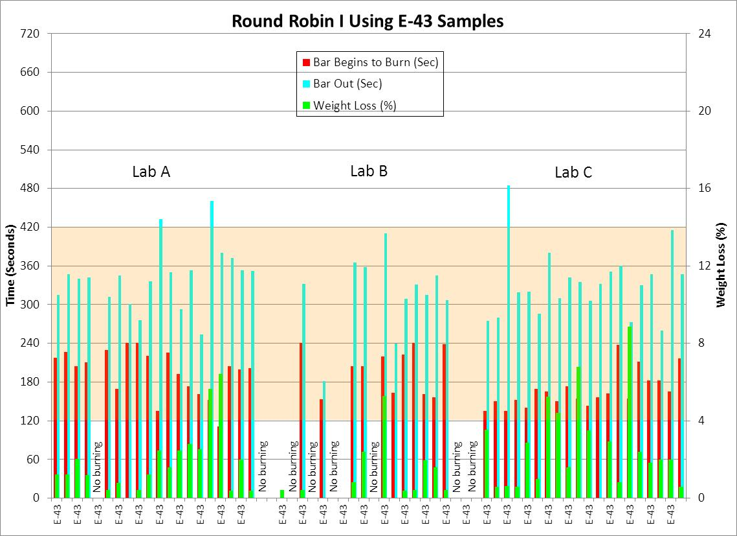
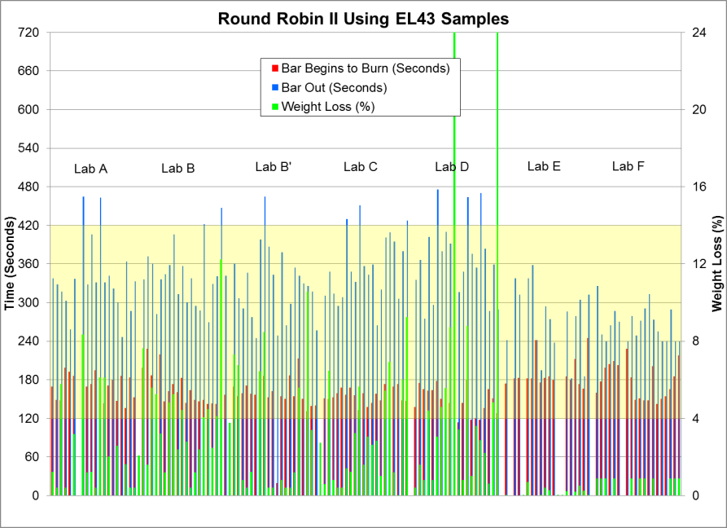
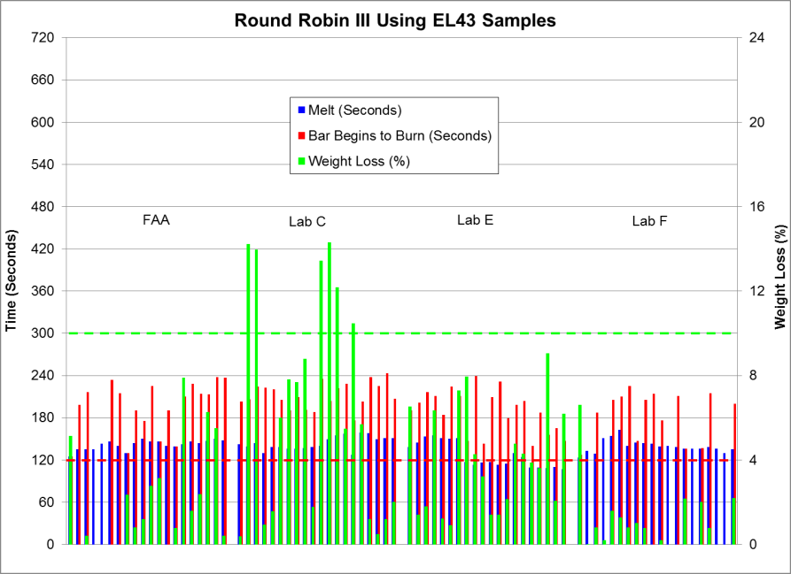
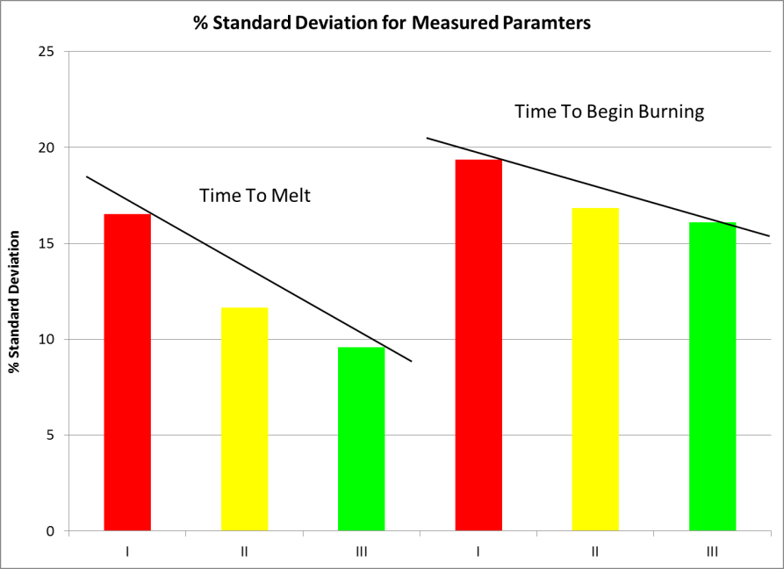
Inter-Laboratory Studies (2013-2015)
I
II
III

Slide 18
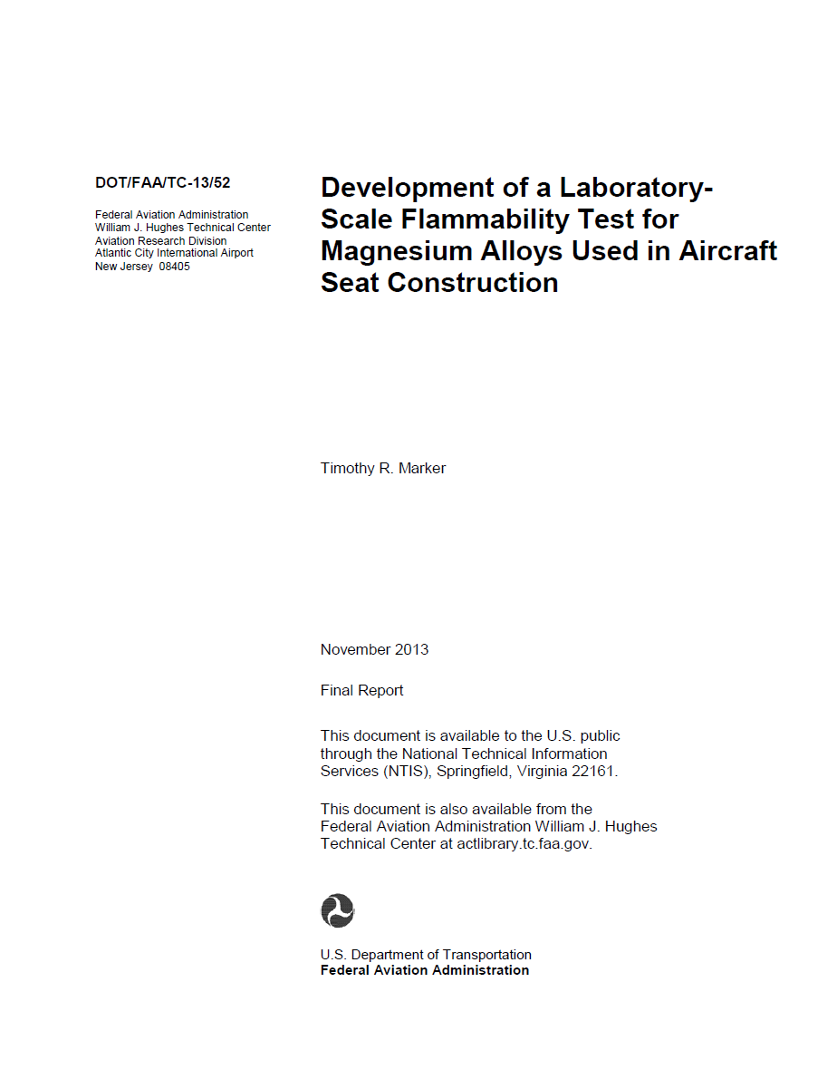
https://www.fire.tc.faa.gov/pdf/TC-13-52.pdf

Slide 19

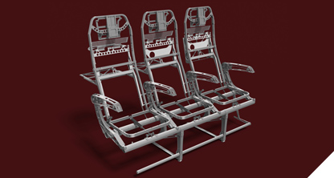
The Use of Magnesium Alloy in Cabin Areas
What is the appropriate method of test?
Use in 5 primary
seat components
Use in other non-primary
seat components
Use in other
cabin components
Oil Burner
Seatback frame
Spreaders
Legs
Crosstubes
Luggage bar

Slide 20
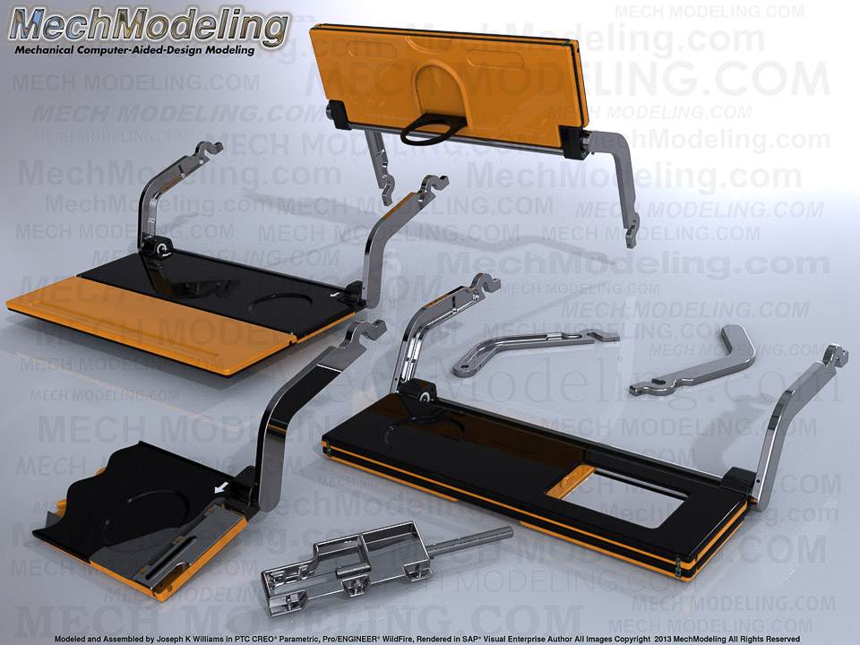
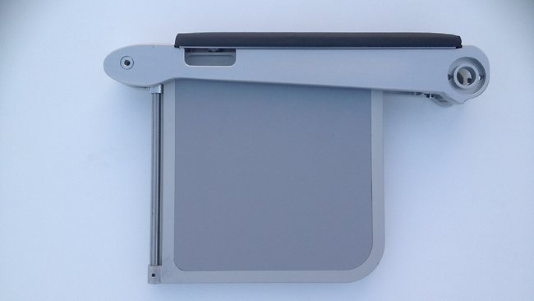
Non-Primary Seat Components
tray table arms
tray tables
hardware

Slide 21

Non-Primary Seat Components
What is the appropriate method of test, since these components were not
represented during full-scale tests?
Consider surface area-to-volume (SAV) ratio…
Higher SAV
Higher Probability of Ignition
Lower SAV
Lower Probability of Ignition
SAV Ratio = 2.2
SAV Ratio = 63.1

Slide 22

Surface Area-to-Volume (SAV) Ratios of Seat Components
SAV ratio solid component ≤ 20
SAV ratio hollow component ≤ 40

Slide 23
The Use of Magnesium Alloy in Cabin Areas
What is the appropriate method of test?
Use in 5 primary
seat components
Use in other non-primary
seat components
Use in other
cabin components
Oil Burner
Oil Burner
SAV ratio req
Accessible
Below seat height
Accessible
Above seat height
Inaccessible

Slide 24
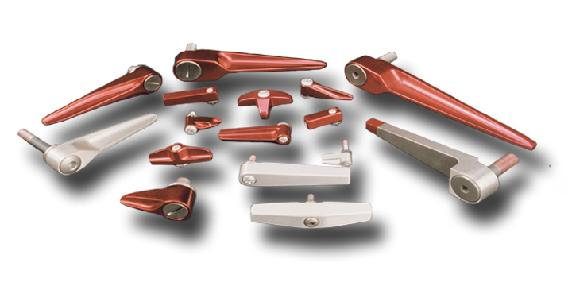
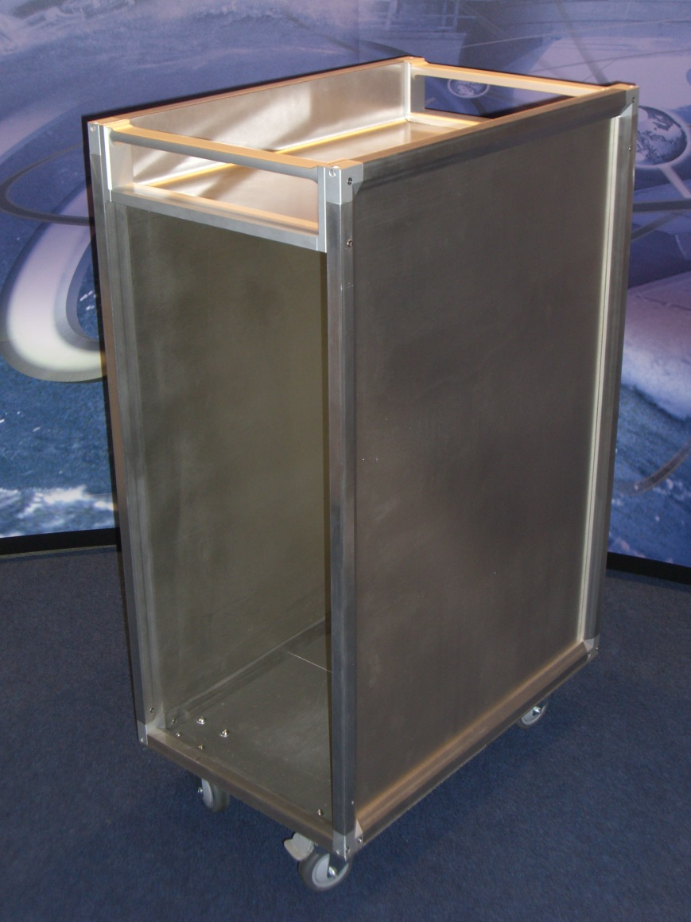
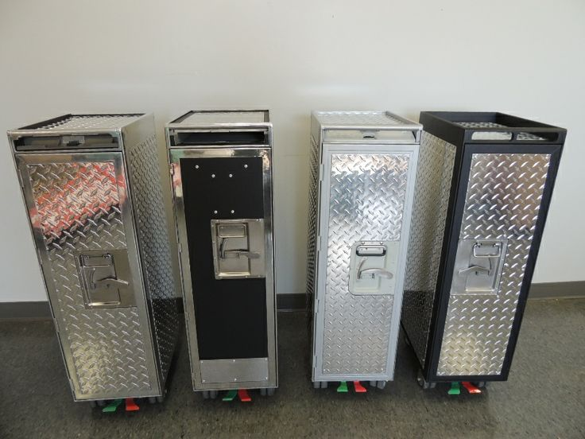
Accessible Components Below Seatback Height

Slide 25
The Use of Magnesium Alloy in Cabin Areas
What is the appropriate method of test?
Use in 5 primary
seat components
Use in other non-primary
seat components
Use in other
cabin components
Oil Burner
Oil Burner
SAV ratio req
Accessible
Below seat height
Accessible
Above seat height
Inaccessible
Oil Burner
SAV ratio req

Slide 26
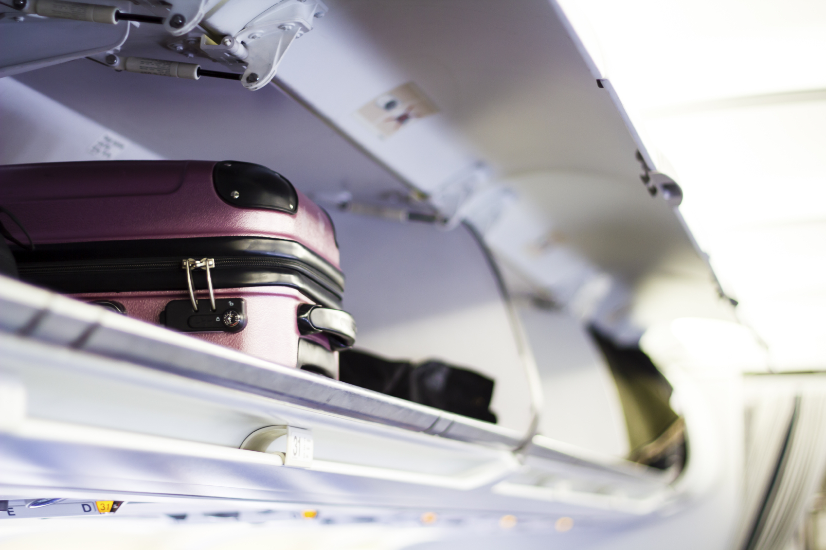
Accessible Components Above Seatback Height

Slide 27
The Use of Magnesium Alloy in Cabin Areas
What is the appropriate method of test?
Use in 5 primary
seat components
Use in other non-primary
seat components
Use in other
cabin components
Oil Burner
Oil Burner
SAV ratio req
Accessible
Below seat height
Accessible
Above seat height
Inaccessible
Oil Burner
Oil Burner
?
Ignition/Self
Extinguishment
SAV ratio req
SAV ratio req
?
?
Run full-scale test

Slide 28
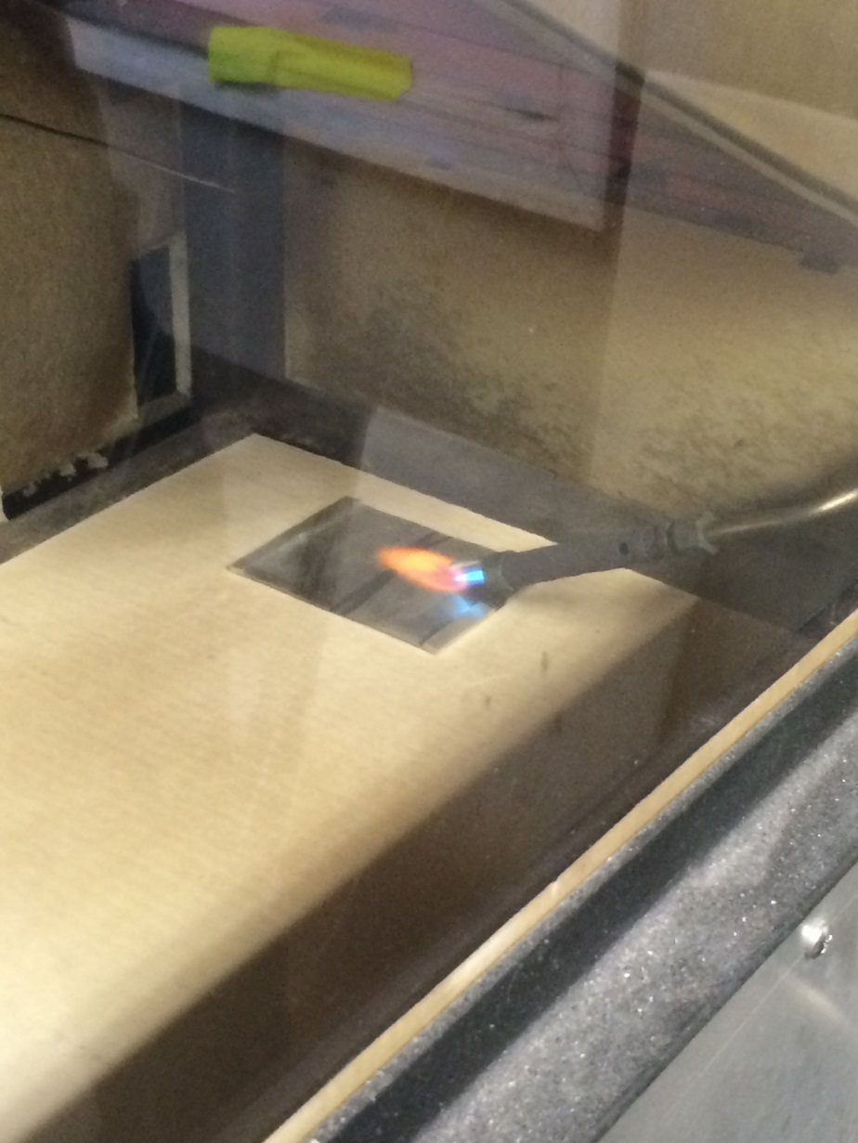
Testing of Thin Magnesium Sheet in Radiant Panel
Electrical arc testing
Initial Testing:
3- by 4-inch sample size
3- by 3-inch sample size
3- by 6-inch sample size
Objective: force ignition of sample, and
determine it’s ability to self extinguish

Slide 29
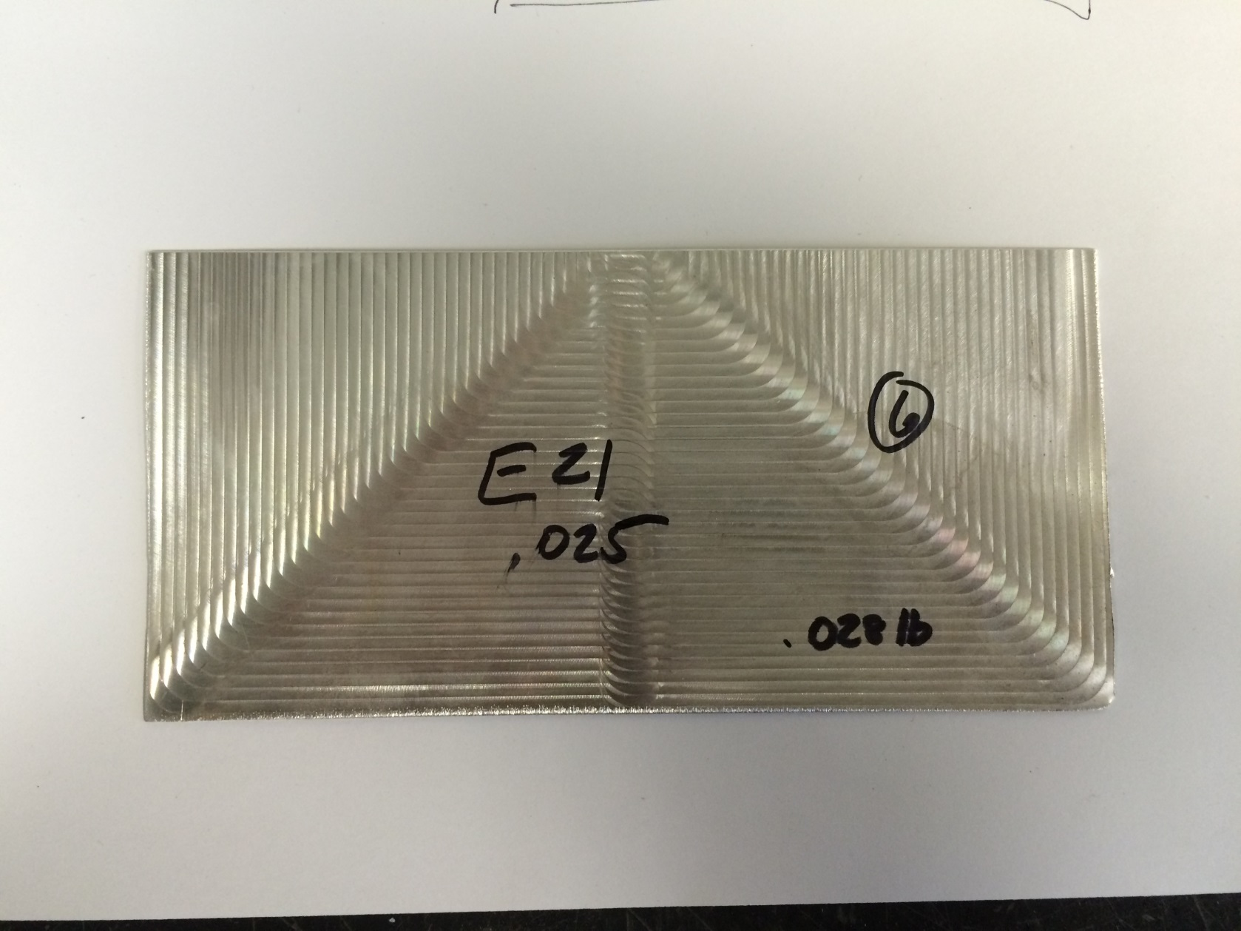
3- by 6-inch Thin Magnesium Sample
Initial piloted ignition
Burn

Slide 30
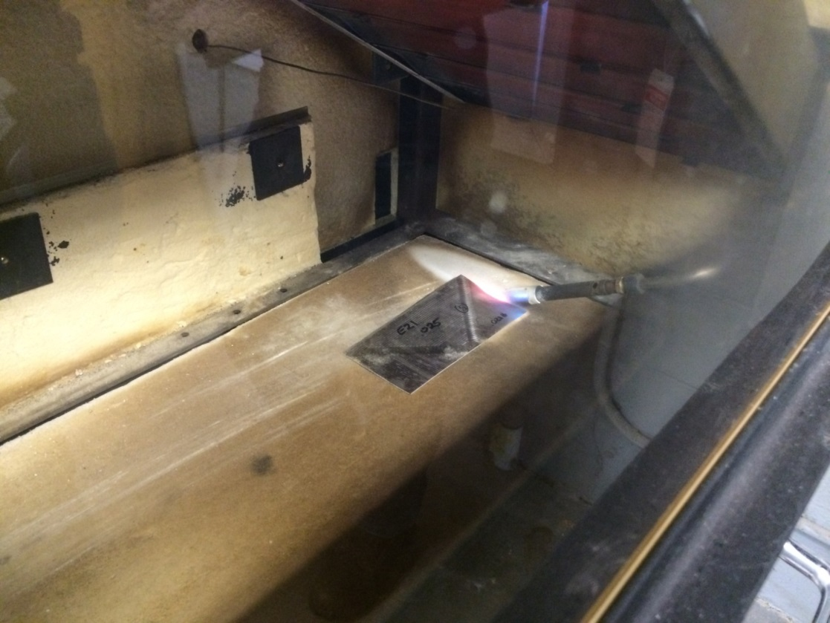
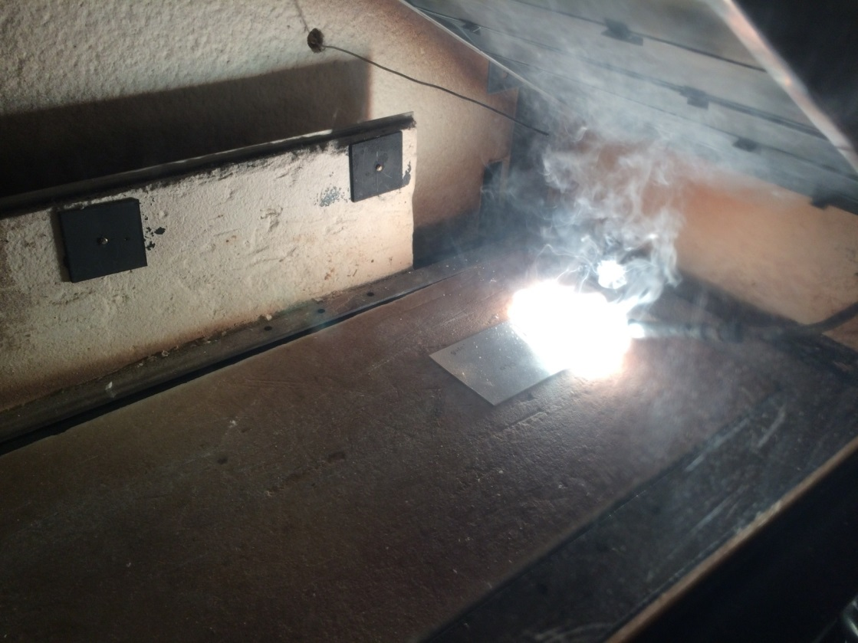
3- by 6-inch Thin Magnesium Sample

Slide 31
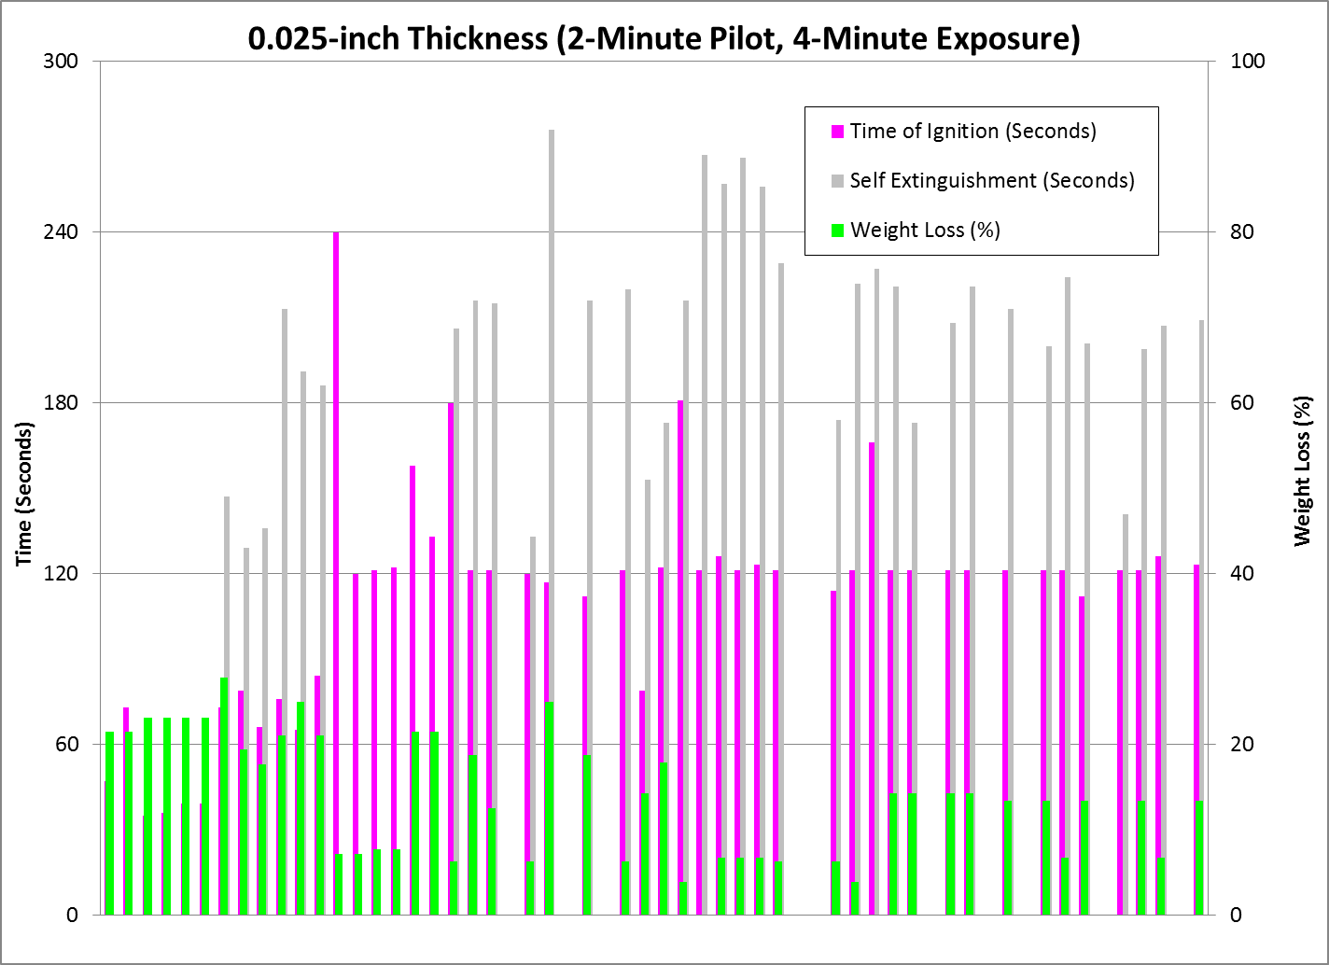

Slide 32
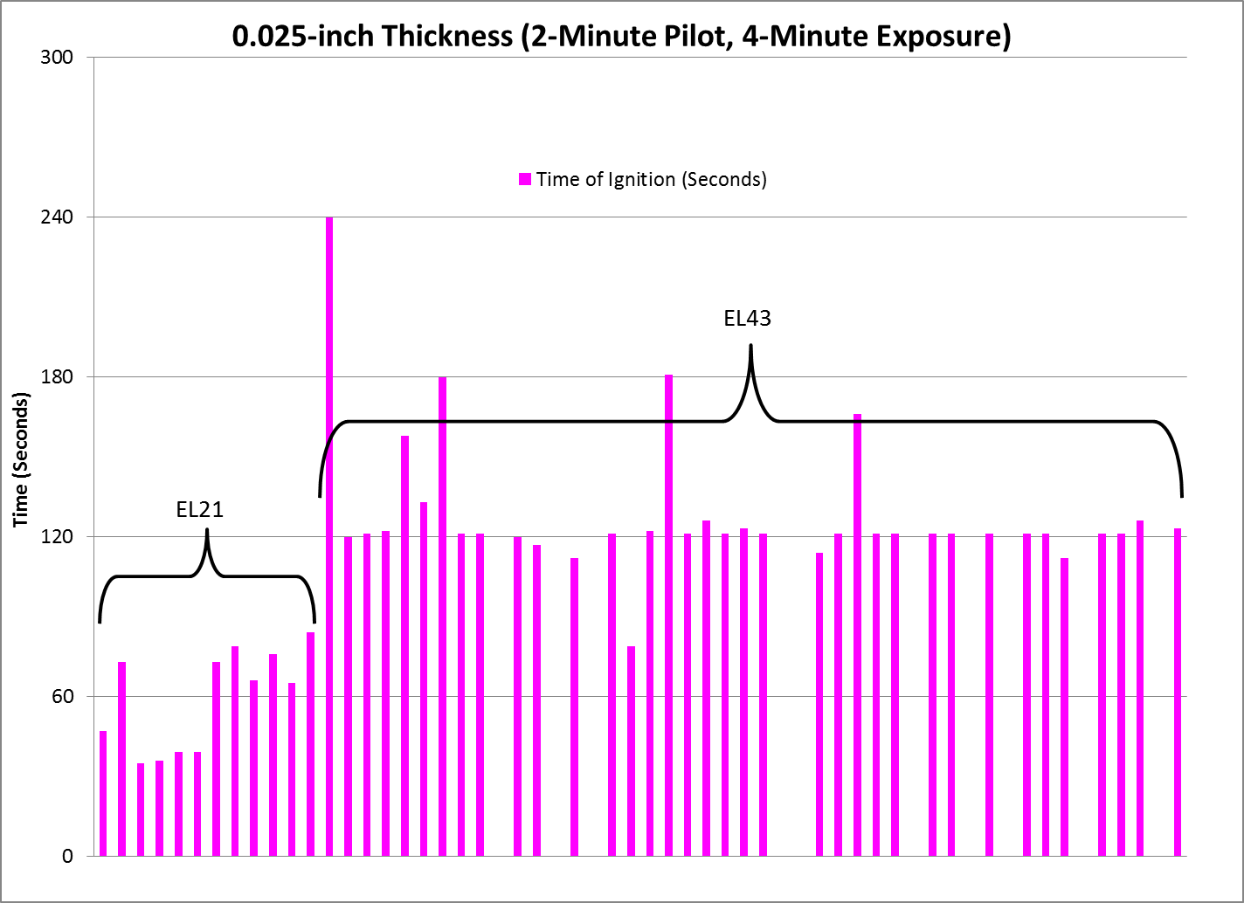

Slide 33
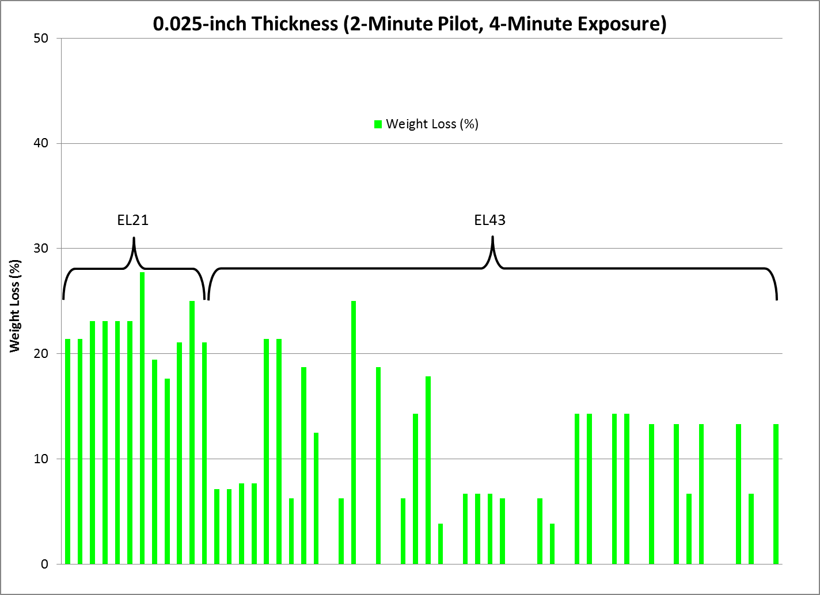

Slide 34
Results of 3- by 6-inch Magnesium Sample Testing
When using 3- by 6-inch sample size, good separation between good and poor alloys
Difficult to ignite 0.050-inch sample thickness; 0.025-inch thickness more appropriate
Increased sample length allows sample the opportunity to self extinguish
Ignition often occurs as pilot flame is removed
Time of ignition may not be important, provided the sample demonstrates ability to
self-extinguish
Weight loss consistent per alloy, between 5 and 30%
Weight loss more accurate assessment of amount of burning

Slide 35
Wrap-Up, Conclusions, Future Work
Finalize test parameters and pass/fail criteria for magnesium alloy components
located in inaccessible areas:
Radiant Panel Apparatus, 3- by 6-inch sample size, 0.025-inch thickness
No ignition before 60 seconds (proposed)
Maximum weight loss of 30% (proposed)
Investigate use of sample holder to prevent thin test samples from curling or lifting.
Discuss use of magnesium alloy components located in accessible areas that are
situated higher than seat back height. Is there a need to conduct full-scale tests?

Slide 36
Questions?

