Slide 1
Smoke transport modeling: detection system design
Changmin Cao, Kalyan Gottiparthi, Jordan Snyder, Jason Wegge, Vaidya Sankaran, May Corn
United Technologies Research Center
Amanda Daly, Kenneth Bell, Terry Simpson, Eli Baldwin
Kidde Fire Protection Systems
9th Triennial International Aircraft Fire and Cabin Safety Research Conference
October 28-31, 2019
Atlantic City, New Jersey, USA

Slide 2
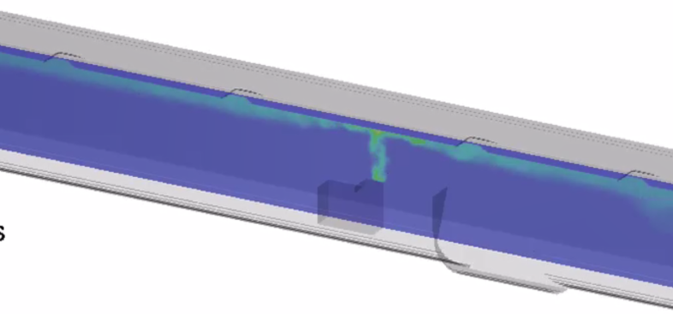
Detection system design tool development
augment and streamline detection system certification process
Benefits:
Virtual tests
Parametric variations
Physical insight
Accelerate design & development
Provide confidence in detection system layout
Reduce number of flight certification tests
Reduce cost of certification
© 2019 Collins Aerospace, a United Technologies company. All rights reserved.
9th Triennial International Aircraft Fire and Cabin Safety Research Conference, October 28-31, 2019, Atlantic City, New Jersey, USA

Slide 3
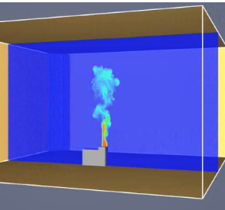
Model Development approach
Validate models in a
laboratory setting
Today’s Presentation
Modeling approach validated to date:
Smoke generator input conditions
Buoyant plume
Ceiling jet flow
Additional models to validate:
Smoke arrival time
Detector response time
(2) Apply validated models
to the cargo bay
Pre-Test Prediction of System Response in Cargo Bay
© 2019 Collins Aerospace, a United Technologies company. All rights reserved.
9th Triennial International Aircraft Fire and Cabin Safety Research Conference, October 28-31, 2019, Atlantic City, New Jersey, USA

Slide 4
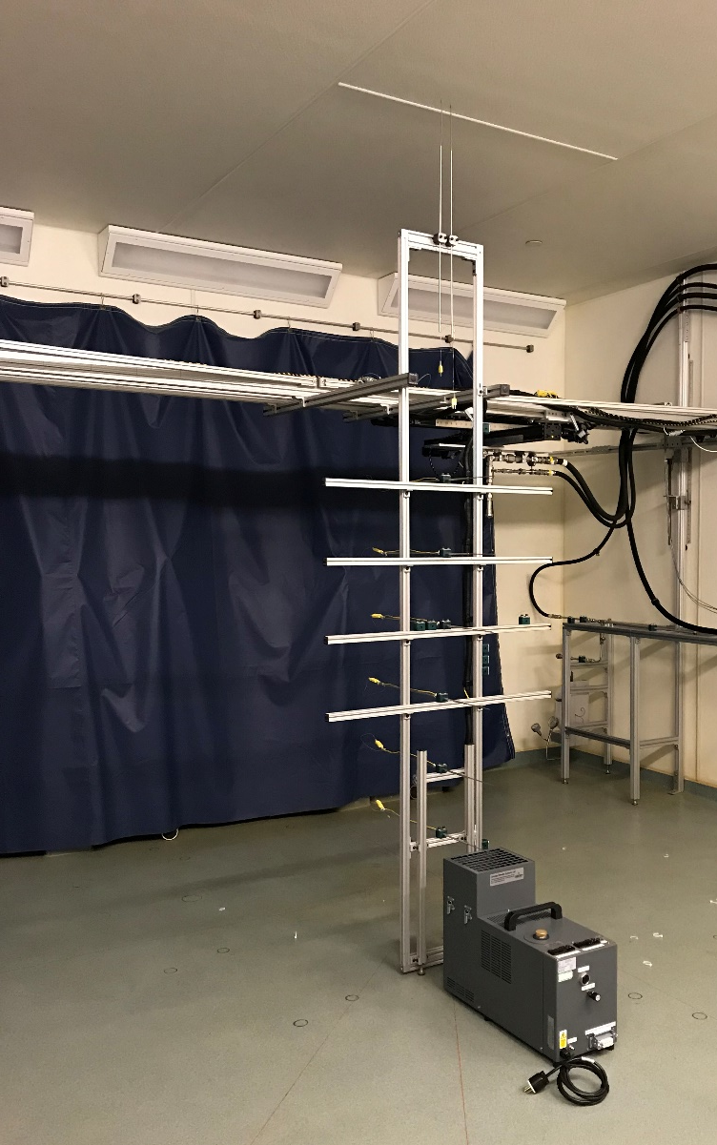
alarm time measurements: UTRC Lab
Detector
3
2
Smoke arrival time
Determined from the time lag between obscuration beam measurements &
1
2
Detector response time
Determined from the obscuration beam measurement and the time when detector alarms
1
2
3
© 2019 Collins Aerospace, a United Technologies company. All rights reserved.
9th Triennial International Aircraft Fire and Cabin Safety Research Conference, October 28-31, 2019, Atlantic City, New Jersey, USA

Slide 5
CFD model set-Up: UTRC LAb
Fire Dynamics Simulator (FDS)
3-D, unsteady solver from NIST (version 6.6.0) Large Eddy Simulation (LES)
Numerical simulation using a non-uniform sized mesh
Input conditions: measured at smoke generator exit plane
Detector response model: calibrated to detector
© 2019 Collins Aerospace, a United Technologies company. All rights reserved.
9th Triennial International Aircraft Fire and Cabin Safety Research Conference, October 28-31, 2019, Atlantic City, New Jersey, USA

Slide 6
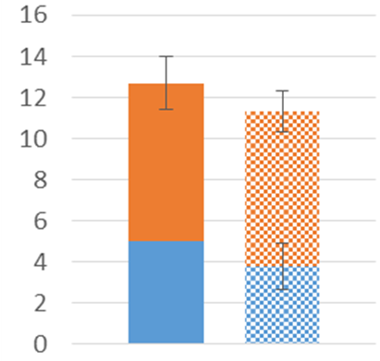
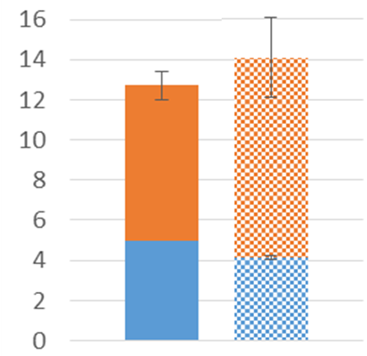
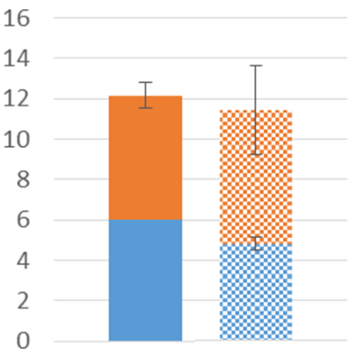
Validation of smoke transport & detector response models with lab data
Low smoke mass flow
Low ceiling
Mid smoke mass flow
Low ceiling
High smoke mass flow
High ceiling
Time to alarm (sec)
Detector response time
Smoke arrival time
Model Exp. Data
Model Exp. Data
Model Exp. Data
Simulation predicts within 2-3 seconds of measured data
Next step: Apply modeling approach to the cargo bay
© 2019 Collins Aerospace, a United Technologies company. All rights reserved.
9th Triennial International Aircraft Fire and Cabin Safety Research Conference, October 28-31, 2019, Atlantic City, New Jersey, USA

Slide 7
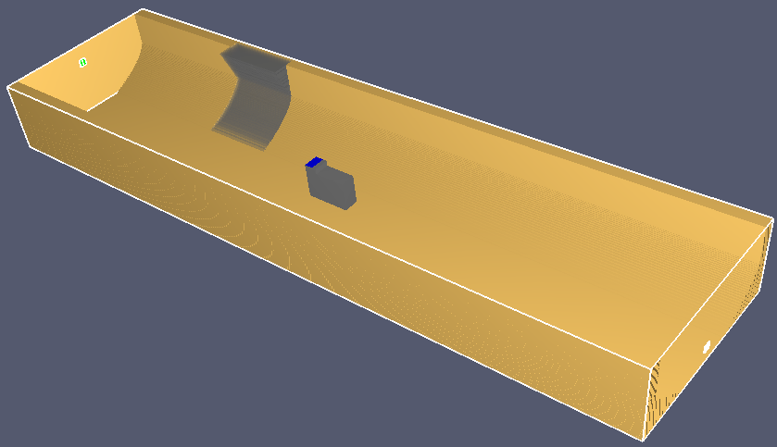
CFD model set-Up: cargo bay
Fire Dynamics Simulator (FDS)
3-D, unsteady solver from NIST (version 6.6.0) Large Eddy Simulation (LES)
Simulation using Non-uniform sized mesh
Utilized same smoke generator input conditions and calibrated detector response model used in UTRC lab simulation
© 2019 Collins Aerospace, a United Technologies company. All rights reserved.
9th Triennial International Aircraft Fire and Cabin Safety Research Conference, October 28-31, 2019, Atlantic City, New Jersey, USA

Slide 8
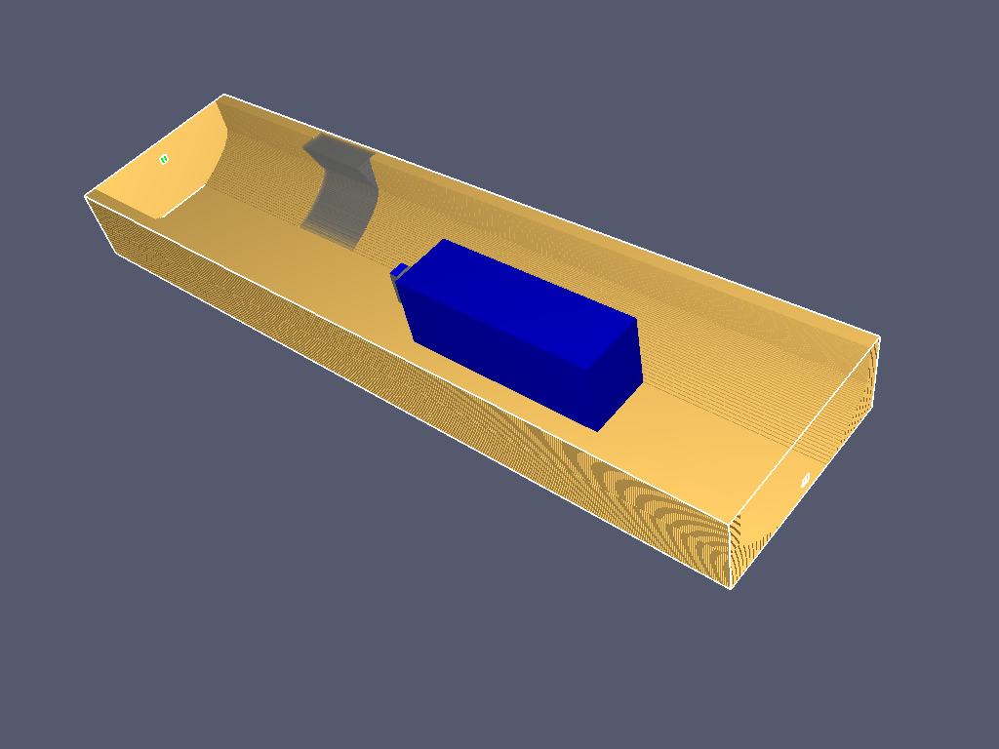
Simulation matrix variables
Ventilation Schedule
Obstruction
Inlet vent
Outlet vent
Smoke Generator Positions
Door
Inlet vent
D4
D3
D2
D1
Outlet vent
SG1
SG2
SG3
SG4
SG5
Obstruction location
© 2019 Collins Aerospace, a United Technologies company. All rights reserved.
9th Triennial International Aircraft Fire and Cabin Safety Research Conference, October 28-31, 2019, Atlantic City, New Jersey, USA

Slide 9
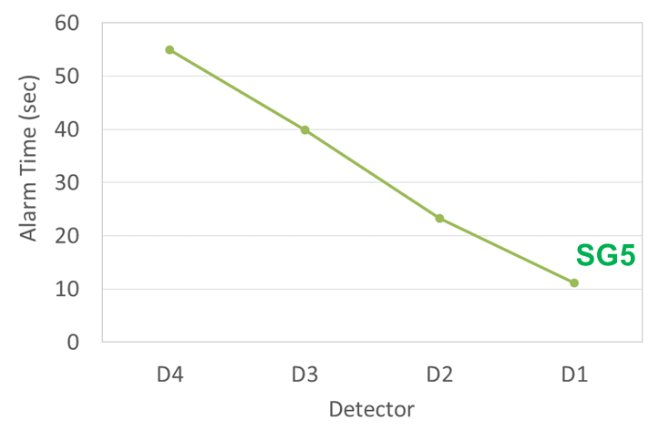
smoke transport & alarm time: empty cargo bay
- Smoke generator located toward one end of the cargo bay
- No ventilation
D4
D3
D2
D1
0.0
Smoke mass fraction
1.0
from simulation
SG5
Simulated smoke propagation
Alarm time for each detector from simulation
© 2019 Collins Aerospace, a United Technologies company. All rights reserved.
9th Triennial International Aircraft Fire and Cabin Safety Research Conference, October 28-31, 2019, Atlantic City, New Jersey, USA

Slide 10
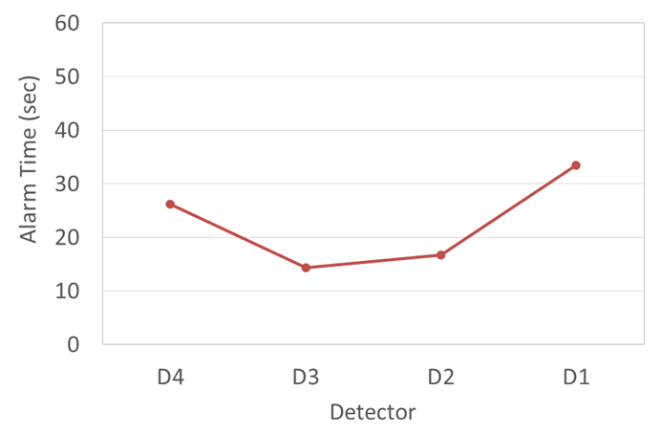
smoke transport & alarm time: empty cargo bay
- Smoke generator located in the center of the cargo bay
- No ventilation
D4
D3
D2
D1
0.0
Smoke mass fraction
1.0
SG3
from simulation
SG3
Simulated smoke propagation
Alarm time for each detector from simulation
© 2019 Collins Aerospace, a United Technologies company. All rights reserved.
9th Triennial International Aircraft Fire and Cabin Safety Research Conference, October 28-31, 2019, Atlantic City, New Jersey, USA

Slide 11
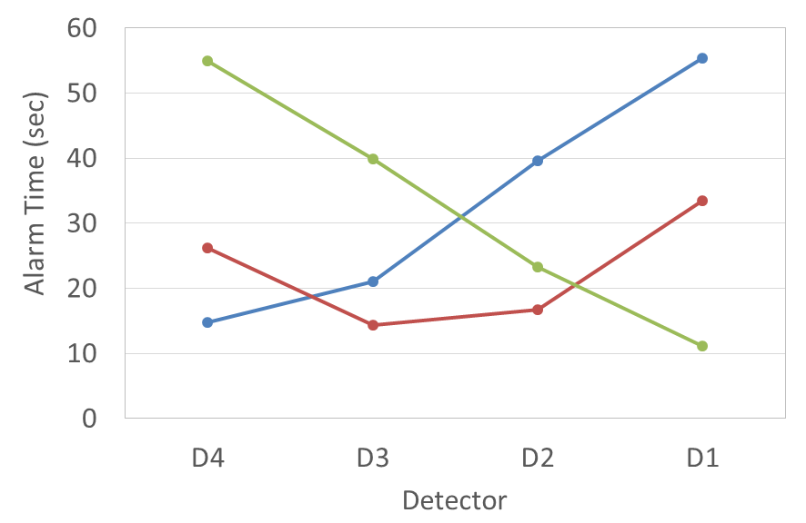
smoke transport & alarm time: empty cargo bay
Simulations predict expected trends in detector alarm time
D4
D3
D2
D1
SG1
SG2
SG3
SG4
SG5
SG1
SG3
SG5
Alarm time for each detector from simulations
© 2019 Collins Aerospace, a United Technologies company. All rights reserved.
9th Triennial International Aircraft Fire and Cabin Safety Research Conference, October 28-31, 2019, Atlantic City, New Jersey, USA

Slide 12
empty cargo bay — Effect of ventilation
inlet air initially pushes against smoke transported across ceiling
No ventilation
Inlet vent
With ventilation
SG3
SG3
Outlet vent
Simulated smoke propagation
Simulated smoke propagation
© 2019 Collins Aerospace, a United Technologies company. All rights reserved.
9th Triennial International Aircraft Fire and Cabin Safety Research Conference, October 28-31, 2019, Atlantic City, New Jersey, USA

Slide 13
empty cargo bay — Effect of ventilation
inlet air initially pushes against smoke transported across ceiling
D4
D3
D2
D1
No ventilation
SG3
With ventilation
SG3
0.0
1.0
Smoke mass fraction
from simulation
© 2019 Collins Aerospace, a United Technologies company. All rights reserved.
9th Triennial International Aircraft Fire and Cabin Safety Research Conference, October 28-31, 2019, Atlantic City, New Jersey, USA

Slide 14
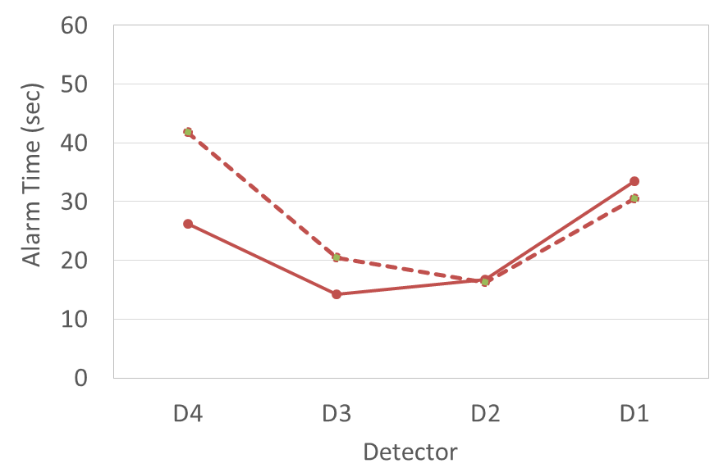
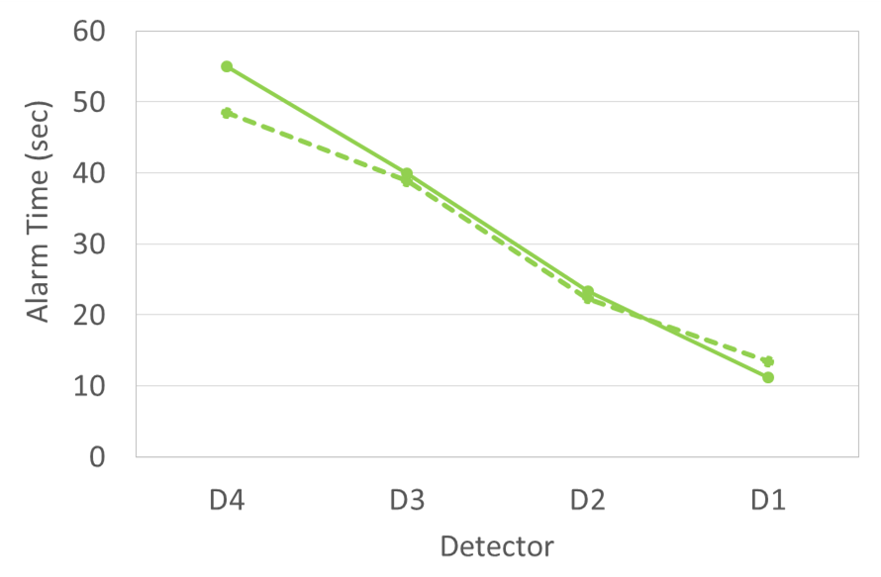
empty cargo bay — Effect of ventilation
Ventilation effect on smoke transport depends on smoke generator position
D4
D3
D2
D1
Inlet vent
Outlet vent
SG1
SG2
SG3
SG4
SG5
SG5
SG3 With ventilation schedule
SG5 with ventilation schedule
SG3
Alarm time for each detector from simulations
© 2019 Collins Aerospace, a United Technologies company. All rights reserved.
9th Triennial International Aircraft Fire and Cabin Safety Research Conference, October 28-31, 2019, Atlantic City, New Jersey, USA

Slide 15
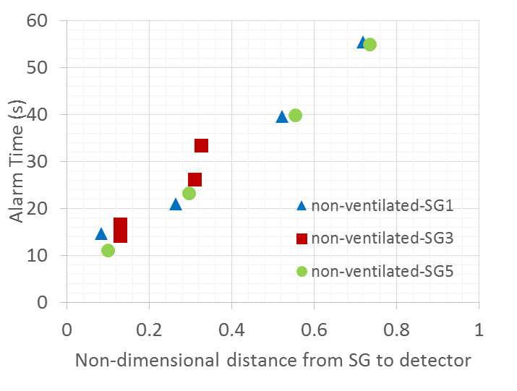
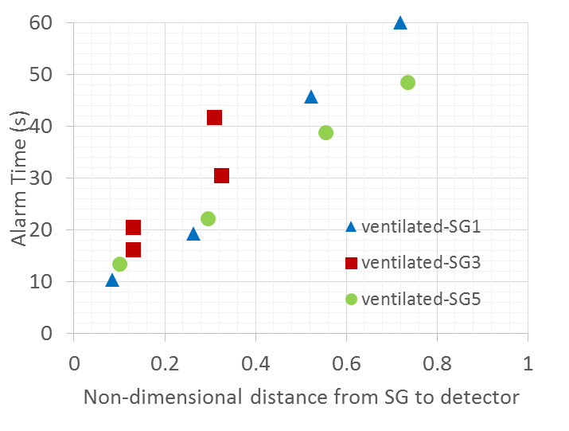
Analysis of empty cargo bay results
Alarm times versus distance between smoke generator and detector
Empty cargo bay
Empty cargo bay with ventilation schedule
Detection time > 60 sec
Alarm time for each detector from simulations
Alarm time for each detector from simulations
Ventilation introduces additional flow field dynamics that cause non-linear deviations
© 2019 Collins Aerospace, a United Technologies company. All rights reserved.
9th Triennial International Aircraft Fire and Cabin Safety Research Conference, October 28-31, 2019, Atlantic City, New Jersey, USA

Slide 16
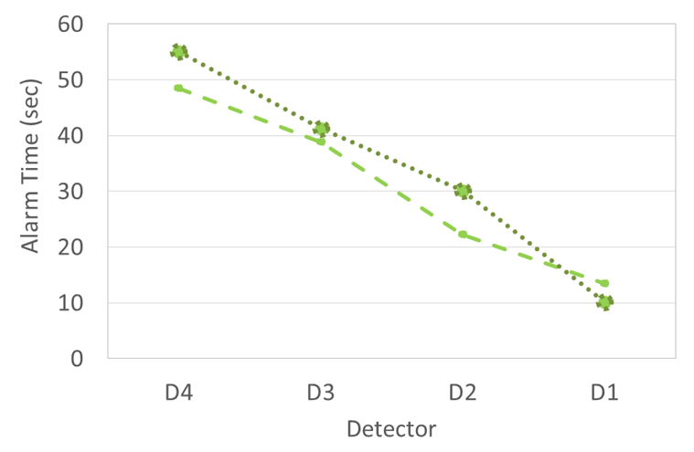
Ventilated Cargo bay with obstruction
- Smoke generator located toward one end of the cargo bay
D4
D3
D2
D1
Inlet vent
SG5
0.0
Smoke mass fraction
1.0
from simulation
SG5 + ventilation schedule + obstruction
SG5 with ventilation schedule
SG5
Outlet vent
Simulated smoke propagation
Alarm time for each detector from simulation
© 2019 Collins Aerospace, a United Technologies company. All rights reserved.
9th Triennial International Aircraft Fire and Cabin Safety Research Conference, October 28-31, 2019, Atlantic City, New Jersey, USA

Slide 17
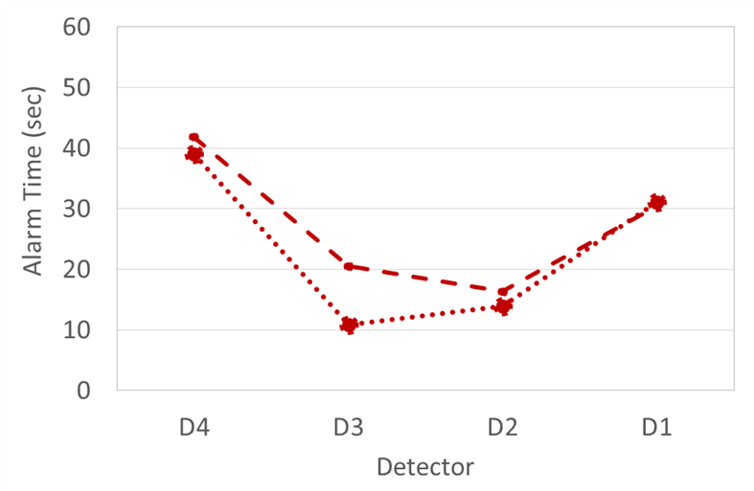
Ventilated Cargo bay with obstruction
- Smoke generator located in the center of the cargo bay
Inlet vent
D4
D3
D2
D1
SG3
0.0
Smoke mass fraction
1.0
from simulation
SG3
SG3 with ventilation schedule
Outlet vent
SG3 + ventilation schedule + obstruction
Simulated smoke propagation
Alarm time for each detector from simulation
© 2019 Collins Aerospace, a United Technologies company. All rights reserved.
9th Triennial International Aircraft Fire and Cabin Safety Research Conference, October 28-31, 2019, Atlantic City, New Jersey, USA

Slide 18
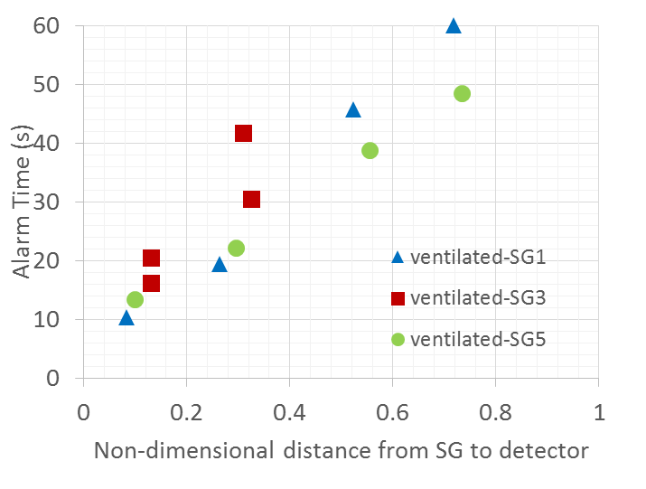
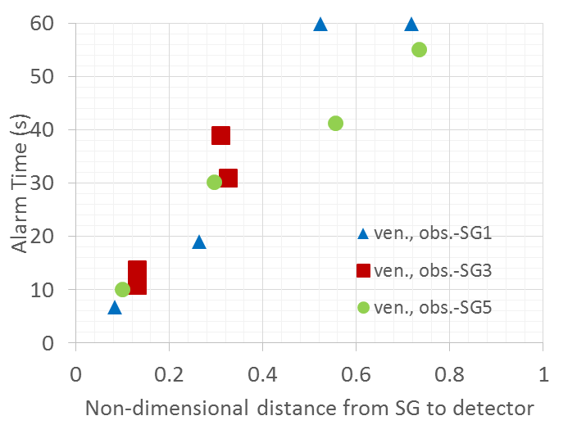
Analysis of cases with obstruction
Alarm times versus distance between smoke generator and detector
Ventilated cargo bay, no obstruction
Ventilated cargo bay with obstruction
Detection time > 60 sec
Detection times > 60 sec
Alarm time for each detector from simulations
Alarm time for each detector from simulations
Obstruction can additionally affect smoke transport and subsequently the detector alarm time
© 2019 Collins Aerospace, a United Technologies company. All rights reserved.
9th Triennial International Aircraft Fire and Cabin Safety Research Conference, October 28-31, 2019, Atlantic City, New Jersey, USA

Slide 19
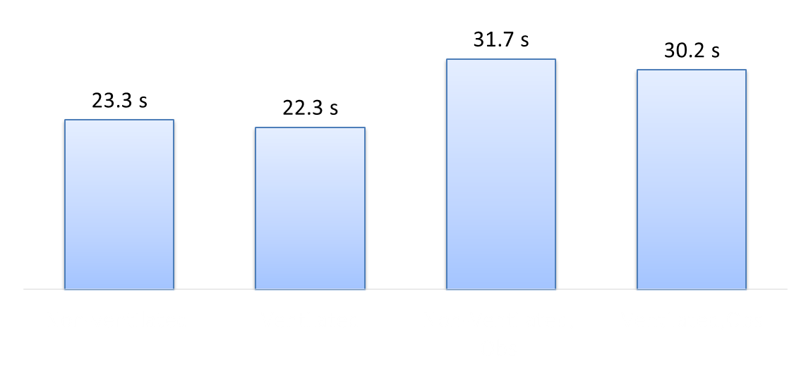
Detection system performance evaluation
Predicted system times based on when two detectors alarm
12 cases simulated:
Varied smoke generator positions
Effect of ventilation schedule
Effect of obstruction
No ventilation
With ventilation
No ventilation
With obstruction
With ventilation
With obstruction
In this particular configuration, the presence of an obstruction is predicted to increase the system alarm time by ~35%
© 2019 Collins Aerospace, a United Technologies company. All rights reserved.
9th Triennial International Aircraft Fire and Cabin Safety Research Conference, October 28-31, 2019, Atlantic City, New Jersey, USA

Slide 20
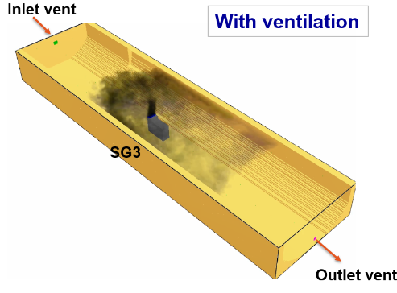
Summary and Next steps
Additional models validated
Smoke arrival time
Detector response time
In this specific modeled cargo bay configuration
Ventilation location and schedule impacts smoke transport
Obstructions produce a significant effect on smoke transport
Next step
Collect data in the cargo bay test facility to validate these simulations and mature tool
© 2019 Collins Aerospace, a United Technologies company. All rights reserved.
9th Triennial International Aircraft Fire and Cabin Safety Research Conference, October 28-31, 2019, Atlantic City, New Jersey, USA

