Slide 1
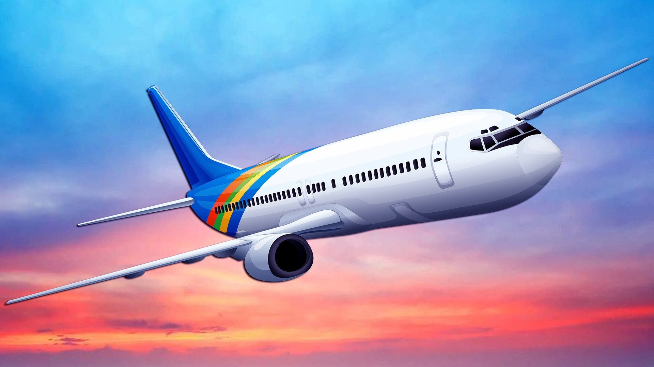
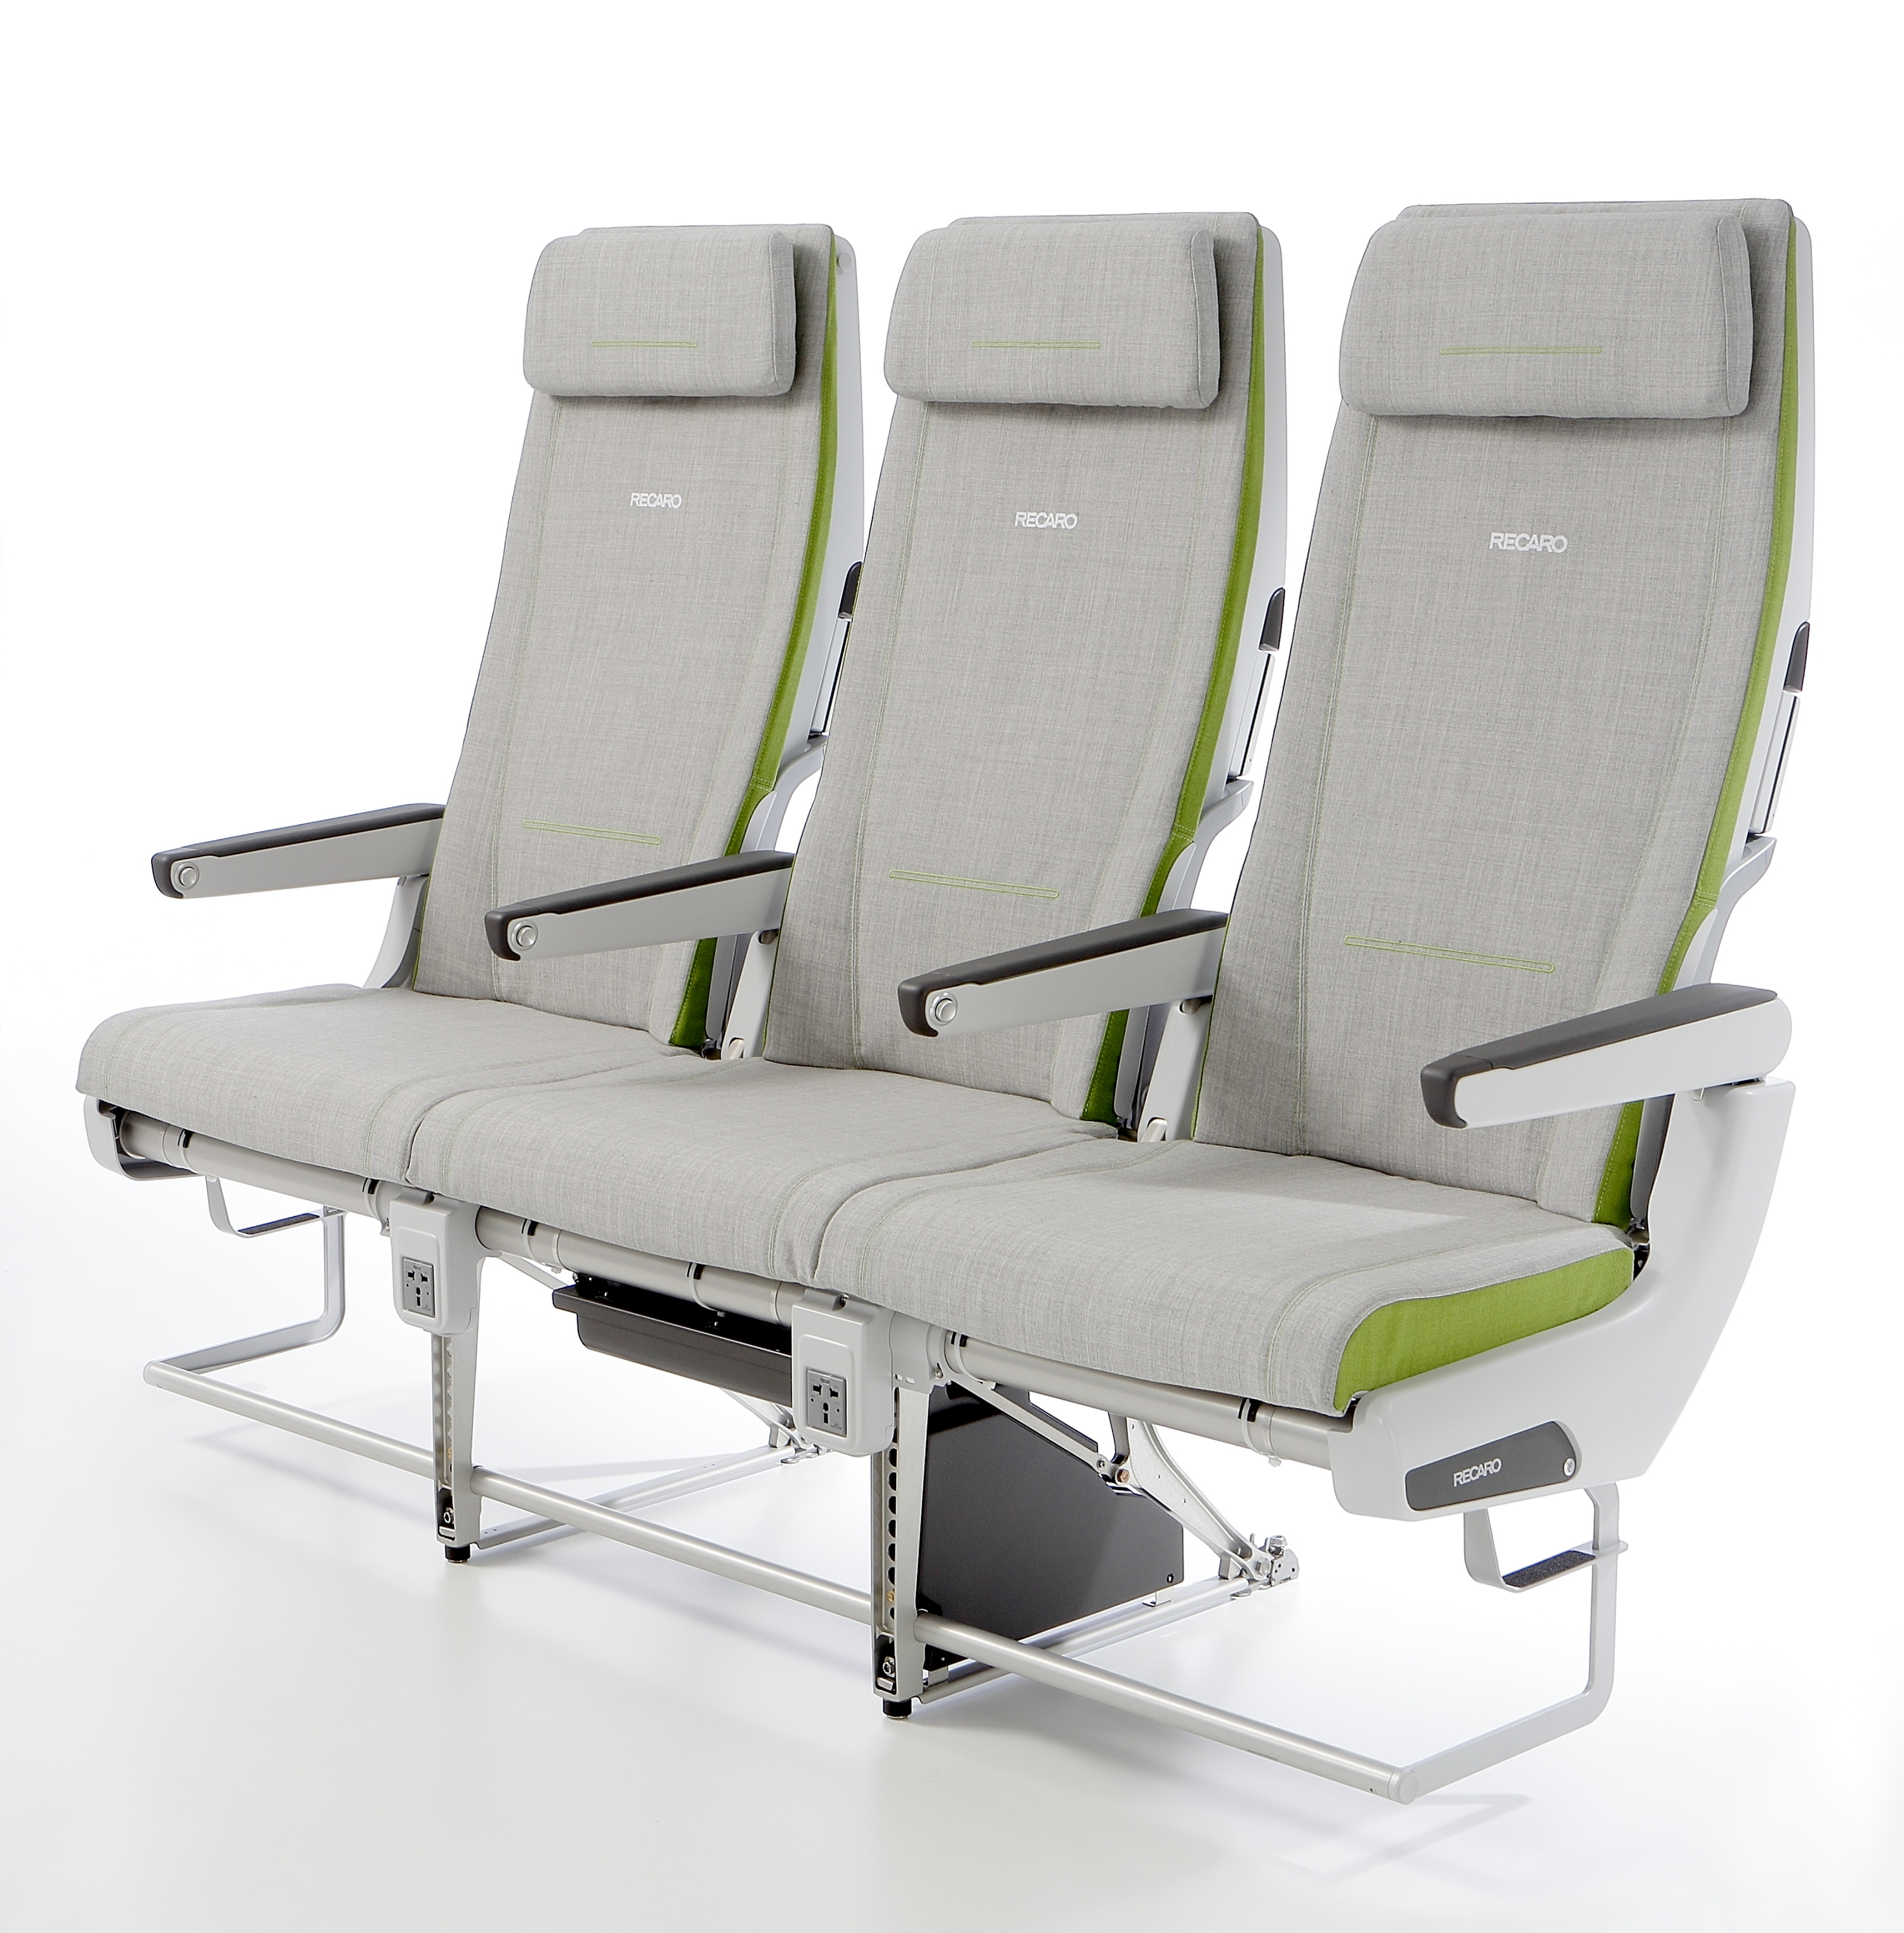
Fuselage and Seat Compliance: How Safe is the Occupant?
Lance Frazer
Alexander Carpenter
Travis Eliason
Dan Nicolella
Southwest Research Institute
October 31st, 2019
Displacement
Force
Displacement
Force

Slide 2
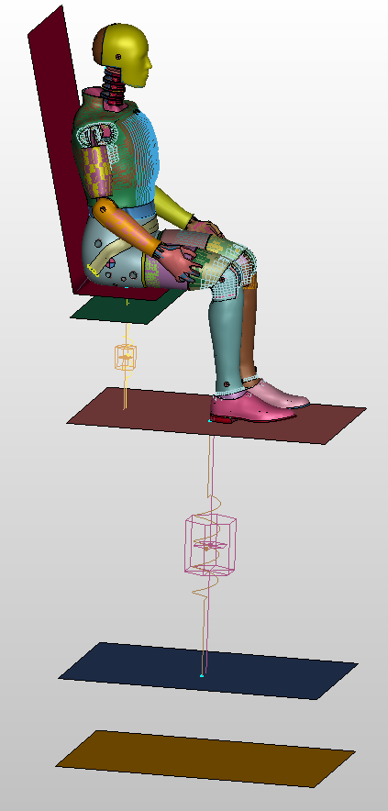
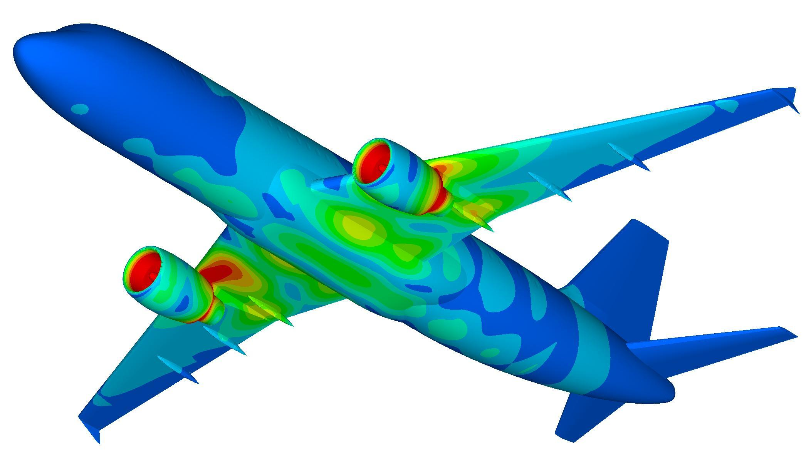
This presentation is about how we are able to investigate an occupant’s response to different fuselage and seat response characteristics in a crash-landing scenario
Displacement
Force
Displacement
Force

Slide 3
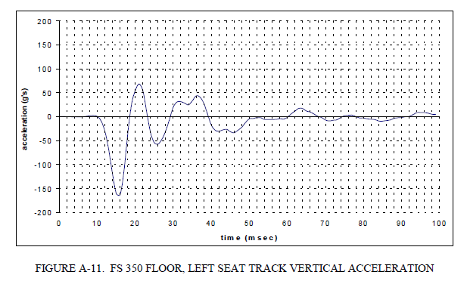
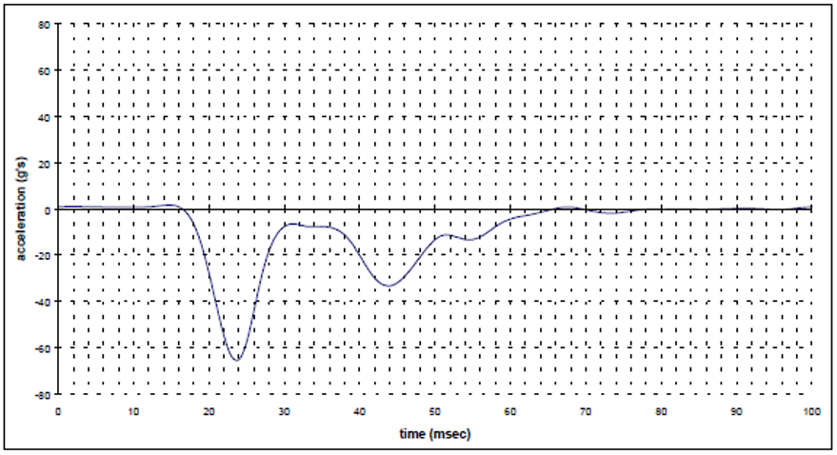
We can model the aircraft structural response using discrete non-linear spring elements
Floor (Fuselage) Response
Seat Response
150 Gs
60 Gs

Slide 4
We can model the aircraft structural response using discrete non-linear spring elements
Floor (Fuselage) Response
Seat Response

Slide 5
Seat Cushion
Seat Response
Fuselage Response

Slide 6
We can model the aircraft structural response using discrete non-linear spring elements
Lumbar Accelerations in the Dummy

Slide 7
Cushion
Seat Response
Ax²+Bx
Fuselage Response
Mass, A, B, IS, PD, PA, TS for Fuselage, Seat
A, B for Cushion
16 Variables

Slide 8
Notes:
Body slide from the second section of the presentation’s middle. For the first body slide of this second section, consider repeating the corresponding image (or equation) from the mapping slide. Use the headline to make an assertion about this topic. In the body of the slide, support that headline assertion with images and needed callouts. See Chapter 4 of The Craft of Scientific Presentations, 2nd ed.
This slide shows one orientation for the image and text in the body of the slide. Other orientations appear in this template. Choose the orientation that best supports your headline assertion.

Slide 9
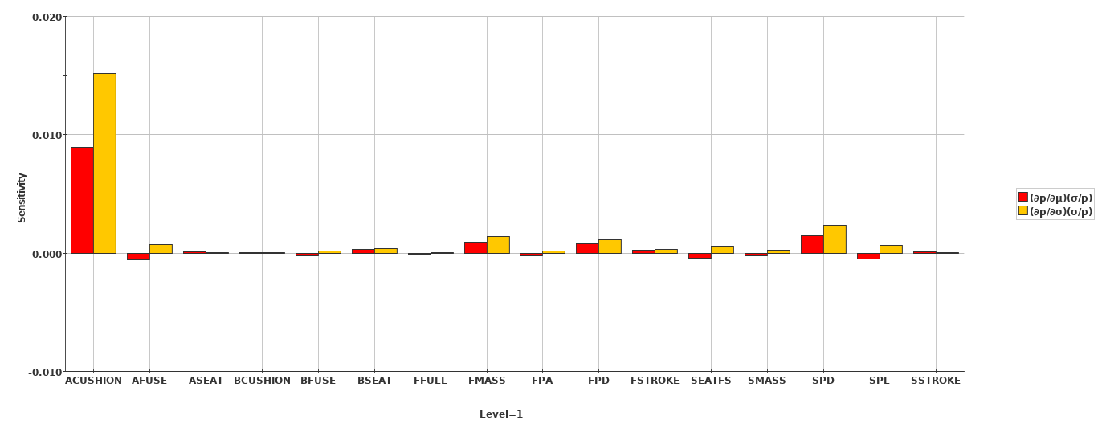
The cushion is all that matters!
Notes:
Sample slide from the middle of a presentation. Notice how animation works to allow the speaker to present fairly complex connections in a way that the audience can digest. Notice how the arrows show connections—something that bullets could not achieve.
Reference
This slide is a composite slide from a number of mechanical engineering seniors in ME 4006, a laboratory course at Virginia Tech. These presentations occurred during the Fall 2004 semester.

Slide 10
The cushion is all that matters! But probably not..
Notes:
Sample slide from the middle of a presentation. Notice how animation works to allow the speaker to present fairly complex connections in a way that the audience can digest. Notice how the arrows show connections—something that bullets could not achieve.
Reference
This slide is a composite slide from a number of mechanical engineering seniors in ME 4006, a laboratory course at Virginia Tech. These presentations occurred during the Fall 2004 semester.

Slide 11
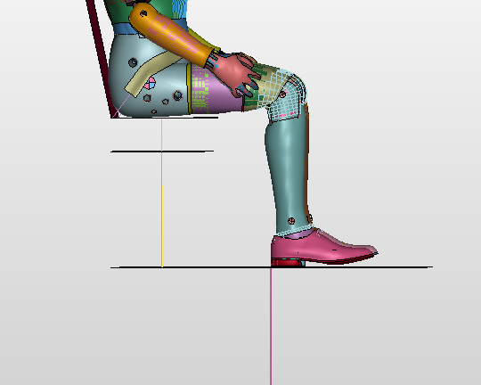
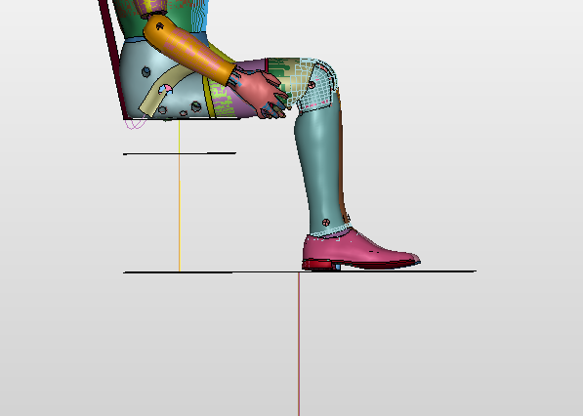
The cushion is all that matters! But probably not..
Energy moves upward
Notes:
Blank slide for drafting a body slide.

Slide 12
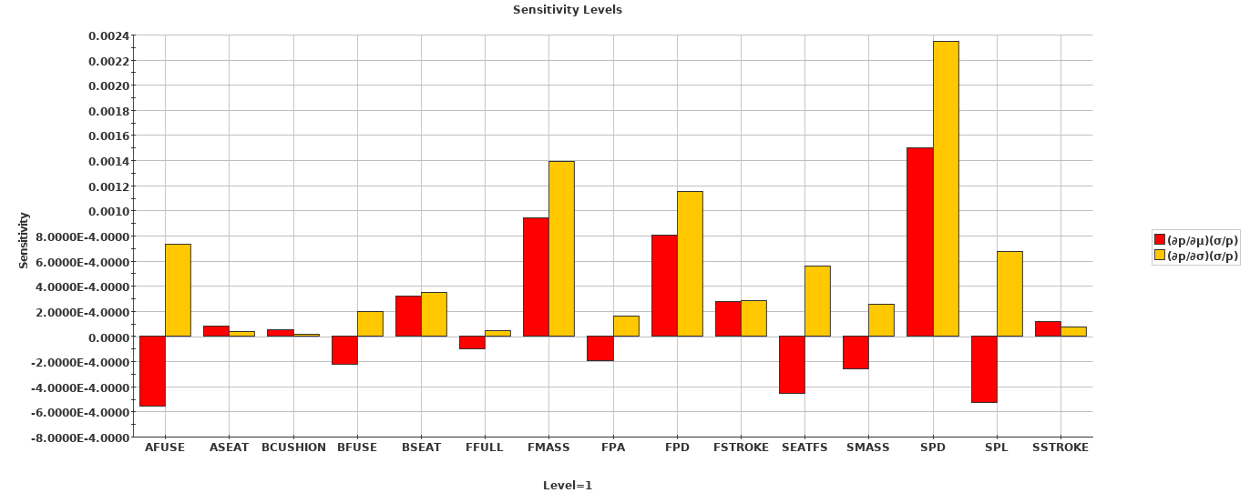
Fuselage mass, (initial) fuselage stiffness, plastic behavior heavily influence occupant safety
Notes:
Body slide from the third section of the presentation’s middle. For the first body slide of this third section, consider repeating the corresponding image from the mapping slide. Use the headline to say state an assertion about this topic. In the body of the slide, support that headline with images and with needed callouts. See Chapter 4 of The Craft of Scientific Presentations, 2nd ed..
This slide shows one orientation for the image and text in the body of the slide. Other orientations appear in this template. Choose the orientation that best supports your headline assertion.

Slide 13
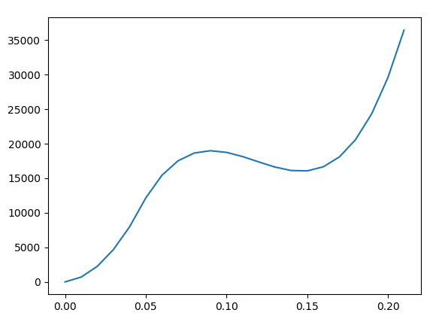
Fuselage mass, (initial) fuselage stiffness, plastic behavior heavily influence occupant safety
Notes:
Body slide from the third section of the presentation’s middle. For the first body slide of this third section, consider repeating the corresponding image from the mapping slide. Use the headline to say state an assertion about this topic. In the body of the slide, support that headline with images and with needed callouts. See Chapter 4 of The Craft of Scientific Presentations, 2nd ed..
This slide shows one orientation for the image and text in the body of the slide. Other orientations appear in this template. Choose the orientation that best supports your headline assertion.

Slide 14
[Lai et al., 2007]
Notes:
14
This slide was created by Lauren Sawarynski, who earned her B.S. in Bioengineering at Penn State in 2010 and is now in the Physician Assistant Program at Yale Medical School.
Reference for data:
J.K. Lai, M.A. Martin, R. Meyricke, T. O’neill, and S. Roberts (2007, February). Factors associated with short-term hospital readmission rates for breast cancer patients in Western Australia: an observational study. J Am Coll Surg. 204 (2):193-200.
14

