Slide 1
Effects of Thermal Conductivity on Flame Spread over Carbon-fiber Composites
9th Triennial International Fire & Cabin Safety Research Conference
Oct 29 – 31, 2019
Atlantic City, NJ
Haiqing Guo¹, Richard Walters², Richard Lyon², James Quintiere³, Sean Crowley²
¹ C-FAR Services, USA
² Fire Safety Branch, FAA William J. Hughes Technical Center, USA
³ Dept. of Fire Protection Engineering, Univ. of Maryland, USA

Slide 2
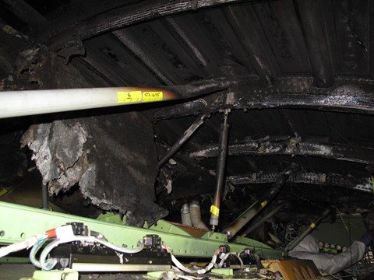
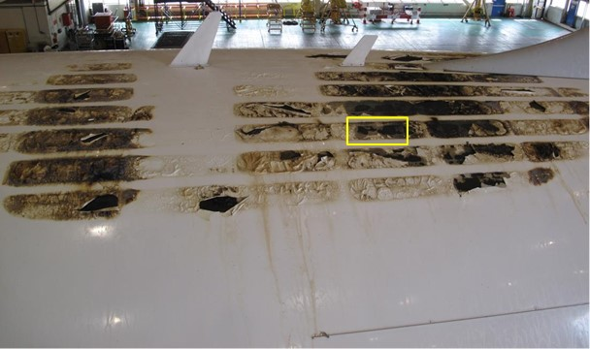
Background
Carbon fiber-reinforced polymer structural composite is widely used in commercial airplanes (high strength-to-weight ratio).
The polymeric binder (epoxy resin) is flammable. Fire in the inaccessible areas of an airplane is hazardous to in-flight safety.
In 2013, a composite fuselage Boeing 787 experienced a battery fire in the overhead space that propagated along the crown of the airplane.

Slide 3
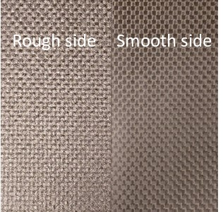
Background
In-plane thermal conductivity is about one magnitude larger than the in-depth thermal conductivity*.
While the upward flame spread is more dominated by the flame radiation, the downward flame spread is anticipated to be affected by the high in-plane thermal conductivity.
Material:
Material: 3KPW/TCR (3K plain weave fiber pre-impregnated with TCR resin.
Three thickness: 4 ply (0.9 mm), 8 ply (1.8 mm), 16 ply (3.5 mm).
*McKinnon et al., 2016, Journal of Fire Science 35(1), pp.36-61.

Slide 4
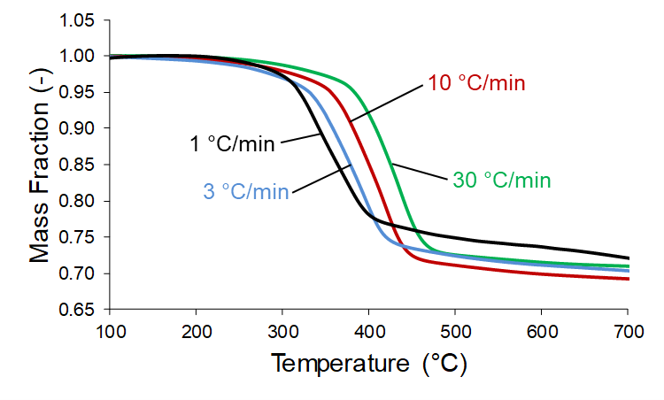
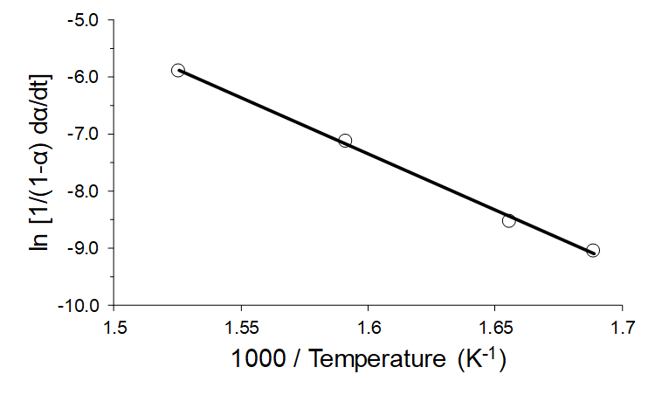
Pyrolysis Kinetics
TGA tests in N₂ at heating rates of: 1, 3, 10, and 30 ˚C/min
Residual: 69.7 ± 0.8 %.
ASTM E1641: E = 163 kJ / mol, and A = 2.76×10¹⁰ s⁻¹. @ 5% mass conversion
Ignition T: 403 ˚C (based on 1.2 mg/g-s mass flow at 30 ˚C/min heating rate*)
*Lyon, R.E., Safronava, N., Crowley, S., 2018, Fire and Materials 42(6), pp.668-679.

Slide 5
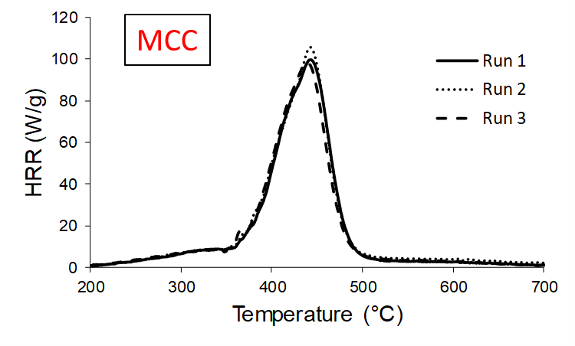
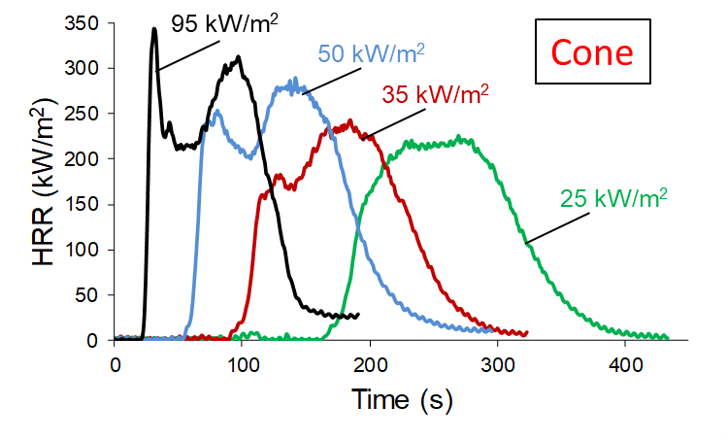
Heat Release
MCC (ASTM D7309)
MCC: 1 ˚C/s heating rate (ASTM D7309).
Peak HRR: 100 W/g at 440 ˚C.
Heat of combustion (13.1 kJ/g-O₂): 7.8 kJ/g initial sample, or 24.8 kJ/g volatile.
Cone (ASTM E1354)
Heat flux: 16 ply composite at 20, 22.5, 25, 35, 50, 75, and 95 kW/m².
No ignition below 20 kW/m².
Separation of peaks at higher radiant heat flux.

Slide 6
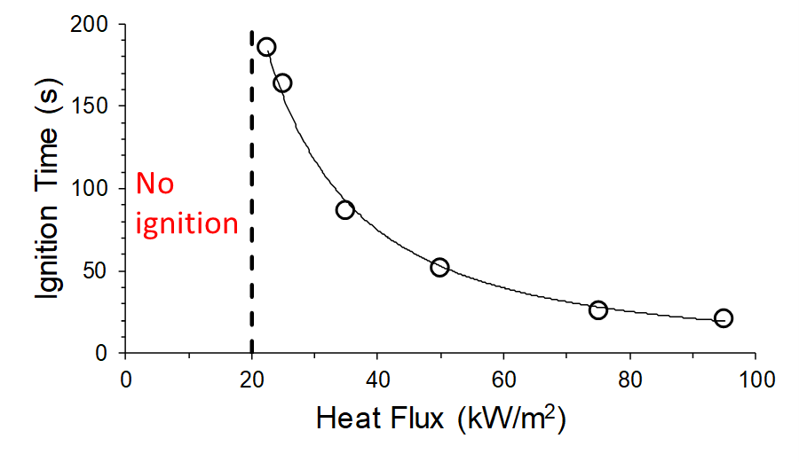
Ignition
Simultaneous ignition happens above 20 kW/m².
Flame spread is anticipated below the critical heat flux.
Small difference is expected due to the difference in boundary condition and ignition source.

Slide 7
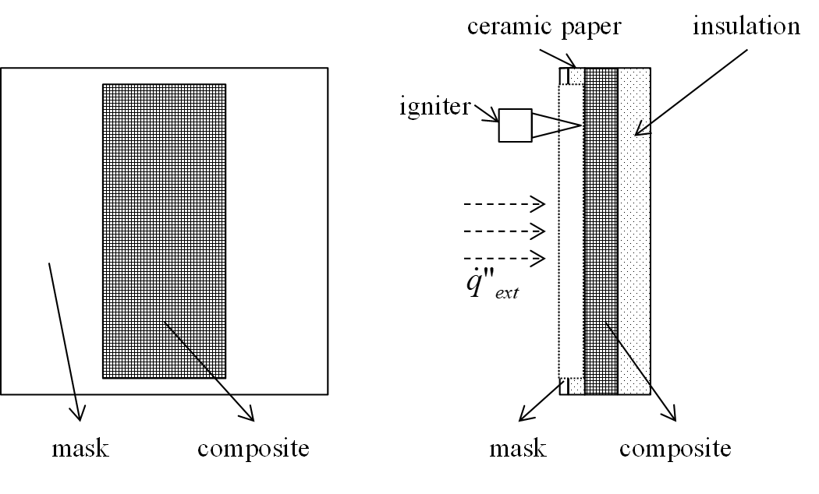
Downward Flame Spread Diagram
Cone heater is used as external heat flux.
Ignitor: Premixed propane/air flame. (Ignites at T_{s} = 250 ˚C).
Mask (metal + ceramic paper) to avoid delamination and edge burning.

Slide 8
Flame Spread
16 ply composite @ 22.5 kW/m².
Steady state flame spread rate is calculated.
Highly parabolic flame front, indicating in-plane heat loss laterally.

Slide 9
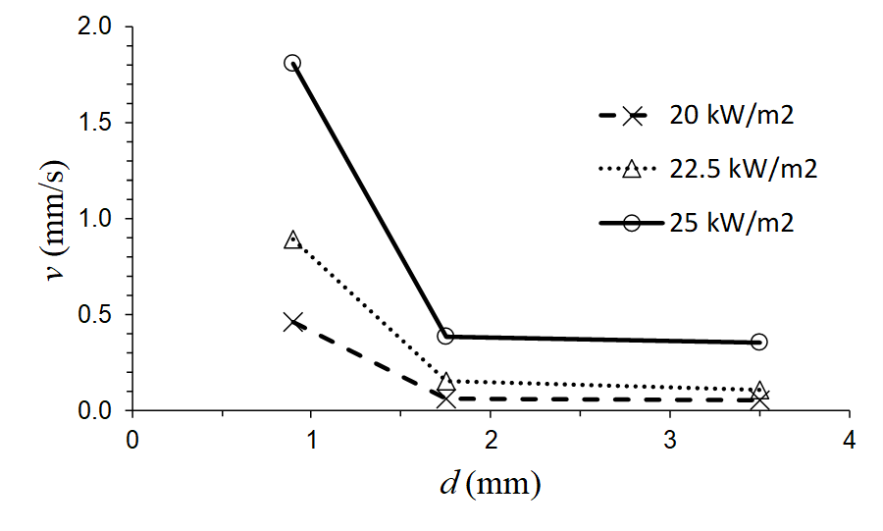
Flame Spread Rate
Heat fluxes: 20, 22.5, 25 kW/m².
Flame spread rate ranges between 0.1 – 1.8 mm/s in the explored region.
Spread rate increases drastically as thickness decreases.

Slide 10
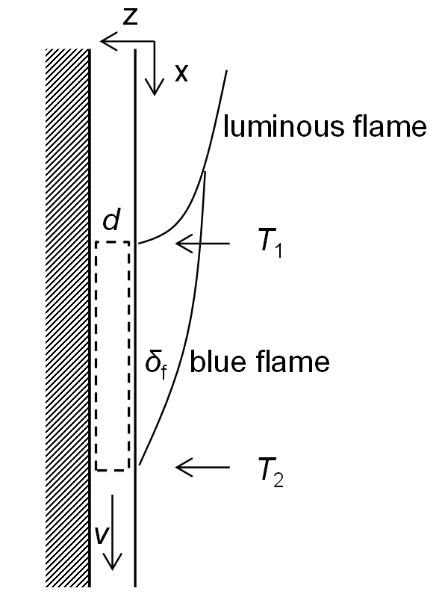
2-D Model
2-D downward flame spread model based on classic pure conduction theory.
Assume steady state and thermally thin.
Conductive heat loss in y-axis (both direction) comparable to that in x-axis.

Slide 11
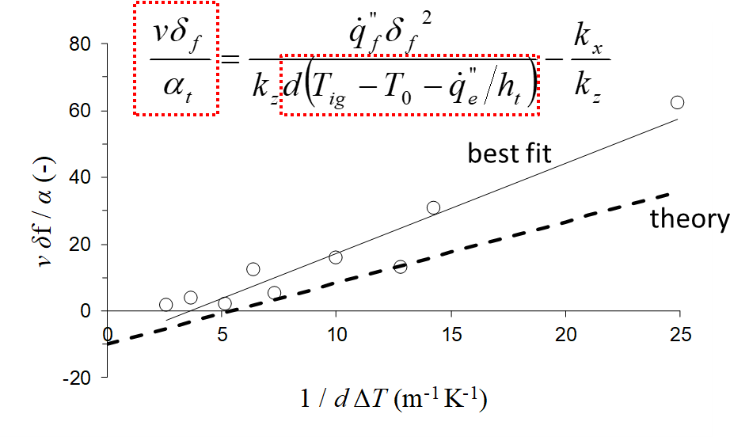
Normalized Flame Spread Rate
k_{x} and k_{y} is assumed about 10 times higher than the k_{z}.
In-plane k effect becomes negligible when the sample is thin or the external heat flux is high, the ability of heat to penetrate the sample is dominating.

Slide 12
Summary and Future Work
The flammability of a specific carbon fiber-reinforced epoxy composite 3KPW/TCR type is researched in this study.
The composite composes primarily carbon fiber (~ 70%) and the overall heat of combustion is as low as 7.8 kJ/g.
The relatively high ignition temperature and low critical heat flux does not leave much space for a steady downward flame spread study.
Downward flame spread on carbon fiber composite surface is studied at external heat fluxes between 20 – 25 kW/m².
The flame spread rate was measured between a range of 0.1 – 1.8 mm/s.
In conditions where unconfined boundary exists and the heat also conducts laterally in-plane, the extra heat loss creates a parabolic flame front shape, and inhibits the flame spread rate.
In the future, the 3-aixs thermal conductivity needs to be accurately measured and a more detailed numerical model needs to be done.

