Slide 1
Federal Aviation
Administration
Wiring Tests Overview
Pat Cahill AJP-632; Fire Safety Team Wm. J. Hughes Technical Center Federal Aviation Administration Petar Glamoclija EWIS – Electrical Wiring Interconnection Systems BOMBARDIER AEROSPACE Balma FR June 20-21, 2012

Slide 2
Purpose
Develop an improved and simplified test method and procedure for aircraft electrical wiring.
This test method is intended for determining the resistance of electric wire insulation to flame using test methods according to the Technical Report No. DOT/FAA/AR-10/2 “Development of an Improved Fire Test Method and Criteria for Aircraft Electrical Wiring”.
This is the new wire test we are currently developing at the FAA Technical Center.

Slide 3
Test Specimens
XLETFE wire insulation type from two manufacturers, AWG # 20, with 0.006, 0.008 & 0.010” wall thicknesses, compatible with SAE AS22759/41, /42, /45 specifications. For cable construction were used twisted pairs with same component wires as above, AWG # 2, # 20 and # 22, flat and round shields & jacket, compatible with NEMA WC 27500 specification
And COMPOSITE – POLYTETRAFLUOROETHYLENE/POLYIMIDE wire insulation type, smooth surface, light weight and normal weight, nickel-coated copper conductor, AWG # 20 and 22, compatible with SAE AS22759/187 & /192 specifications from two manufacturers. For cable construction we used twisted pairs with the same component wires as above, AWG # 20 and # 22, round shields & jacket, compatible with NEMA WC 27500 DK and DR specifications.

Slide 4
Test Methods and Apparatus
With exception of number of wires and cables in the bundles and bundle diameters, test methods and apparatus were in accordance with Draft version 5.7, Chapter 4 (Flammability Test Method and Criteria for Aircraft Electrical Wiring).
Tests were performed on individual wires and cables and on bundles with 7 wires and 7 cables.

Slide 5
Conclusions
Results of these tests demonstrate that no significant difference in resistance to flame of electric wire or cable with XLETFE or Composite (Polytetrafluoroethylene/Polyimide) insulation are noted when tested in the wire bundle configuration or as individual components, with different wall thicknesses, different shields (for cables), or with different AWG.

Slide 6
Recommendations to Working Group
Discussion on testing a single wire/cable versus bundles.
Testing three (3) specimens of single wires from same manufacturer of AWG = 20, 0.008” wall thicknesses for XLETFE insulation type, and normal weight for Composite insulation type (as per SAE AS or EN specs).
Or
Three (3) specimens of the cables, having twisted pair, component wires from above (AWG = 20, 0.008” wall thicknesses or normal weight for Composite insulation ) from same manufacturer and in accordance with NEMA WC 27500 or EN specs.
Round Robin with clear and pre-established parameters.

Slide 7
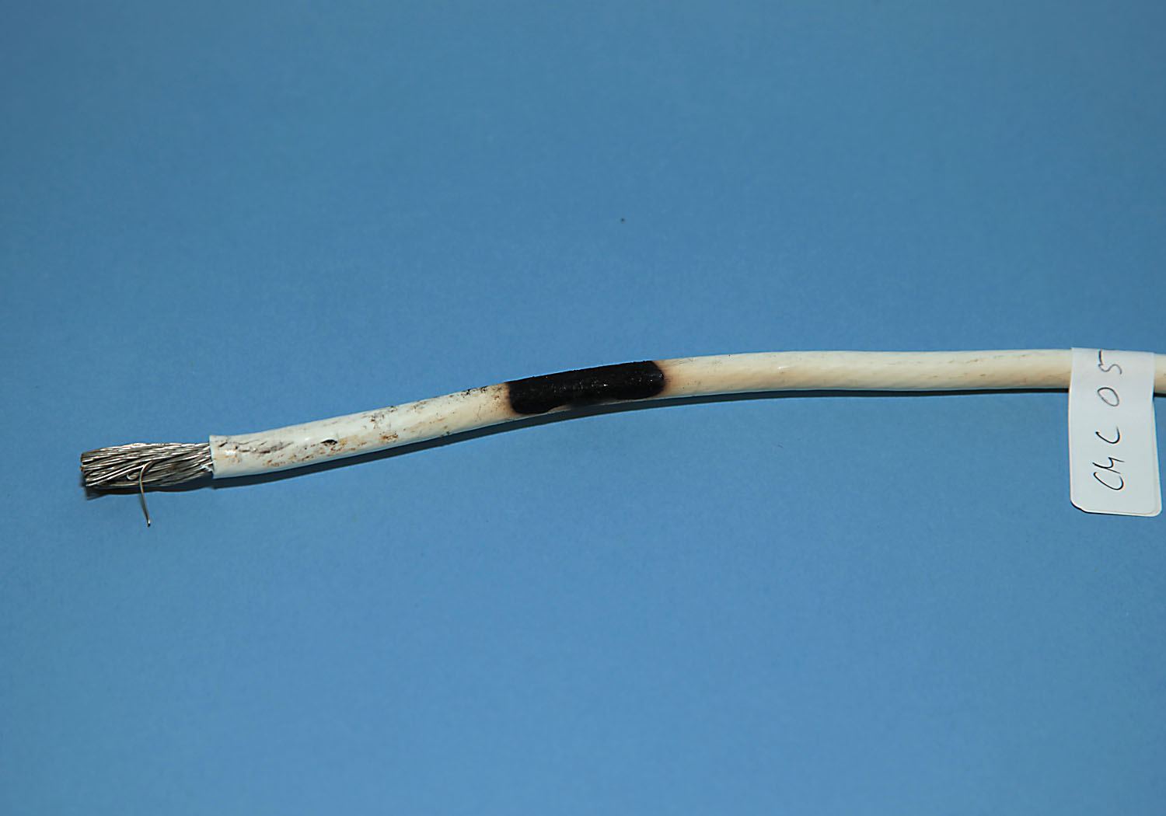
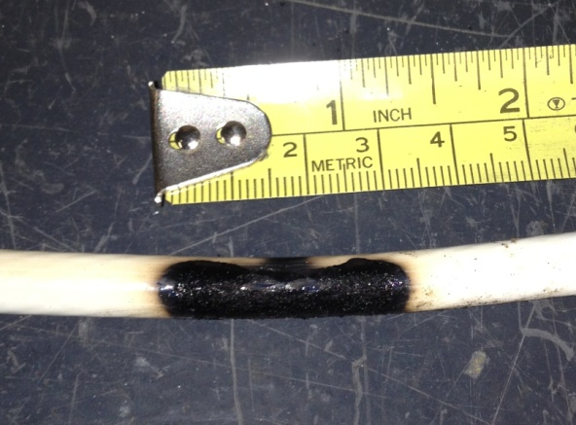
XLETFE – Power Feeder AWG # 2

Slide 8
XLETFE - Wires

Slide 9
XLETFE - Cables

Slide 10
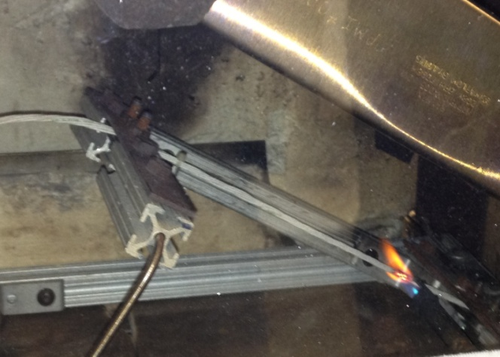
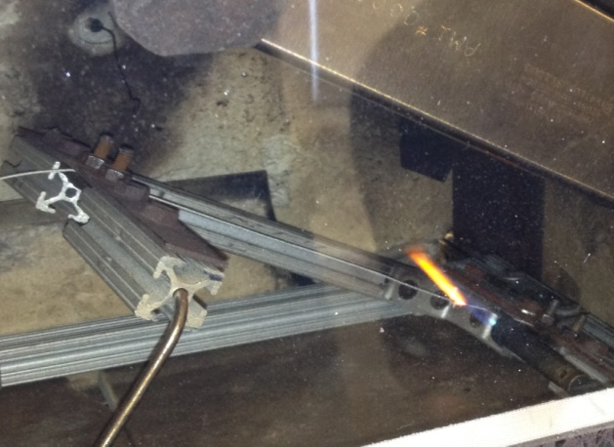
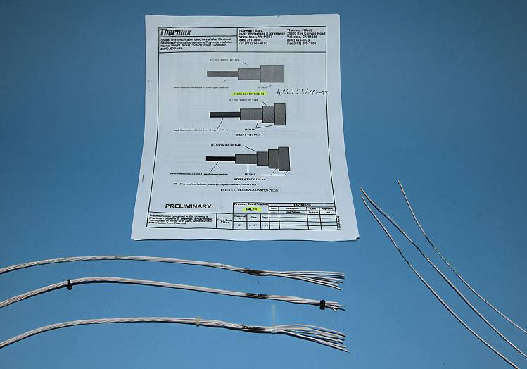
Composite - Wires

Slide 11
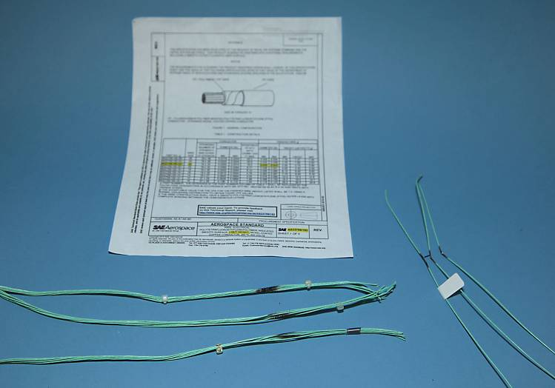
Composite - Wires

Slide 12
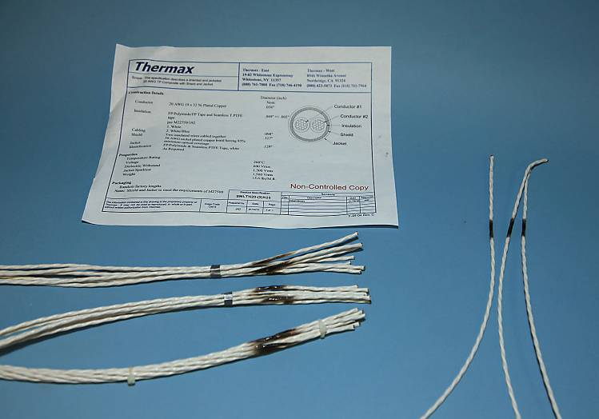
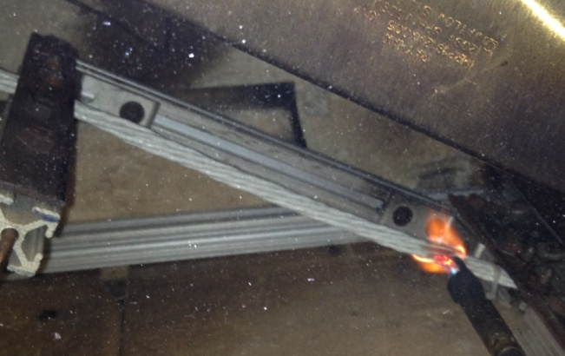
Composite - Cables

Slide 13
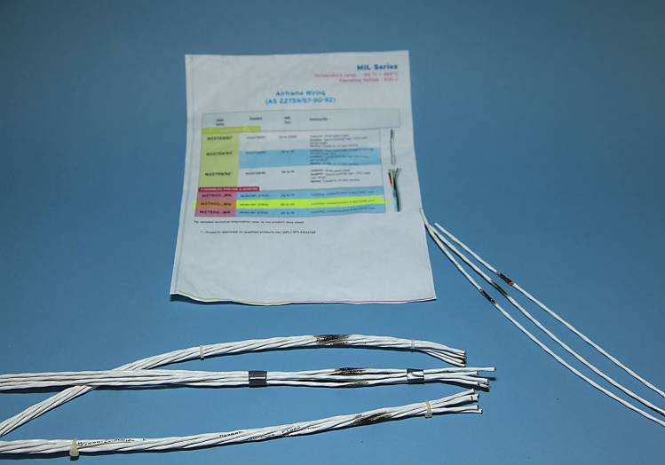
Composite - Cables

Slide 14
Wire Testing
Many different wires have been tested including non-aviation grade wires. Each of these wires was tested as a single wire (not a bundle).
The following are pictures of some of these wires:
12 AWG THNN black solid
10 AWG THNN white stranded
Transformer GTO-15 ignition cable
Green braid less silicone rubber
MIL-W-22759/11 black
Clear communication
CCTV PTZ cable white
MIL –W-81044 20 AWG
Blue Cat 3
From these pictures, it is obvious that this new test is quite stringent and very few (if any) non-aviation grade wires can pass this test.

Slide 15
Wire Testing

Slide 16
Sleeves and Heat Shrink Tubing
Sleeves
We made the decision to use copper tubing as the non-combustible core for sleeves and heat shrink tubing.
A 13 inch +/- 0.125 inch (330mm+/_ 6.35mm) long piece of ¼ inch (6.35mm) outer diameter (OD) copper tube is the size used for sleeves.
A 14 ½ inch (368mm) long piece of ½ inch (12.7mm) sleeve material is the size for use over the copper tube.
Lacing cord or safety wire should be used to tie the sleeving around the copper tube.

Slide 17
Polyethylene Sleeve over 1/4 inch Copper Tube

Slide 18
Polyethylene Sleeve over 1/4 inch Copper Tube

Slide 19
Polyethylene Sleeve over 1/4 inch Copper Tube

Slide 20
TFE Sleeve over 1/4 inch Copper Tube

Slide 21
TFE Sleeve over 1/4 inch Copper Tube

Slide 22
TFE Sleeve over 1/4 inch Copper Tube

Slide 23
Sleeves and Heat Shrink Tubing
Heat Shrink Tubing
A 13 inch +/-0.125 inch (330mm+/- 6.35mm) piece of 3/8 inch OD (9.52mm) copper tube is used for heat shrink tubing.
A 14 inch (355mm) long 2:1 piece of 0.47inch (11.9mm) shrink tubing is the size for use over the copper tube.

Slide 24
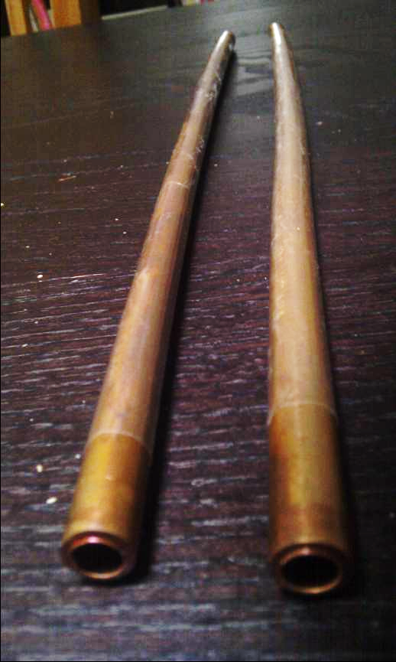
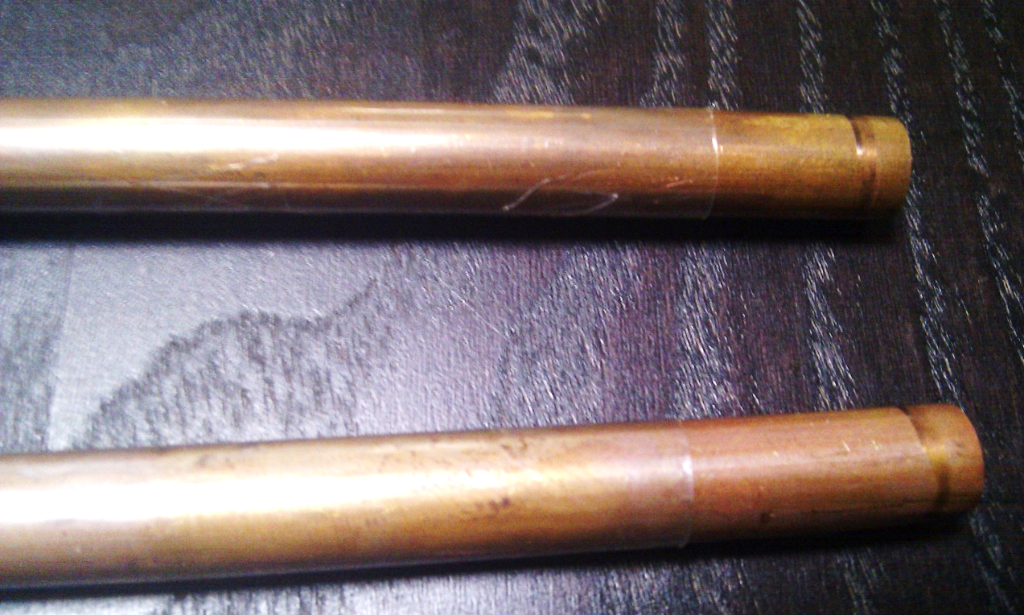
TFE Heat Shrink Tubing over 3/8 inch Copper Tube

Slide 25
Heat Shrink Tubing over 3/8 inch Copper Tube

Slide 26
Heat Shrink Tubing over 3/8 inch Copper Tube

Slide 27
Task Group Discussion
What labs will conduct wire testing?
Questions concerning the test method.
Sentiments on single wire testing, sleeve and heat shrink tubing methods using the copper tube.
Plans for a Round Robin.
Independent labs interested in participating in the Round Robin testing are not represented at this meeting. They will be contacted.

