Slide 1
International Aircraft Materials Fire Test Forum Meeting
Cargo Liner & Seat Cushion Air Shrouds,
Insulation Burnthrough Update
International Aircraft Materials Fire Test Forum
Tim Salter, FAA Technical Center
June 8-11, 2020

Slide 2
Sonic Burner Cargo Liner Test: Air Shroud Update

Slide 3
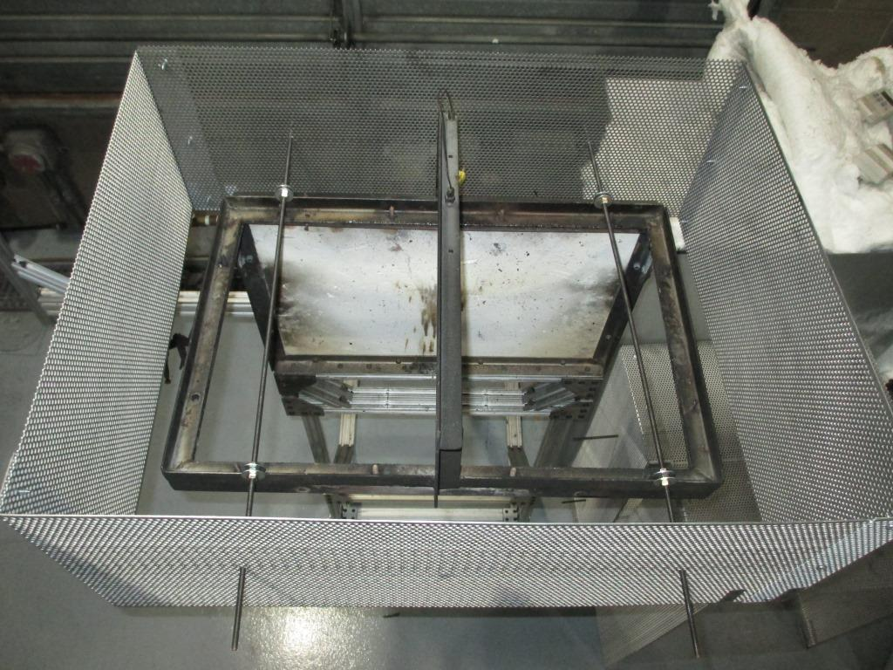
Cargo Air Shroud
Phase 1 completed
Shroud concept tested and proven
Successful interlab study with lots of beneficial data

Slide 4
Cargo Air Shroud
7 out of 9 labs experienced a slight increase in average temperatures with the shroud (~20 F or less)
2 out of 9 labs experienced lower average temperatures with the shroud
7 out of 9 labs showed that the shroud improved test result repeatability and consistency
None of the labs experienced a sample failure

Slide 6
Cargo Air Shroud
Shroud works as intended
Improves test result repeatability
Does not significantly increase test temperatures or likelihood of flame penetration for samples tested
However, fitment issues need to be addressed…

Slide 7
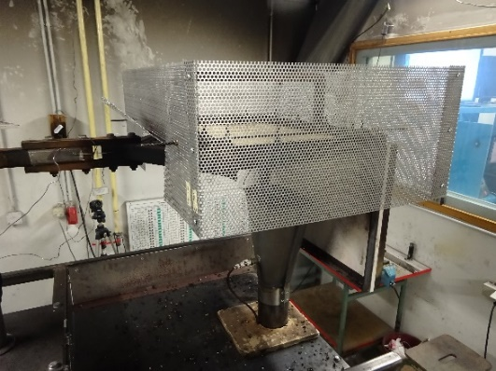
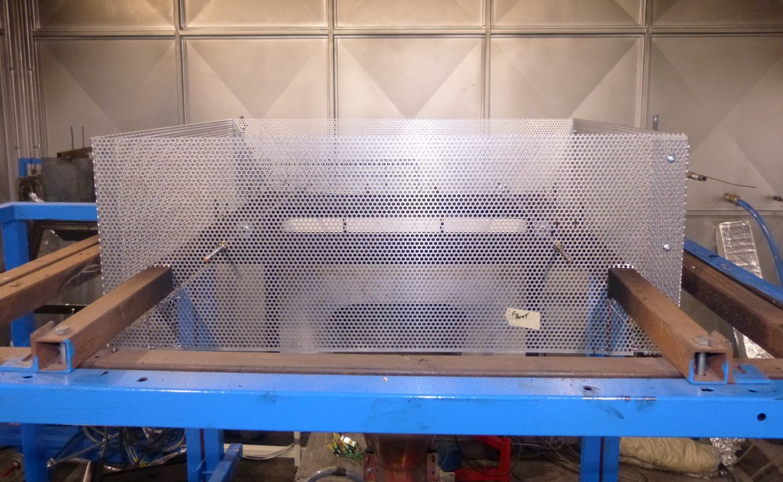
Cargo Air Shroud

Slide 8
Cargo Shroud Phase 2
Phase 2 of cargo shroud study
Update shroud design to be more accommodating for labs that need to make modifications for fitment
Make more robust to reduce chance of heat damage or warpage

Slide 9
Cargo Air Shroud
Basic design/location parameters will be defined (X, Y, Z locations)
Modifications can be made… shroud must be capable of performing its intended purpose
Some room for fitment adjustments

Slide 10
Cargo Air Shroud
New shroud design concepts
Aluminum: strength considerations
Steel: Strong but heavy
Steel frame screen hybrid concept

Slide 11
Cargo Air Shroud
Plans for shroud work once returned to lab
Testing in FAA TC lab
Development of new design
New shipment of test materials available

Slide 12
Cargo Air Shroud
Phase 2 round robin interlab study planned
Seeking more interlab study participants
No modifications needed for test rig
Modifications can be made to shroud

Slide 13
Sonic Burner Seat Cushion Test: Air Shroud Update

Slide 14
Seat Air Shroud
Next step for shroud development
- Adapt shroud concept to seat test method

Slide 15
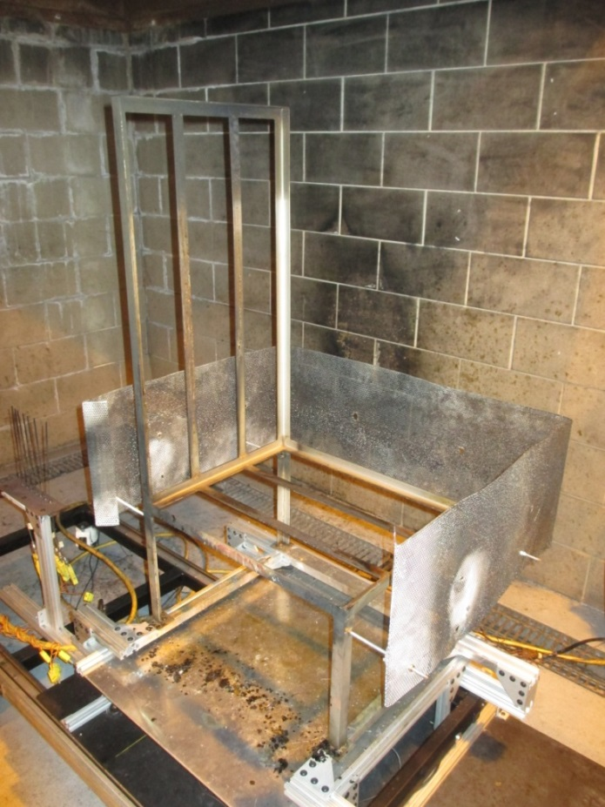
Seat Air Shroud
Same purpose as cargo shroud
Reduced influence of air currents
Modified cargo shroud design
Shroud on three sides
Open on flame side
Does not interfere with sample mounting
No frame modifications
Proven FAA TC results

Slide 16
Seat Air Shroud
Interlab Study
3 sample foam types with 3 of each foam type provided to each participating lab
Same dress covers for all samples
Shroud provided with assembly and sample fire test instructions

Slide 17
Insulation Burnthrough Update

Slide 18
Insulation Burnthrough
The heat flux measurement was slightly higher than measured previously in Phase 1 using the same blanket sample materials
This would indicate the burner flame is more severe for Phase 3 compared to Phase 1 and Phase 2

Slide 19
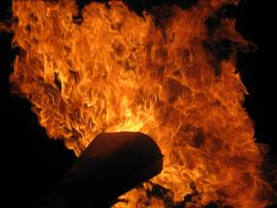
Insulation Burnthrough
Working to update igniter-configured burner to igniterless configuration
Retain equivalent test results
With improved repeatability
And interlab correlation

Slide 20
Insulation Burnthrough
Test Phase 1 (stator with igniters) configuration with new insulation material to establish baseline data
Compare test results to Phase 3 (igniterless stator) burner configuration
Adjust burner settings to achieve equivalent results to Phase 1 burner configuration

Slide 21
Insulation Burnthrough
Test Phase 1 (stator with igniters) configuration with new insulation material to establish baseline data
Compare test results to Phase 3 (igniterless stator) burner configuration
Adjust burner settings to achieve equivalent results to Phase 1 burner configuration

Slide 22
Insulation Burnthrough
Interlab study with another lab to confirm test data and updated burner settings using new blanket materials
Purpose is to update Sonic burner settings in chapter 24 of the FTH
Phase 4 interlab study possible

Slide 23
Powerplant Test Update

Slide 24
Powerplant Test
Propane burner has been removed from the powerplant AC documentation
No formal task group for powerplant testing this meeting
Questions in burner task groups if needed

Slide 25
Insulation Burnthrough Instructional Video

Slide 26
Insulation Burnthrough Video
Final draft 99%
Posted to Fire Safety website ASAP
Updates for task group members

Slide 27
Sonic Burner Instructional Video
https://www.fire.tc.faa.gov/Handbook

Slide 28
Questions?
timothy.salter@faa.gov
(1)-609-485-6952

