Slide 1
Electronic enclosure fire test – RTCA
Element Minneapolis
Alan Thompson, GM

Slide 2
Objectives
Burn boxes whole using a programmable line burner with methane
Determine placement of the burner within the box
Determine how many burns necessary/test locations
Evaluate results of test
Compare approach/results with Airbus foam block method

Slide 3
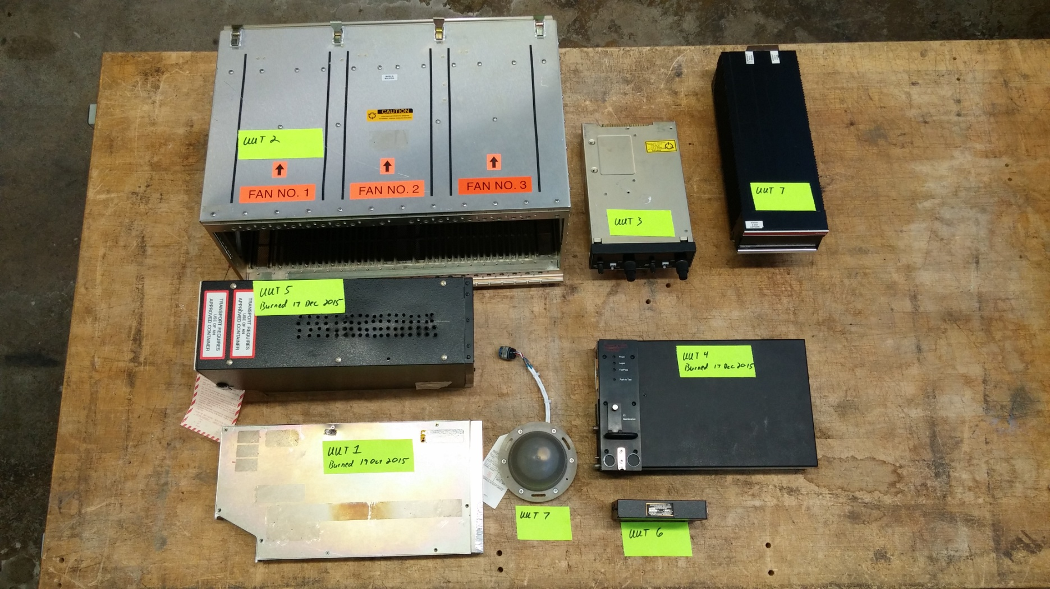
The Victims

Slide 4
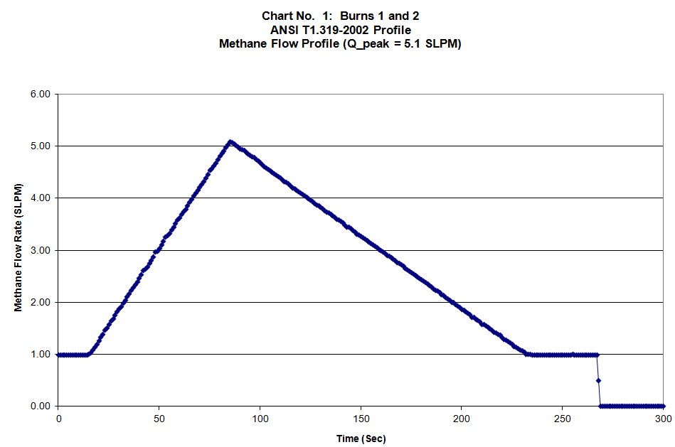
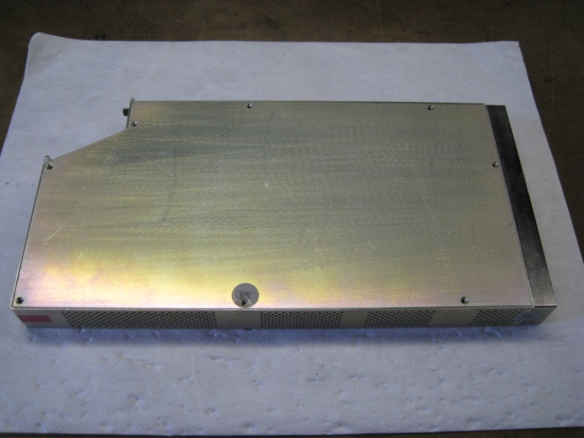
Round Robin Test Unit
Two units were provided for comparative testing
This unit consisted of two circuit board assemblies mounted inside of an aluminum chassis
The chassis had ventilation holes at the top and the bottom
Methane flow profile was calculated based on height of PCB

Slide 5
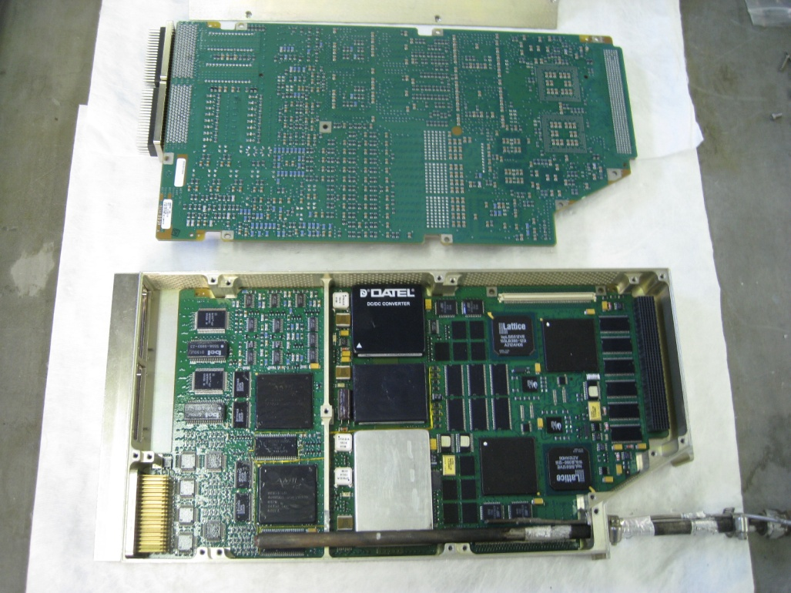
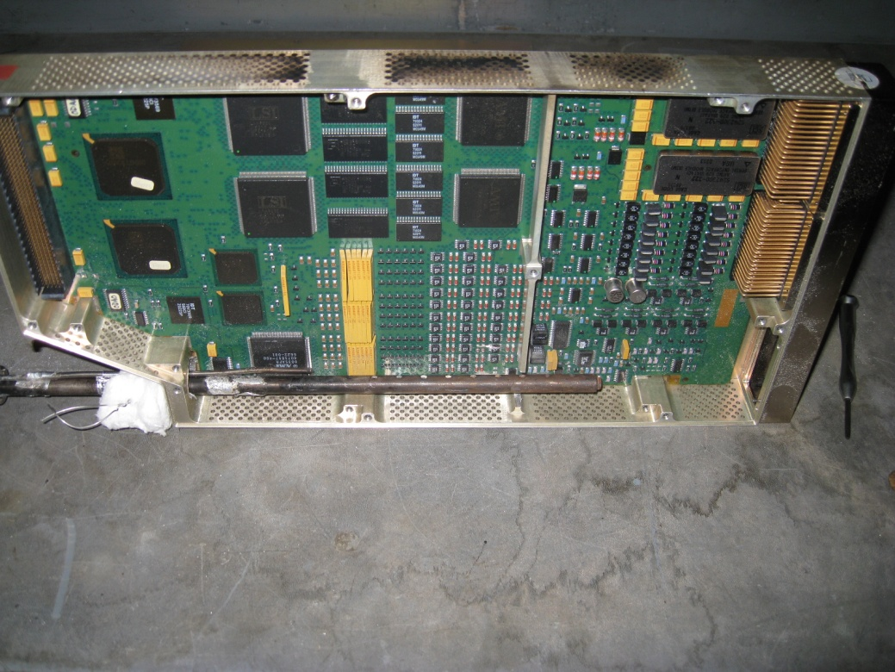
Round Robin Test
Two burns were conducted
In each case one of the two circuit boards was replaced by the line burner.
First burn straight up, second burn rotated to impinge circuit board

Slide 6
Video

Slide 7
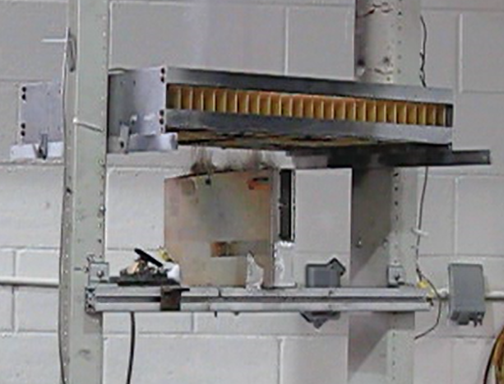
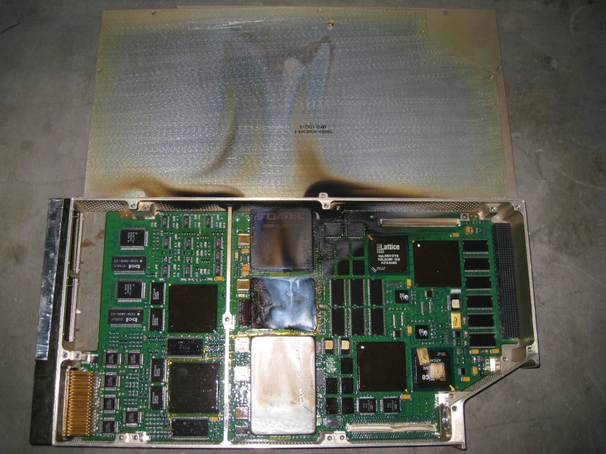
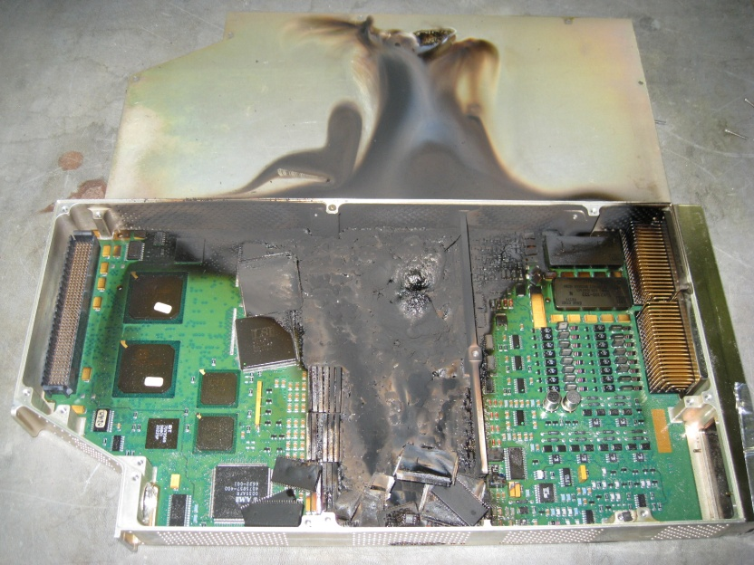
Round Robin Test Results
No visible flames outside of the unit throughout the duration of both tests
Damage more severe from the second burn
Smoke mirrored line burner

Slide 8
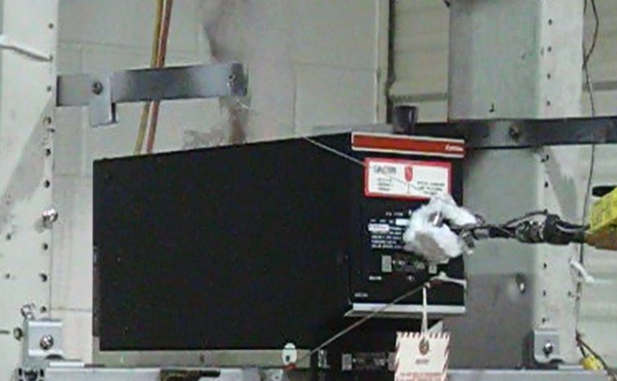
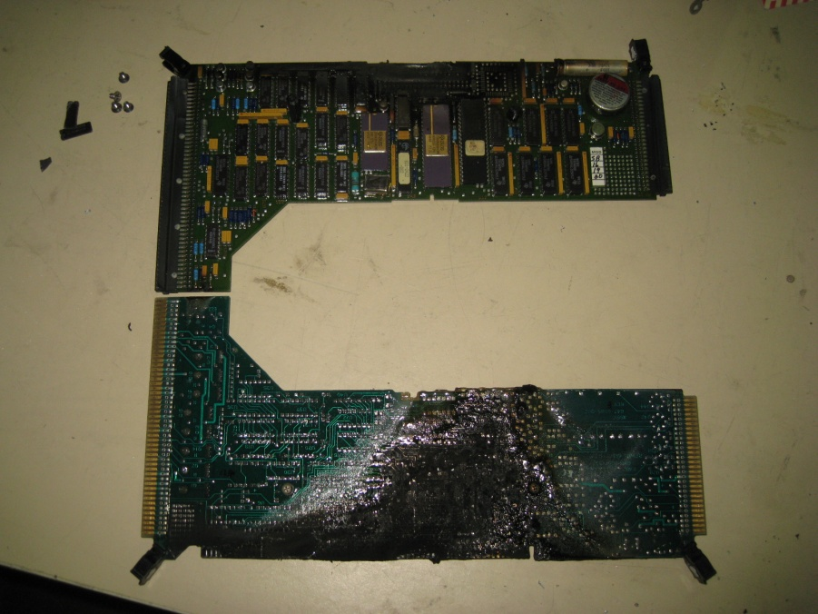
Additional Testing – December RTCA Working Group Members
Unit consists of 6 PCBs mounted inside of an aluminum enclosure
Methane line burner self-extinguished in multiple locations
Experiment: additional holes drilled into top and bottom of enclosure – Ventilation to support combustion, insert flame sideways – hit all 6 PCBs

Slide 9
Video

Slide 10
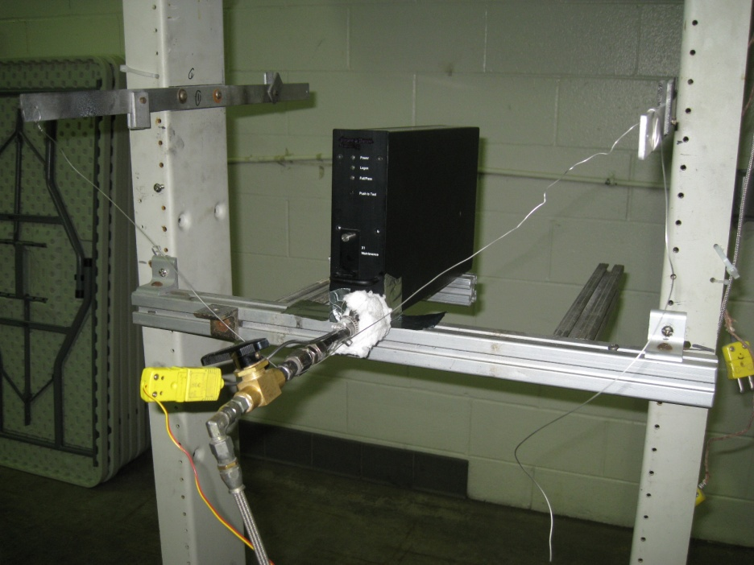
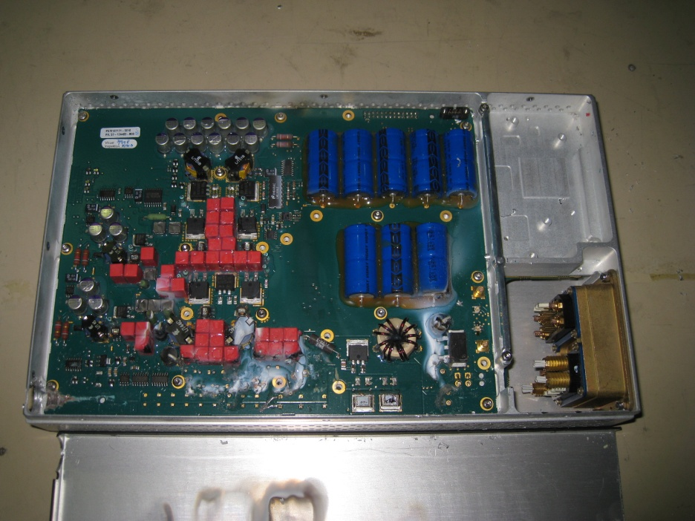
Additional Testing
The unit consists of one vertically orientated PCB
The chassis has ventilation holes at the top and the bottom
One burn was conducted
No flames visible outside of the unit throughout the duration of the test.

Slide 11
Lessons Learned
Evaluation and Testing can be performed in one day
Placement of line burner and number of test locations is subjective
Line burner may be too large for small units
Burner rotation can affect test results
The line burner may self extinguish prior to a draft forming (enclosures with limited ventilation)
Need a clear definition of pass / fail

Slide 12
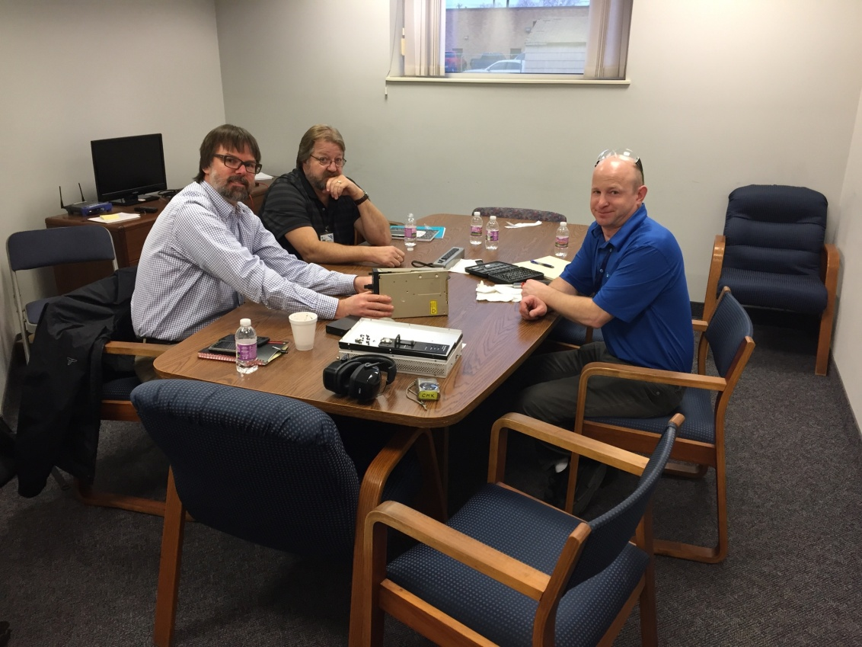
Thank you
Matt Anglin, Boeing
Stuart (Skip) Scott, Rockwell Collins
Chris Kieser, Element
Honeywell and Rockwell for supplying the victims

Slide 13
Contact Information
Alan Thompson
Element Materials Technology, Minneapolis
9725 Girard Avenue South
Minneapolis MN 55431
952 567 2301
Alan.thompson@element.com

