Slide 1
International Aircraft Materials Fire Test Working Group Meeting
Test Cell Airflow Study
For Cargo Liner NexGen Oil Burner Test
International Aircraft Materials Fire Test Working Group
Tim Salter, FAA Technical Center
March 16-17, 2016, Bordeaux, France

Slide 2
Introduction
Previous Meeting Overview
2015 Round Robin Test Results
Studying the Influence of Air Velocity
Recent FAA Test Results
Work Performed by University of Cincinnati (UC)
Specific Air Velocity Range around Test Rig
Suggested “Calibration” of Test Apparatus
NexGen Cargo Liner Oil Burner Video
Updated “Handbook” Status

Slide 3
Refresher for Previous Materials Meeting

Slide 4
Previously...
Test results presented at the materials working group meeting in October 2015 revealed a wide range of temperatures measured during testing
Efforts have recently been focused on how lab conditions are affecting test results
Air velocity around the sample
Size and configuration of the test environment

Slide 5
2015 Cargo Round Robin Study
** Temperatures varied as much as 125°F among the labs involved in the study **
FAA

Slide 6
Test Cell Air Velocity Study using the NexGen Cargo Liner Oil Burner

Slide 7
Test Cell Air Velocity Study
Recently, the NexGen cargo liner oil burner apparatus was used to study the influence of localized air velocity around the test sample
Purpose: Determine how the air movement around the test sample can affect the temperatures measured by the 1/16” TC located above the ceiling (horizontal) cargo liner test sample

Slide 8
Test Cell Air Velocity Study
All tests were conducted using the same woven fiberglass/polyester reinforced cargo liner samples oriented in the horizontal sample position and an insulating board in place of the vertical liner sample
Unless otherwise specified
Each plotted temperature profile represents an average for 3 individual sample tests

Slide 9
Test Cell Air Velocity Study
Testing Performed
Shrouding of the 1/16” TC
Isolate 1/16” TC from air crossflow in horizontal plane
Substitute horizontal cargo sample with insulating board
Minimize heat transfer from burner flame to 1/16” TC
Setup large fan to move air across top face of horizontal cargo sample to simulate “extreme” case of air crossflow
Perform tests in both small (10’x10’) and full-scale test environments

Slide 10
Test Cell Air Velocity Study
Testing begun by running cargo liner test samples under normal test conditions in FAA Technical Center 10’x10’ cargo liner oil burner test cell to establish “baseline” or “control data”
Data collected from “modified tests” which differ from the standard test procedure were compared to control data to determine the influence of each modification

Slide 11
Baseline Data Results

Slide 12
Shrouded Thermocouple

Slide 13
Shrouded Thermocouple
A six-inch length of 2.75” O.D. schedule-40 steel pipe was attached to the sample rig to shroud the 1/16” TC above the horizontal liner sample and isolate the TC from airflow in the horizontal plane
The tip of the TC was located in the center of the shroud (pipe) with both ends of the shroud open to allow heat and combustion gases to pass through vertically

Slide 14
Shrouded Thermocouple

Slide 15
Shrouded Thermocouple
Temperatures were elevated towards the end of the 5-minute test compared to baseline results
Approximately 100°F more after 5 minutes
The increase in temperatures may be attributed to isolating the TC from airflow in the horizontal plane (cooling effect)
Temperature readings may have been increased by heat transfer from the shroud (steel pipe)
Insulating the shroud would reduce heat transfer

Slide 16
Insulating Board

Slide 17
Insulating Board
Another modified test was performed using an insulating board (1” thick Superwool®) to minimize heat transfer through the horizontal test sample from the burner flame
The intent was to determine how heated air in the test cell could contribute to the temperatures measured above the horizontal test sample

Slide 18
Insulating Board

Slide 19
Insulating Board
Measured temperatures were significantly lower throughout the test with the insulating board compared to baseline results
Further testing and temperature instrumentation would be required to isolate the influence of the heated air in the test cell
Heat transferred through insulating board to TC needs to be quantified to make data results useful

Slide 20
Air Crossflow with Fan

Slide 21
Air Crossflow with Fan
An industrial-sized cooling fan was positioned in the test cell and aimed directly at the test sample rig to simulate an “extreme case” of how air velocity can influence measured temperatures during testing

Slide 22
Air Crossflow with Fan

Slide 23
Air Crossflow with Fan
Prior to testing, it was assumed the fan would create a cooling affect
The strong air current from the fan created a “swirling” effect within the chamber and reduced the effectiveness of the exhaust fan to remove hot air and combustion byproducts from within the test cell
This lead to an increase in measured temperatures at the start and end of the test period

Slide 24
Full-Scale Test Cell

Slide 25
Full-Scale Test Cell
The cargo liner oil burner test apparatus was relocated from the 10’x10’ test cell to the full-scale test area
Baseline tests performed in the 10’x10’ test cell were repeated in the full-scale test area
Can the size of the test environment in some way contribute to influencing the temperature readings above the cargo liner test sample?

Slide 27
Full-Scale Test Cell
100°F decrease in temperature during testing

Slide 28
Full-Scale Test Cell
Temperatures readings significantly lower in the full-scale environment
Air movement around the test sample rig is essentially zero (no cooling effect)
Hot air and combustion gases are not confined to a small test environment
Lower temperatures despite minimal air velocity

Slide 29
Full-Scale Test Cell with Fan

Slide 30
Full-Scale Test Cell with Fan
Testing was repeated in the full-scale test area with the addition of the same industrial fan used previously in the 10’x10’ test cell
Again, this was to simulate an extreme case of high air velocity around the test sample

Slide 32
Full-Scale Test Cell with Fan

Slide 33
Full-Scale Test Cell with Fan
The test results when using the large fan showed a decrease in measured temperatures in the full-scale facility
This was the opposite result compared to the increased temperatures in the 10’x10’ test cell when using the fan while testing

Slide 34
Full-Scale Testing Comparison

Slide 35
Test Result Conclusions

Slide 36
Conclusion
Size of the test cell and air velocity around test sample can drastically impact results for the same sample material and apparatus
Insufficient exhaust airflow can raise the temperatures measured above the liner sample, especially in smaller size test cells
What can be done about the problem???

Slide 37
Specific Air Velocity Ranges
Current specified air velocities in Handbook are inadequate and do not provide minimum air velocity values
Must determine an appropriate range for horizontal and vertical air velocities at specified points relative to the test sample frame
Also….

Slide 38
Cargo Apparatus Calibration
Use of a “control” or “standardized” material tested in place of horizontal cargo sample before sample testing
Temperatures measured above the “control” material must stay within a specific temperature range over a specified flame exposure period
Labs can adjust test environment conditions as needed to meet criteria

Slide 39
Collaborative Work with University of Cincinnati (UC)

Slide 40
Collaborative Work with UC
Testing for this study conducted at the FAA Technical Center is currently underway at the University of Cincinnati (UC) oil burner test lab
The ability to run the same tests in two different labs should provide more insight on how the test environment can influence test results and how to reduce disparities in data among test labs

Slide 41
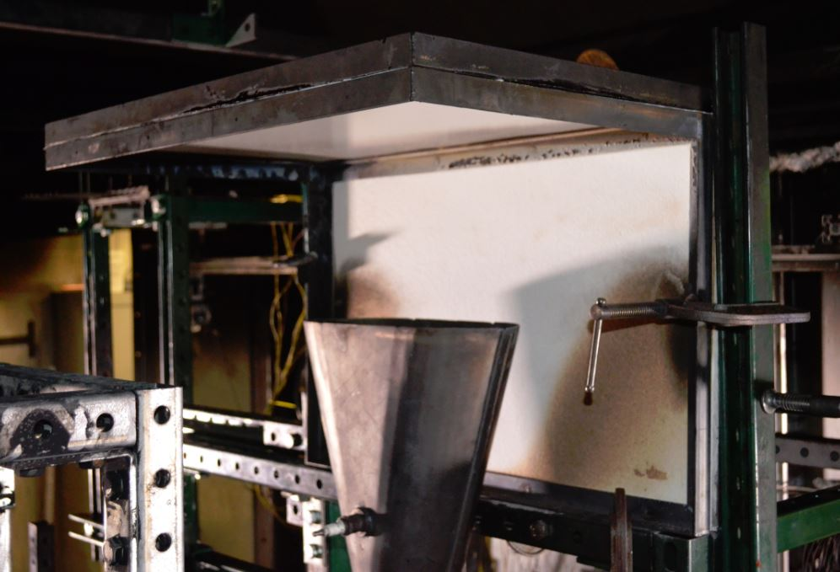
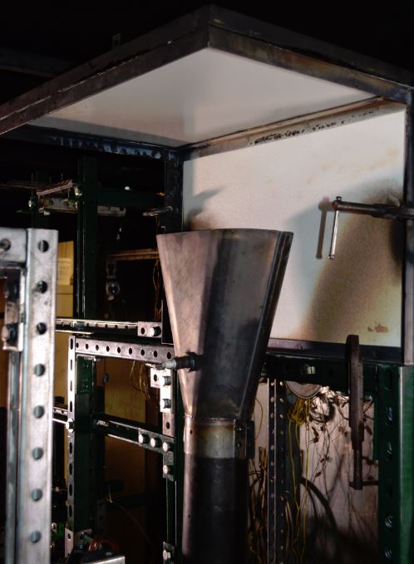
UC Test Set Up

Slide 42
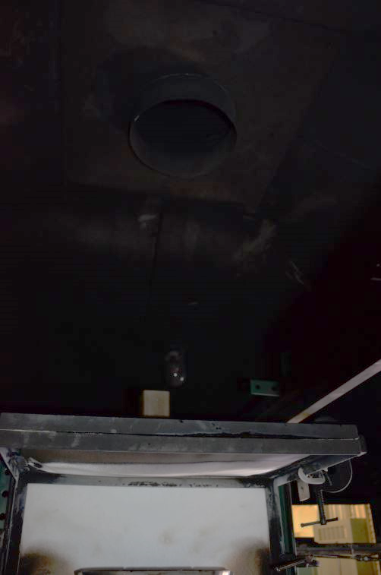
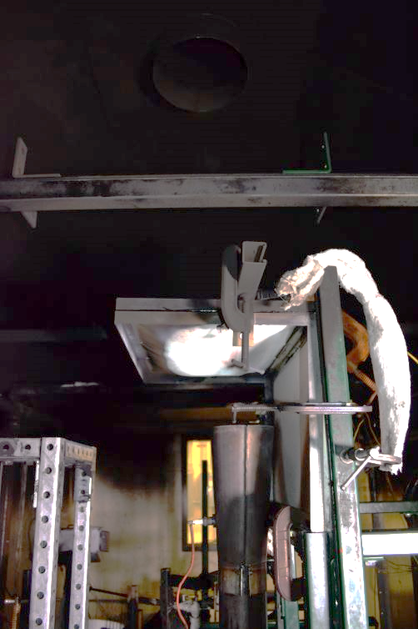
UC Test Setup

Slide 43
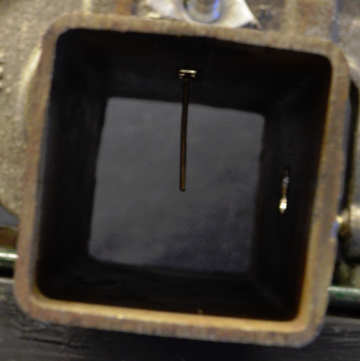
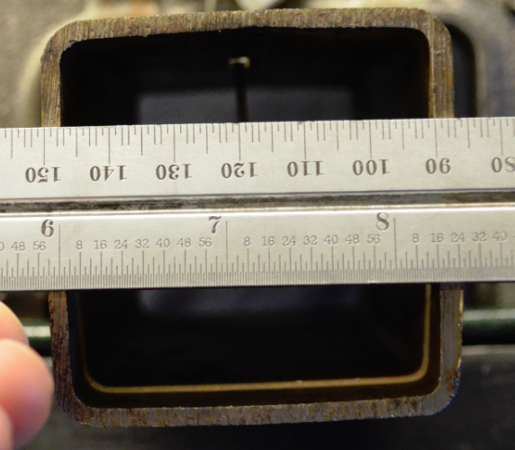
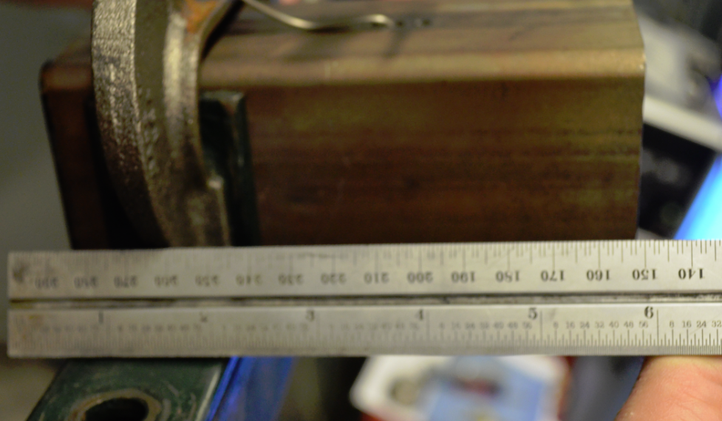
UC Shrouded Thermocouple

Slide 44
Shroud Test Results
*Test results from UC indicate trends similar to FAA findings*

Slide 45
Instructional Video for NexGen Cargo Liner Oil Burner Test Method

Slide 46
Cargo Test Instructional Video
Completed first rough cut of instructional video for NexGen cargo liner oil burner test method
Final video expected to be available by next Materials Working Group Meeting in June 2016
Instruction using NexGen burner only
Instructional video using Park oil burner for cargo test method already available

Slide 47
Future Testing and Development

Slide 48
Future Testing and Development
Conclude air velocity study and compare FAA results with UC results
Provide more specific guidance to labs regarding test cell conditions
Devise a method or plan allowing labs to modify test facilities to meet FAA specified criteria such as a “calibration test sample”

Slide 49
Questions?
timothy.salter@faa.gov
(1)-609-485-6952

