Slide 1
Flow Visualization in the OSU
Presented to: Materials Fire Test Working Group
By: Tina Emami
Date: March 6 2018

Slide 2
Introduction
PIV (Particle Image Velocimetry) system was set up around an OSU rate of heat release apparatus
The airflow through certain chambers of the OSU were measured and analyzed

Slide 3
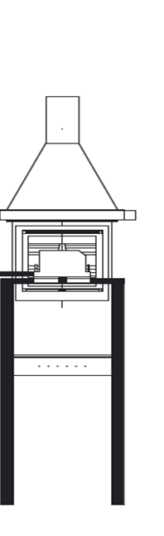
Test Setup
81.03mm
Aluminum oxide powder is seeded through the OSU
Laser light sheet is directed towards the side of the OSU and the PIV camera is placed perpendicular to this light sheet to capture seeding particles
Camera can capture data of size 81.03mm x 60.78mm
The width of the OSU fits 5 measurement frames
Measurement frame
60.78mm

Slide 4
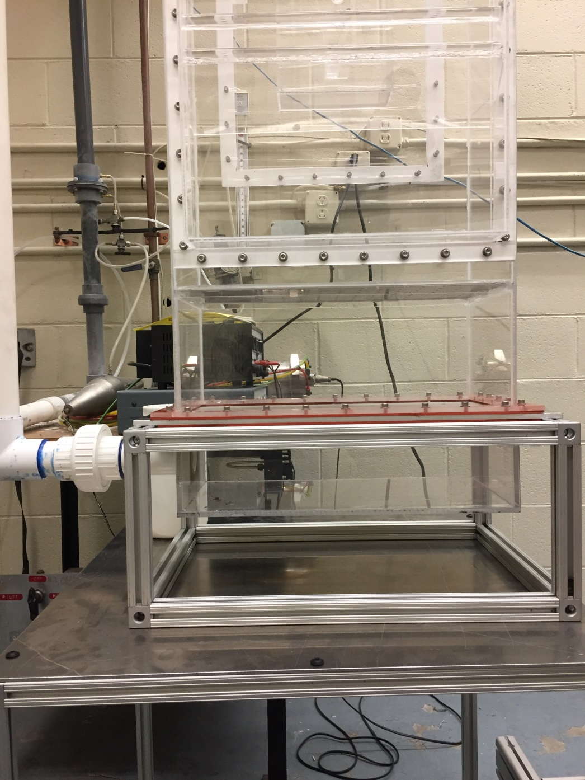
Test Setup 1
CAMERA
Chamber 1
LASER
OSU is oriented so the glow bars are facing the camera

Slide 5
Measurement Locations- Chamber 1

Slide 6
Bottom Chamber – Front View Current Test Setup
Results shown are averages of 500 data images

Slide 7
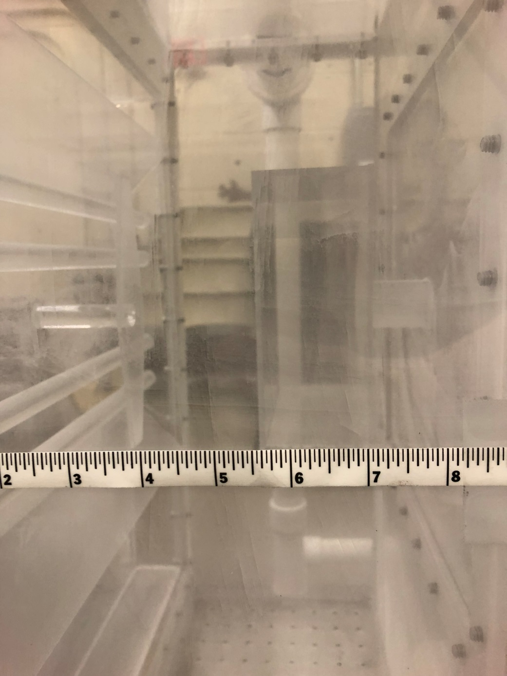
Test Setup 2

Slide 8
Test Setup 2
The PIV camera is aligned to see between the middle two glow bars

Slide 9
Near Test Sample – Front View Current Test Setup

Slide 10
Seeding Powder Collection
Air inlet

Slide 11
New Setup Comparison
Current Set Up
New Set Up

Slide 12
New Bottom Chamber Comparison
New Test Setup
Current Test Setup

Slide 13
New Near Test Sample Comparison
New Test Setup
Current Test Setup

Slide 14
New Test Setup Middle Frame
The 500 data images used to find the average that is highlighted on the new near test sample data

Slide 15
Ideas for Further Testing
Filling the bottom chamber of the OSU with reticulated foam
Testing the foam with and without air distribution plates

Slide 16
Ideas for Further Testing Cont.
A potential design where plates can be inserted above the first chamber to straighten the flow that is introduced to the test sample

Slide 17
Questions or Comments?
Tina Emami
FAA William J. Hughes Technical Center
ANG-E212 Materials Fire Test
Building 275
Atlantic City Int’l Airport, NJ 08405
tina.emami@faa.gov
609-485-4277

