Slide 1
Inaccessible Area Fire Tests on Composite Structure - Update

Slide 2
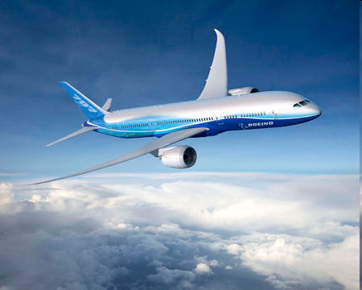
CFRP Aircraft Structures
Carbon fiber composites are being used more frequently in aerospace applications
Increased strength
Lower density
Better corrosion resistance
New designs of commercial transport airplanes include primary and secondary structure constructed from carbon fiber composites
14CFR 25.853 specifies requirements for flame resistance of cabin interior materials (panels, seat cushions, fabrics, etc.)
Current FAR’s do not require flammability testing for fuselage skins or structures, as traditional designs are inherently non-flammable
Special Conditions for certification of fire resistance of composite fuselage
Must demonstrate level of safety equivalent to or better than traditional constructions
To continue with the FAA’s efforts to enhance in-flight fire safety, materials in inaccessible areas of the cabin should meet a flammability test based on the “block of foam” fire source

Slide 3
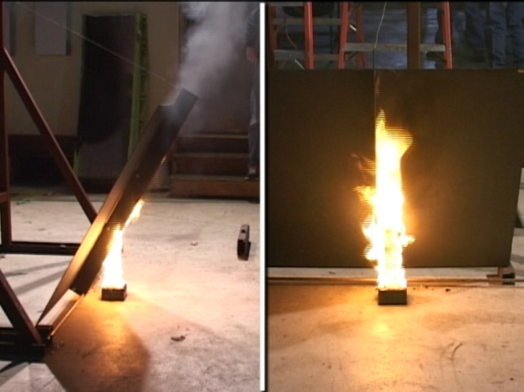
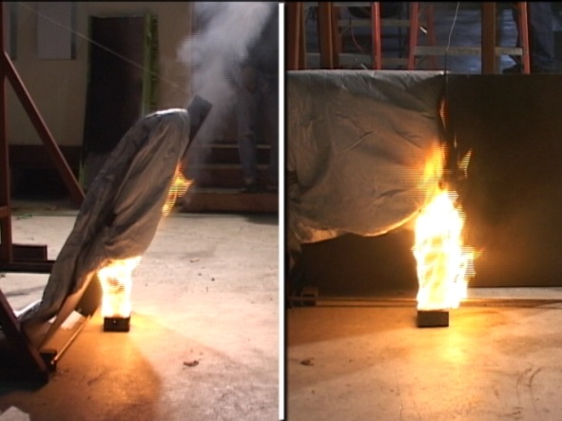
Initial CFRP Flammability Testing
Frame
Flaming Block of Foam
Shear Tie
Stringer

Slide 4
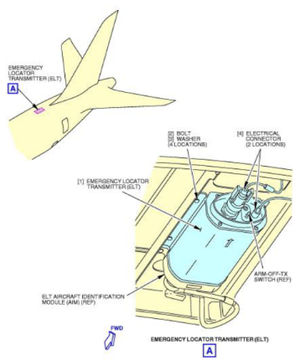
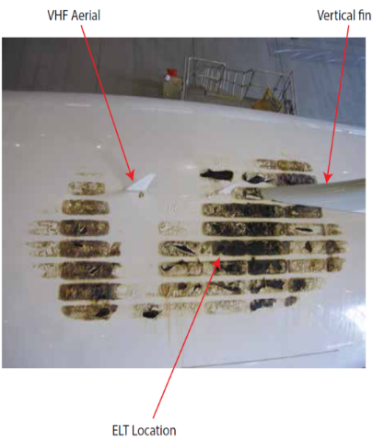
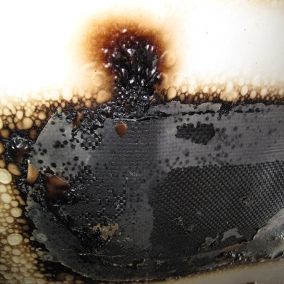
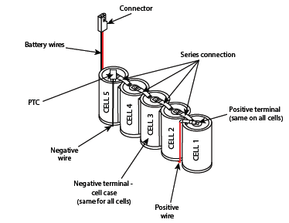
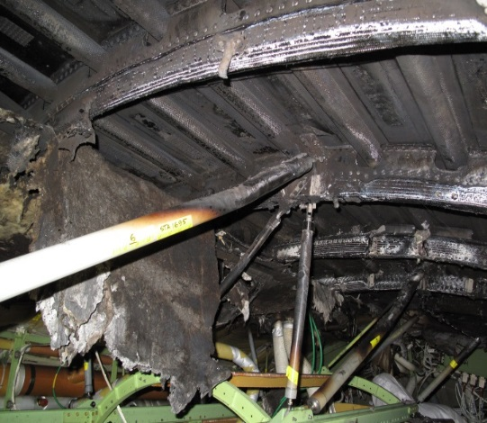
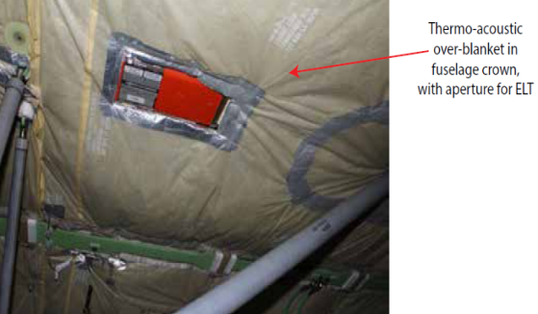
ET-AOP 787 Fire, London Heathrow, July 2013

Slide 5
Outlet Temp [°F] | Inlet Temp [°F] | ΔT [°F] | Flowrate [mL/min] | Flowrate [GPH] | Flowrate [lb/hr] | Q [BTU/hr] | Q'‘ [BTU/ft2s] | Q'‘ [W/m2]
125 | 116 | 9 | 2070.00 | 32.81 | 272.32 | 2477.25 | 0.15 | 1666.53
$$Q=mc_{p}∆T$$
T_{i}=116°F
$$Q=272.32\frac{lb}{hr}×1\frac{BTU}{lb℉}×\left(125℉−116℉\right)=2477.25\frac{BTU}{hr}$$
Power Supply
Heater Power Input = 843 Watts= $2876\frac{BTU}{hr}$
Heat Transfer Calculation Error =
$$\frac{\left(2876\frac{BTU}{hr}−2477\frac{BTU}{hr} \right)}{2876\frac{BTU}{hr}}=0.14$$
To Blanket Heater
Flowrate=272.32 lb/hr
T_{o}=125°F

Slide 6
In flight conditions:
M=0.85
Velocity $U=903\frac{Km}{hr}=250.8\frac{m}{s}$
Altitude=40,000’=12,192m
Density $ρ=0.302\frac{kg}{m^{3}}$
Dynamic Viscosity¹ $μ=14.27×{10}^{−6}Pa∙s=\left(\frac{N}{m^{2}}\right)∙s=\left(\frac{\frac{kg∙m}{s^{2}}}{m^{2}}\right)∙s=14.27×{10}^{−6}\frac{kg}{m∙s}$
Temperature $T=−69.7℉=216.65K$
Pressure $P=2.72 psi=18,753.9 \frac{N}{m^{2}}$
Reynolds Number $Re=\frac{ρUδ}{μ}$
Characteristic Length $δ=62m$(fuselage length)
$Re=\frac{0.302\frac{kg}{m^{3}}∙250.8\frac{m}{s}∙62m}{14.27×{10}^{−6}\frac{kg}{m∙s}}=3.29×{10}^{8}$
$Nu=\frac{hx}{k}$
Thermal Conductivity¹
$k≈0.01965 \frac{W}{m∙K}$
$Pr=\frac{ν}{α}=\frac{μC_{p}}{k}$
Dynamic Viscosity¹
$μ=14.27×{10}^{−6}Pa∙s=\left(\frac{N}{m^{2}}\right)∙s=\left(\frac{\frac{kg∙m}{s^{2}}}{m^{2}}\right)∙s=14.27×{10}^{−6}\frac{kg}{m∙s}$
$\text{Specific} \text{Heat} \text{Capacity}$
$c_{p}=1.005\frac{kJ}{kg∙K}$
Thermal Conductivity¹
$k=0.01965 \frac{W}{m∙K}$
$Pr=\frac{ν}{α}=\frac{μC_{p}}{k}=\frac{14.27×{10}^{−6}\frac{kg}{m∙s}∙1005\frac{J}{kg∙K}}{0.01965\frac{W}{m∙K}}=0.72984$
¹ Viscosity and Thermal Conductivity of Dry Air in the Gaseous Phase K. Kadoya, N. Matsunaga, A. Nagashima, J. Phys. Chem. Ref. Data, Vol. 14, No. 4, 1985

Slide 7
Flat Plate in Parallel Flow with Unheated Starting Length
$$U_{∞}, T_{∞}$$
$$δ$$
$$δt$$
$$T_{s}=T_{∞}$$
$$T_{s}>T_{∞}$$
Fire
$$x$$
Aircraft Skin
$$ξ$$
Uniform surface heat flux, turbulent flow, unheated starting length
${Nu}_{x}=0.0308{{∙Re}_{x}}_{}^{4/5 }∙{Pr}^{1/3}$, 0.6≲Pr ≲60 ${Nu}_{x}=\frac{hx}{k}=0.0308{{∙Re}_{x}}_{}^{4/5 }∙{Pr}^{\frac{1}{3}}$ $h=\frac{1}{62 m}∙0.01965 \frac{W}{m∙K}∙0.0308∙{\left(3.29×{10}^{8}\right)}^{\frac{4}{5}}∙{\left(0.72984\right)}^{\frac{1}{3}}$ $h=57.24 \frac{W}{m^{2}K}$
$q^{′′}=h\left(T_{s}−T_{∞}\right)=57.24\frac{W}{m^{2}K}×\left(T_{s}−T_{∞}\right)K=\frac{W}{m^{2}}$

Slide 8
At an ambient air temperature of -70°F (216K)
Need to calculate outside surface temperature
~500°F (533K) : observed during CFRP burn tests with FLIR
70°F (294K) : inside cabin temperature
$$q^{′′}=57.24\frac{W}{m^{2}K}×\left(T_{s}−216\right)K$$
For T_{s} of 500°F (533K), q’’=18,145 W/m²
For T_{s} of 70°F (294K), q’’=4,464 W/m²
Heat Transfer Rig Only Reaches q’’=1,666 W/m²
With current configuration
Corresponds to a T_{s} of 245K=-18.67°F

Slide 9
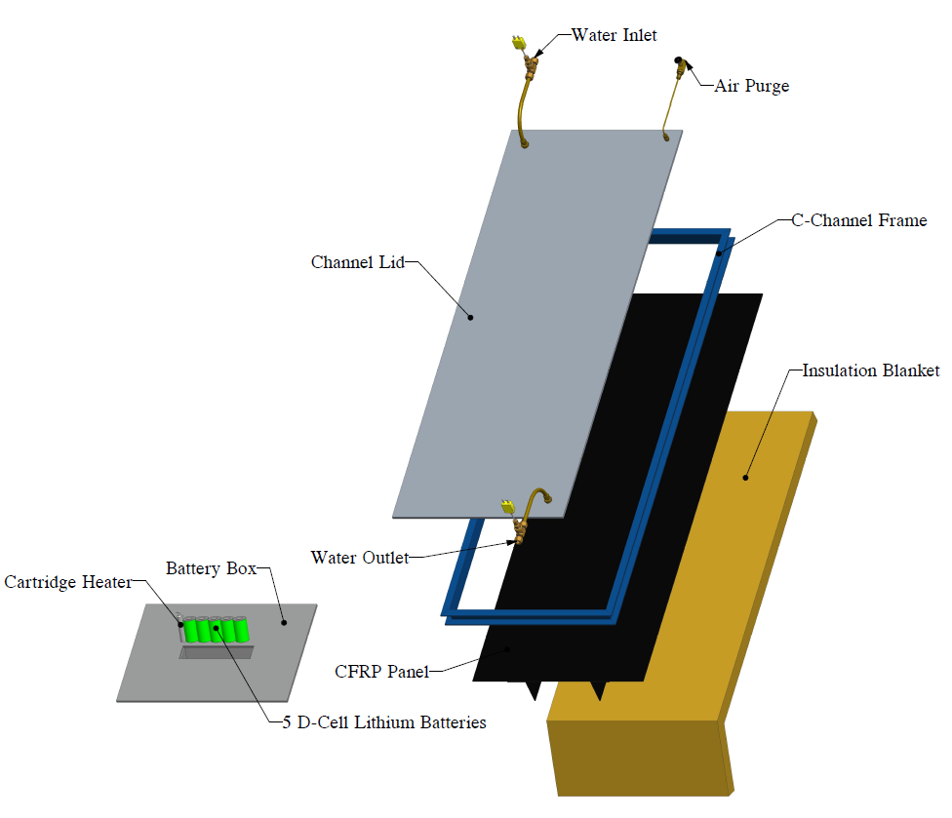

Slide 10
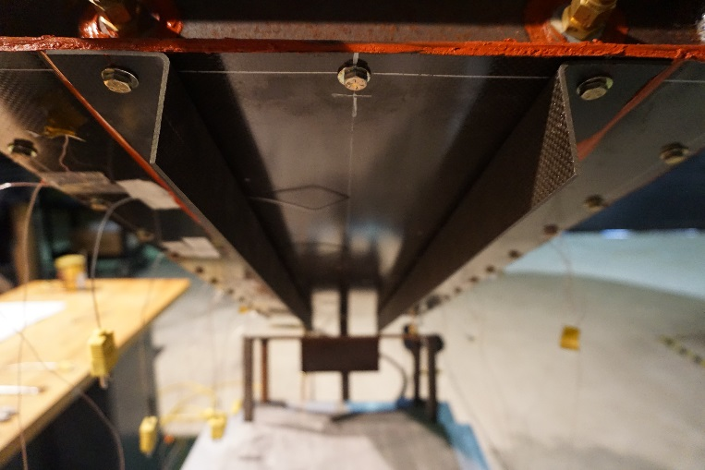
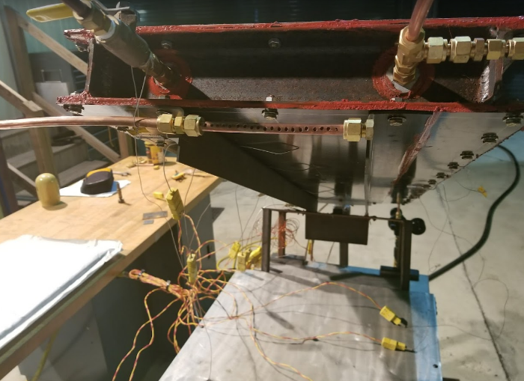
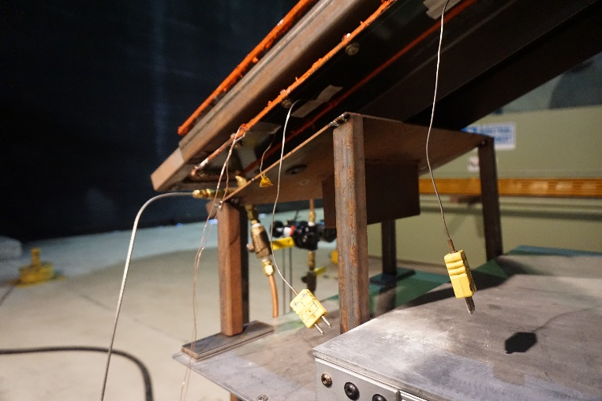
Channel Dimensions
6 ¾”
2 ½”
Gas Measurement
Simulated ELT
Ignition Source
Insulation Attached
To Test Fixture

Slide 11
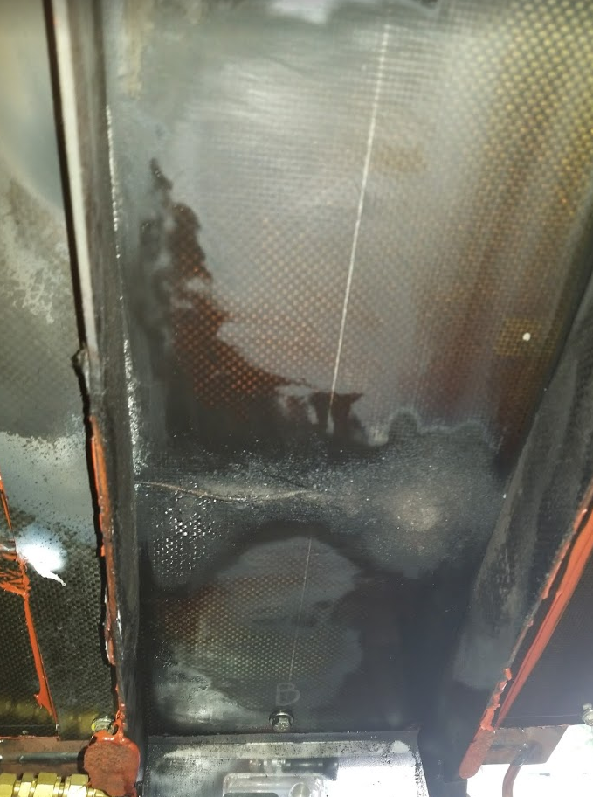
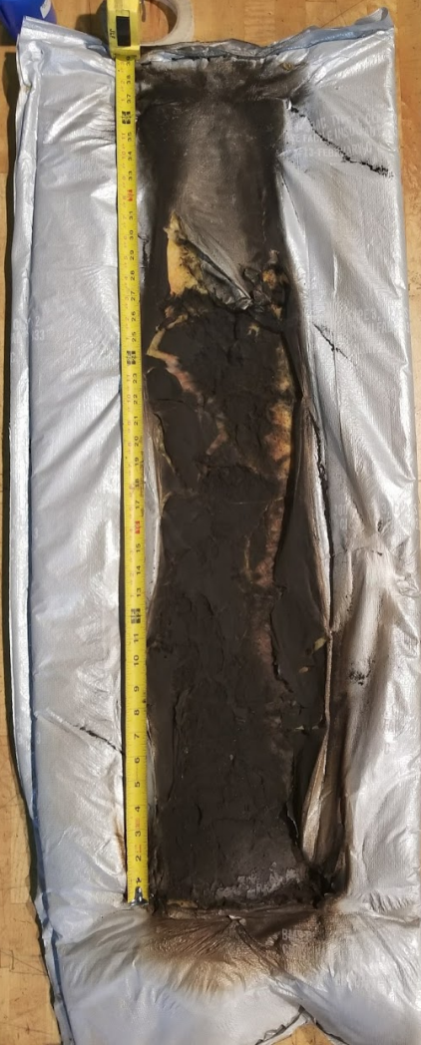

Slide 12
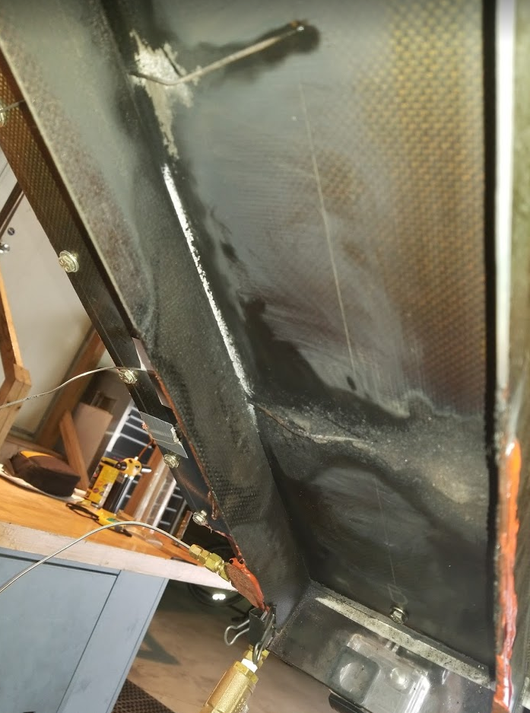

Slide 13
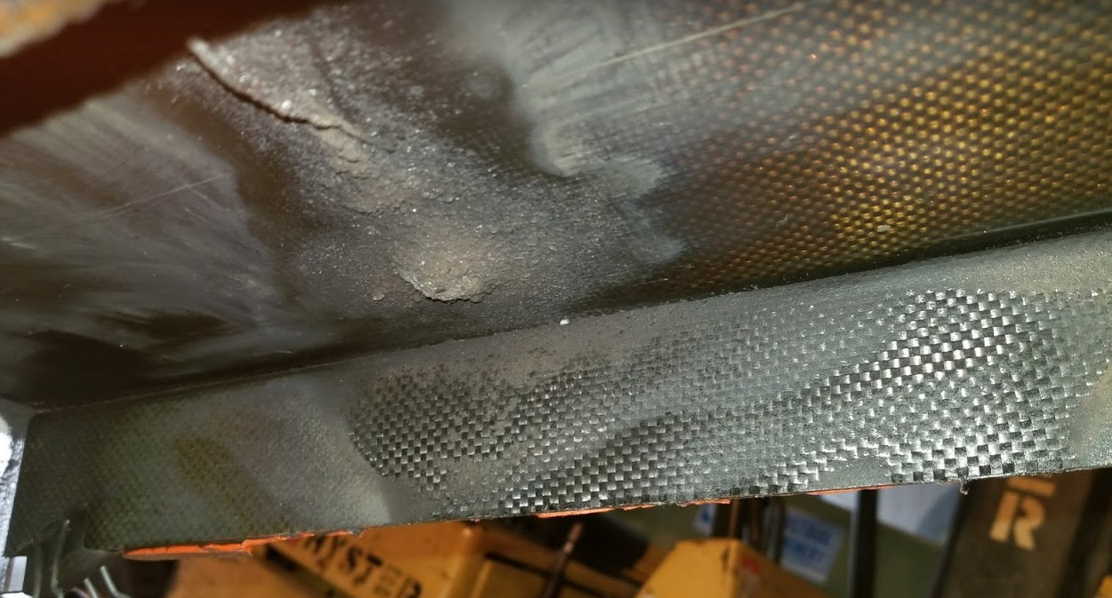

Slide 14
Heat Transfer Calculation
Energy required for water heating
$$Q=mc_{p}∆T$$
Q is heat, BTU
m is mass of water heated, lb.
c_{p} is heat capacity of water, $1\frac{BTU}{lb ℉}$
$∆T$ is temperature difference, $℉$
Heat Flux $Q^{′′}=\frac{Q}{At}$
Q’’ is heat flux, $\frac{BTU}{{ft}^{2}s}$
A is area, ft²
t is time, sec
T_{i}
T_{o}

Slide 15
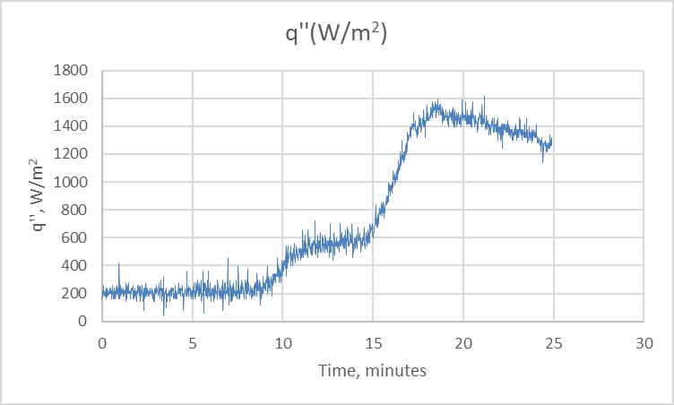
Heat Transfer Rate Calculated From Cooling Water ΔT
Estimated in-flight cooling:
For T_{s} of 500°F (533K), q’’ = 18,145 W/m²
For T_{s} of 70°F (294K), q’’ = 4,464 W/m²
Measured Heat Transfer Max = 1,617 W/m²
Below estimated in-flight range of
4,464 to 18,145 W/m²

Slide 16
Next Test
During previous test, the most damage was found on structure that was not in direct contact with outboard cooled surface
A second test will be performed with additional structure, including stringers, frames, and shear ties, that are not in contact with the outboard surface

