Slide 1
Vertical Flame Propagation Test Method (VFP)
Materials Working Group
Rick Whedbee
Oct 30-31, 2017

Slide 2
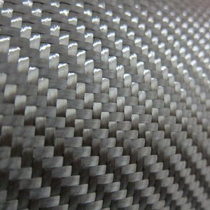
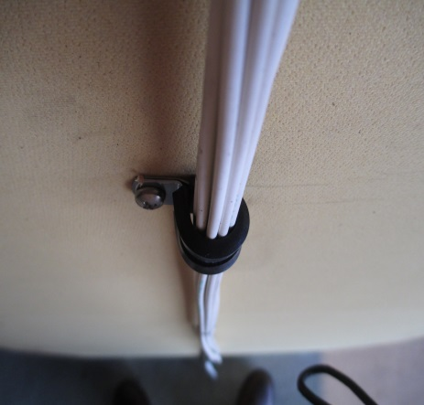
Background
Planned method to test composite structure components and other non-metallic, extensively used parts in inaccessible areas.
Composite Fuselage
Wires
Ducting
Sleeving
This test method was developed from values established with the intermediate scale foam block test.

Slide 3
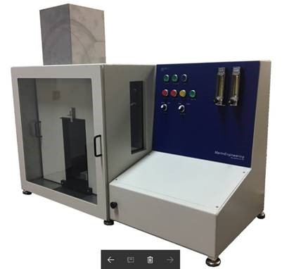
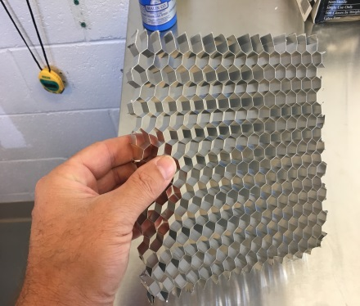
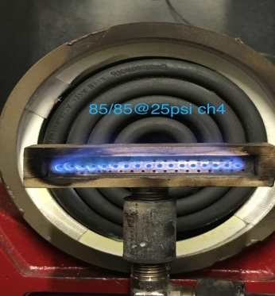
Updates/Changes
Diffuser w/Airflow Values
Ribbon Burner
Methane/Propane Comparison
Chamber Temps
Ducting
Progress of Commercial Unit(s)
Notes:
Unfortunately we don’t have a large data set to share with you today as samples have been hard to come by as well as some other hurdles…so this should be pretty painless. I HOPE! Here are some of the things we will highlight today: airflow values, burner comparison, methane vs propane, chamber temperatures, duct samples, future work, and then finally progress of commercial fixtures.

Slide 4
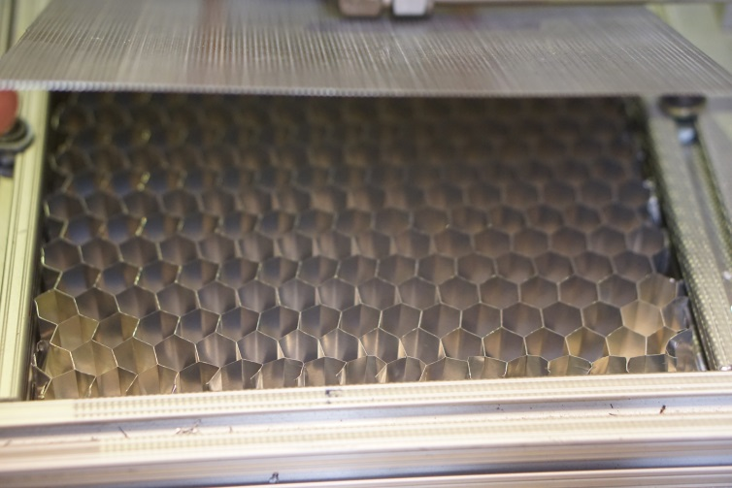
Make-up air Diffuser
Old filter media: 141 fpm
Metal media: 138 fpm

Slide 5
Ribbon Burner
Gen 1 Ribbon Burner
Marlin Burner

Slide 6
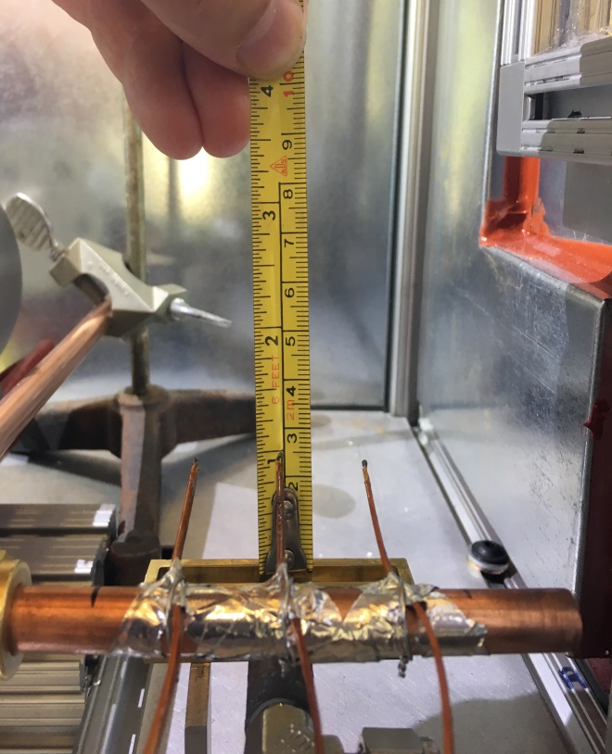
Ribbon Burner Cont.

Slide 7
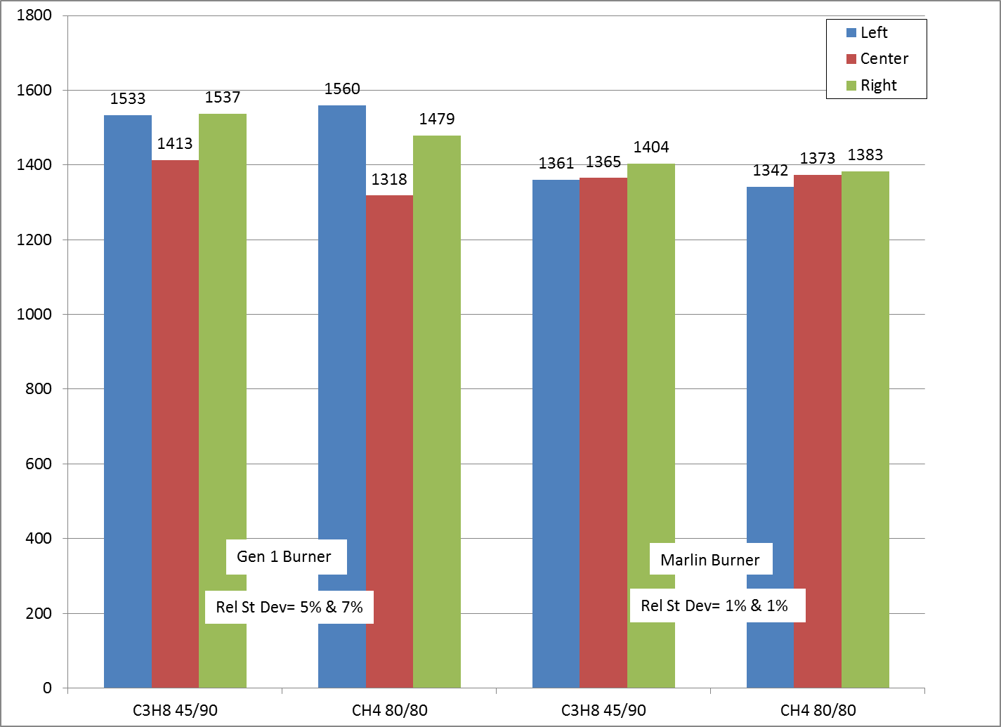
Ribbon Burner Cont.
Temp (F)

Slide 8
Impingement Comparison
Gen 1 Ribbon Burner
Marlin Burner
Notes:
The result is visible with a more even heat signature at the impingement point. Fabrication matters!...and the design will probably have to be within very specific parameters.

Slide 9
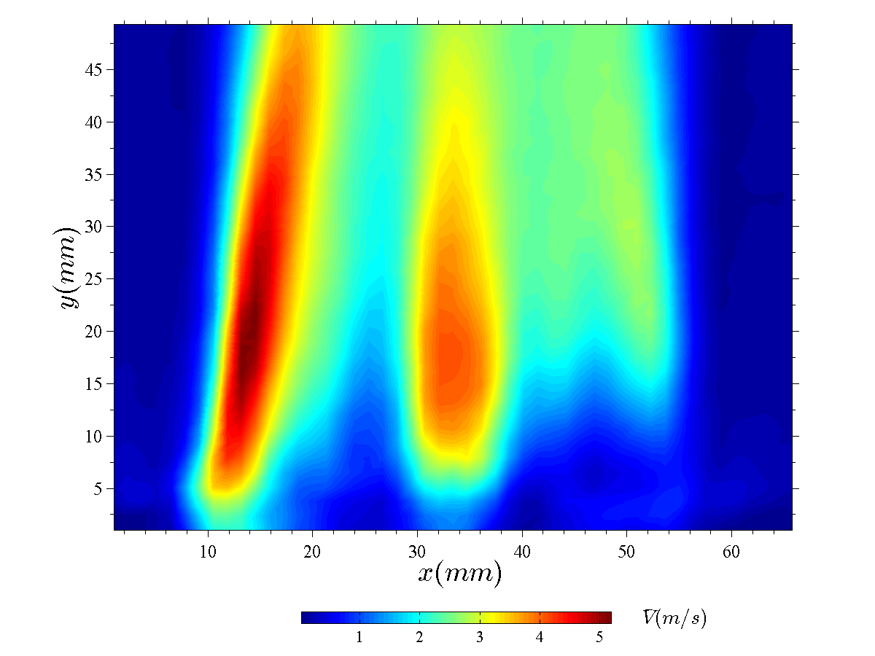
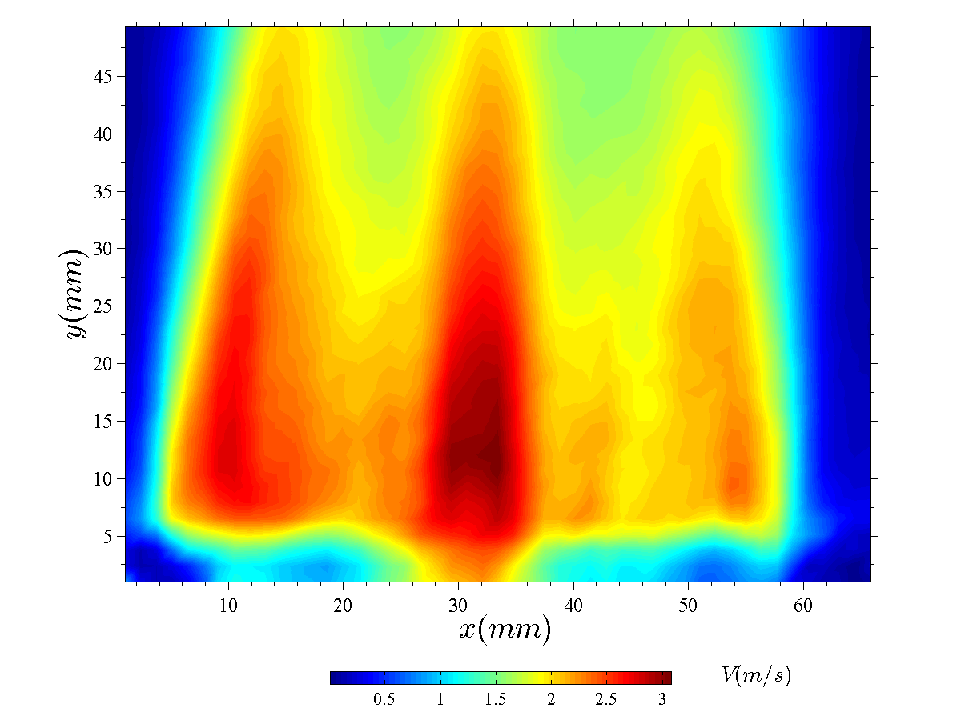
Mean Velocity Fields
Gen 1 Burner
Marlin Burner
Notes:
And just to solidfy this just a little further I borrowed this data from Rob, this is a PIV image showing the difference in velocities of the old burner vs the Marlin Burner. The scale on the bottom tells us that the more red the color the higher the velocity, translating equally to temps.

Slide 10
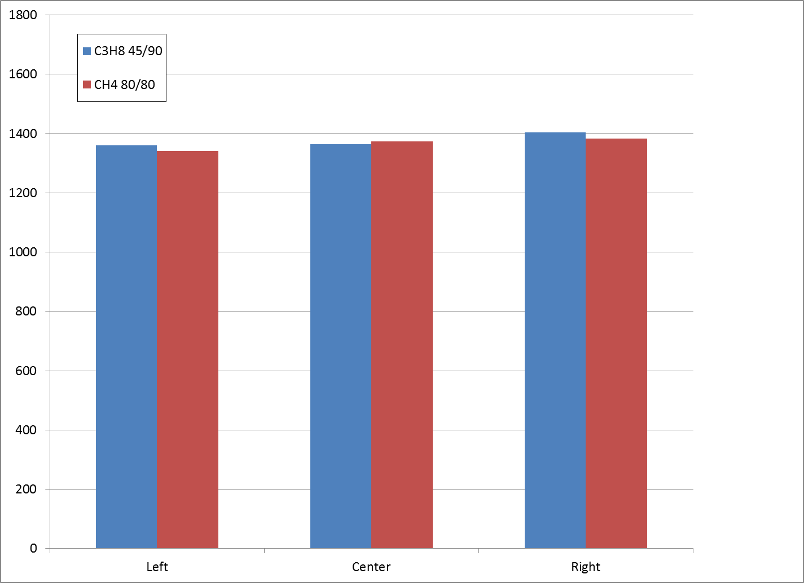
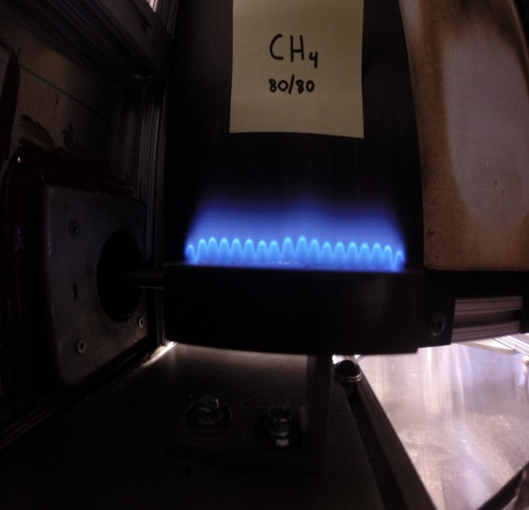
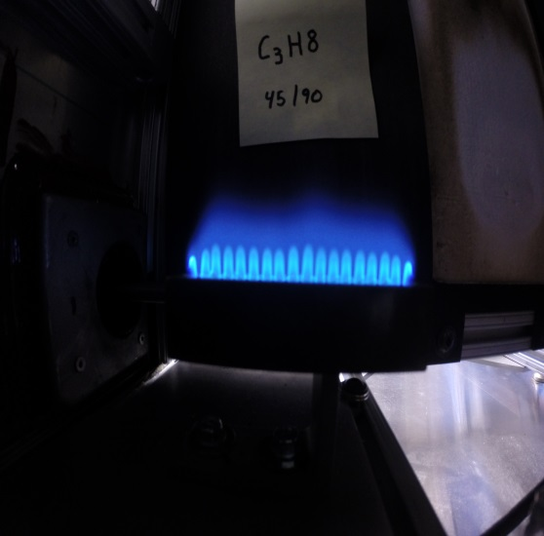
Methane Vs Propane
Temp (F)

Slide 11
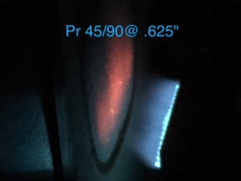
Methane vs Propane cont.
Began to notice visible differences day/day, test/test.
Fuel, new burner, flows?
Began trials with mass flow controllers to quantify air/fuel flow rates

Slide 12
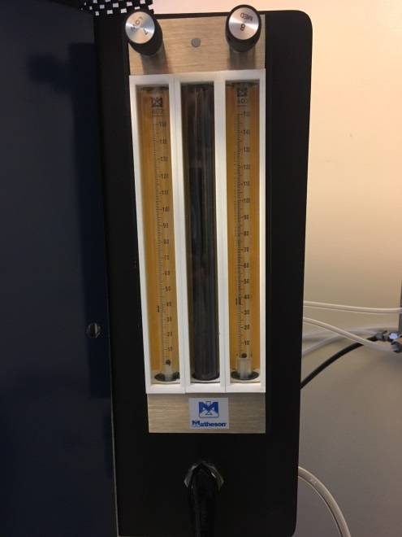
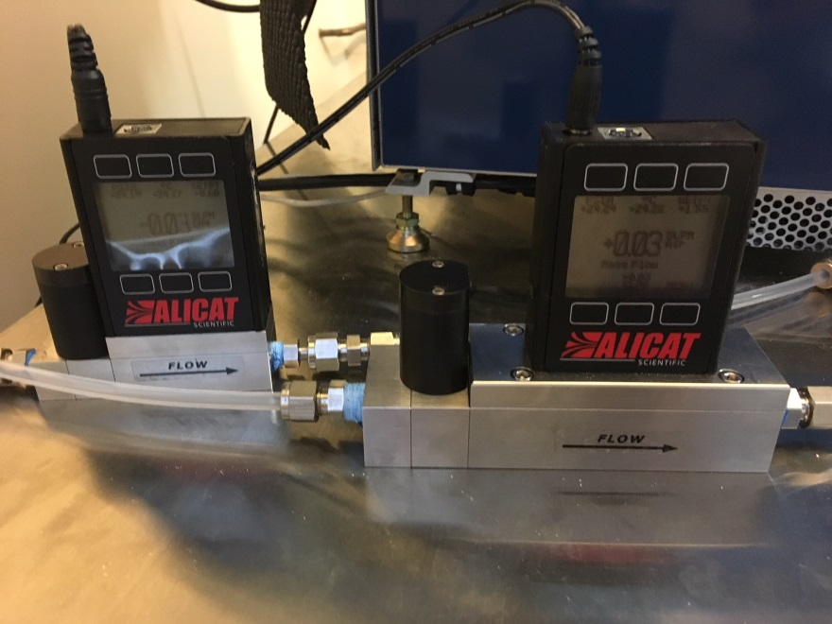
Flow control
MC-20SLPM-D/5M
MCP-50SLPM-D/5M
$2700 w/ peripherals
G24B201E301/E5
$1000 +/-
Notes:
Until now we have referenced our fuel flows such as 45/90, 80/80 or 100/100 etc. These numbers come from the rotometer world where flows were are measured in a 150mm long tube with a glass float. The numbers corresponded as a measurement of that tube. These values then had conversion factors to a flow correcting for gas weight, temp and pressures. Obviously there is a cost increase to go this route, however we feel the benefit of accuracy is worth it in the end. Ultimately, we don’t have exact flow rates yet as more work remains to be done with the mass flow controllers.

Slide 13
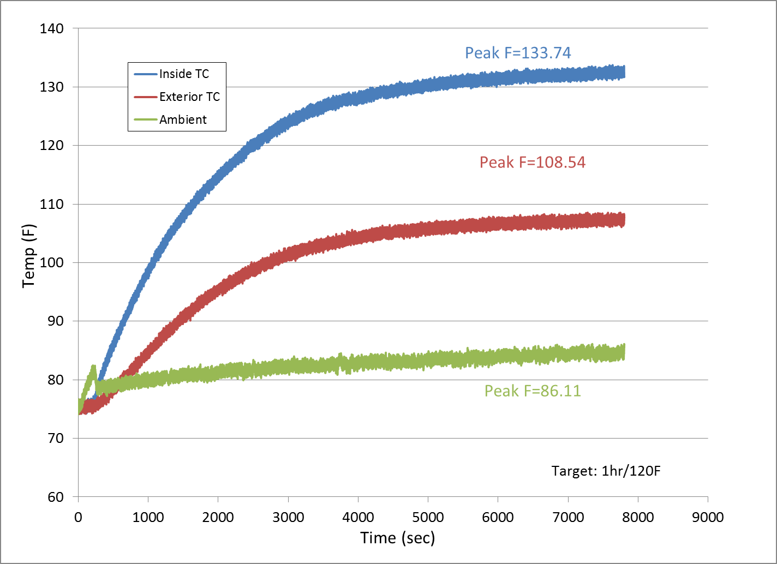
VFP Chamber Temp
Notes:
We are working towards a target temp that will be our go/no go reference thermocouple going forward. In this 2 hour test we reached a peak internal temp of about 133F so we will be in the ball park of about 1 hr and/or 120F for that target.

Slide 14
Ducting Materials
Ideal Sample Configuration?
Notes:
Ok so on to duct materials; what is the best configuration to introduce these samples of various diameters, materials, and design? This is just a short video of a standard silicone duct with nylon ribbing. This sample is 1” in diameter and was left intact for this test, only cut to length.

Slide 15
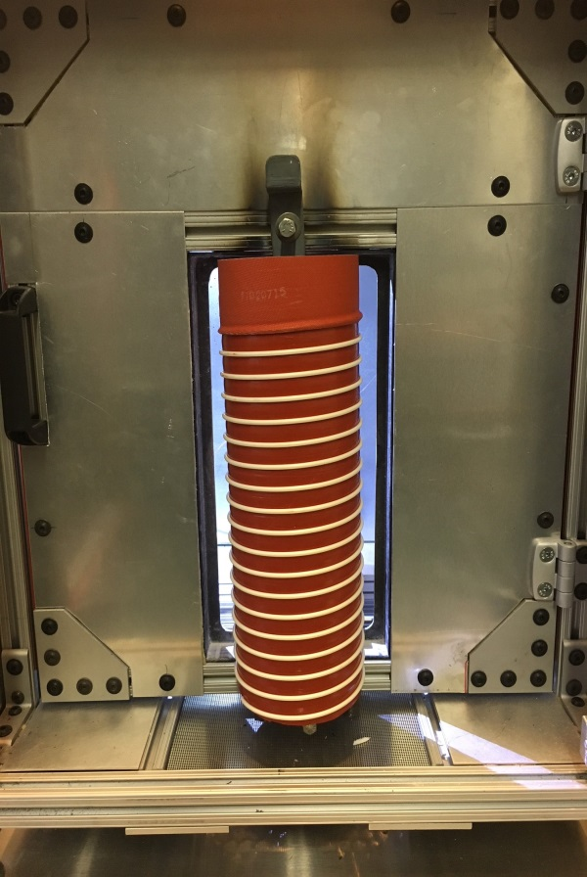
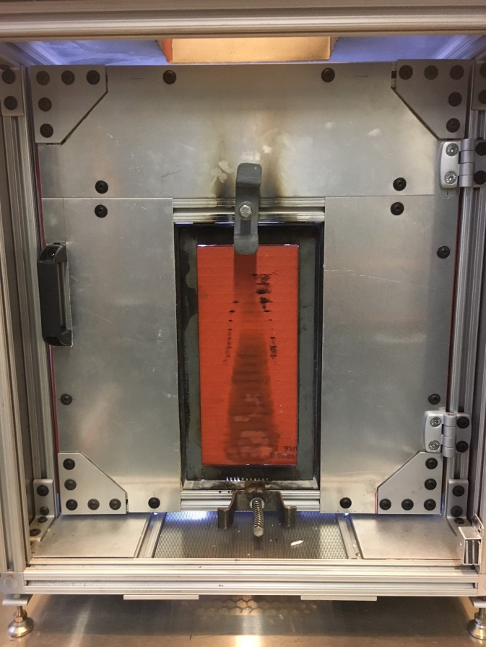
Ducting Materials
Intact, as designed
Sheet Lay up

Slide 16
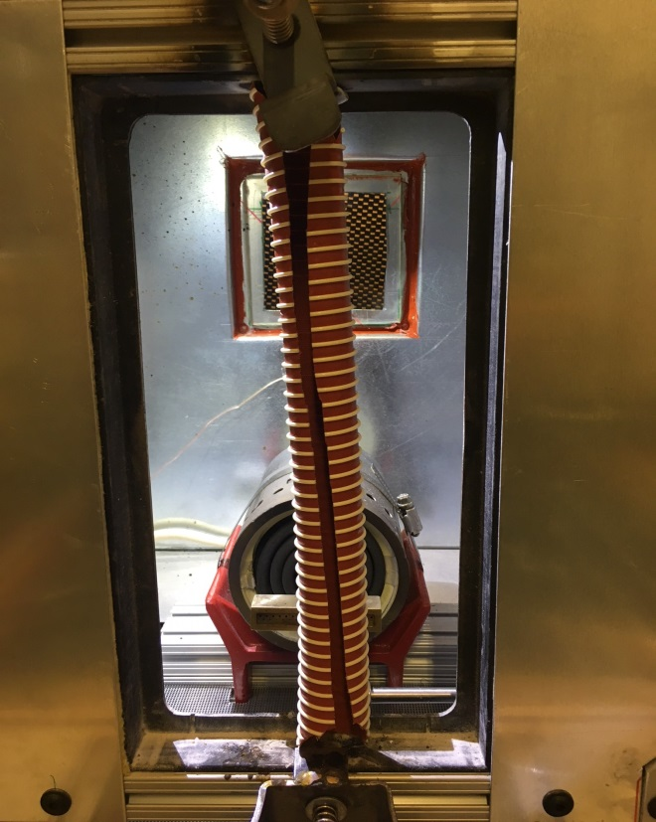
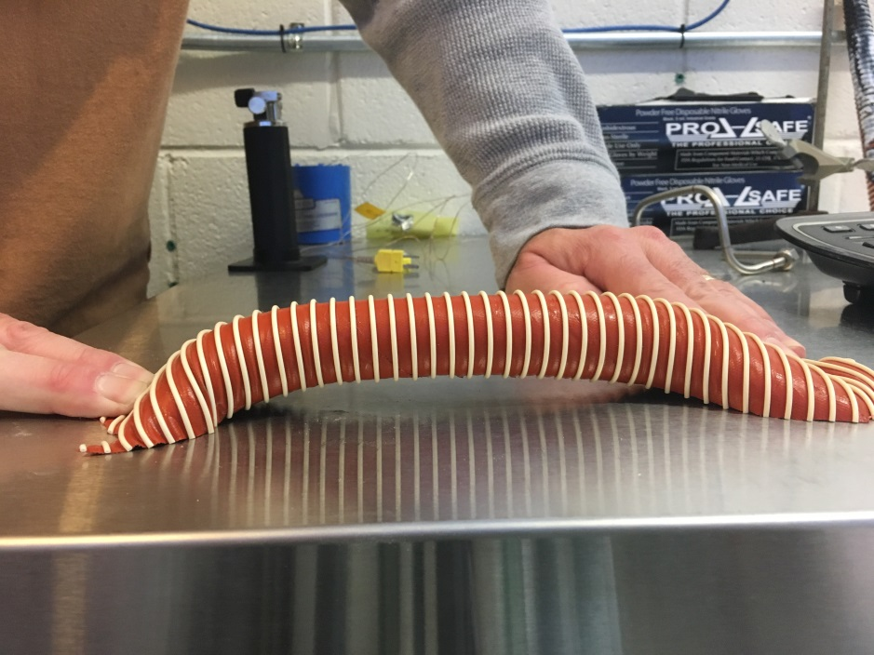
Ducting
Filet
????

Slide 17
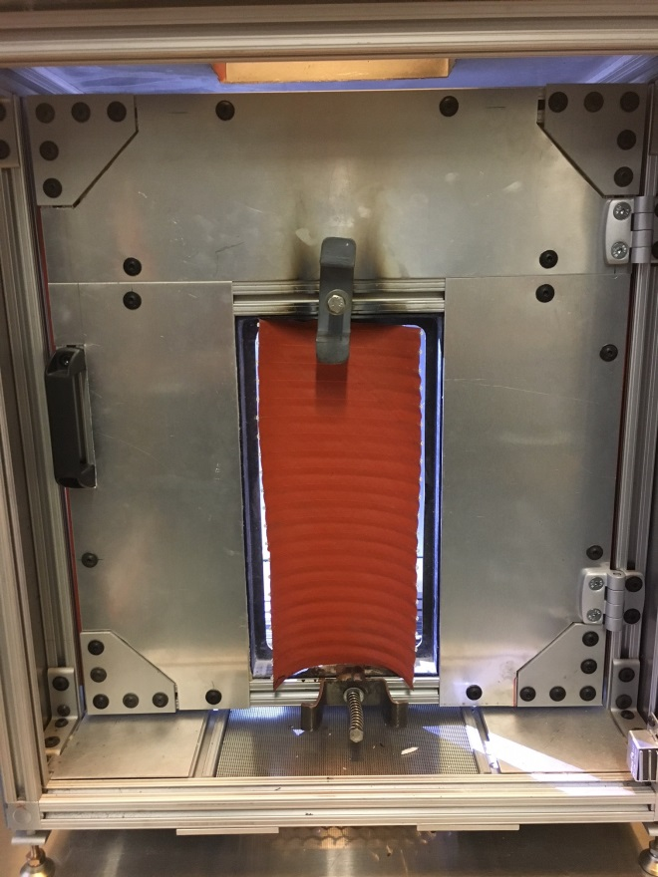
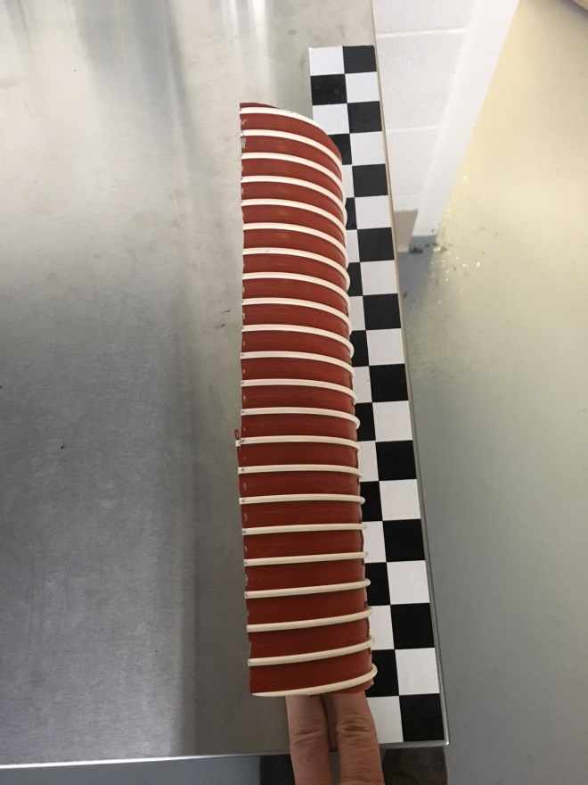
Ducting
Vertical Cross Section
Notes:
And lastly we tested a vertical cross section on a 4” silicone/nylon sample. All of those configurations seem to work, (with the exception of that filet job) for this particular product but they probably introduce more variables to the mix than perhaps we would like. For example the air movement around the open sides between the sample and the sample holder, or the possibility of backside involvement as we saw with the smaller diameter tubes.

Slide 18
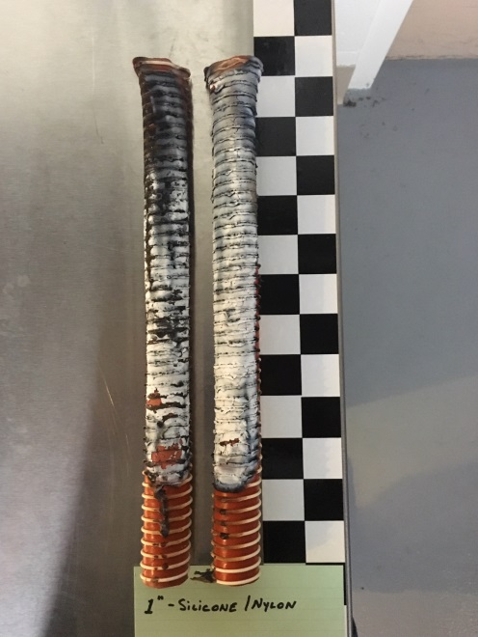
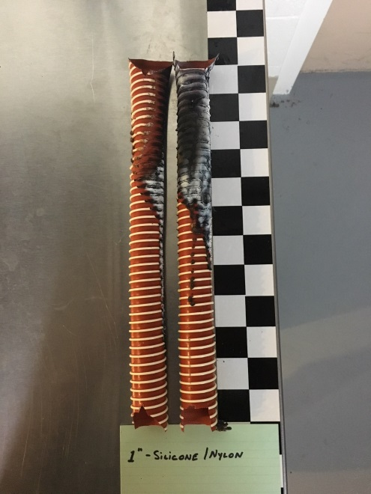
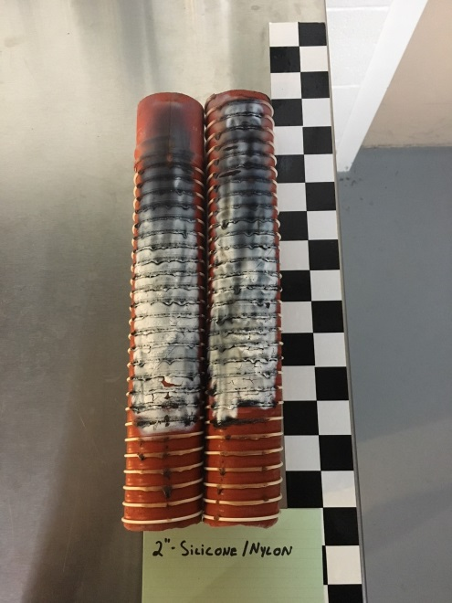
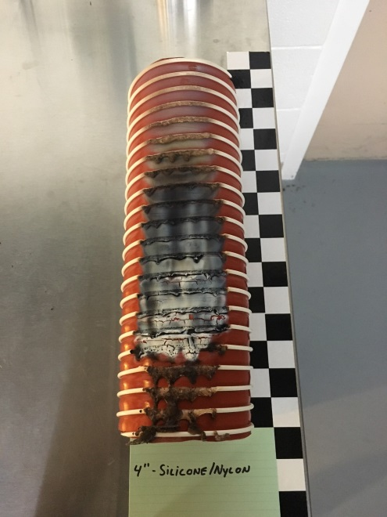
Ducting
Post-Test measurements
Notes:
Then of course there's the post test measurements, totaling the burned surface area of a cylinder as opposed to a flat sheet type layup. The varying sizes of this particular material didn’t seem to matter as far as ignition goes.

Slide 19
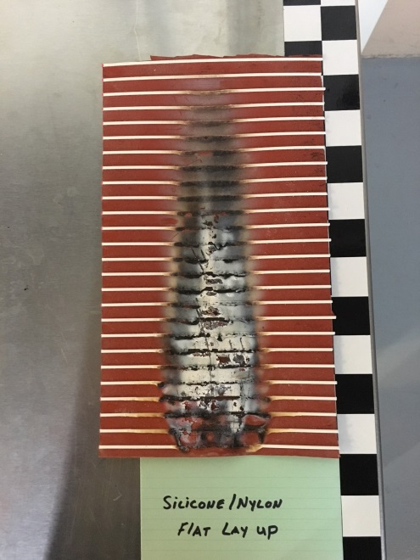
Ducting
Post-Test Measurements
Notes:
I should mention that in this case it did not matter how the sample was introduced. Rather the spacing of each nylon rib had a greater effect on the burn length than the shape of the sample. So going forward, there should be samples tested that are a 1 to 1 representation of any different configurations. Even though they may be the same materials.

Slide 20
Future Work
ASAP:
-Flow rates for both CH4 & C3H8
-Finalize pilot flame parameters
-Substrate for sleeving
-Sample holder for wires
-Verify dimensions and performance of commercial units

Slide 21
Voilà!
Marlin VFP

