Slide 1
AkroFire
Shipment of Lithium Batteries
Technology Concept, Development and Testing
- update -
Jonathan Green
The statements contained herein are presented in good faith
for general information only.

Slide 2
Shipment of Lithium Batteries
AkroFire
Presentation follows on from the one made at the:
Seventh Triennial International Fire & Cabin Safety Research Conference (December 2013)
http://www.fire.tc.faa.gov/2013Conference/files/Battery_Fires_II/GreenBatteryPackaging/GreenBatteryPackaginPres.pptx
and provides an update on the continued research and development.

Slide 3
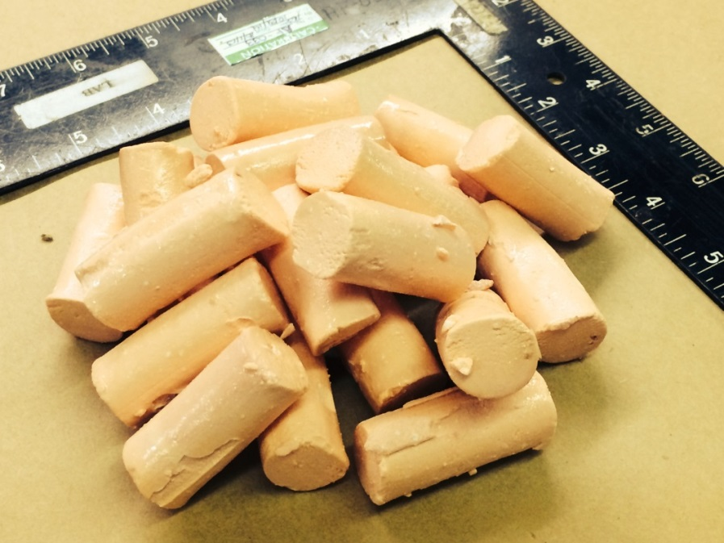
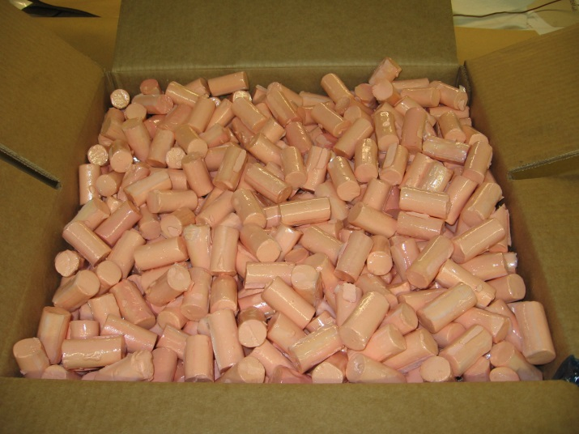
Shipment of Lithium Batteries
Background
Using the guidelines provided by the FAA: Protection for the Shipment of Lithium Batteries in Aircraft Cargo Compartments
Concept: ‘overpack’ method that utilizes a free-flowing, loose fill “Packing Nut” that would provide a versatile method for safely transporting Lithium batteries and lithium battery containing equipment.
‘Versatile’ in that the loose fill could be used with other common packaging media such as HazMat rated cardboard boxes.
Packaging needs to be fiscally practical

Slide 4
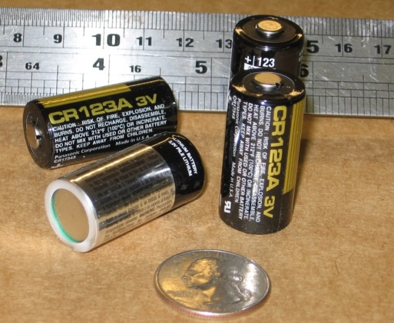
Shipment of Lithium Batteries
The testing parameters used for the development are:
1. Protect batteries from external fire: direct flame impingement
2. Protect batteries from heat: halon suppressed cargo fire
3. Containment: Prevent a battery thermal runaway from affecting adjacent shipments
Various batteries have been used in the research however most frequently CR123 3v 1550mA.hr Primary Cells are used as an ideal test specimen:
Highly energetic
Readily available
Render more conservative testing when
compared to Li-ion Secondary (rechargeable) cells
One C123 has a similar power capacity as a ‘smart phone’

Slide 5
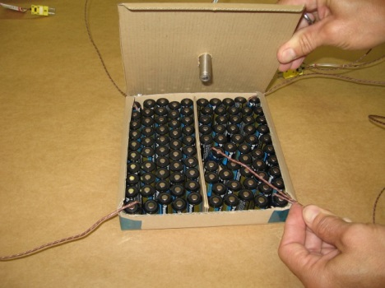
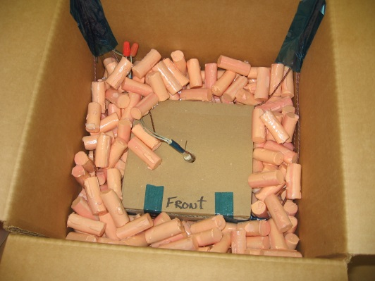
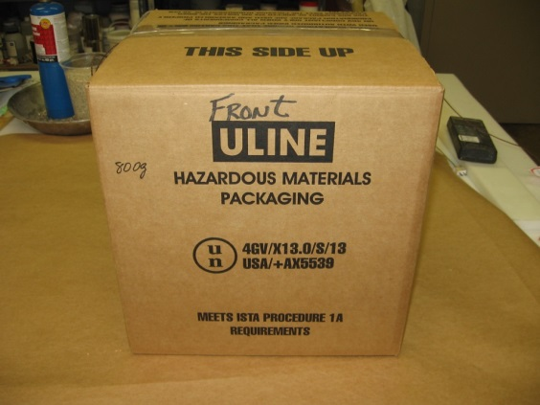
Shipment of Lithium Batteries
In all testing, a standardized packaging method was used which utilized an inner battery containing carton packed in an outer HazMat box. The inner space filled with the packing nuts:
100 cells packed in single
wall inner carton.
Inner carton surrounded
by packing nuts.
Double-wall outer box taped
shut.

Slide 6
Shipment of Lithium Batteries
In such a configuration, it was shown that multiple 100’s of batteries could be protected from
Direct Flame Impingement: prevent the packed batteries from the effect of exposure to flame.
Thermal Protection: protect the packed batteries from the thermal effects of a controlled cargo compartment fire.
Contain thermal runaway: prevent the thermal and fire threat to adjacent packages
- Smoke leaking through seals is acceptable
Fire or flames escaping is not acceptable
Packing must maintain its structural integrity

Slide 7
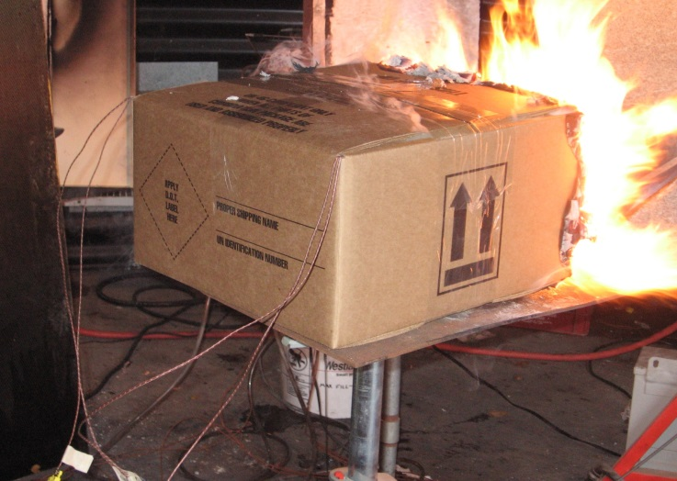
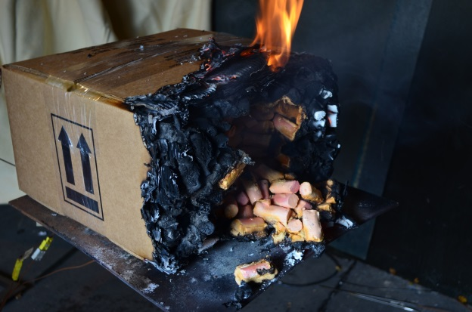
Shipment of Lithium Batteries
Direct flame impingement
Oil burner in horizontal configuration.
Burner throttled to:
Heat Flux: 7.5BTU(ft²sec) / 8.6W/cm²
Flame Temp: min 1600ºF / 871ºC
(generally as per requirements of FAR25.855
cargo liner burn through)
Result
Maximum ‘battery’ temperature after 5 min
= 92ºF / 33ºC

Slide 8
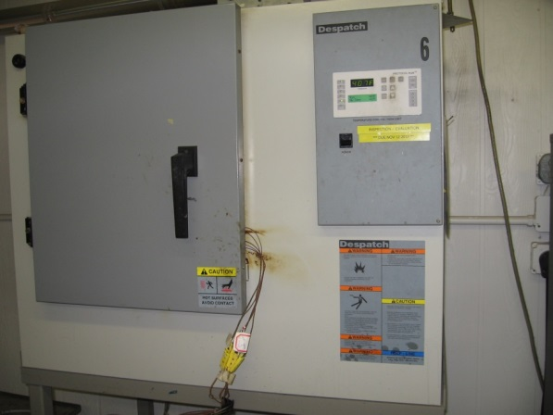
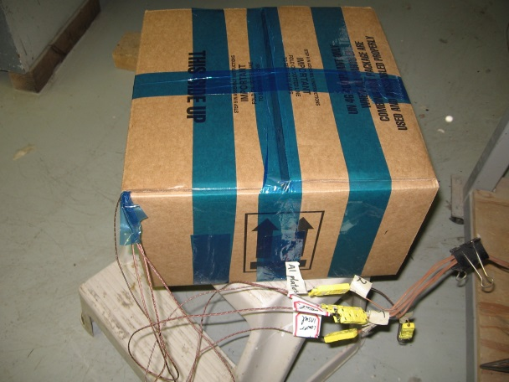
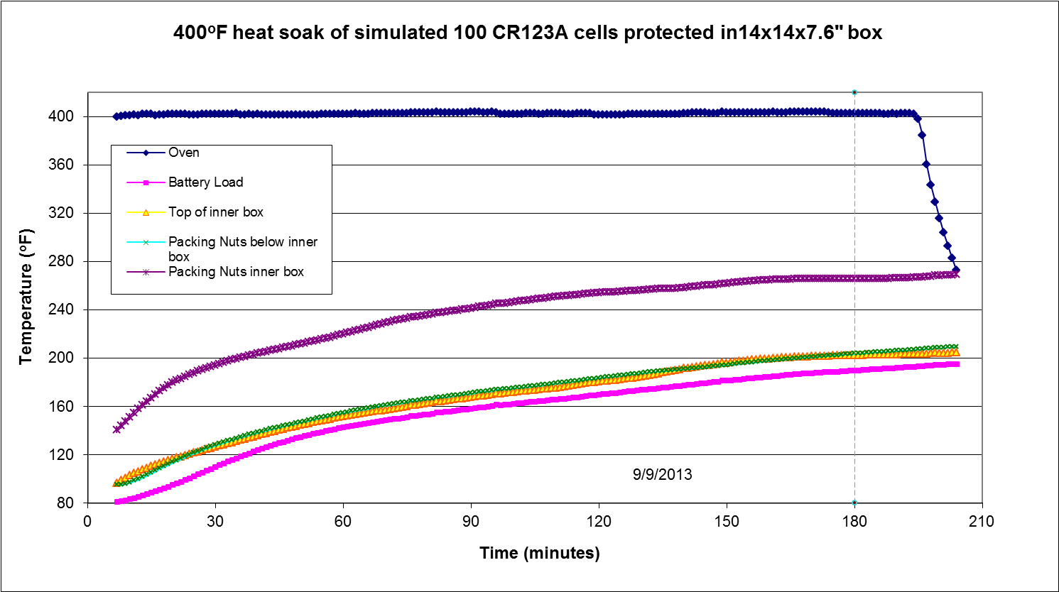
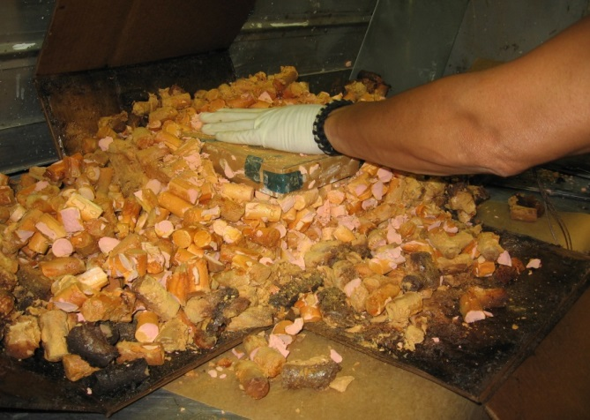
Shipment of Lithium Batteries
Suppressed cargo fire – Thermal Resistance Test
General parameters as per PHSMA Rule HM224B:
400ºF / 204ºC Environment for 3 hours. cargo compartment during a halon suppressed fire + aircraft diversion. Critical internal temperature is the point at which thermal runaway is initiated:
Lithium Metal: ~350ºF
Lithium-ion: ~ 450ºF
Lithium –polymer: ~ 330ºF

Slide 9
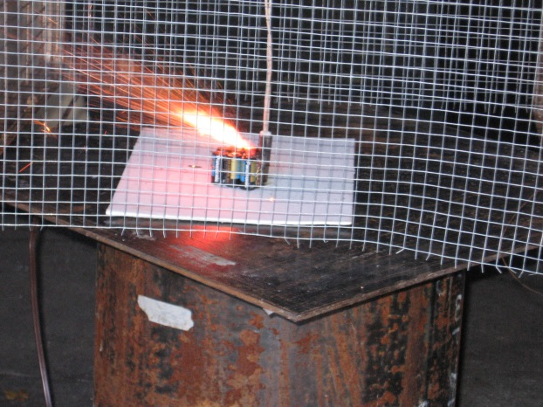
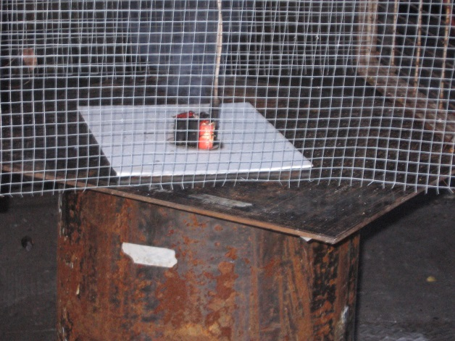
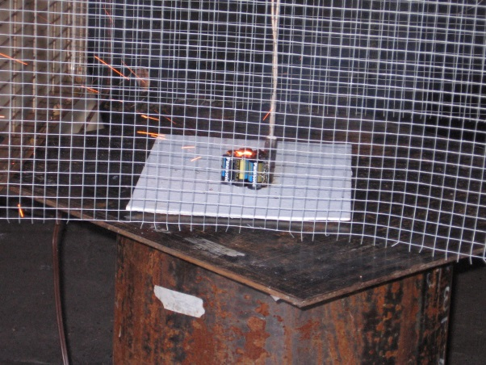
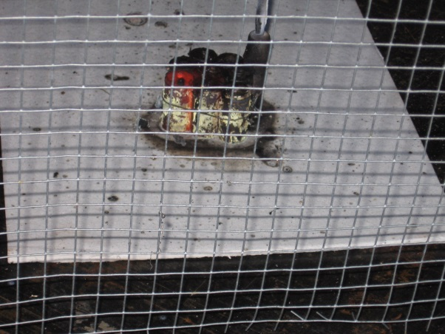
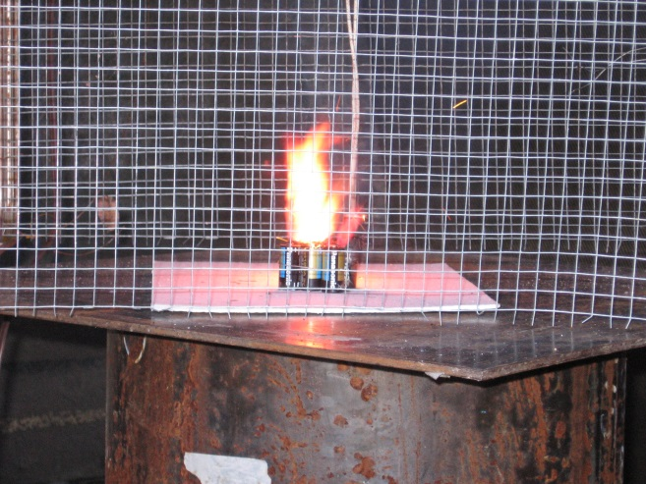
Shipment of Lithium Batteries
Thermal runaway
Lithium metal represents a more severe scenario with runaway characterized by:
Venting, smoke, sparks and flame together with rapid temp. rise, 1500ºF +

Slide 10
Shipment of Lithium Batteries
Thermal runaway

Slide 11
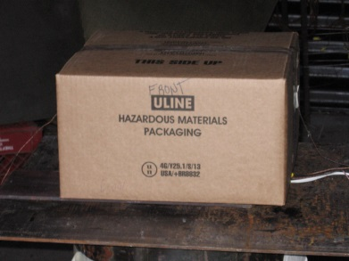
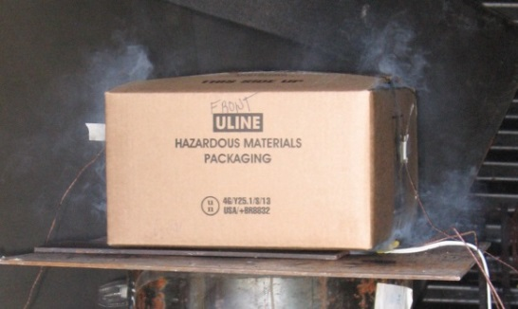
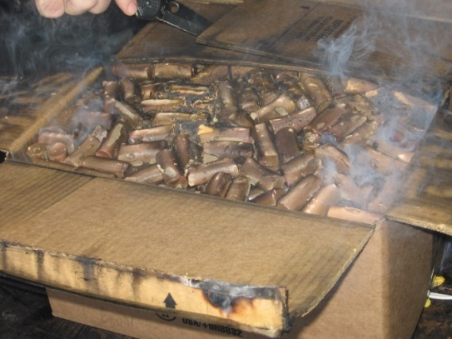
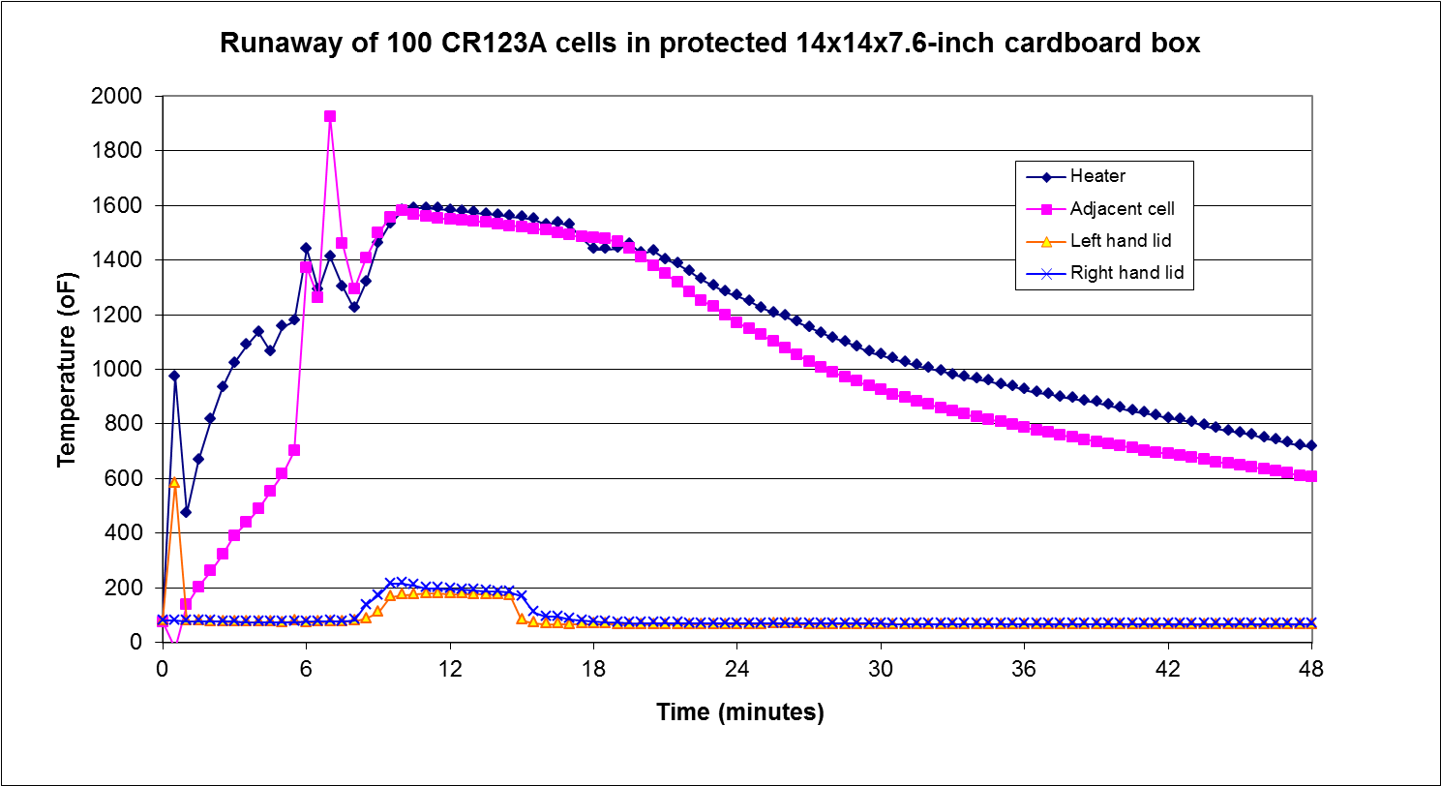
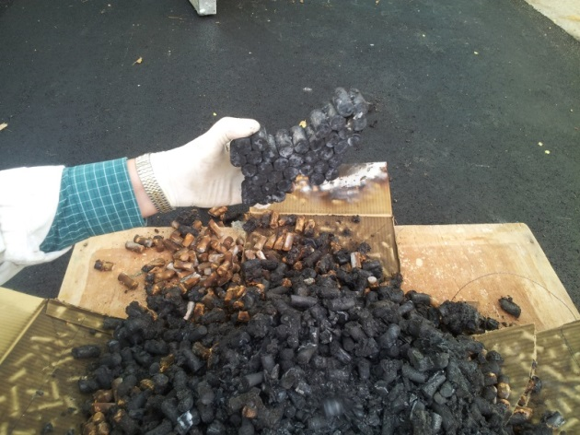
Shipment of Lithium Batteries
Thermal runaway
Thermal runaway initiated with a 75watt cartridge heater inserted into the test group.
Up to 300 Cells have been tested - 100 cells used for ongoing screening.
All cells are consumed- cascading thermal runaway

Slide 12
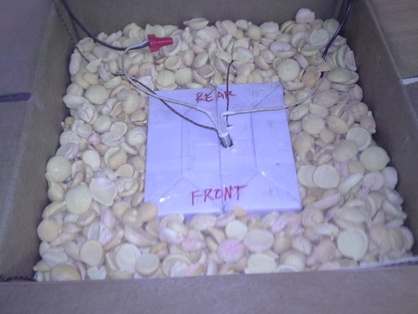
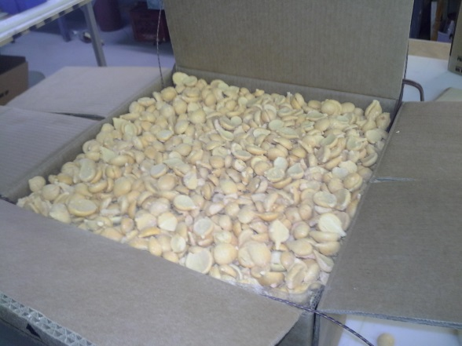
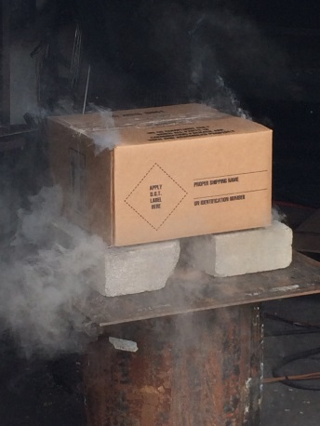
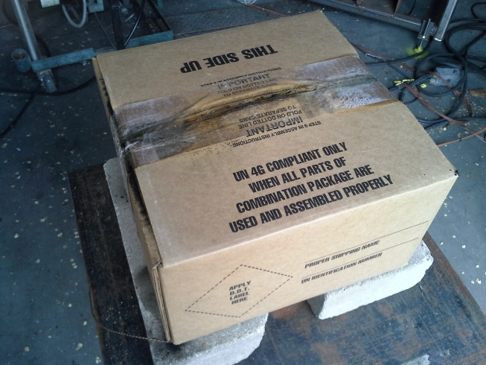
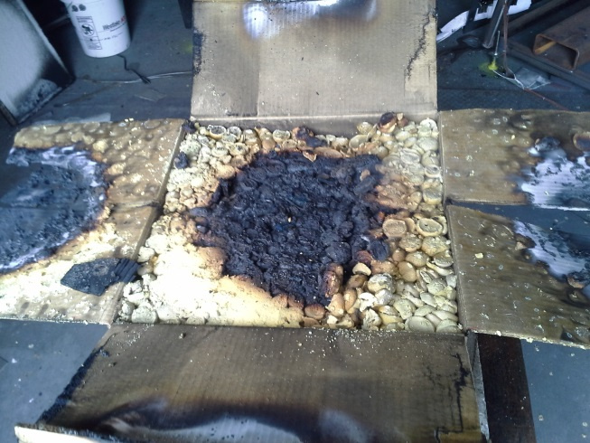
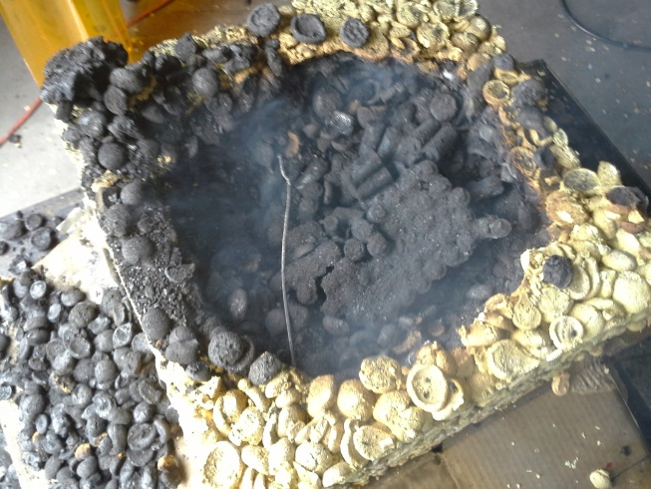
Shipment of Lithium Batteries
Product Optimization: Revised form – weight /cost
inner carton
LooseFill
Post test
LooseFill beneath lid
Cell remains

Slide 13
Shipment of Lithium Batteries
Product Optimization: Revised form – weight /cost

Slide 14
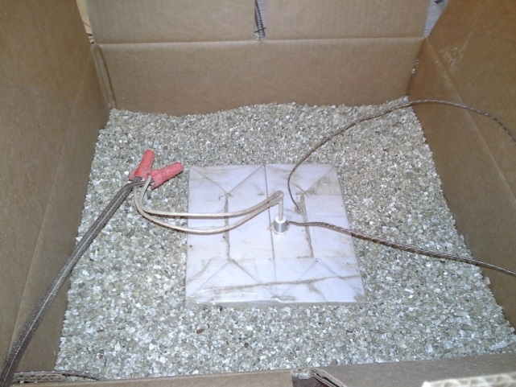
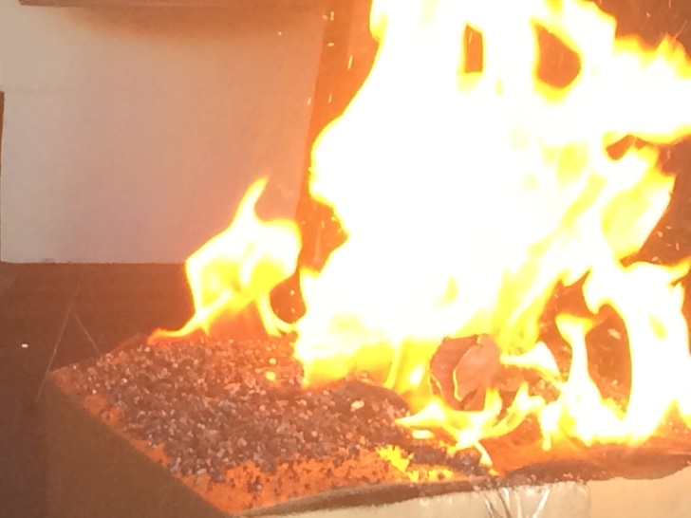
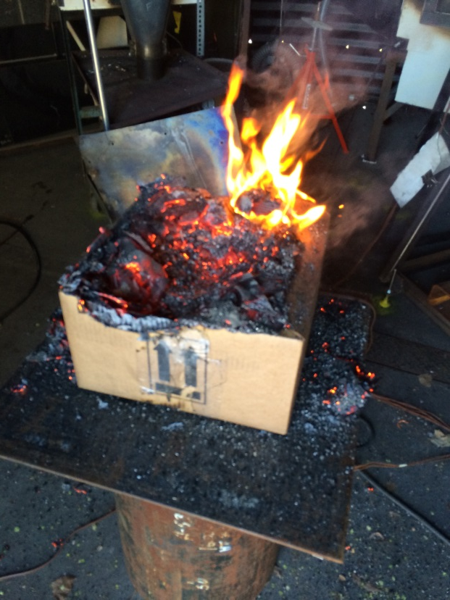
Shipment of Lithium Batteries
Performance evaluation of existing materials
Vermiculite – being used for ground transportation of damaged Li batteries through
special permit process.
100 cell screening test to determine comparative performance.
Outer packing burnt away
leaving exposed batteries
Inner carton surrounded
by Vermiculite
Packing is forcibly expelled from
the box

Slide 15
Shipment of Lithium Batteries

Slide 16
Shipment of Lithium Batteries
Ongoing R&D
Product optimization
Alternative packaging media
Power vs. chemistry in determining threat level
Conclusion
The loose fill concept provides a practical and economical method of enhancing the
safety of lithium battery / equipment shipments
Loose fill concept is an effective way to ship Lithium battery containing equipment
such as cell phones, computers etc.
Loose fill concept would be an effective and practical method for shipping damaged
and prototype batteries
AkroFire
9001 Rosehill Road
Lenexa KS USA
+1 913 888 7172
www.akrofire.com

