Slide 1
Smoke transport modeling: validation study
Changmin Cao, Ke Wang, Jordan Snyder, Jason Wegge, Vaidya Sankaran, May Corn
United Technologies Research Center
Amanda Daly, Kenneth Bell, Terry Simpson
Kidde Fire Protection Systems
International Aircraft Systems Fire Protection Forum
May 14-15, 2019
EASA, Cologne, Germany

Slide 2
Detection system design tool development
Objective:
develop a model-based tool to augment DETECTION SYSTEM DESIGN and streamline Certification process
Cargo Bay Detection System Design Tool
Benefits:
Virtual tests
Parametric variations
Physical insight
Accelerate design & development
Reduce number of flight certification tests
Reduce cost of certification
International Aircraft Systems Fire Protection Forum, May 14-15, 2019, Cologne, Germany

Slide 3
Components of the model-based design tool
Detection System Response
Smoke Transport
Smoke Generator
Smoke transport takes up a large portion of the detection system response time.
Predicting smoke transport accurately is key to the design tool robustness.
International Aircraft Systems Fire Protection Forum, May 14-15, 2019, Cologne, Germany

Slide 4
design tool development status
May 2018: Developed approach to model smoke generator dispersion
Nov 2018: Demonstrated method to simulate smoke transport and predict alarm times in a cargo bay
Today’s focus:
Validate development of buoyant plume from the smoke generator
Investigate the effect of ceiling height on the buoyant plume and ceiling jet
International Aircraft Systems Fire Protection Forum, May 14-15, 2019, Cologne, Germany

Slide 5
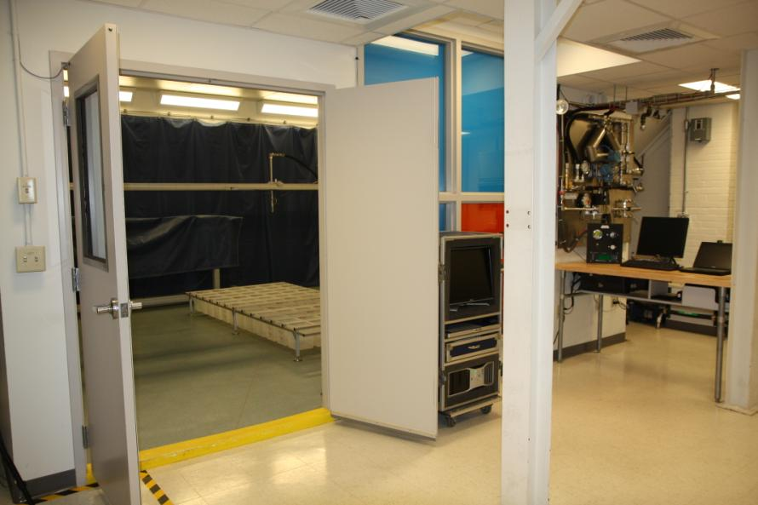
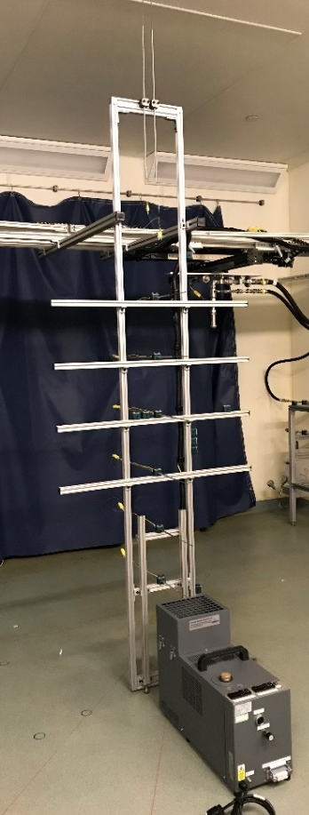
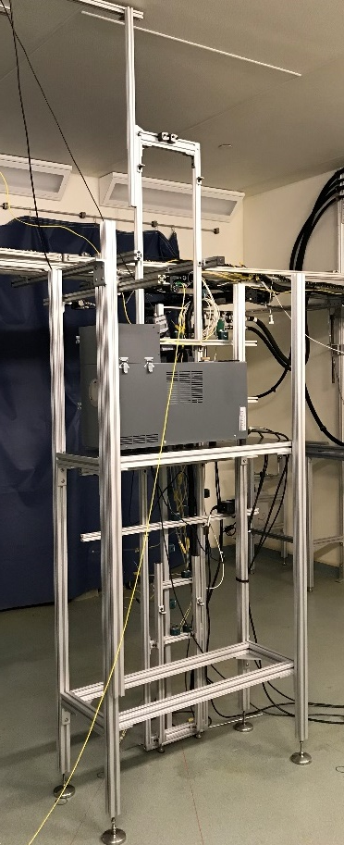
Smoke generator characterization set-UP
Smoke Generator (SG) Placement
UTRC Multiphase Injection Lab
Enclosed room
Option to turn ventilation off during tests
Ground SG
Ceiling height comparable to cargo bay with high ceilings
Raised SG
Ceiling height comparable to cargo bay with low ceilings
International Aircraft Systems Fire Protection Forum, May 14-15, 2019, Cologne, Germany

Slide 6
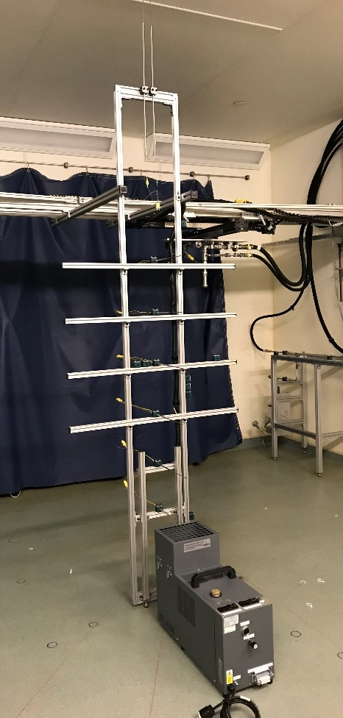
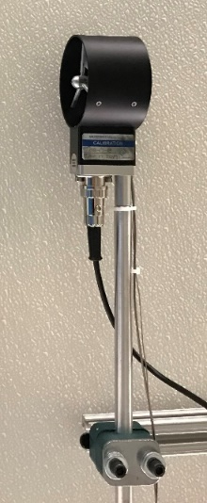
test methods
One set of smoke generator settings tested
Velocity and temperatures measured at multiple increments along plume centerline
Multi-channel data acquisition system sampled at 10 Hz
Tests repeated on different days
Experimental error within 10%
Vane anemometer cross-checked with hot film anemometer
Detailed characterization methodology used to acquire data sets for model validation
International Aircraft Systems Fire Protection Forum, May 14-15, 2019, Cologne, Germany

Slide 7
CFD model set-Up
Simulation Settings
Fire Dynamics Simulator (FDS)
3-D, unsteady solver from NIST (version 6.6.0)
Large Eddy Simulation (LES)
Parametric Study
Mesh size and distribution
SG exit plane boundary conditions
Turbulence intensity
Turbulence model
Average number of hexahedral cells: 40 million
Non-uniform sized mesh
Input conditions: measurements at SG exit plane
Parallel computing cluster: ~60 cores
Wall clock time: 80 hours
Over 30 simulations conducted to identify best methodology to simulate buoyant plume
International Aircraft Systems Fire Protection Forum, May 14-15, 2019, Cologne, Germany

Slide 8
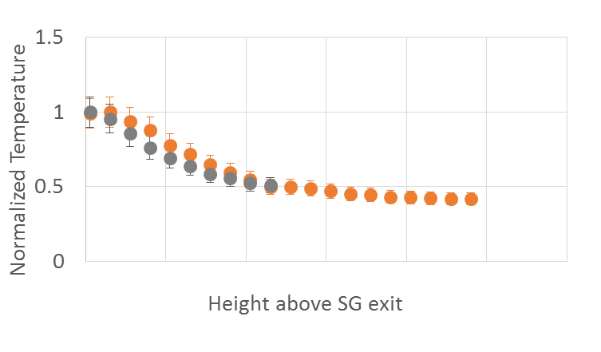
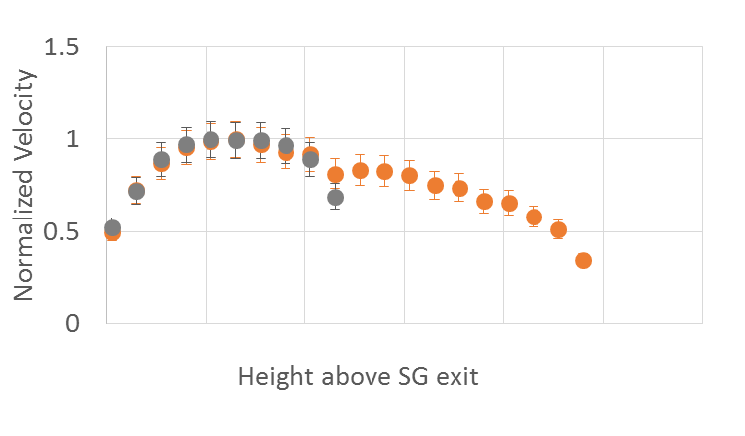
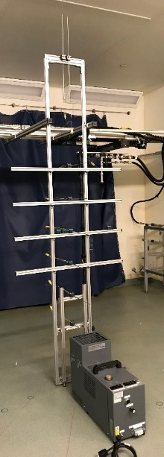
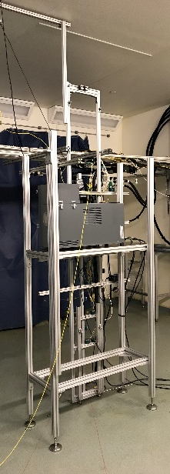
Measurements: plume centerline
Ground SG
Raised SG
Plume Centerline Temperature
Plume Centerline Velocity
Raised SG
Ceiling
Ground SG
Ceiling
Raised SG
Ceiling
Ground SG
Ceiling
Similar plume centerline profiles obtained for the two ceiling heights
International Aircraft Systems Fire Protection Forum, May 14-15, 2019, Cologne, Germany

Slide 9
Cfd: centerline temperature movies
Ground SG
Raised SG
0
Max. Temperature
Similar temperature profiles along the plume centerline at same comparable heights
International Aircraft Systems Fire Protection Forum, May 14-15, 2019, Cologne, Germany

Slide 10
Cfd: total velocity magnitude movies
Ground SG
Raised SG
0
Max. Velocity
Similar velocity profiles along the plume centerline at same comparable heights
International Aircraft Systems Fire Protection Forum, May 14-15, 2019, Cologne, Germany

Slide 11
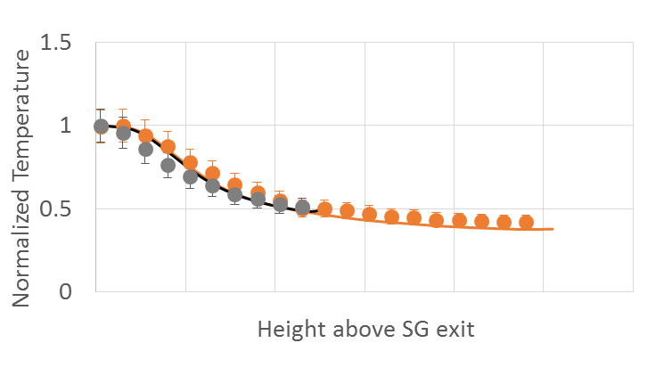
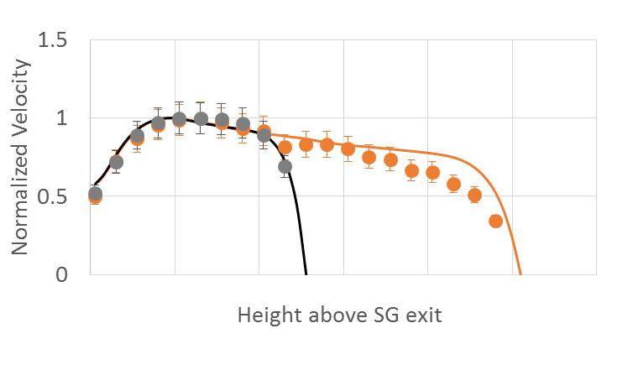
Cfd validation: plume centerline
Plume Centerline Temperature
Plume Centerline Velocity
Raised SG
Ceiling
Ground SG
Ceiling
Raised SG
Ceiling
Ground SG
Ceiling
CFD accurately predicts the measured centerline data for both plume heights
International Aircraft Systems Fire Protection Forum, May 14-15, 2019, Cologne, Germany

Slide 12
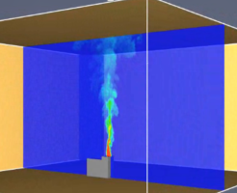
Ceiling jet correlation
Experimentally-derived correlations for ceiling jet flow*
(beyond the turning region at the ceiling)
r
$$T−T_{∞}∝ \frac{{\left({\dot{Q}}/r\right)}^{2/3}}{H}$$
Turning
region
H
For r/H > 0.18
$$U∝ \frac{{\dot{{\dot{Q}}^{1/3}H}}^{1/2}}{r^{5/6}}$$
For r/H > 0.15
Where $\dot{Q}$ is the total energy release rate in kW
$T$ is the temperature in $℃$
$U$ is the velocity in m/s
$r, H$ are the radial position and plume height in meters
*Alpert, R.L., Fire Tech., 8, 181 (1972)
International Aircraft Systems Fire Protection Forum, May 14-15, 2019, Cologne, Germany

Slide 13
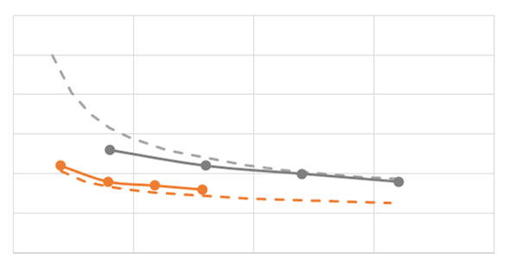
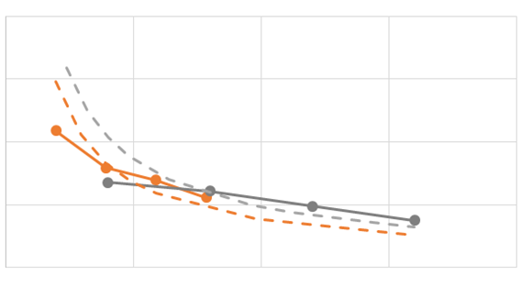
Cfd & correlation comparison: Ceiling jet temperature and velocity
Ceiling Jet Temperature
Ceiling Jet Velocity
temperature
velocity
r/H
r/H
CFD results: Ground SG
Correlation: Ground SG
CFD results: Raised SG
Correlation: Raised SG
CFD simulations confirms correlation trends for ceiling jet temperatures and velocities
International Aircraft Systems Fire Protection Forum, May 14-15, 2019, Cologne, Germany

Slide 14
Detection system design tool development
Summary
Developed CFD simulation / test methodologies to simulate and validate the buoyant plume
Validated CFD simulations of buoyant plumes under two ceiling heights for:
Plume centerline temperatures & velocities Ceiling jet temperatures & velocities
Predictive modeling tool for smoke detection systems
Smoke Transport
Detection System Response
Next step
Validate the detector alarm times predicted by the tool with acquired test data
International Aircraft Systems Fire Protection Forum, May 14-15, 2019, Cologne, Germany

