Slide 1
747 Hidden Fire 2-BTP Testing Systems Working Group Meeting Long Beach, CA
Robert Morrison
November 14 - 15, 2012

Slide 2
Background
November 2011 System’s Meeting Presentation
Presentation on “Analysis of Suppressant‐Enhanced Overpressure in the FAA Aerosol Can Simulator” eluded to the possibility that 2-BTP (2-Bromo-3,3,3-Trifluoropropene) may contribute hydrocarbons to a fire threat
The analysis covered BTP in a pressurized environment
This raised questions about how low of a pressure would BTP exhibit this behavior
FAA Technical Center Meeting
The FAA, Boeing, and American Pacific discussed the merits of BTP’s decomposition product behavior
FAA requested to test BTP in a hidden fire scenario to view its behavior in a real environment

Slide 3
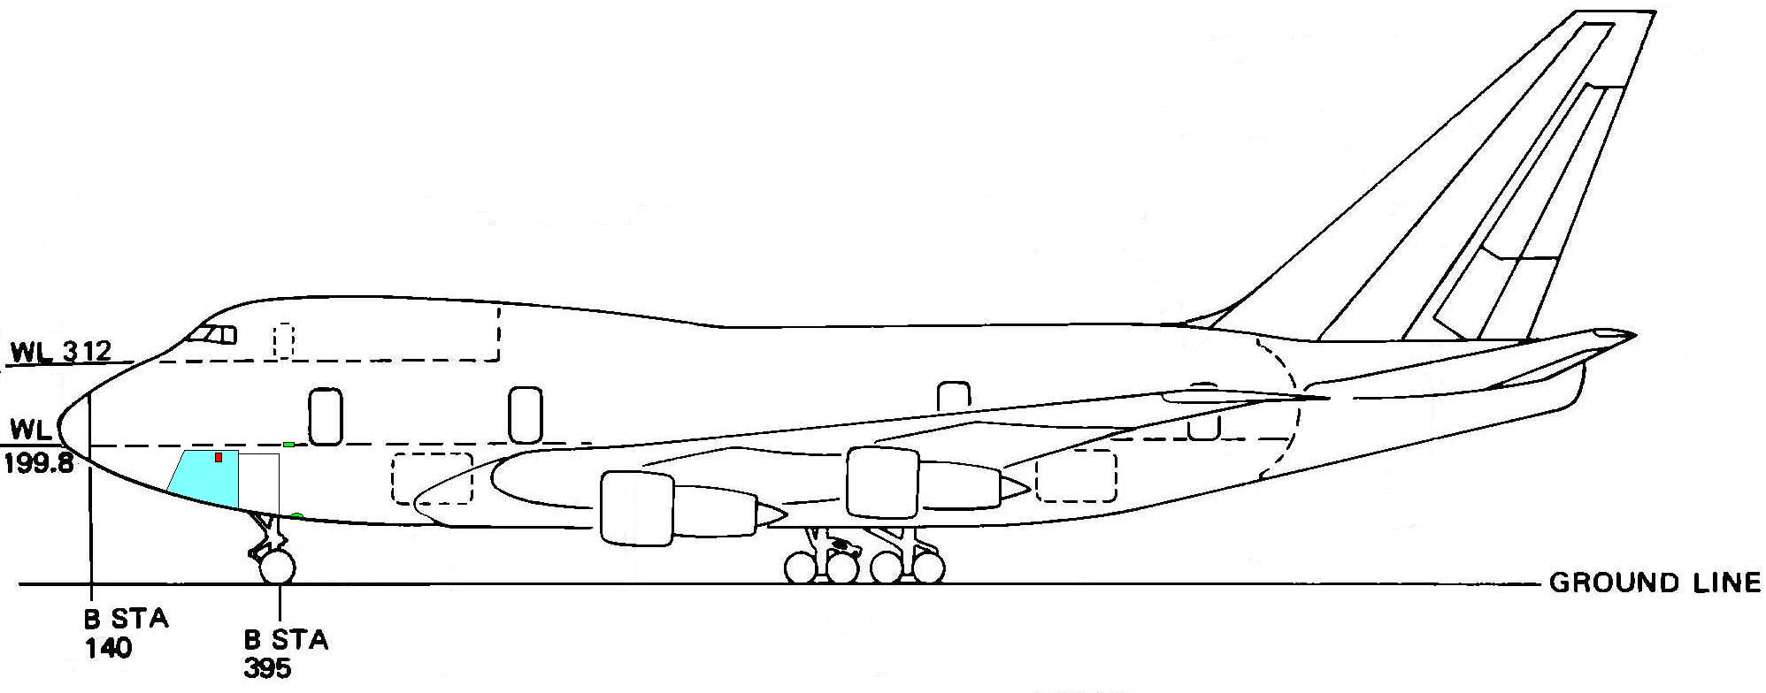
Test Article - Boeing 747SP Aircraft
A145 ft³ area on the left side of the nose landing gear wheel well area, forward of the electronics and equipment (E&E) bay, between Stations 260 and 340 was selected as the test section
This area afforded easy access for instrumentation, project equipment, and emergency response
First Class cabin floor access door to E&E bay
Forward Electronic Access Door behind Nose Gear
Both access doors near Station 420

Slide 4
2-BTP Testing
Problem Overview
Does BTP contribute hydrocarbons (decomposition products) to the fire threat when there isn’t enough BTP present to put out a standard hidden fire test block
2 test scenarios
Suppressed, extinguisher discharge at Station 305 vent
Non-suppressed, extinguisher discharge at Station 290 vent
Fire Threat
Standardized (hidden fire) 4” x 4” x 9” polyurethane foam block
Installed in a 12” x 14” x 20” fire hardened box
Box is open on 3 sides – windows with 1” frame border
Foam block is centered on the 12” x 14” base
Accelerant – 10 cc Heptane
Fire box position is hung 13” below the First Class Cabin floor at Station 310 with the base plate 7 ½” from the outer skin

Slide 5
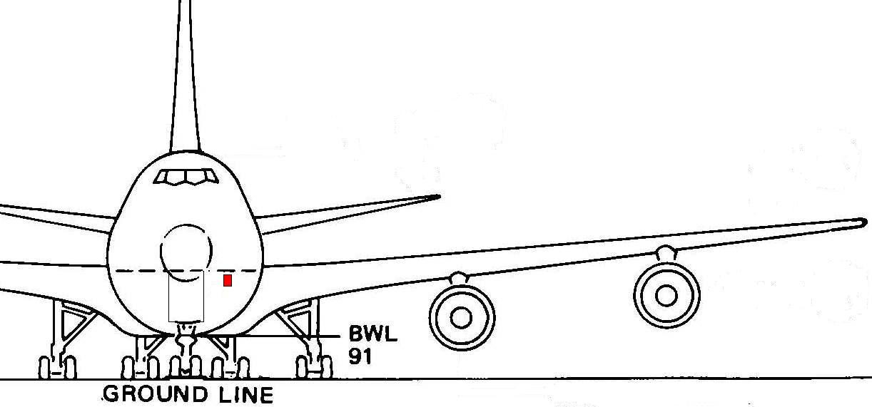
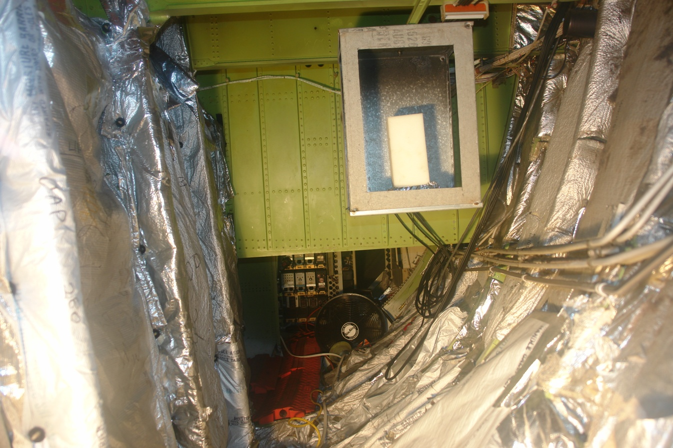

Slide 7
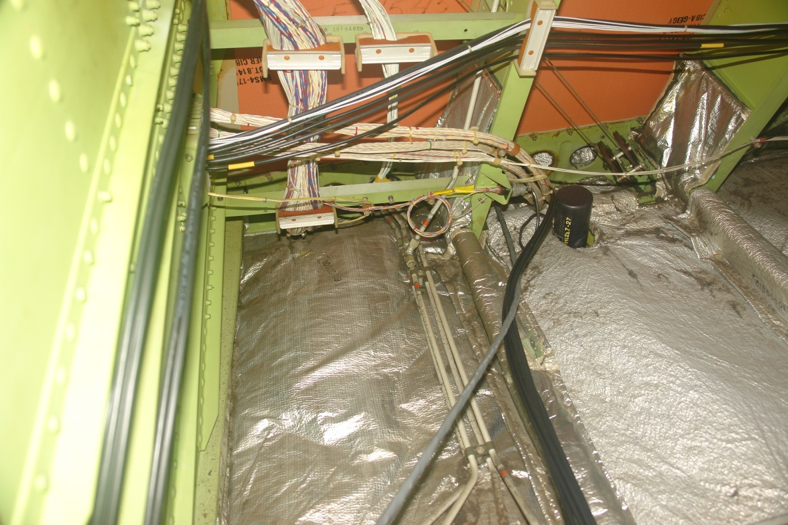

Slide 9
Station 305

Slide 11
Station 305
Station 290

Slide 13
Test Collection
3 Video Channels
Fire Box – wide angle, high resolution
Fire Box – high zoom, high definition
Fire Fighter – wide angle, high resolution
5 Channels
Carbon Monoxide, 0 – 2%
Carbon Dioxide, 0 – 10%
Halon 1211, 0 – 30%
Oxygen, 0 – 25%
Total Hydrocarbon, 0 – 4%

Slide 14
BTP – Non-Suppressed
BTP – Suppressed
Test #2
Test #8

Slide 17
Summary of Results
Video data suggests that BTP does not contribute flammable hydrocarbons or add energy to the fire threat when there isn’t enough agent present to put the fire out (at 1 atm)
THC data supports that BTP does produce hydrocarbons as a decomposition product
Further calibration needed to explain or rule out the peaks starting with neat agent
Hypothesis is that the analyzer is picking up BTP’s extra carbon atoms
A restriction was found in the 5 channel gas analyzer post test
Plan to re-run the Halon test series for validation
This will determine the amount of retesting

