Slide 1
Status of SAE G-27 Lithium Battery packaging performance Committee
Presented to International Aircraft Systems Fire Protection Working Group
November 2, 2017
Atlantic City, NJ, USA
Doug Ferguson, Co-Chair G-27 Committee
Claude Chanson, Co-Chair G-27 Committee Jordanna Bucciere, SAE Specialist G27 Committee

Slide 2
SAE G27 Committee
Current Status for Carriage of Lithium Batteries
Lithium batteries as cargo only allowed on freighter aircraft.
Lithium ion batteries as cargo only allowed on freighter aircraft at a 30% State of Charge (SOC)
Does not apply to batteries packed in or with equipment
Stricter restrictions on Section II batteries – only one package per consignment and no overpacks.
SAE G-27 Lithium Battery Carriage Packaging Standard Committee
Monthly WebEx meetings
Draft Packaging Standard in work – expect finalization of draft in 2017.
Balloting (formal process for approval) expected in 2018

Slide 3
SAE G27 Committee Charter
SAE G-27 Committee formed in March, 2016 to create a performance-based package standard (AS6413) for the safe transport of lithium batteries as cargo by air.
Co-chaired by Doug Ferguson (Boeing) and Claude Chanson (Recharge)
  ~ 160 individuals on G-27 Committee
    Includes international organizations, airframe manufacturers, regulators, cell manufacturers, battery manufacturers, battery users, operators, package manufacturers, test facilities
  Monthly Webex teleconference calls
  Writing Team subcommittee of ~20 people to create draft for the standard
    Several multi-day or week-long face to face meetings, currently on 4th draft
  External Fire Consideration subcommittee of ~20 people to collect and present data to larger committee
    Telecons, 2 face to face meetings to identify issues, gather material and determine potential methods for addressing concern

Slide 4
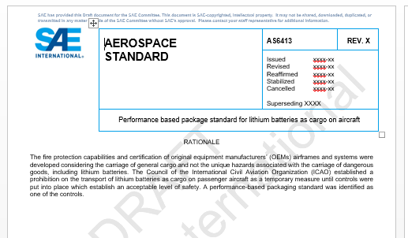
AS 6413 Development and Writing Team
Standards Development Process
      Writing Team developed draft for standard (~20 people)
      Draft standard circulated to entire G-27 committee (over 160 people) for review and comments (iterative process to incorporate comments)
      Balloting process involves all stakeholders with opportunity to comment on proposed standard:
          Ballot disapprovals must be resolved between the commentor and document sponsor.
          Comments from non-voting members must be reviewed and considered.
      Voting members (~50) have been identified

Slide 5
AS 6413 Development and Writing Team
Draft Packaging Standards
Intention is to address the safety of the cell/battery and packaging material (box, etc) together. Allow for less protection from the package if the cell is inherently safer.
No hazardous amount of flame is allowed outside the package;
No hazardous fragments can exit the package and the package must maintain structural integrity;
After confirming thermal runaway in the initiation cell, the external surface temperature of the package cannot exceed the amount that would ignite adjacent packing material or cause batteries or cells in adjacent packages to go into thermal runaway. Initially this was chosen as not exceeding a temperature excursion above [200°C] for more than 3 minutes. Current proposal is to not allow the outer package thermocouple placed adjacent to the initiation cell from increasing by more than 150 C for more than 3 minutes after the heater for the initiation cell is turned off;

Slide 6
AS 6413 Development and Writing Team
Draft Packaging Standards
The quantity of flammable vapour must be less than the amount of gas that when mixed with air and ignited could cause a pressure pulse in a [2.83 m³] volume that could dislodge the overpressure panels of the compartment or damage the cargo liner [3.45 kPa].
    The gases are captured within the test chamber and subject to a constant ignition source. If the gases become flammable and ignite, the test is a failure.
It could be assumed that smoke released outside the package may not be a consideration if the event is contained within the package.
Test methods defined to reduce repetitive testing and also to allow packages that do not fit in the specified test chamber.

Slide 7
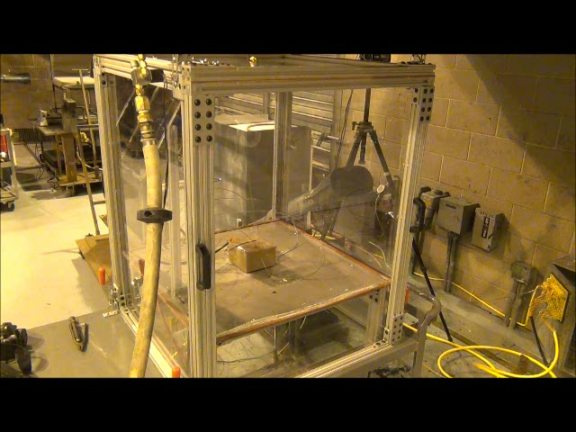
AS 6413 Draft Content
Engineering Development testing for flammable vapor test method

Slide 8
AS 6413 Draft Content update
Draft Packaging Standards – External Fire Considerations
Mixed views on addressing scenarios involving the packaged lithium batteries being exposed to the hazards from a cargo compartment fire originating outside the package.
“External Fire Consideration” subcommittee meetings discussed:
  Probability approach versus SMS approach as a rationale
  Threats from cargo compartment scenario
  Potential mitigations
  Potential criteria for demonstrating acceptable performance
  Potential approaches to address external fire considerations

Slide 9
AS 6413 Draft Content
Draft Packaging Standards – External Fire Considerations
“External fire” meeting in September:
  Recognition that the “internal protection” packaging is reducing the hazard, but not eliminating it completely in case of external fire. Possible protections and tests described. Discussion did not resolve the question about integrating these protections in SAE AS 6413.

Slide 10
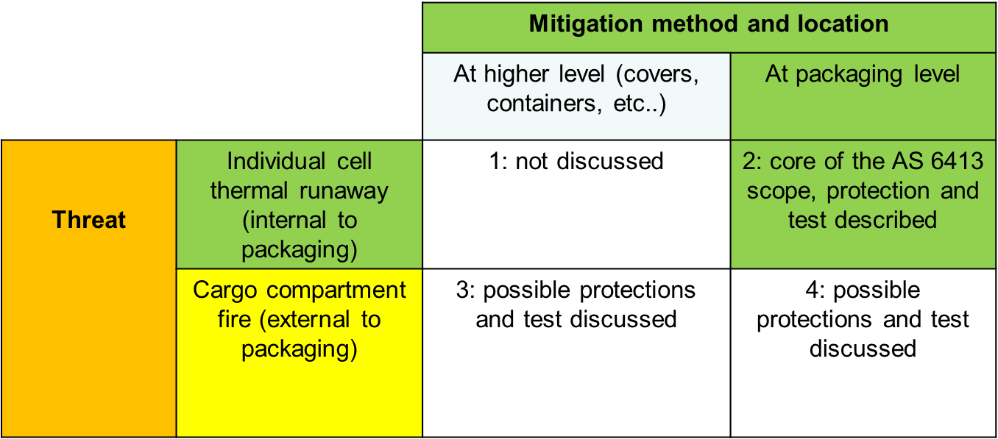
AS 6413 Draft Content
Draft Packaging Standards – External Fire Considerations

Slide 11
AS 6413 Draft Content
Draft Packaging Standards – External Fire Considerations
There was agreement from the members to create an output document to present to the G27 that includes:
  a brief introduction regarding the need for considering an external fire
  the high level characteristics of the threats posed by an external fire to a package of lithium batteries
  some generic requirements for showing an acceptable level of protection against an external fire
  some specific proposals for methods of testing a package for demonstration of protective features
  Pros and Cons of including performance requirements within the AS6413 document or creating a separate AS document.

Slide 12
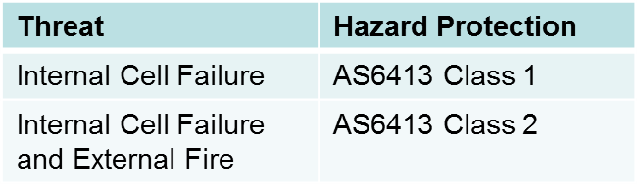
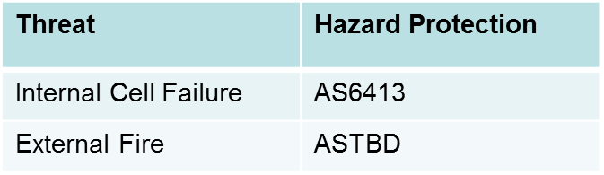
AS 6413 Draft Content update
  Draft Packaging Standards – External Fire Considerations
    2 Potential implementation methods discussed:
  Additional section of AS6413:
    Part A has internal thermal runaway performance criteria
    Part B has external fire performance criteria
  Additional Aerospace Standard [ASTBD]:
    Contains external fire performance criteria
Pro: Clarity when implementing all performance requirements at package level
Con: Implies all mitigation for external fire implemented at package level
Pro: More clearly allows implementation of the external fire performance criteria with different mechanisms according to the various transport conditions
Con: Delay of implementation because of an additive standard requirement. Complexity of solutions implementation.

Slide 13
AS 6413 Draft Content update
Wrap-up
The output document will be discussed during the upcoming G27 face to face meeting in Renton in November.
Expecting a standard to go through the SAE balloting process early in 2018
ICAO Air Navigation Commission have stated that there will need to be other mitigation in addition to packaging standard before allowing lithium ion batteries on passenger aircraft.

Slide 14
QUESTIONS?
Doug Ferguson
Boeing Associate Technical Fellow
SAE G-27 Co-Chair
o +1 562.593.2950
douglas.e.ferguson@boeing.com
Jordanna Bucciere
Aerospace Standards Specialist
SAE International
o +1.724.772.7517
m +1.724.612.5339
Jordanna.bucciere@sae.org
Claude Chanson
General Manager - RECHARGE
SAE G-27 Co-Chair
o +32 (2)777-0567
cchanson@rechargebatteries.org

