Slide 1
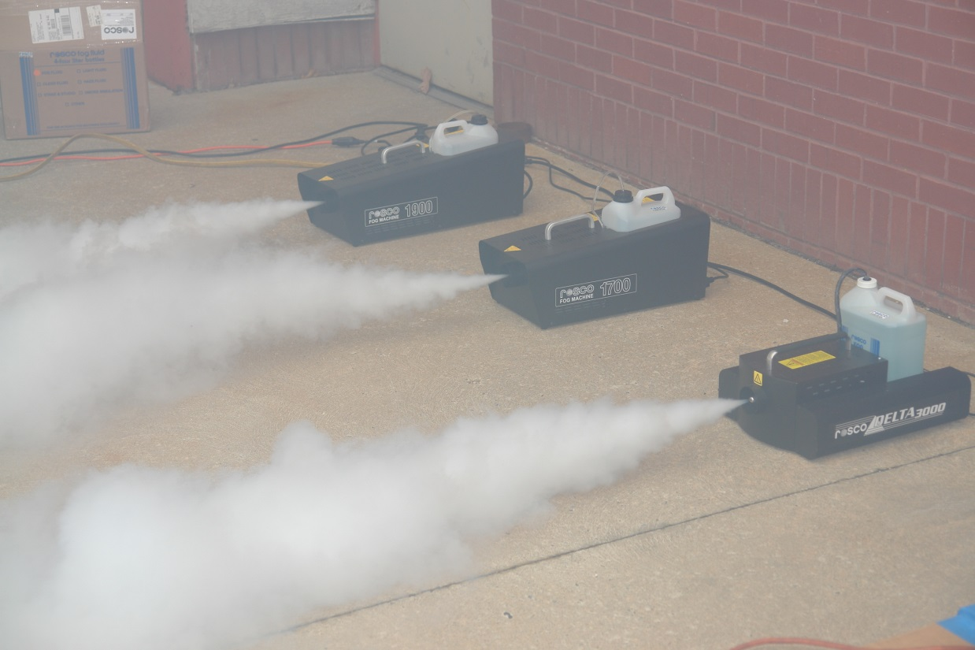
Smoke Source Project
Systems Working Group Meeting Atlantic City, New Jersey
Robert Morrison, FAA Technical Center Fire Safety
October 21 - 22, 2015

Slide 2
Background
The objective is to compare different theatrical smoke generating smoke sources to a 4800 lithium primary battery fire test performed in a Class E cargo compartment that resulted in completely obscuring the flight deck in as little as 16 minutes on a Boeing 727 aircraft.
Harry Webster’s February 26, 2013 Lithium Battery Test Video

Slide 3
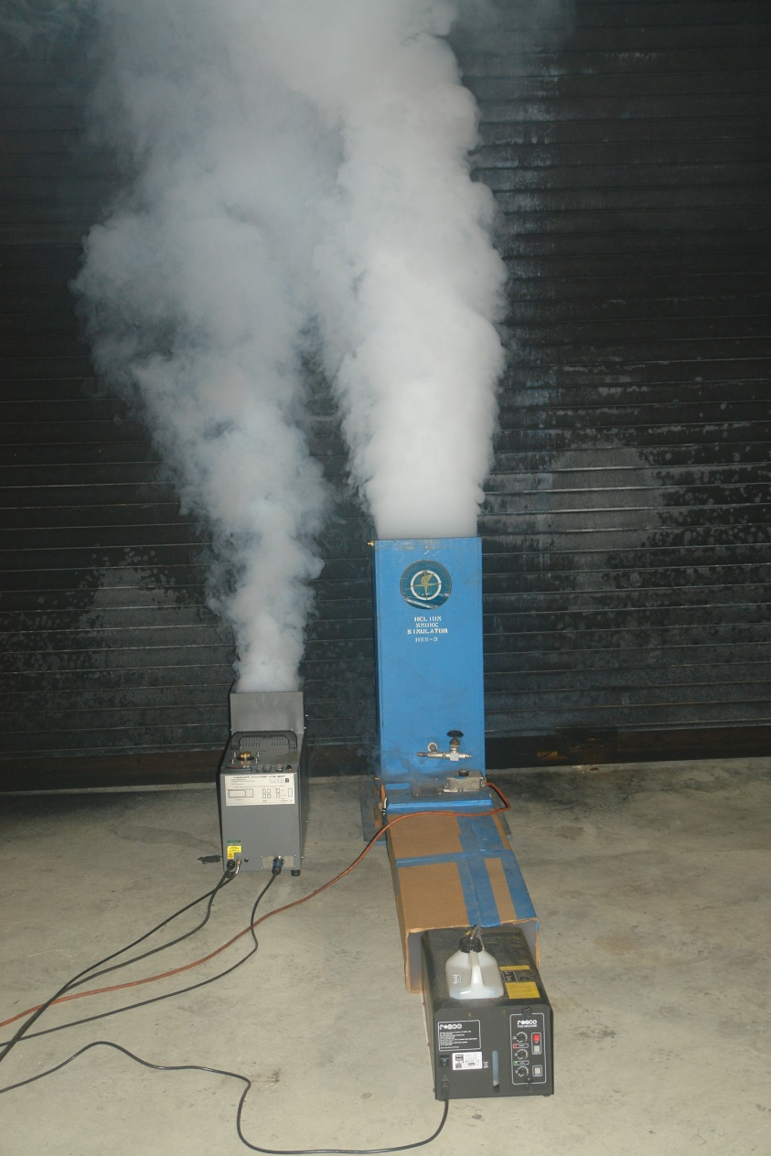
Project Work
Two smoke sources are being evaluated
ViCOUNT SDT theatrical smoke generator series
CO2 injection with 1, 2, 3, & 4 heater bars
Helium injection with 1, 2, 3, & 4 heater bars
Rosco 1700 theatrical smoke generator with FAA Helium injection box series
70/30 Helium/Air mix
50/50 Helium/Air mix
0/100 Helium/Air mix

Slide 4
Smoke tests are being conducted in the
FAA Seat Toxicity Test section inside the TC-10 test article.
Smoke machine positioned against orange kick board replacing the Fire Fighter.

Slide 5
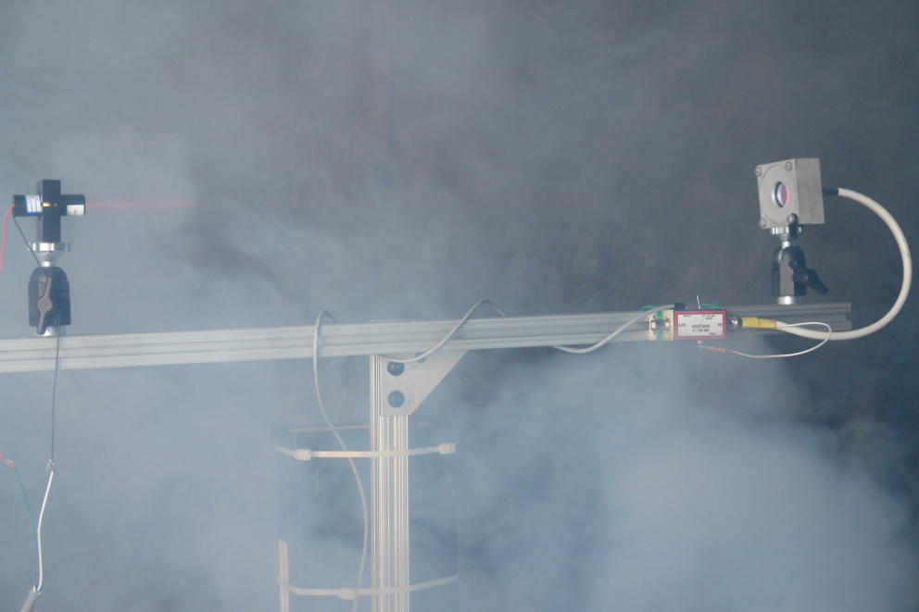
Test Set Up
4 Smoke Meters used to measure smoke plume speed across a total of 16.535 feet
4.91’
4.75’
6.875’

Slide 6
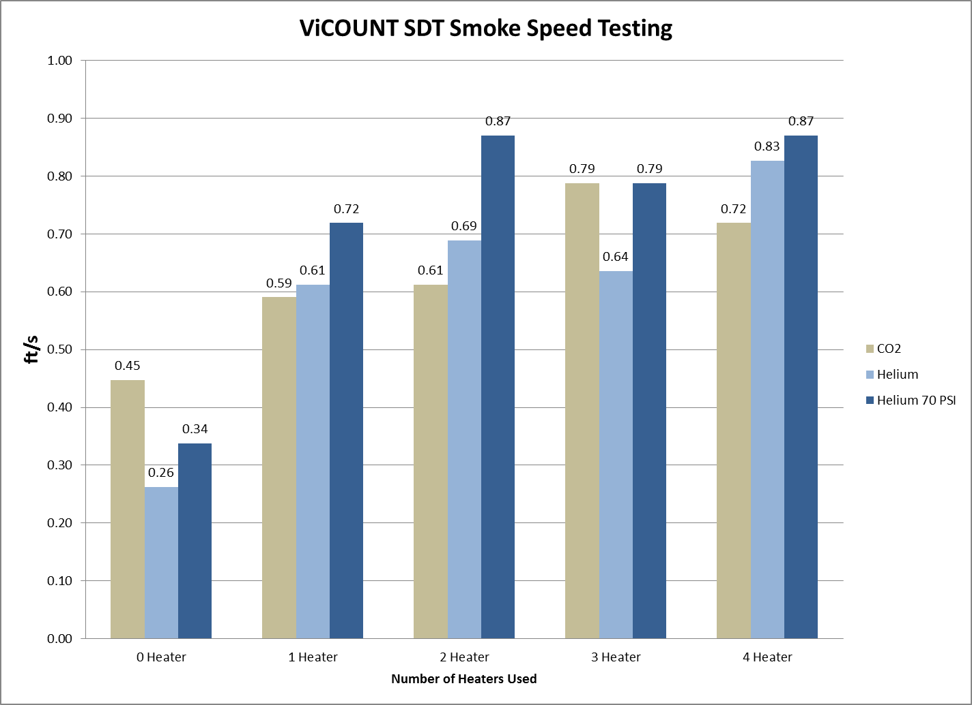
Testing Results

Slide 7
Planned Work
Rosco 1700 theatrical smoke generator with FAA Helium injection box series
70/30 Helium/Air mix
50/50 Helium/Air mix
0/100 Helium/Air mix
Findings will determine next course of action.
Possible adjustments
Heating FAA Helium Box chimney
Changing to a higher output Rosco generator
Contact Info & Questions: robert.morrison@faa.gov (609) 485-4507

