Slide 1
Smoke Transport Modeling in Cargo Bays
Parametric Study
Changmin Cao, May Corn, Vaidya Sankaran
United Technologies Research Center
Kenneth Bell, Amanda Daly, Terry Simpson
Kidde Fire Protection Systems
International Aircraft Systems Fire Protection Forum
Atlantic City, NJ
October 31st – Nov 1st , 2018
This document has been publicly released and is not subject to export controls.

Slide 2
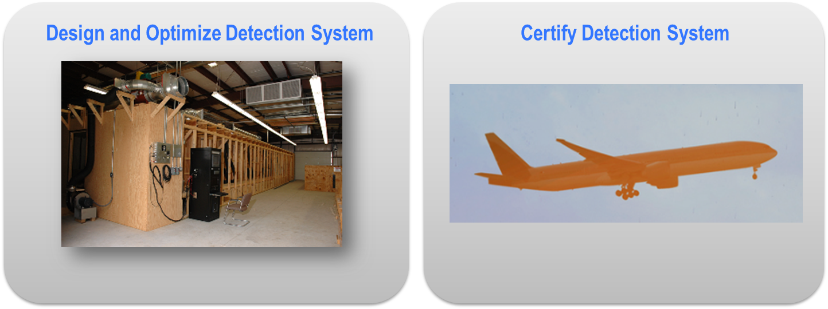
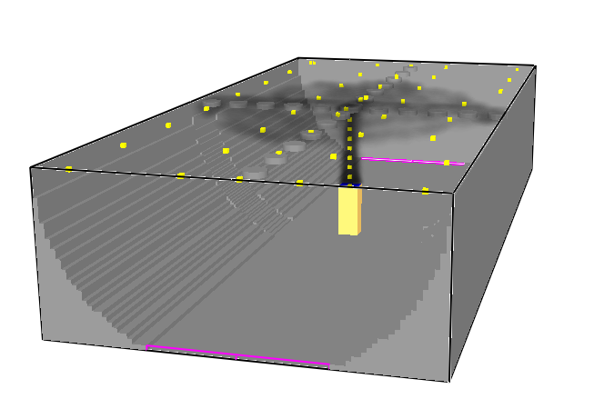
Detection system design
Objective: Develop a model-based tool to augment & streamline certification process
Cargo Bay Detection System Design Tool
Benefits:
Virtual tests
Parametric variations
Physical insight
Accelerate design & development
Reduce number of flight certification tests
Reduce cost of certification
This page does not contain any export controlled technical data.

Slide 3
Model components
What sub-elements or components are needed for a model-based design tool ?
3. System Response Time
Obscuration (smoke concentration) & entry time
2. Smoke Transport
Large room features / obstructions
Small scale features – detector tray
Buoyancy, Ventilation
Environmental conditions
1. Smoke Generator
Size distribution
Temperature, Velocity
Turbulence
Recap from May 2018:
Method for simulating a smoke generator
Methodology to simulate smoke transport in an affordable manner
Demonstrated this method in a cargo bay (image shown above)
FAA Systems WG Meeting – Cologne, Germany
This page does not contain any export controlled technical data.

Slide 4
Model components
What sub-elements or components are needed for a model-based design tool ?
3. System Response Time
Obscuration (smoke concentration) & entry time
2. Smoke Transport
Large room features / obstructions
Small scale features – detector tray
Buoyancy, Ventilation
Environmental conditions
1. Smoke Generator
Size distribution
Temperature, Velocity
Turbulence
FAA Systems WG Meeting – Atlantic City, New Jersey
Today’s focus:
Parametric assessment of smoke generator
System response time
This page does not contain any export controlled technical data.

Slide 5
MOTIVATION: Smoke generator characterization
Why should we characterize Smoke Generator ?
Smoke Generator A
Smoke Generator B
Higher Velocity,
Higher Temperature
Low velocity undulating plume vs. high velocity turbulent plume
Higher ambient T (& low density) not effective in plume slow down & lateral mixing
Buoyancy effects of the (hot) plume can change smoke transport
Smoke Generator inlet conditions affects smoke transport & detector response
This page does not contain any export controlled technical data.

Slide 6
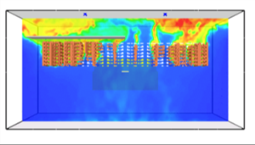
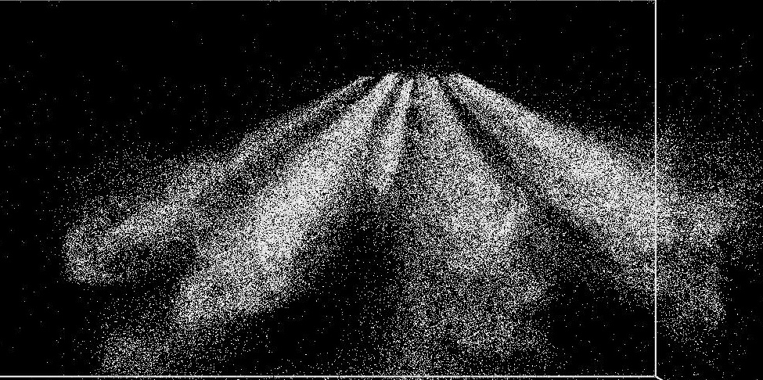
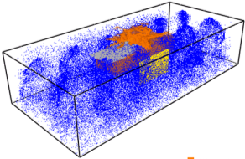
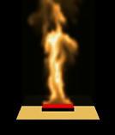
Design - Simulation tool
Fire Dynamics Simulator
3-D, unsteady solver
Large Eddy Simulation (LES)
Low Mach with Direct Poisson equation solver for pressure
Time Integration: 2nd order explicit predictor-corrector scheme
Vary smoke generator & detector position along with other relevant geometrical / flow parameters
Tool simulates multiple design in a day – parallel execution
SD4
SD3
SD2
SD1
Select promising designs to test
Model Cargo Bay
This page does not contain any export controlled technical data.

Slide 7
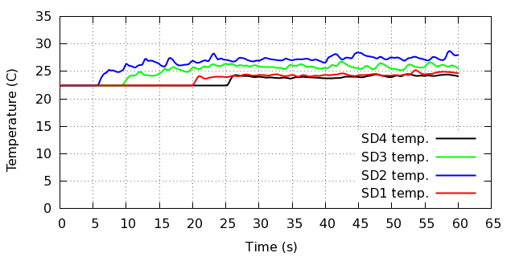
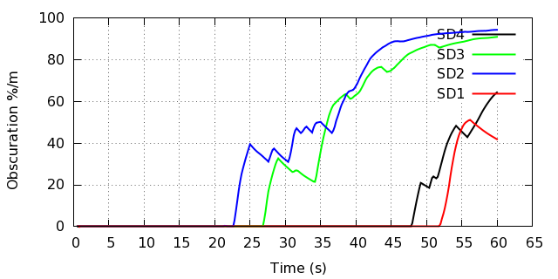
Baseline case 1: Smoke gen A
Case Smoke Generator & Ambient Condition
1 | Baseline SG conditions: STP – Ambient
2 | Higher velocity (V) compared to baseline: STP (Ambient)
3 | Higher V & T compared to baseline: STP (ambient)
4 | Baseline SG conditions: Lower ambient pressure
5 | Baseline SG conditions STP (ambient): With cross ventilation
Temperature (⁰C)
Once the smoke reaches the detector smoke concentration increase quickly and reaches stable value
Obscuration (%/m)
SD4
SD3
SD2
SD1
Temperature and obscuration profiles follow expected trends
This page does not contain any export controlled technical data.

Slide 8
Baseline case 1: alarm time
Calibrate alarm time using experimental data
10%/m
3.2%/m
Predicted Smoke detector alarm time (s) at different obscuration levels
Activation Obscuration | SD1 | SD2 | SD3 | SD4
3.2 %/m (1 %/ft) | 52.2 | 23.0 | 27.2 | 48.2
10 %/m (3 %/ft) | 52.8 | 23.2 | 27.4 | 48.6
Calibrates to experimental data (e.g., same order of magnitude)
This page does not contain any export controlled technical data.

Slide 9
BASELINE vs. Higher t smoke gen.
Effect of higher heat input (temperature) to smoke generator
Case 1: Baseline Smoke Gen A
SD4
SD3
Case Smoke Generator & Ambient Condition
1 | Baseline SG conditions: STP – Ambient
2 | Higher velocity (V) compared to baseline: STP (Ambient)
3 | Higher V & T compared to baseline: STP (ambient)
4 | Baseline SG conditions: Lower ambient pressure
5 | Baseline SG conditions STP (ambient): With cross ventilation
SD2
SD1
Case 3: Smoke Gen B
Smoke generator input conditions impact the plume dispersion to the detectors
This page does not contain any export controlled technical data.

Slide 10
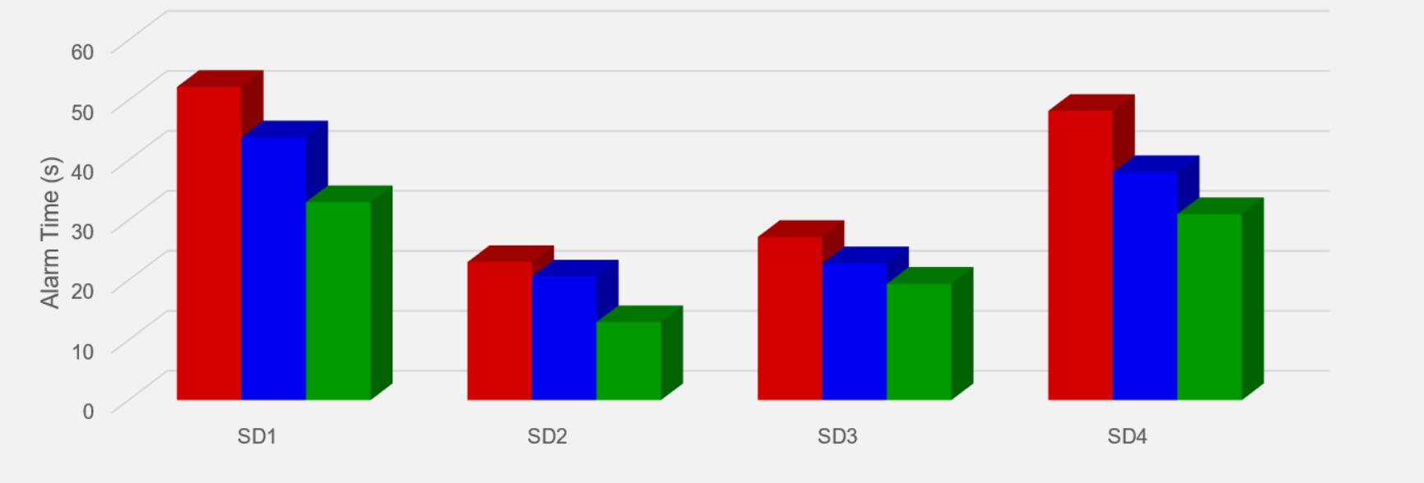
BASELINE vs. Higher temperature sg
Parametric study for different scenarios: Alarm time comparisons
Case 1 | Smoke Generator A
Case 2 | Temperature from Smoke Generator A Velocity from Smoke Generator B
Case 3 | Smoke Generator B
Tool can be used to conduct controlled parametric variations for
design analysis and to understand system response
This page does not contain any export controlled technical data.

Slide 11
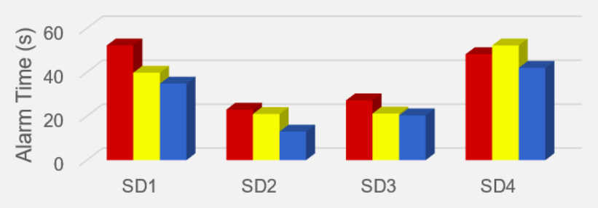
Extensions to other scenarios
Parametric study for different scenarios: Alarm time comparisons
Case 4: In-flight condition
Case 1 | Smoke Generator A at STP
Case 4 | Smoke Generator A at In-Flight ambient Conditions
Case 5 | Smoke Generator A at STP with Ventilation
SD4
SD3
SD2
SD1
Case 5: with ventilation
Smoke arrival time changes in flight and ventilation cases
Ventilation accelerates smoke spread and reduces detector alarm time (for this design)
This page does not contain any export controlled technical data.

Slide 12
Summary and Next steps
Smoke transport simulations capture the effect of different smoke generators
Models demonstrate encouraging ability to capture parametric sensitivity
Linking detector model to the smoke transport is key to accurately predict alarm time
Modeling capability to simulate real-scale cargo-bay with varied input conditions
Ability to perform “virtual tests” to reduce cost of design / certification
Approximately 20 to 30 cases / conditions / designs can be simulated in a week
Next step: Acquiring data to validate transport/detector models for the cargo bay
Kidde Fire Protection Systems - Cargo Bay Test Simulator
This page does not contain any export controlled technical data.

